Slide 1
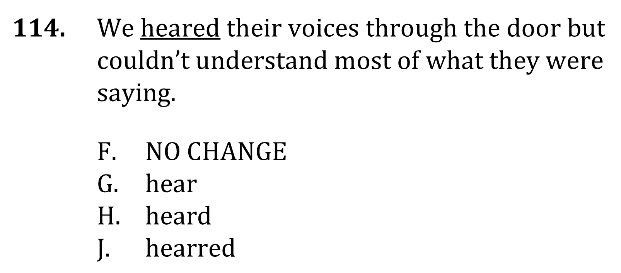
Subject-Verb Agreement

Slide 2
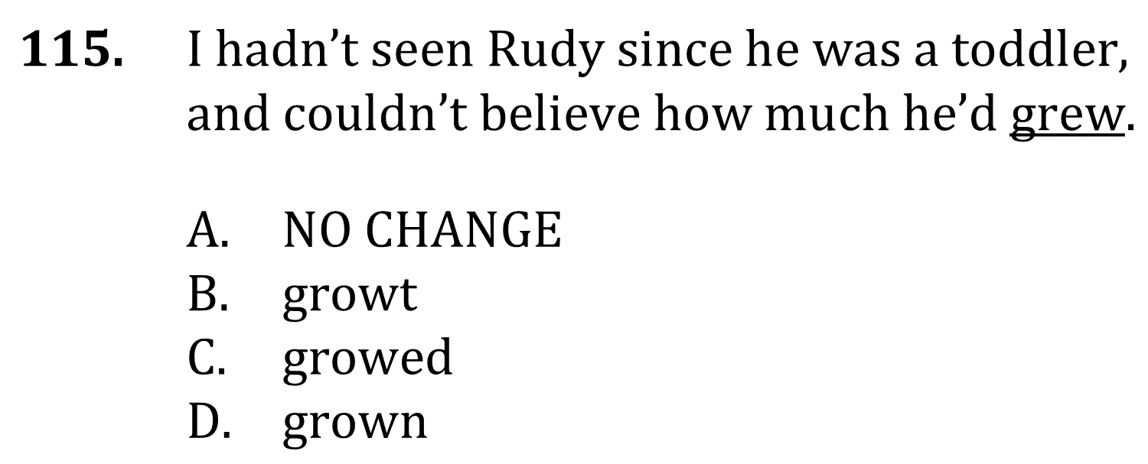
Subject-Verb Agreement

Slide 3
Subject-Verb Agreement

Slide 4
Subject-Verb Agreement

