Slide 1
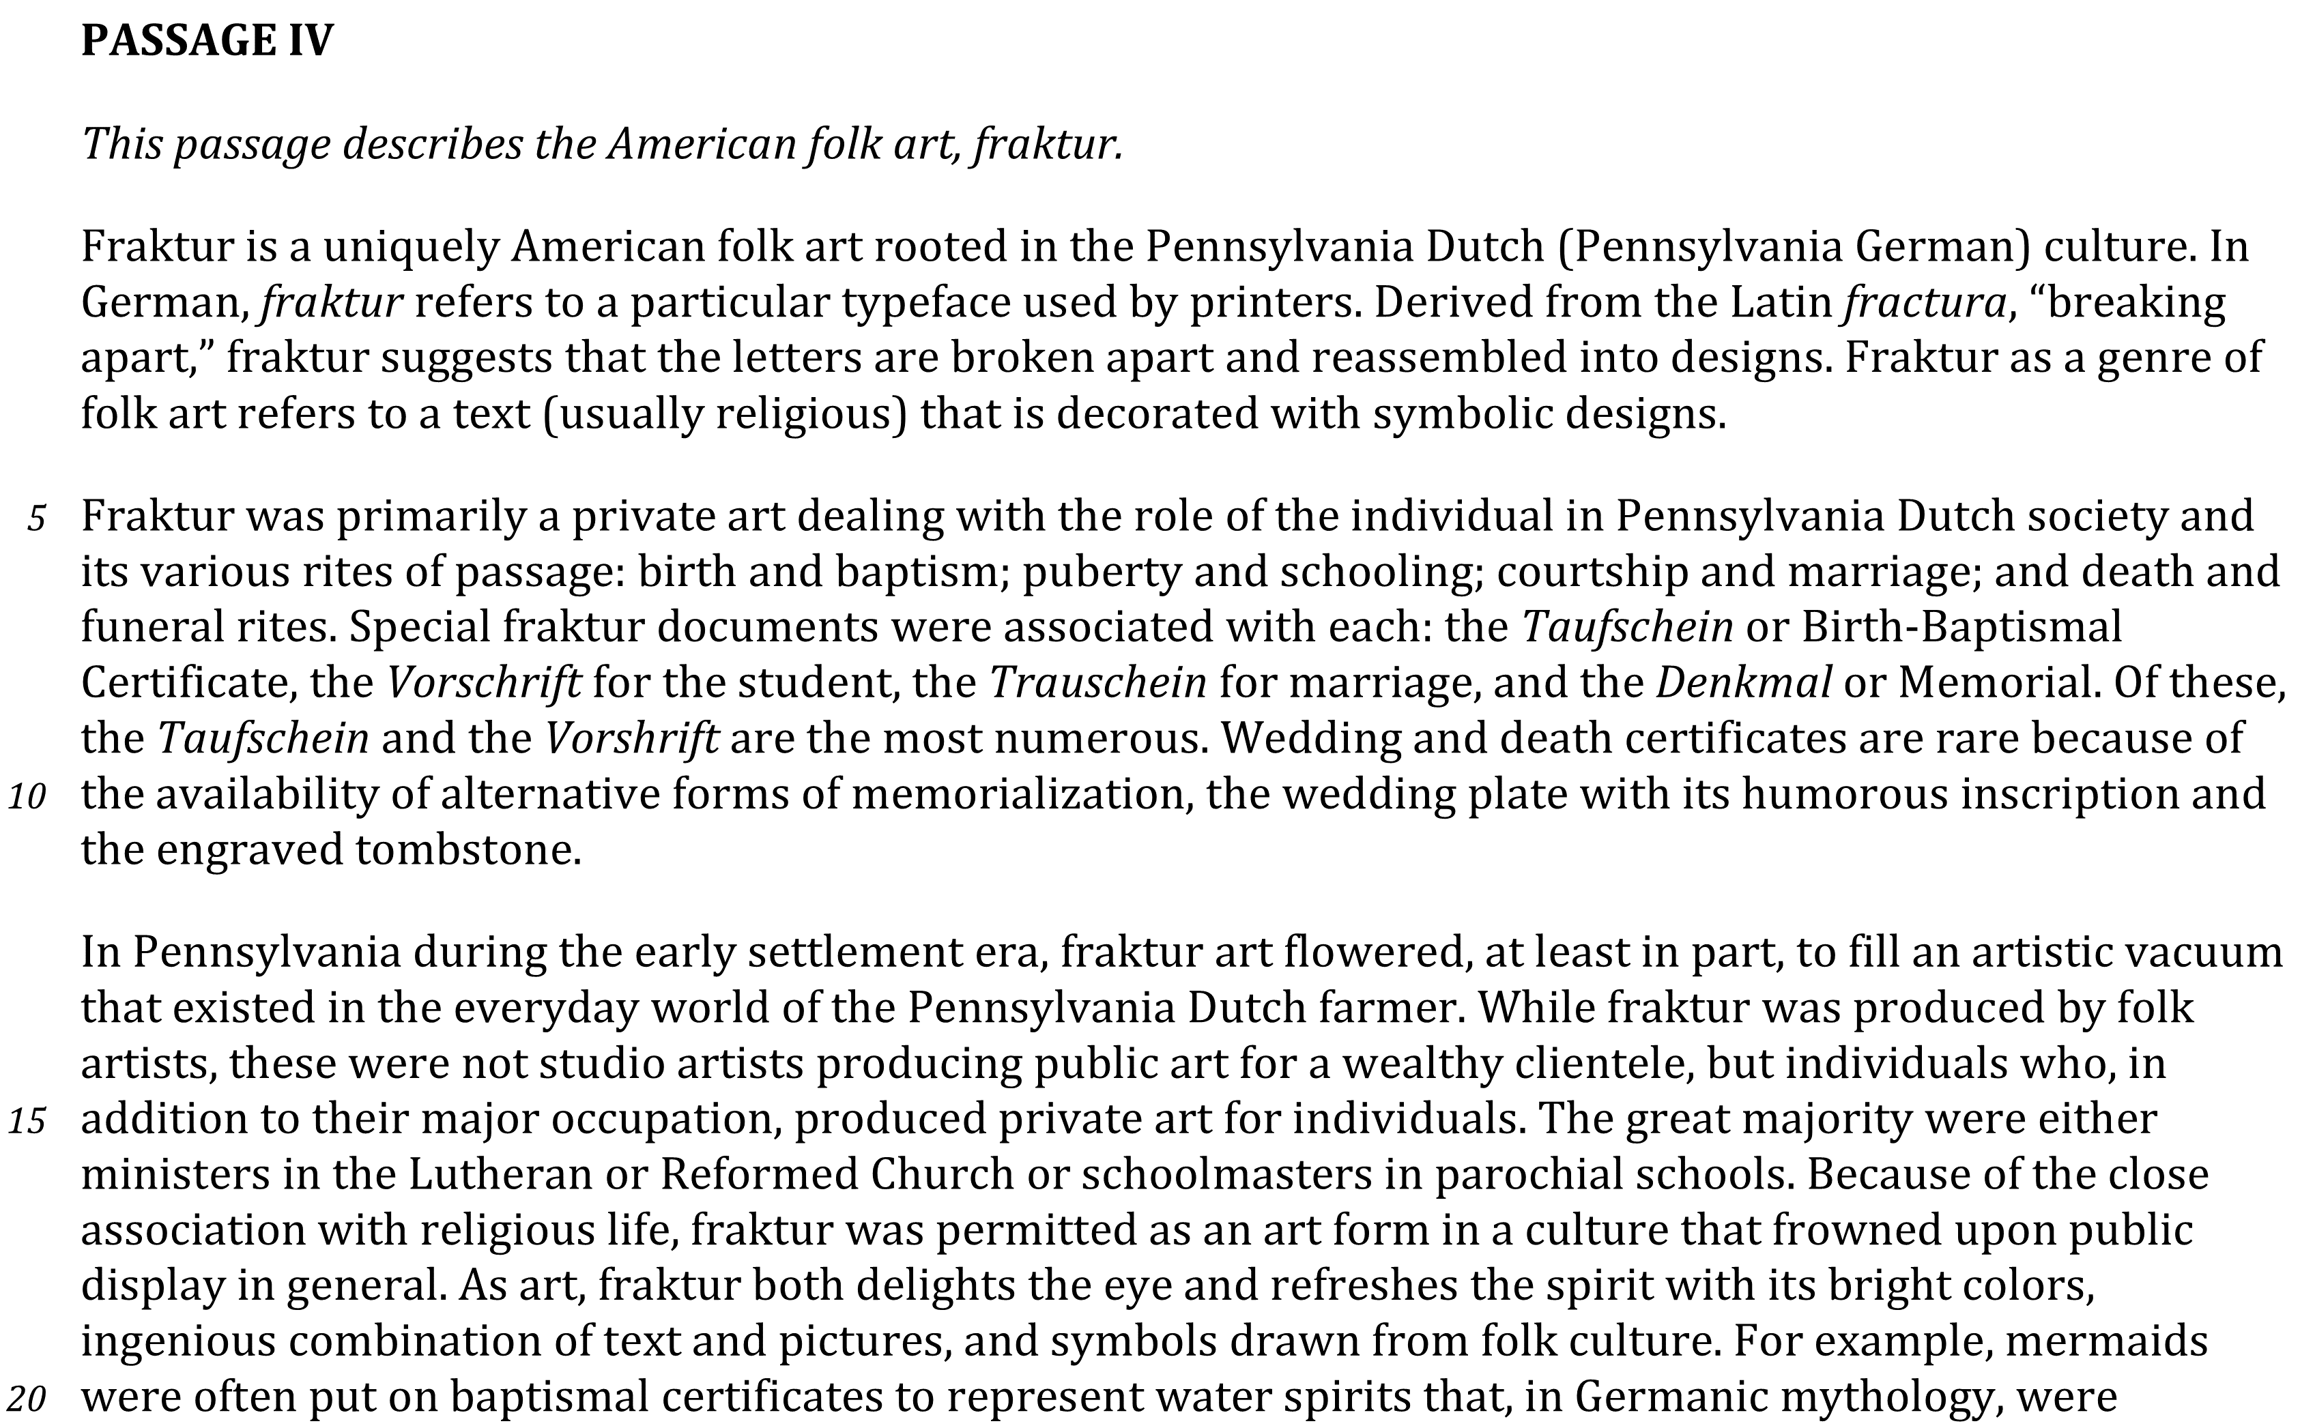
Identify details in a passage Level: Basic Skill Group: Supporting Details

Slide 2
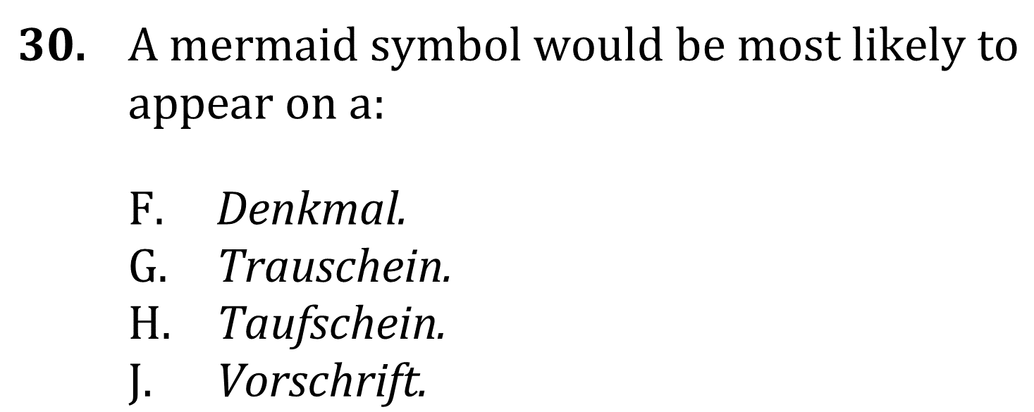
Identify Details

Slide 3
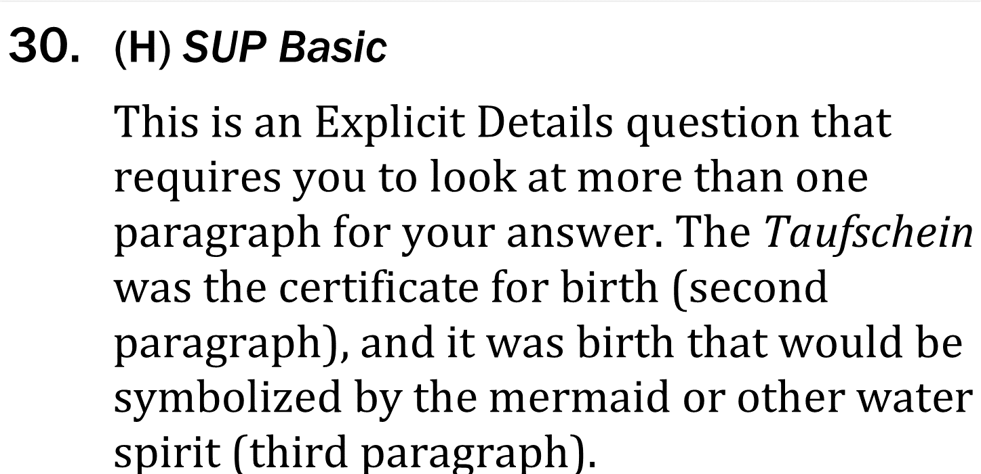
Identify Details

