Slide 1
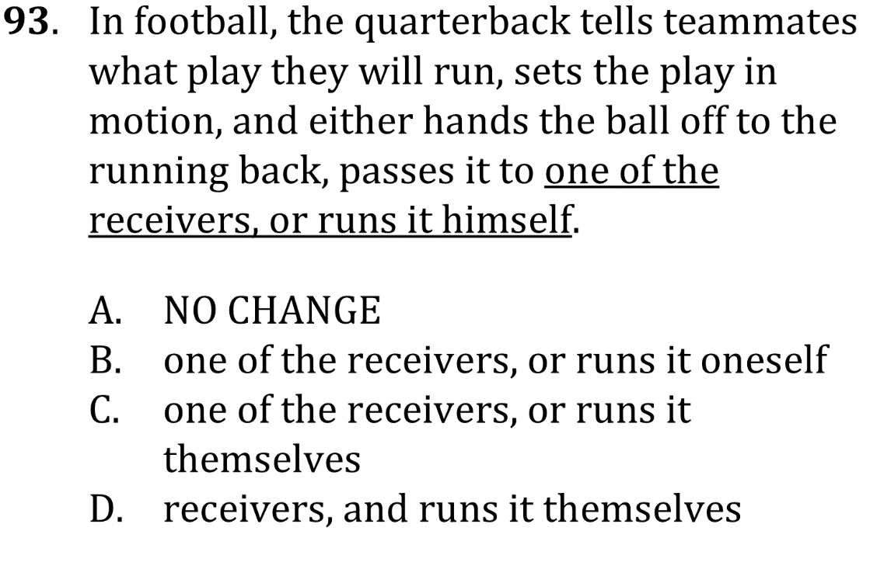

Use pronouns correctly

Slide 2
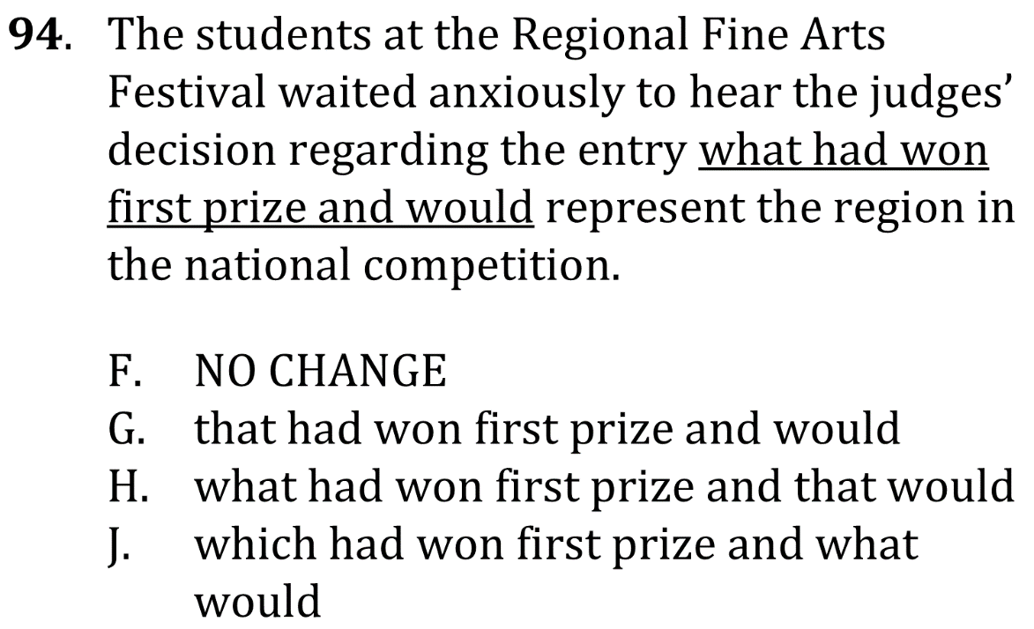
Use pronouns correctly

Slide 3


Use pronouns correctly

Slide 4

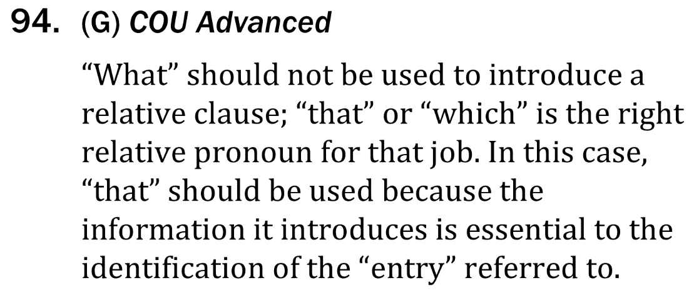
Use pronouns correctly

