Slide 2
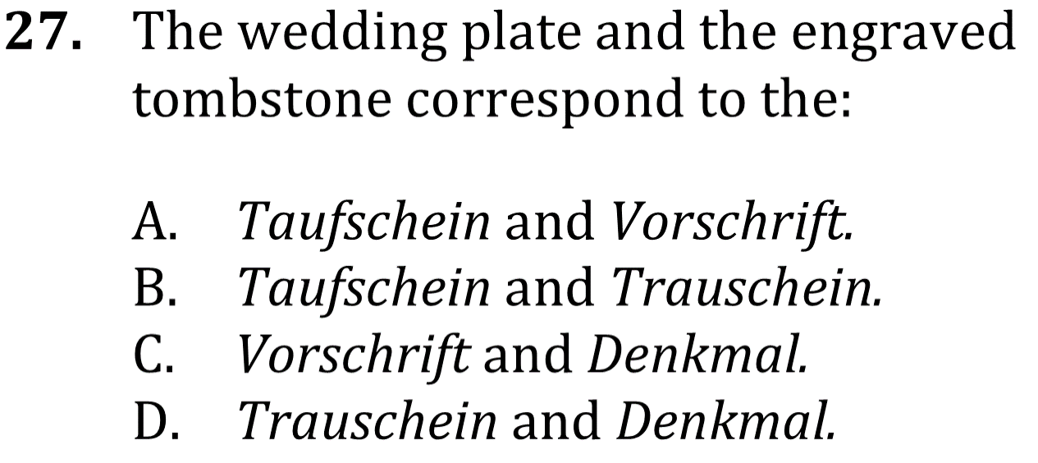
Identify Details

Slide 3
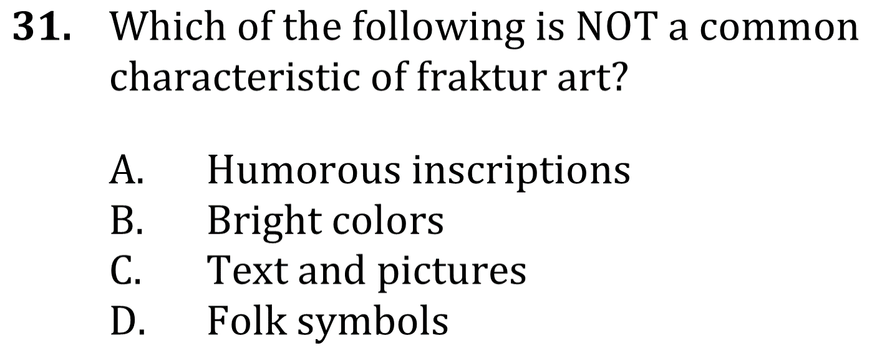
Identify Details

Slide 5
