Slide 1
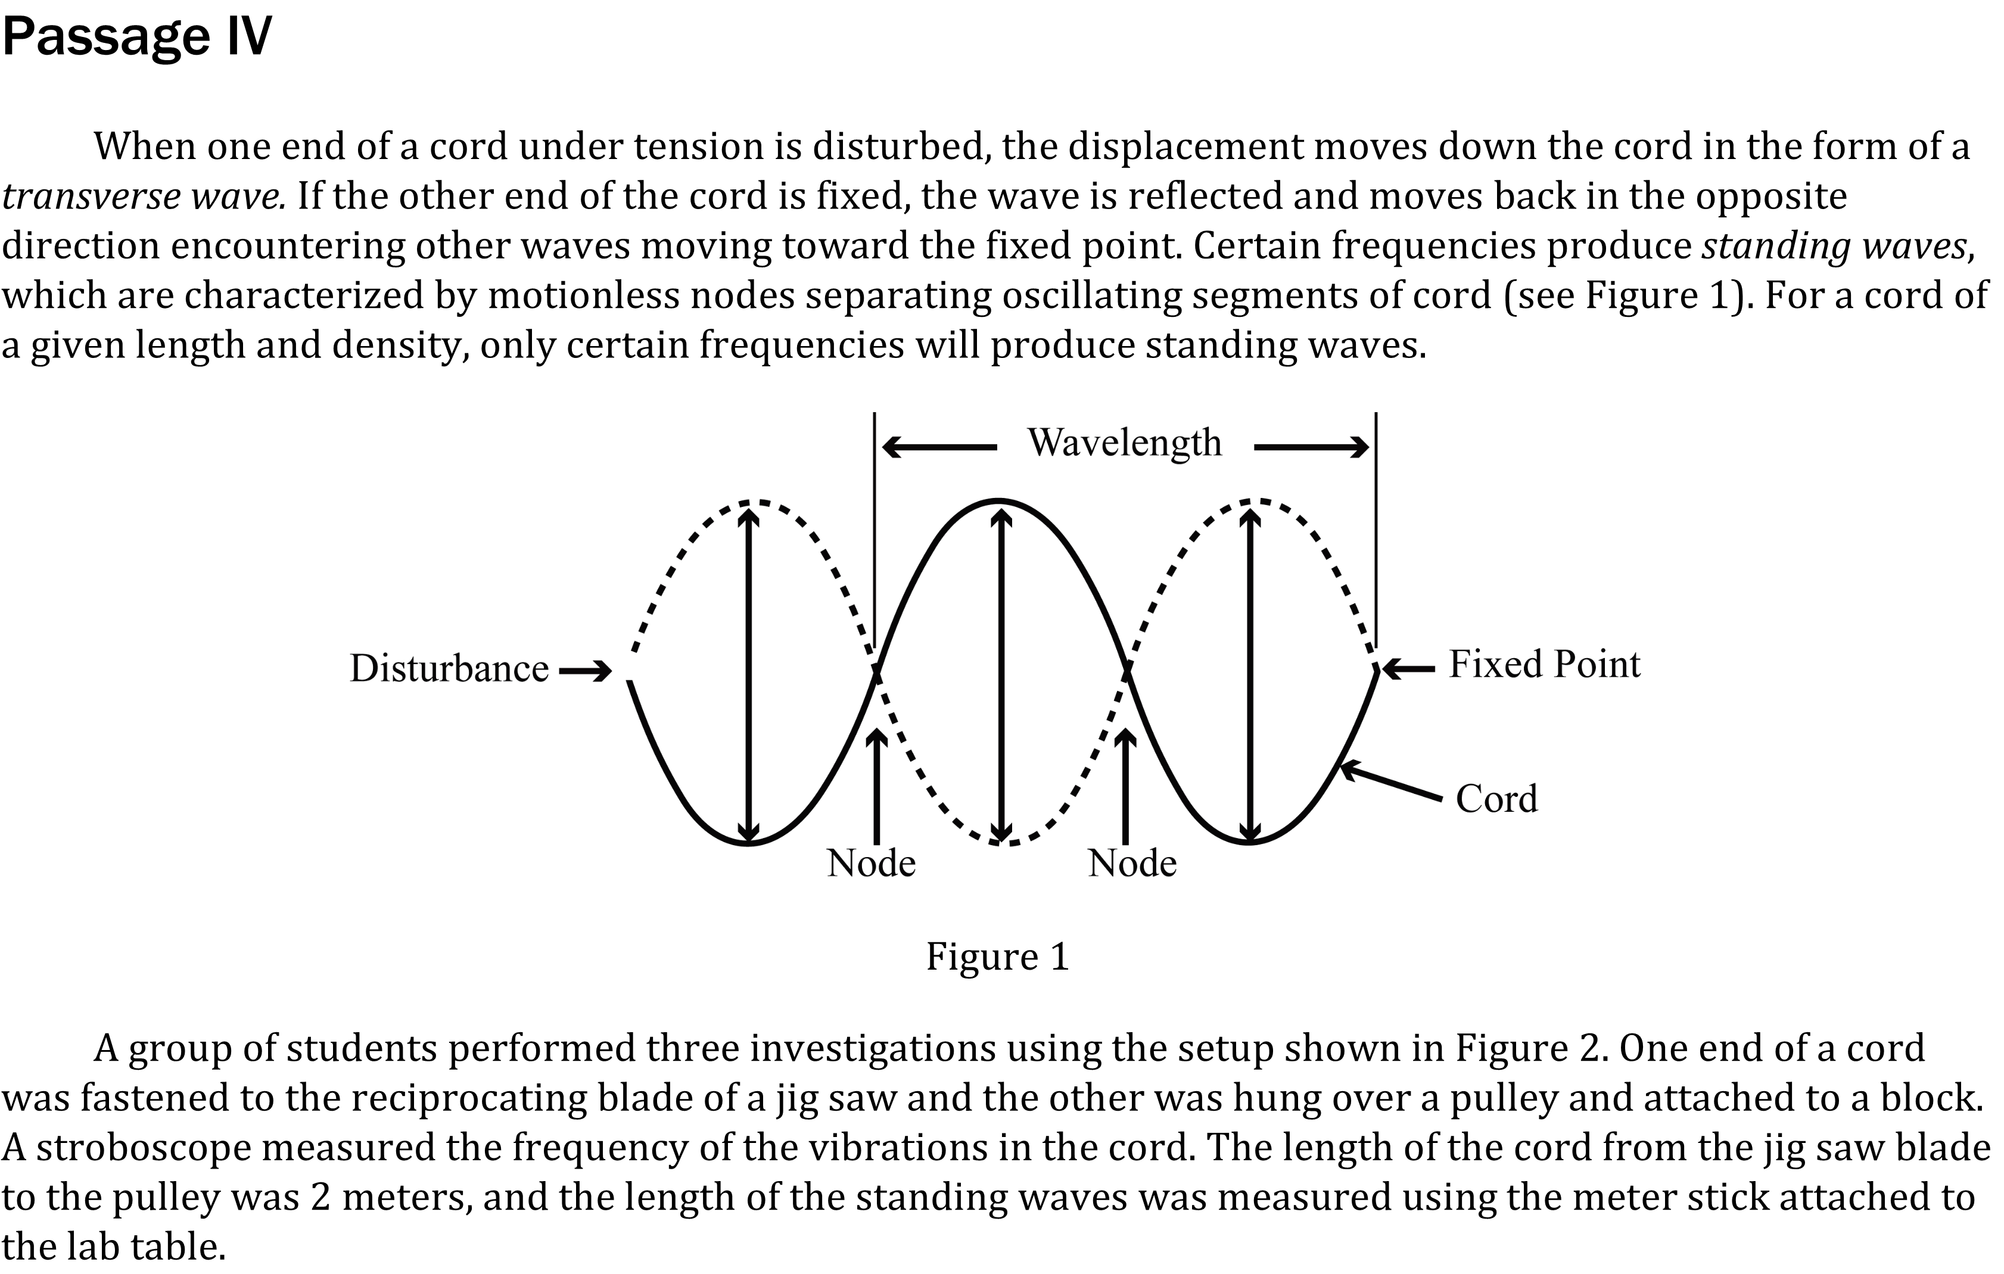

Notes:
Determine what would cause a specific result in an experiment. Level: Intermediate Skill Group: Evaluation of Models

Slide 2
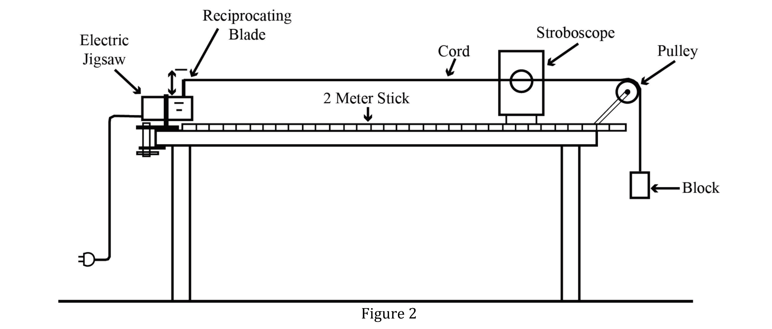
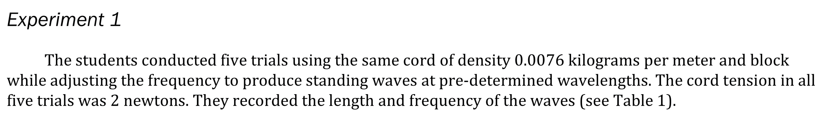
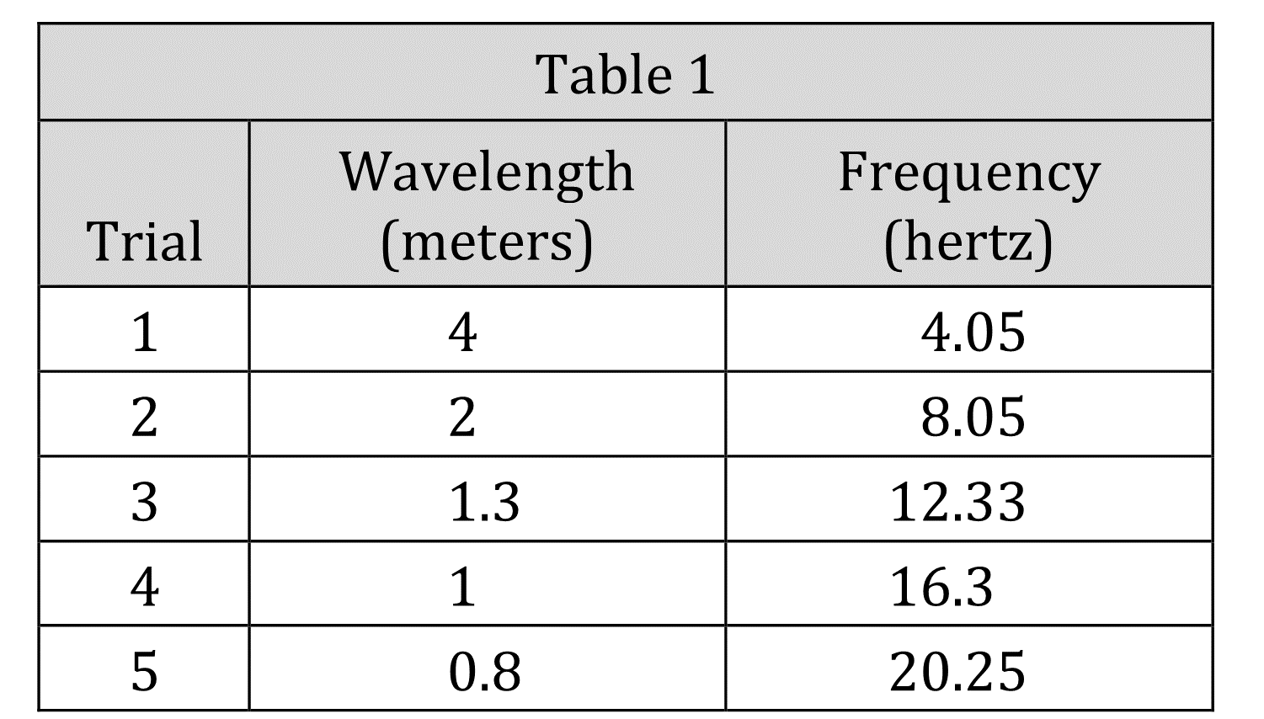
Notes:
Determine what would cause a specific result in an experiment. Level: Intermediate Skill Group: Evaluation of Models

Slide 3
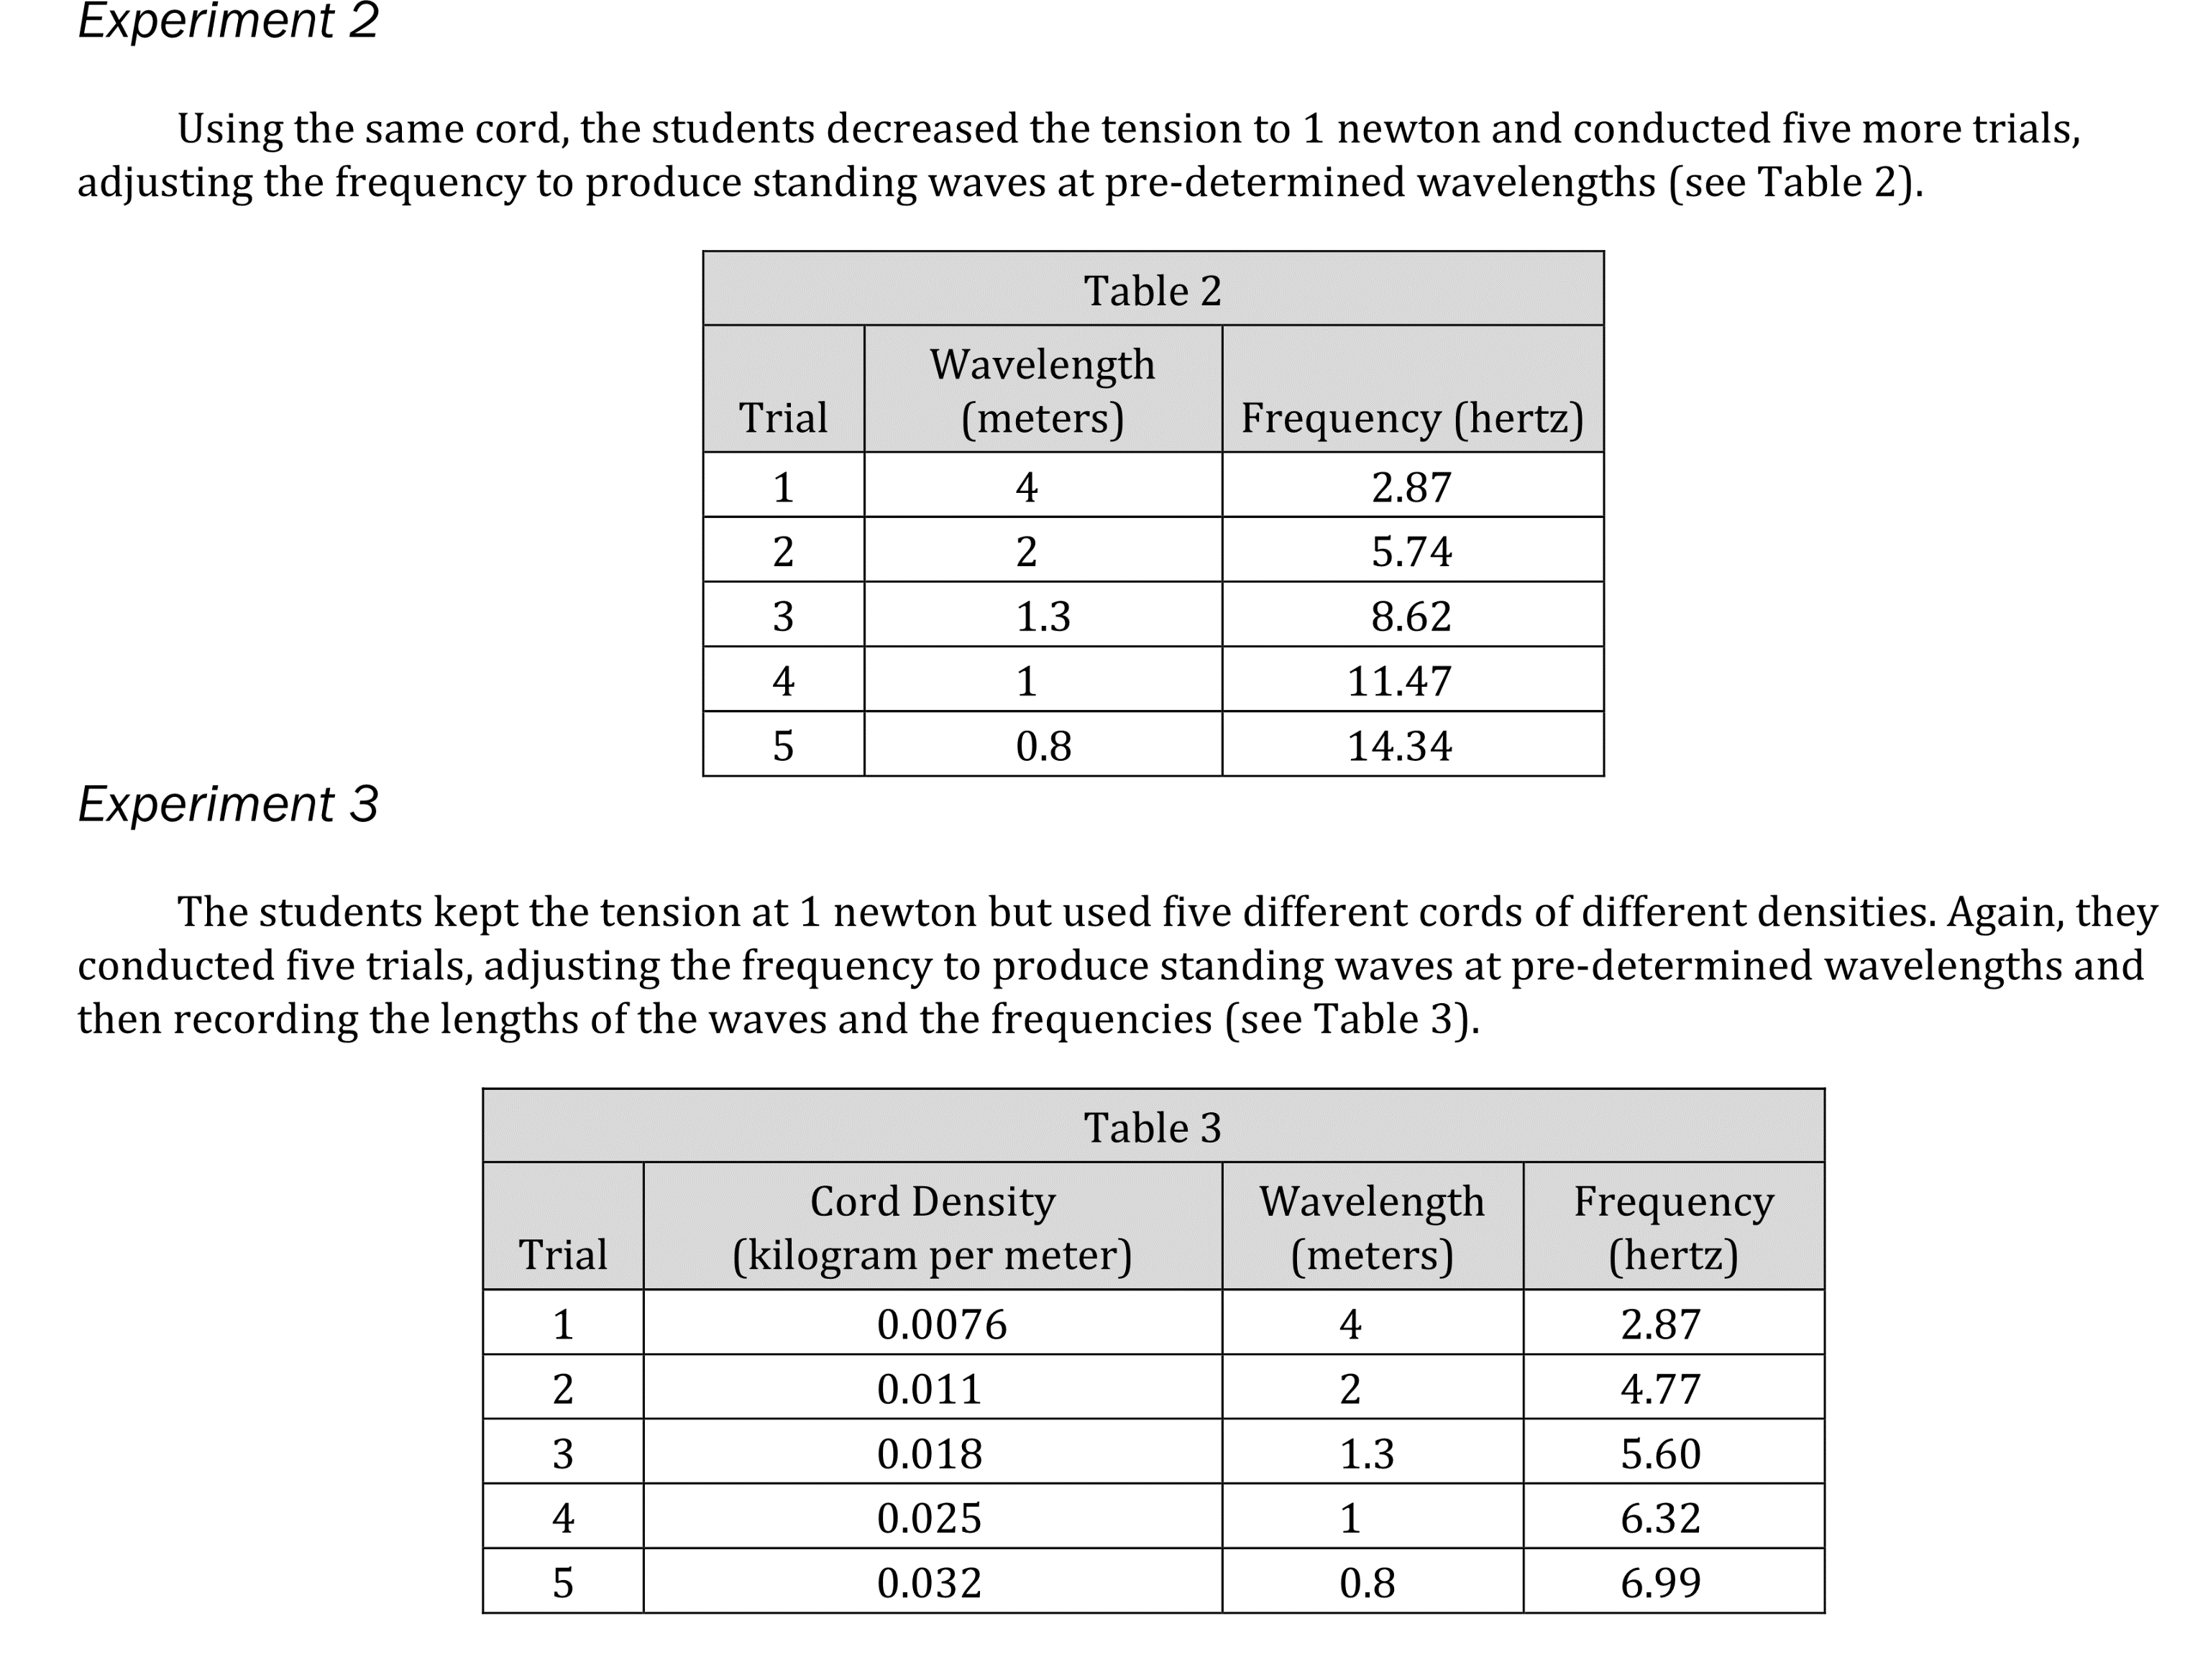
Notes:
Determine what would cause a specific result in an experiment. Level: Intermediate Skill Group: Evaluation of Models

Slide 4
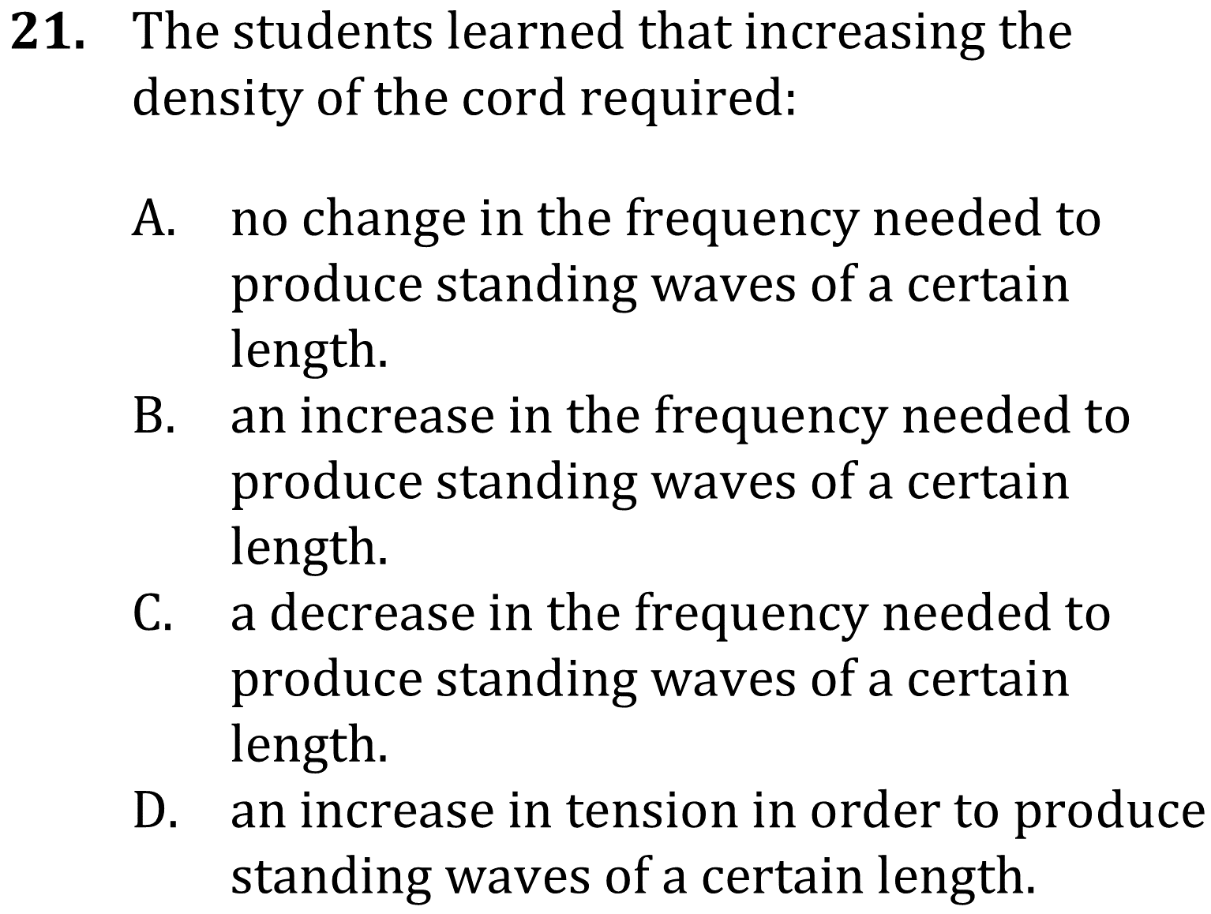
Notes:
Determine what would cause a specific result in an experiment. Level: Intermediate Skill Group: Evaluation of Models

Slide 5
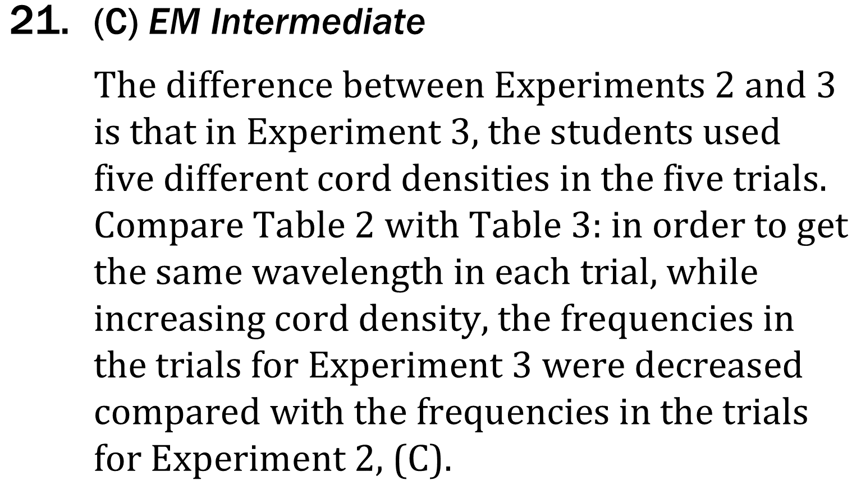
Notes:
Determine what would cause a specific result in an experiment. Level: Intermediate Skill Group: Evaluation of Models

