Slide 1
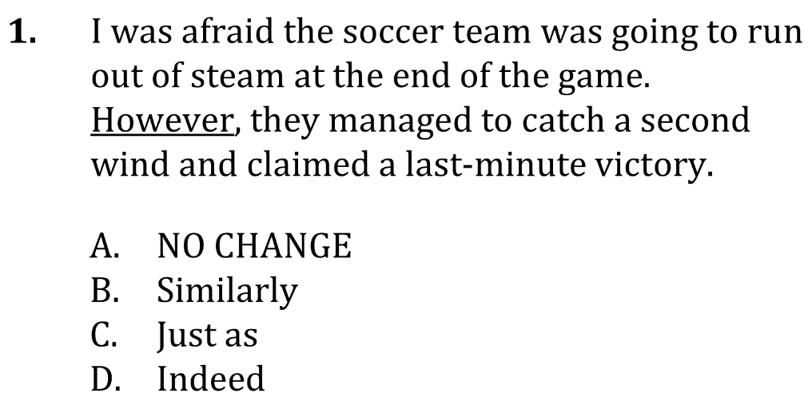

Conjunctive Adverbs

Slide 2
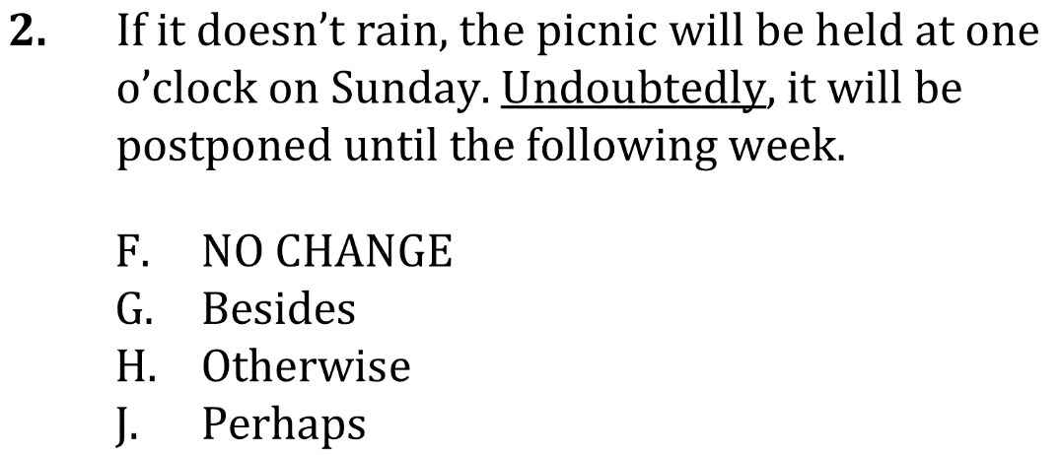
Conjunctive Adverbs

Slide 3
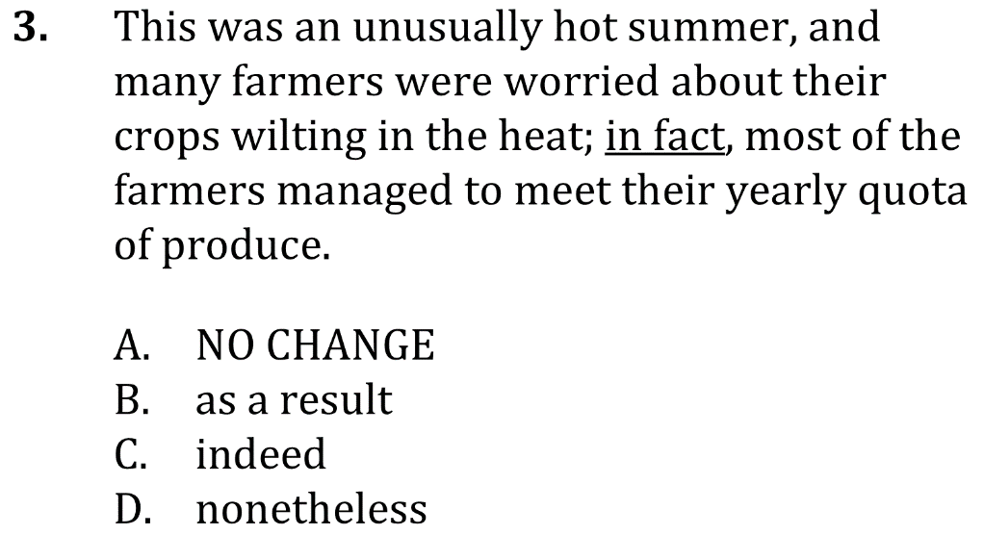
Conjunctive Adverbs

Slide 4


Conjunctive Adverbs

Slide 5
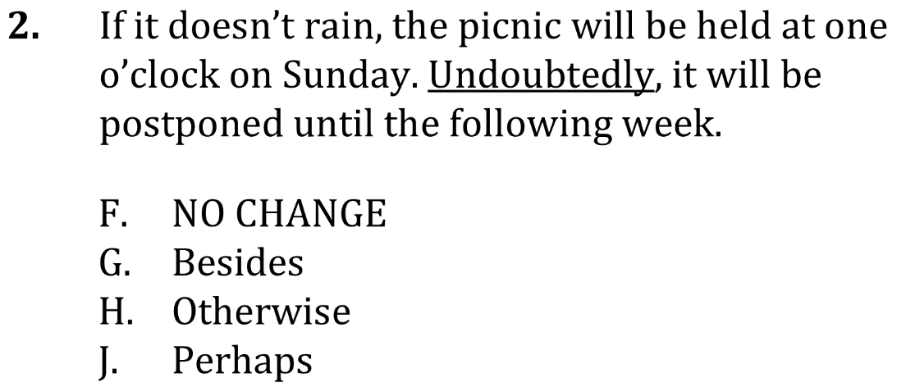
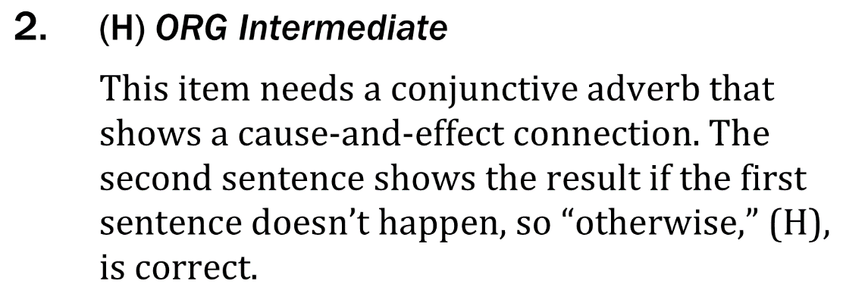
Conjunctive Adverbs

Slide 6
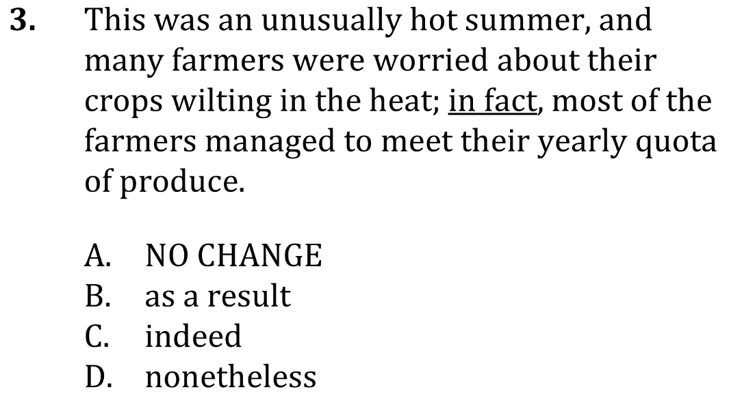
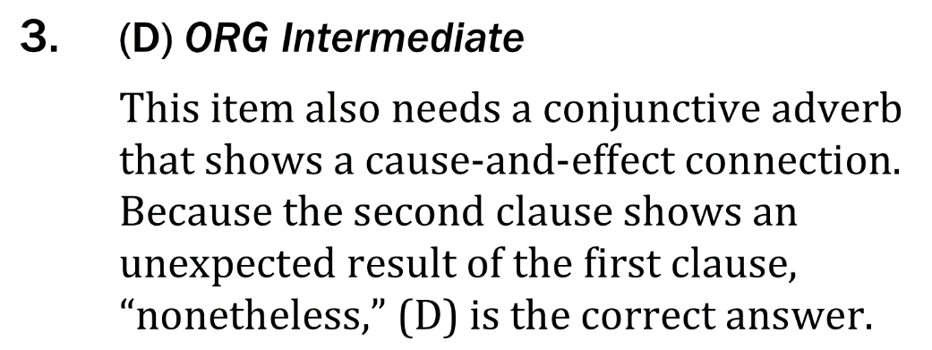
Conjunctive Adverbs

