Slide 1
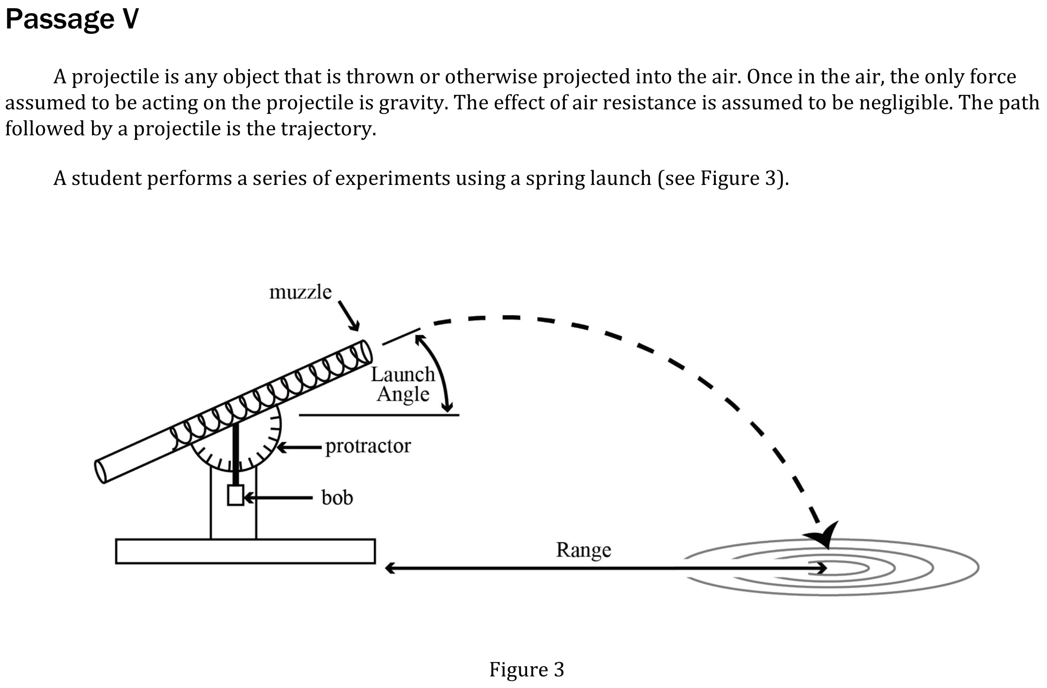

Notes:
Select a hypothesis prediction or conclusion supported by a data presentation or model. Level: Intermediate Skill Group: Evaluation of Models

Slide 2
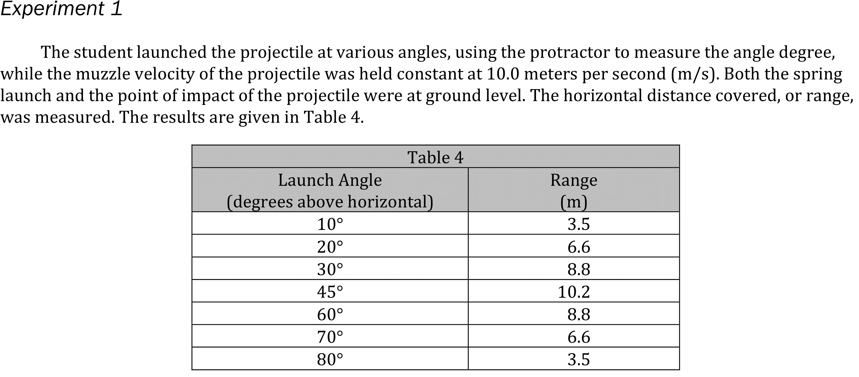
Notes:
Select a hypothesis prediction or conclusion supported by a data presentation or model. Level: Intermediate Skill Group: Evaluation of Models

Slide 3
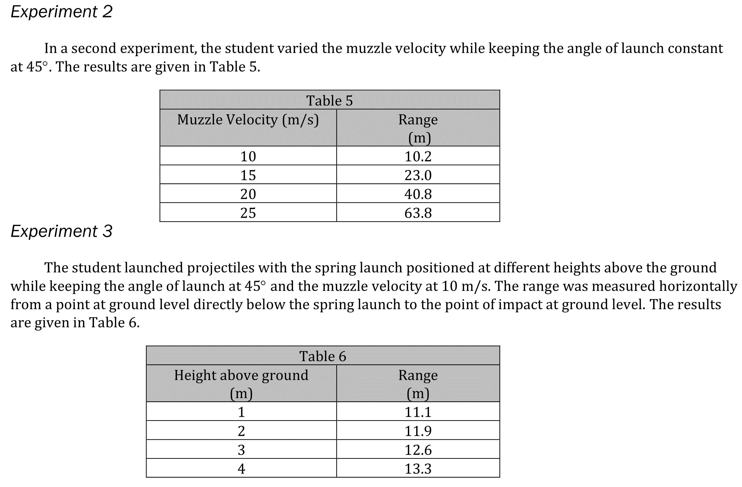
Notes:
Select a hypothesis prediction or conclusion supported by a data presentation or model. Level: Intermediate Skill Group: Evaluation of Models

Slide 4
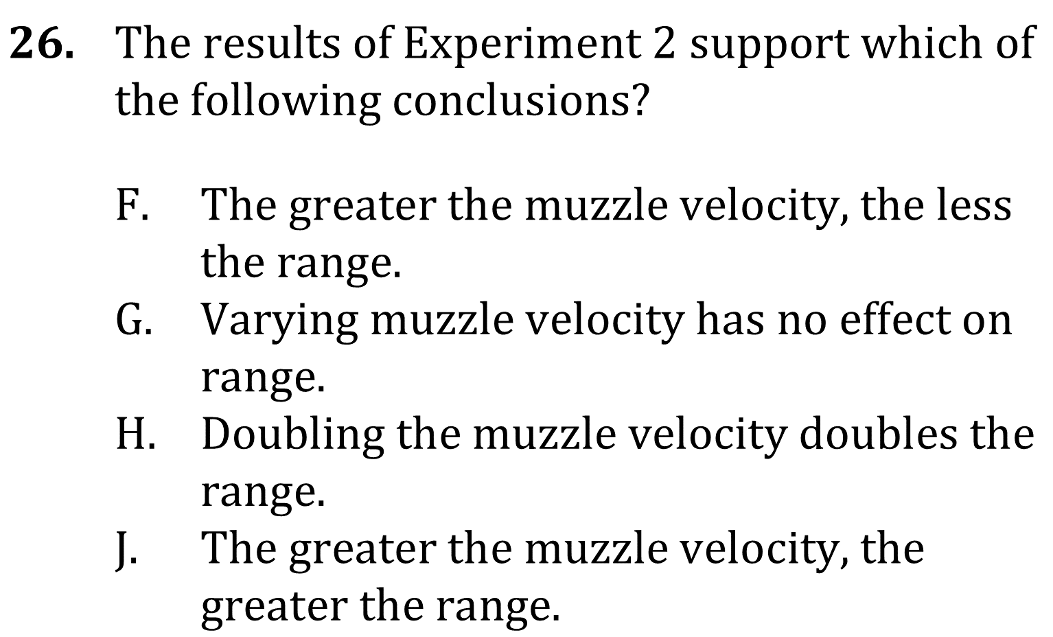
Notes:
Select a hypothesis prediction or conclusion supported by a data presentation or model. Level: Intermediate Skill Group: Evaluation of Models

Slide 5
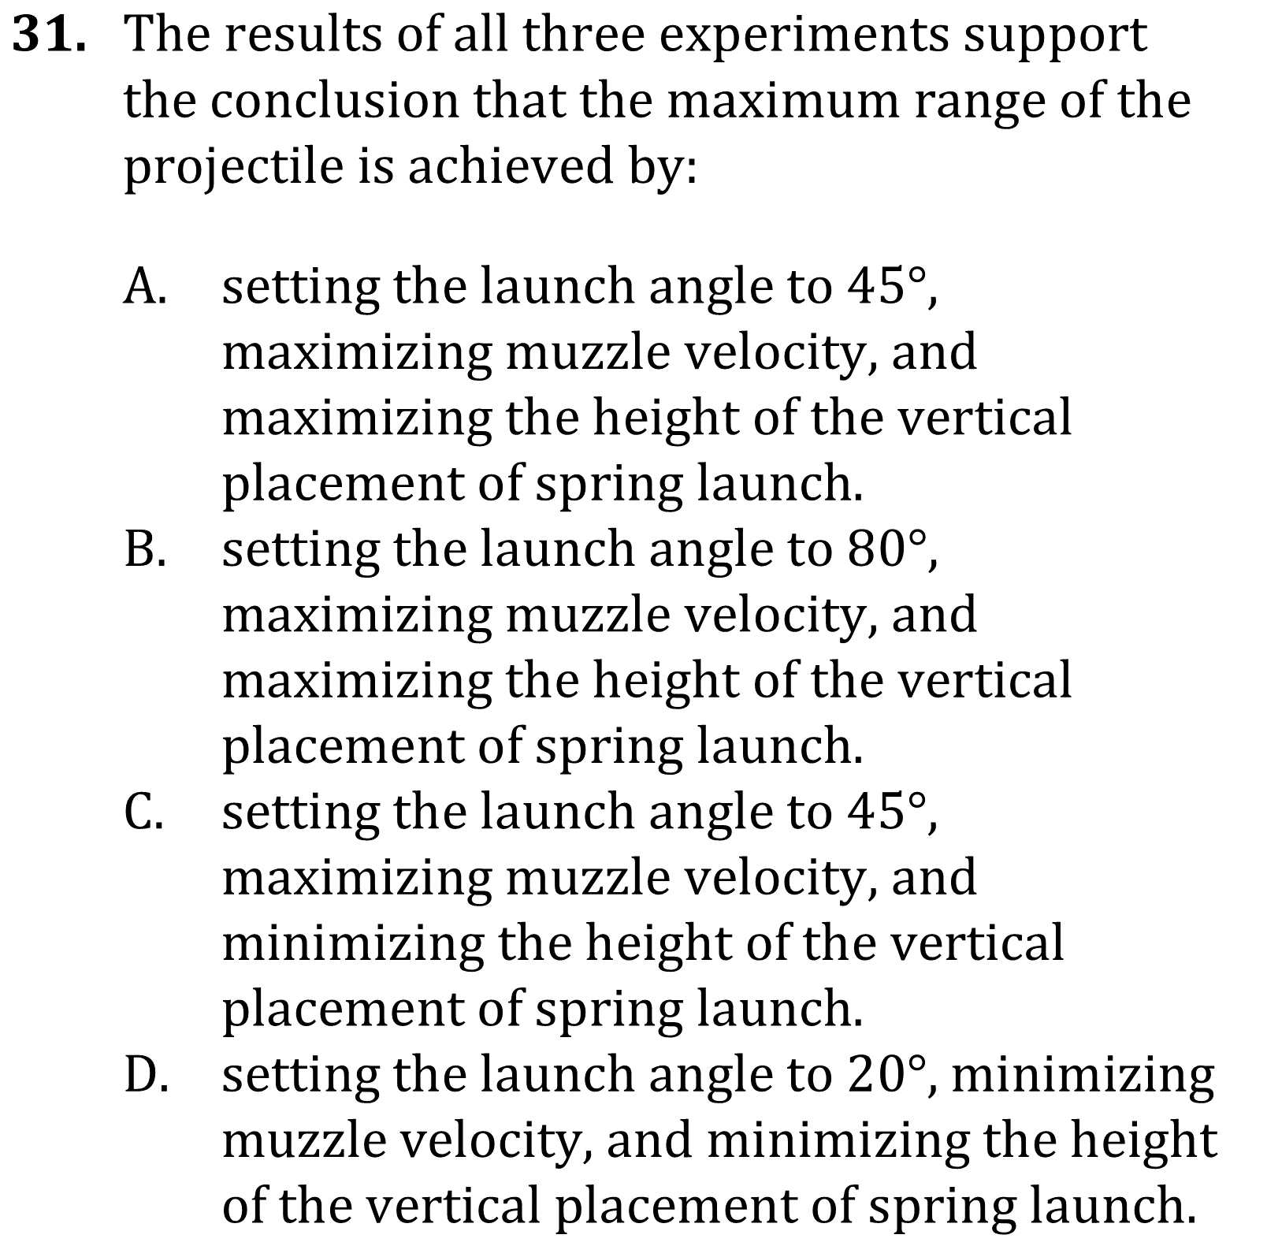
Notes:
Select a hypothesis prediction or conclusion supported by a data presentation or model. Level: Intermediate Skill Group: Evaluation of Models

Slide 6
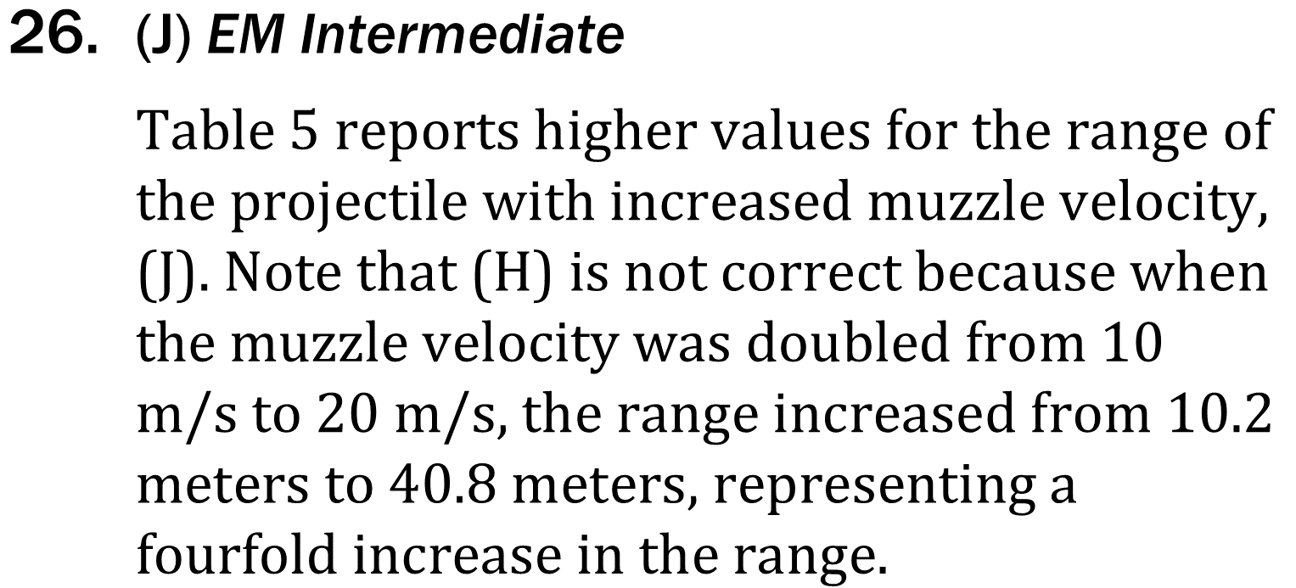
Notes:
Select a hypothesis prediction or conclusion supported by a data presentation or model. Level: Intermediate Skill Group: Evaluation of Models

Slide 7
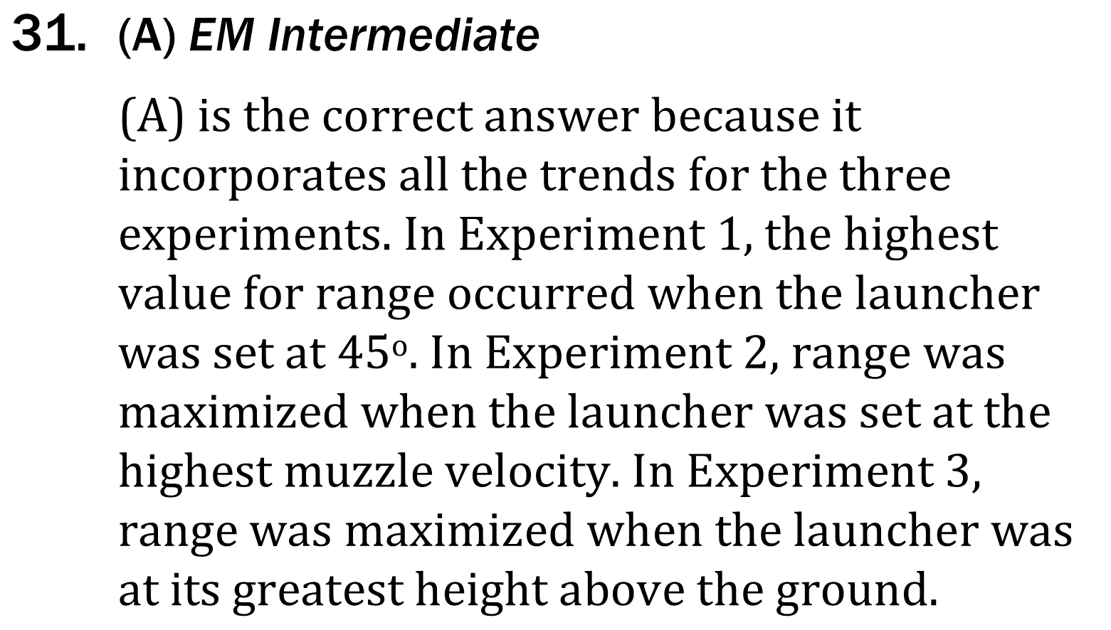
Notes:
Select a hypothesis prediction or conclusion supported by a data presentation or model. Level: Intermediate Skill Group: Evaluation of Models

