Slide 1
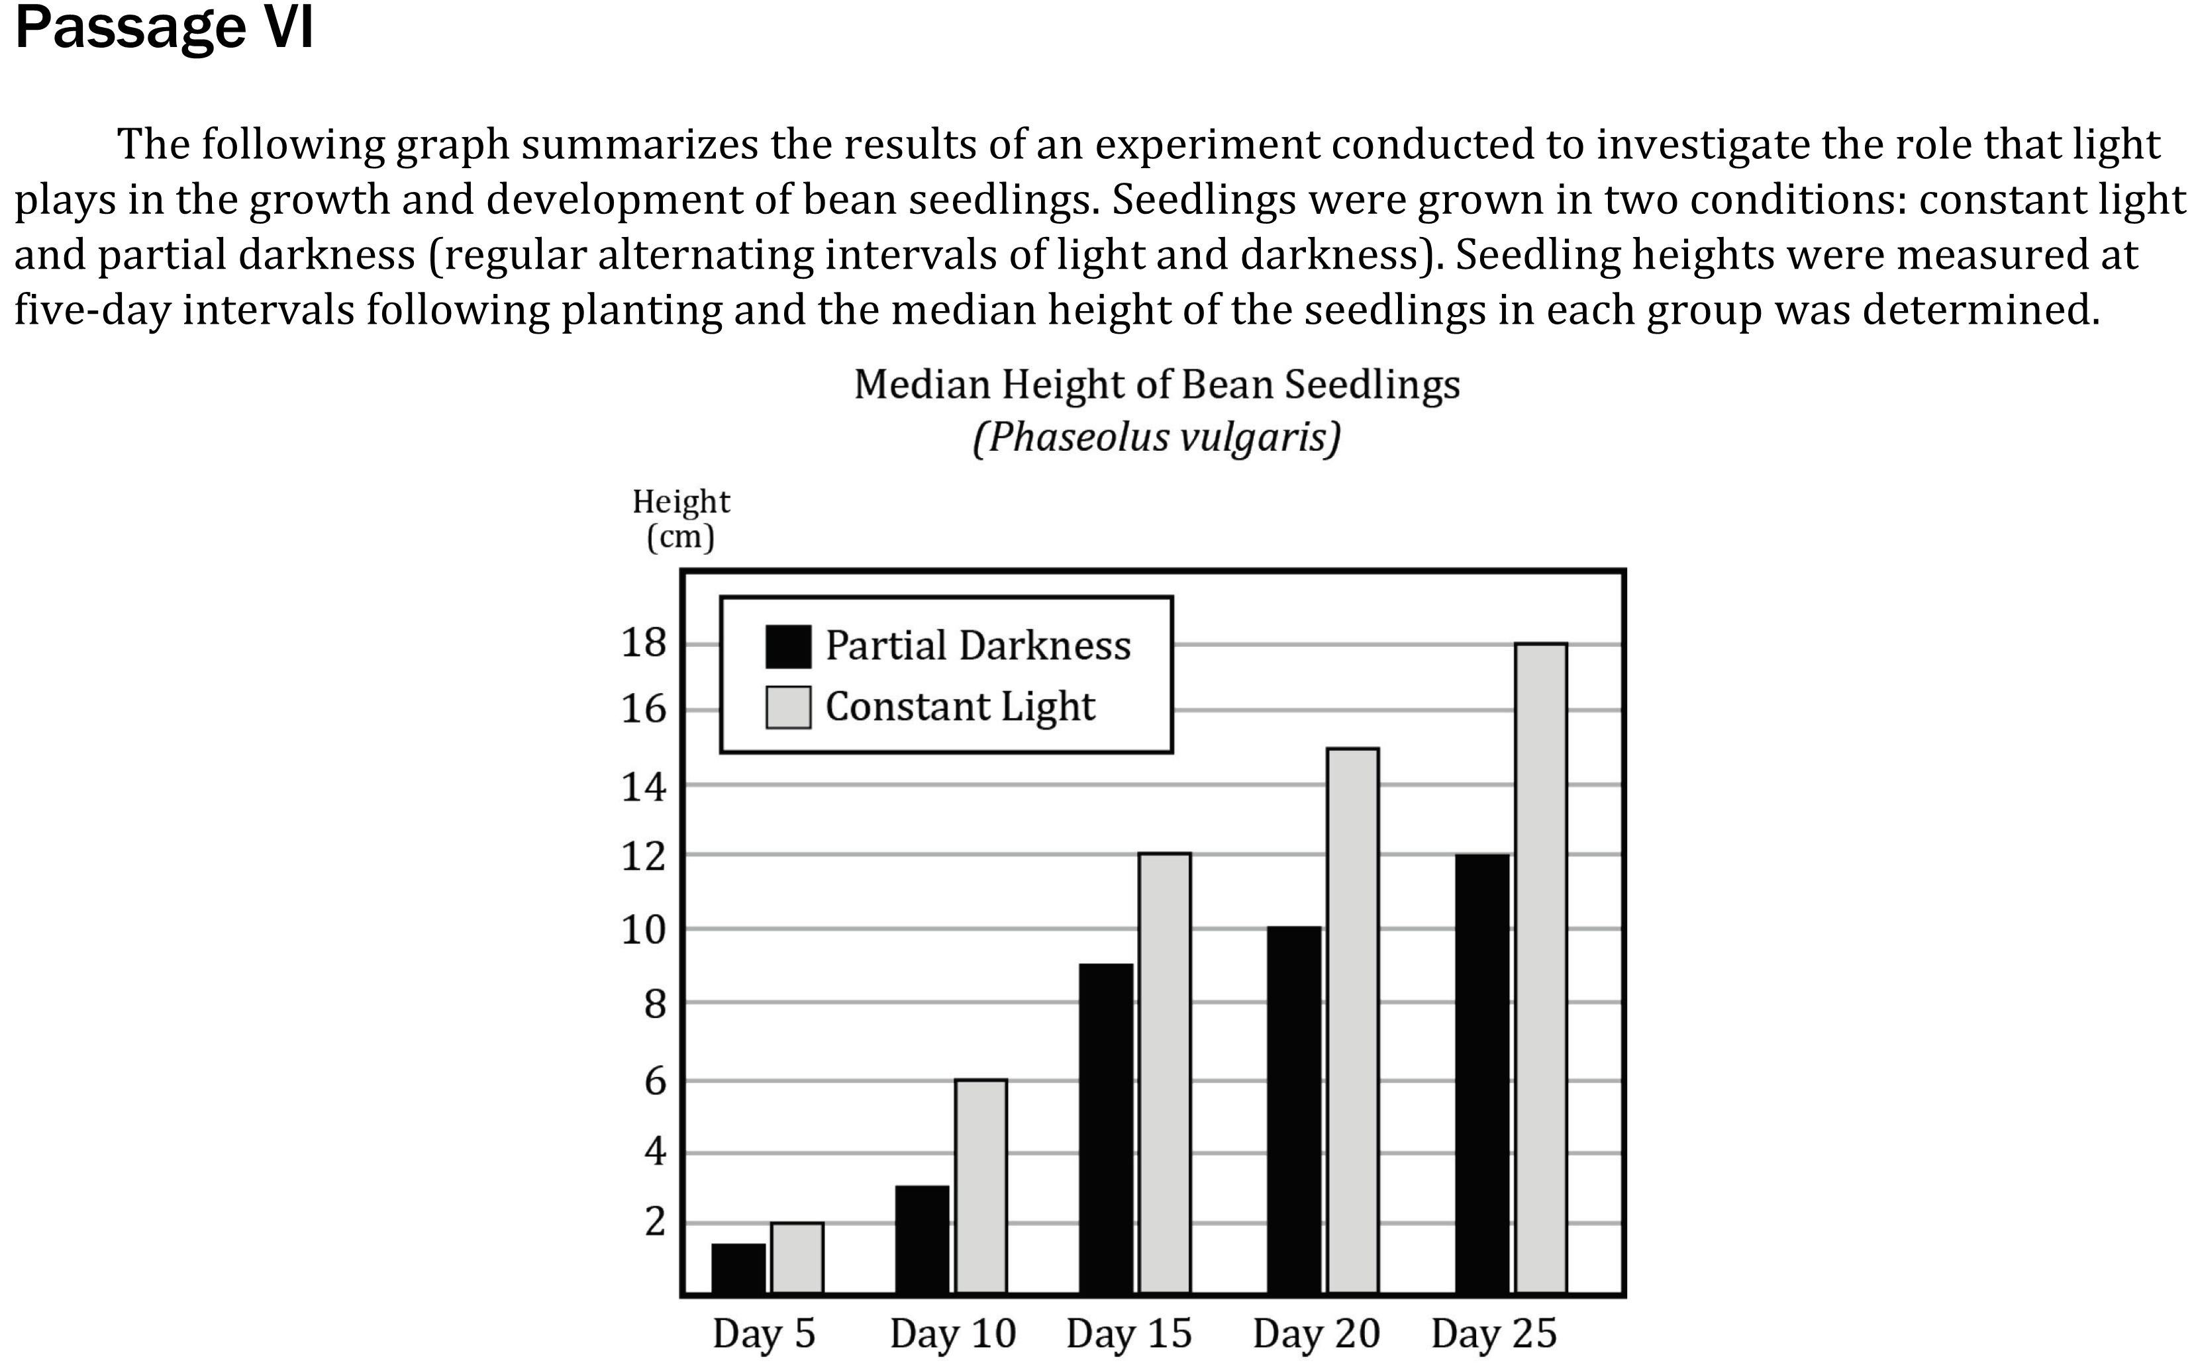

Notes:
Use a simple presentation of data to identify one two or more pieces of data either numerical of non-numerical; Determine direct and inverse relationships of variables in a data presentation. Level: Basic Skill Group: Interpretation of Data

Slide 2
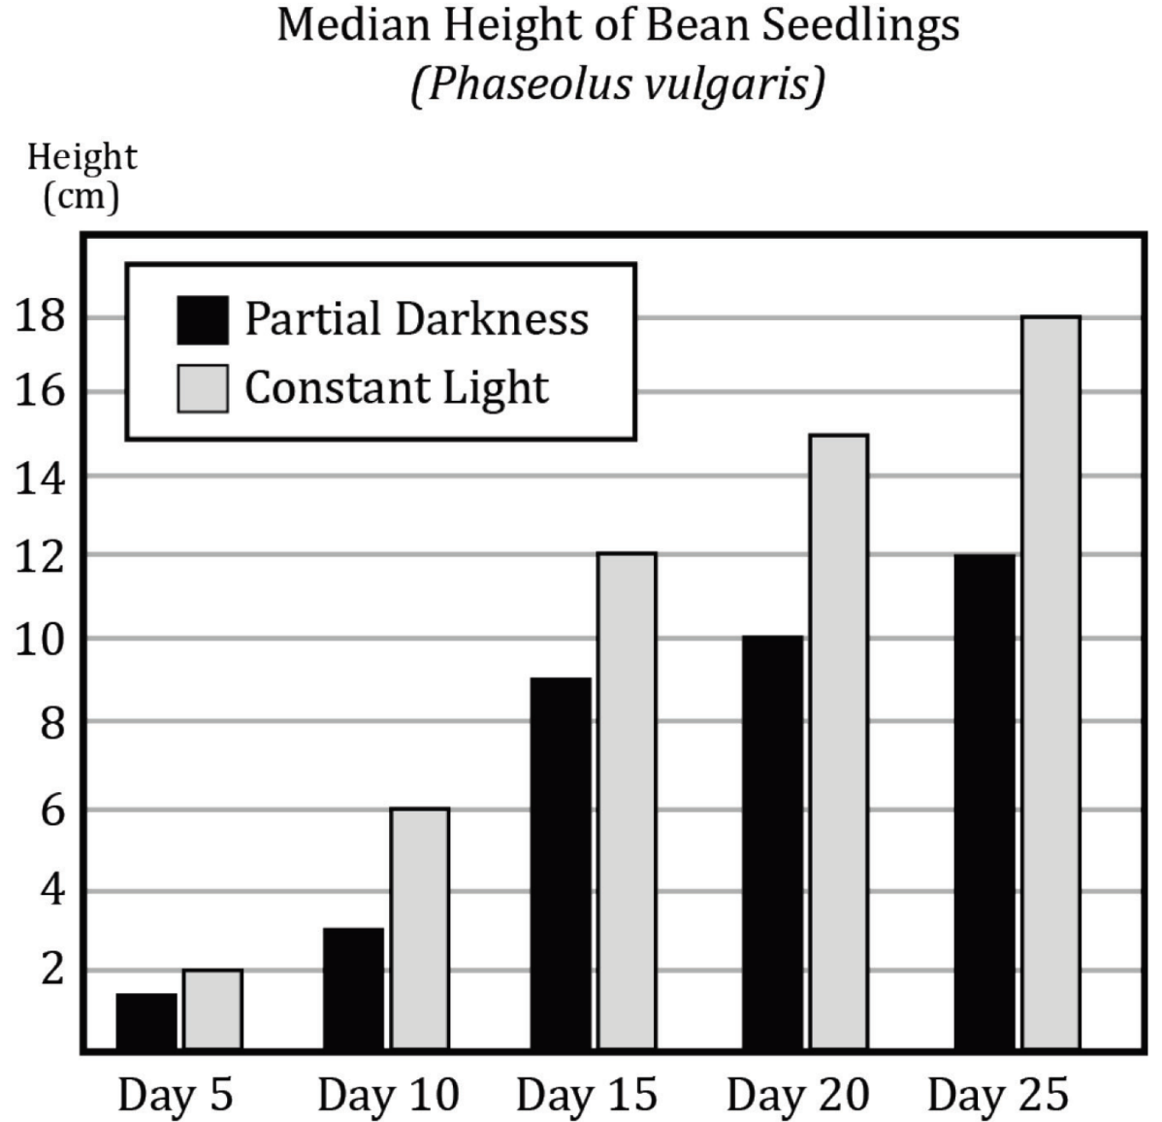
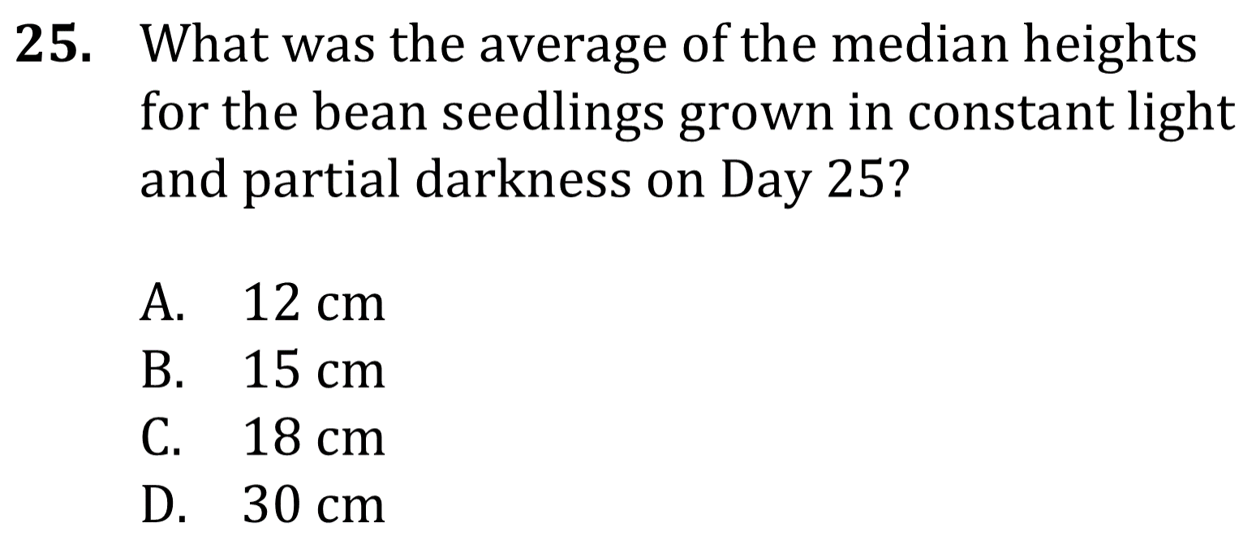
Notes:
Use a simple presentation of data to identify one two or more pieces of data either numerical of non-numerical; Determine direct and inverse relationships of variables in a data presentation. Level: Basic Skill Group: Interpretation of Data

Slide 3

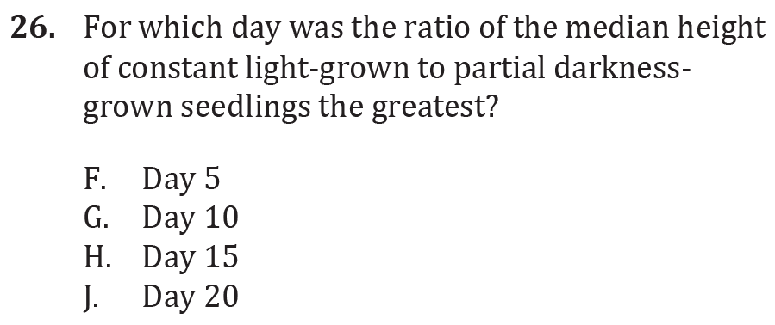
Notes:
Use a simple presentation of data to identify one two or more pieces of data either numerical of non-numerical; Determine direct and inverse relationships of variables in a data presentation. Level: Basic Skill Group: Interpretation of Data

Slide 4

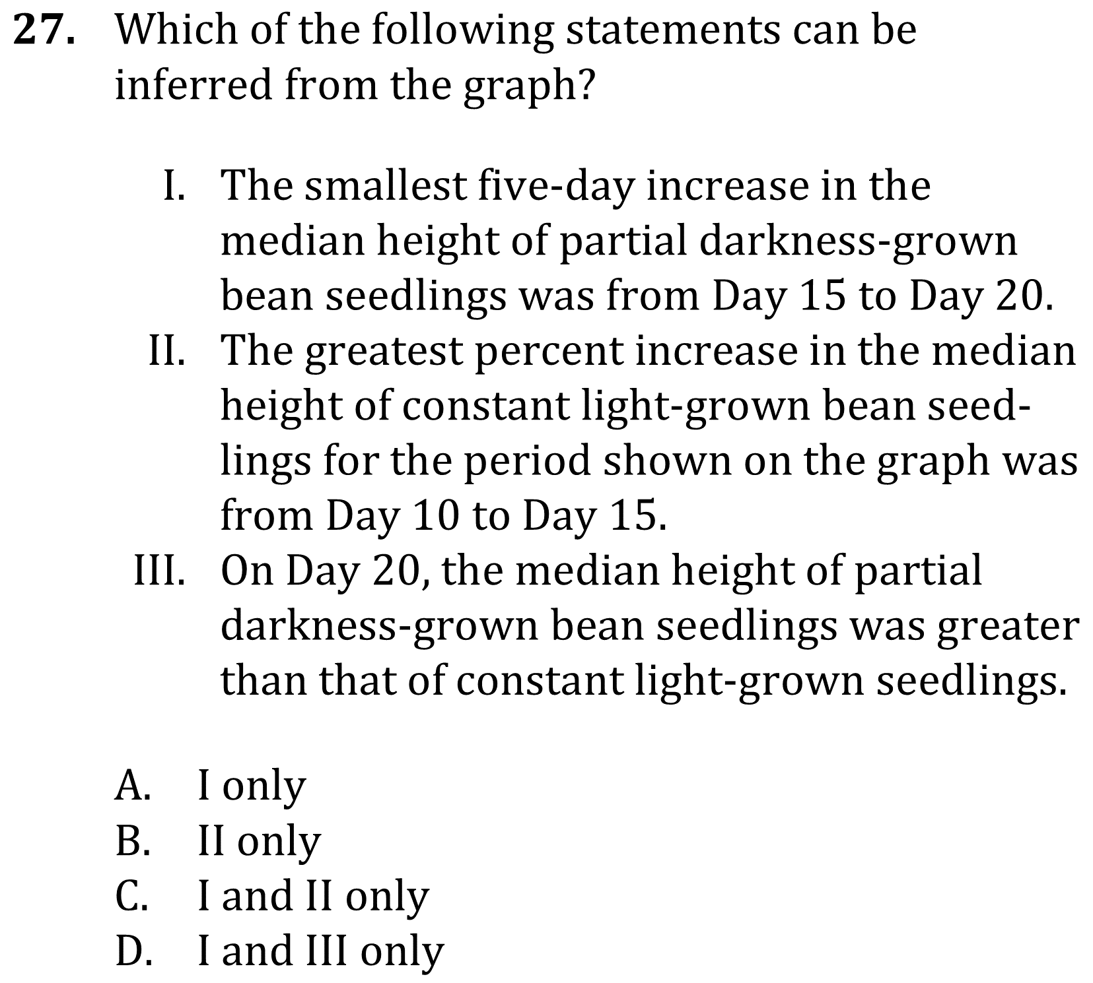
Notes:
Use a simple presentation of data to identify one two or more pieces of data either numerical of non-numerical; Determine direct and inverse relationships of variables in a data presentation. Level: Basic Skill Group: Interpretation of Data

Slide 5

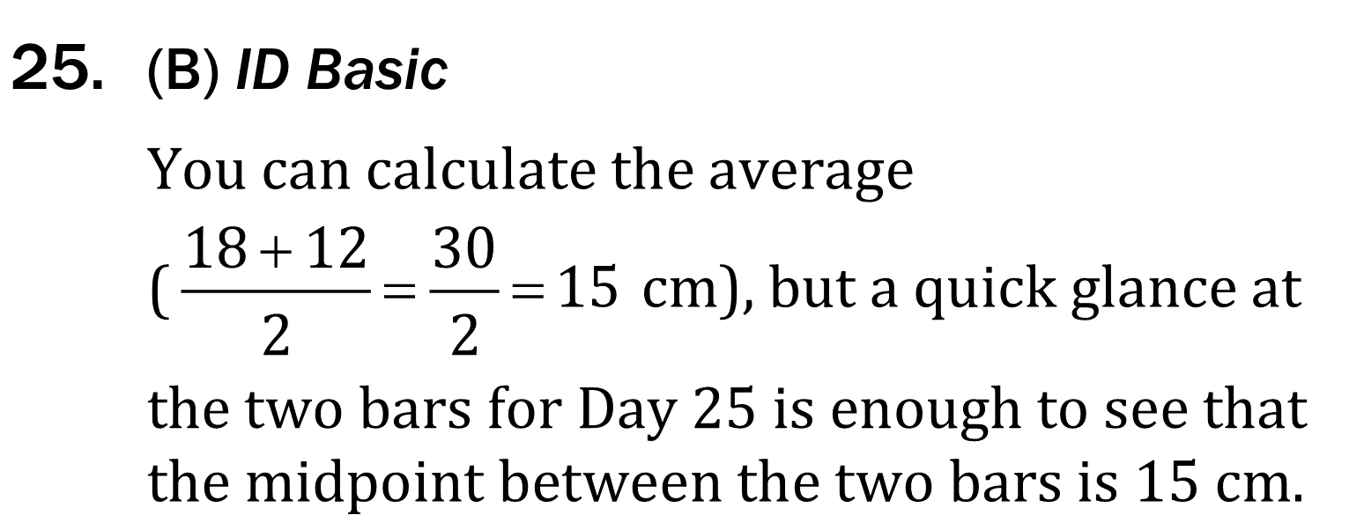
Notes:
Use a simple presentation of data to identify one two or more pieces of data either numerical of non-numerical; Determine direct and inverse relationships of variables in a data presentation. Level: Basic Skill Group: Interpretation of Data

Slide 6
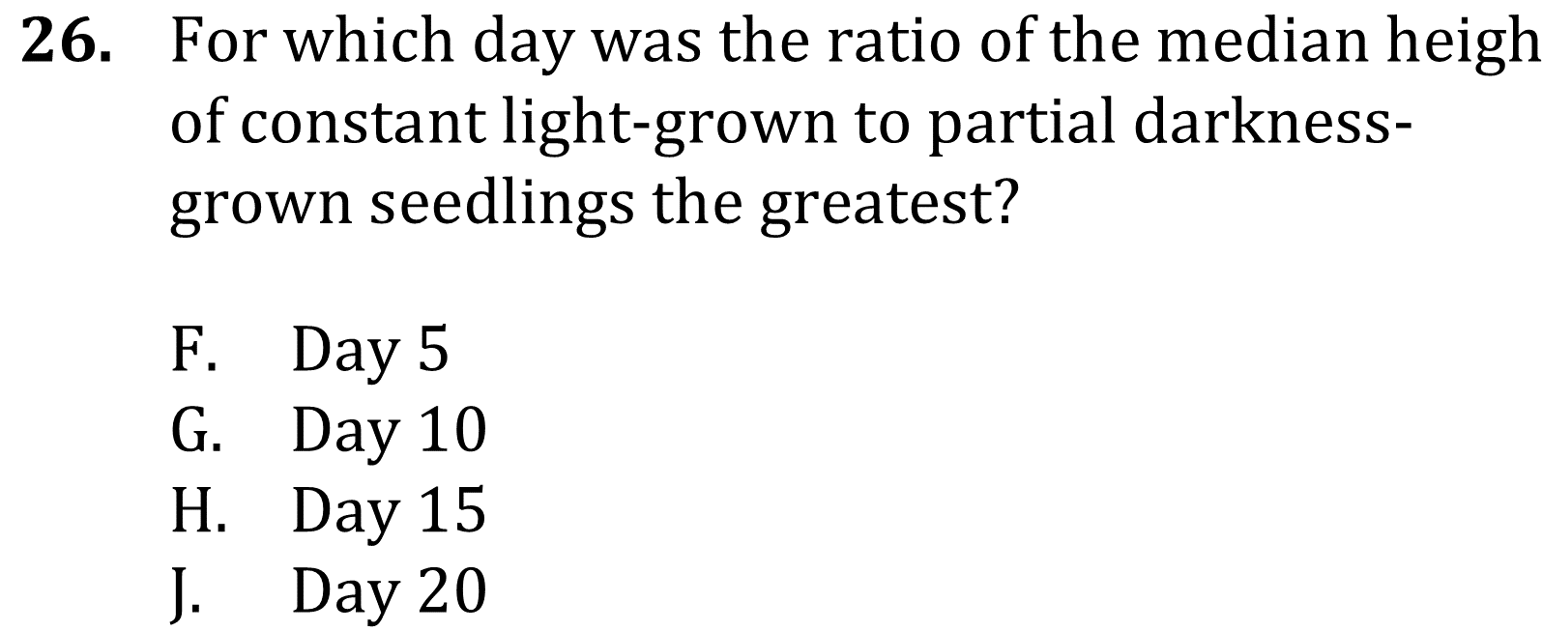
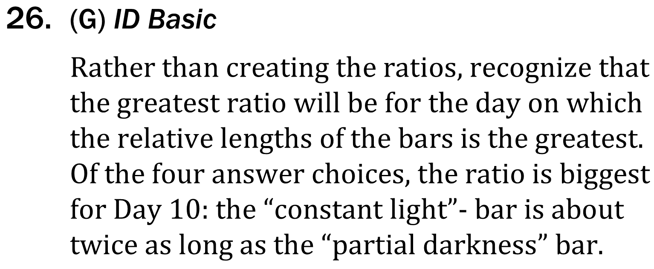
t
Notes:
Use a simple presentation of data to identify one two or more pieces of data either numerical of non-numerical; Determine direct and inverse relationships of variables in a data presentation. Level: Basic Skill Group: Interpretation of Data

Slide 7
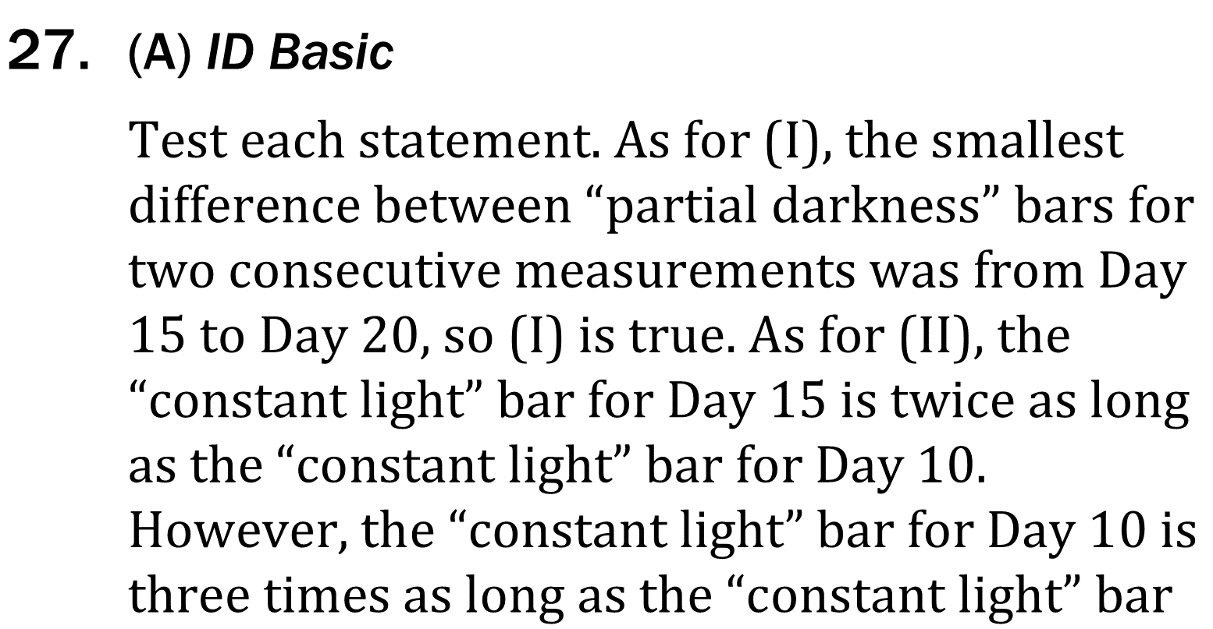
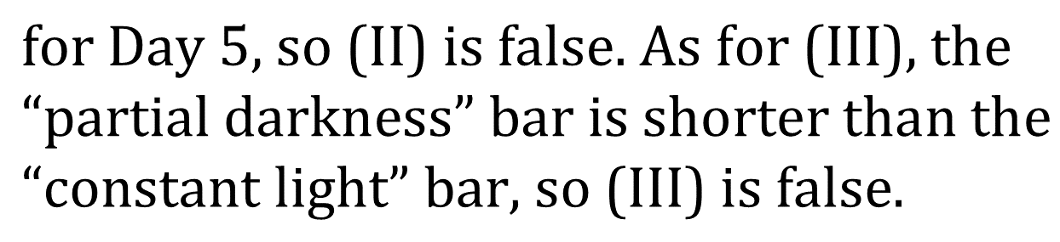
Notes:
Use a simple presentation of data to identify one two or more pieces of data either numerical of non-numerical; Determine direct and inverse relationships of variables in a data presentation. Level: Basic Skill Group: Interpretation of Data

