Slide 1
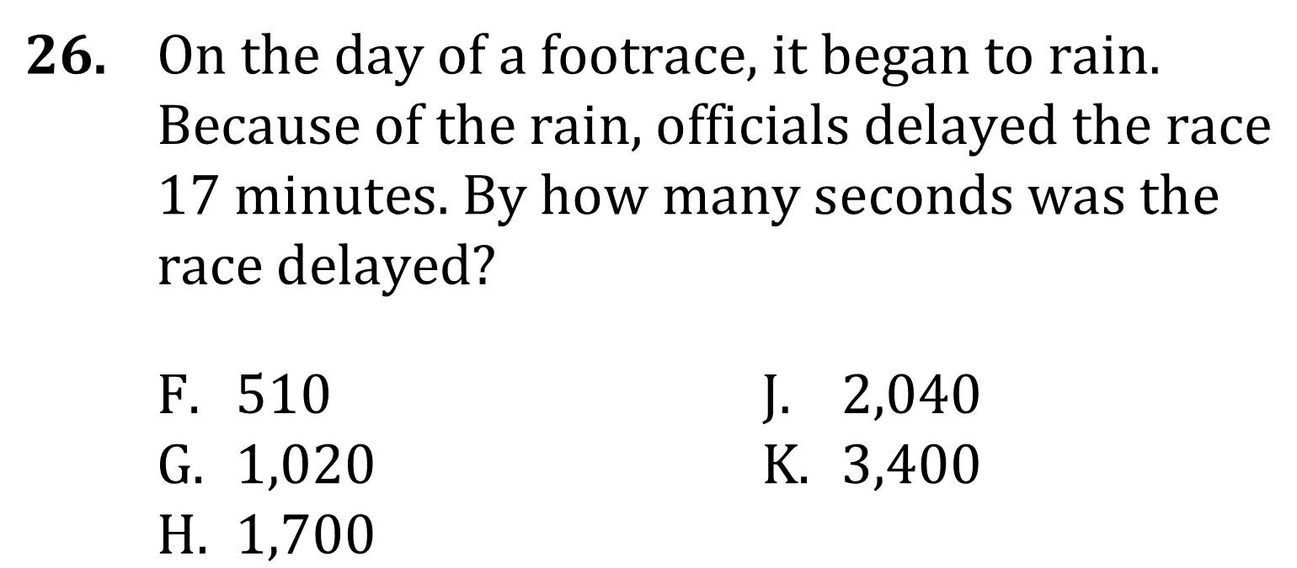
Simple Conversions

Slide 2
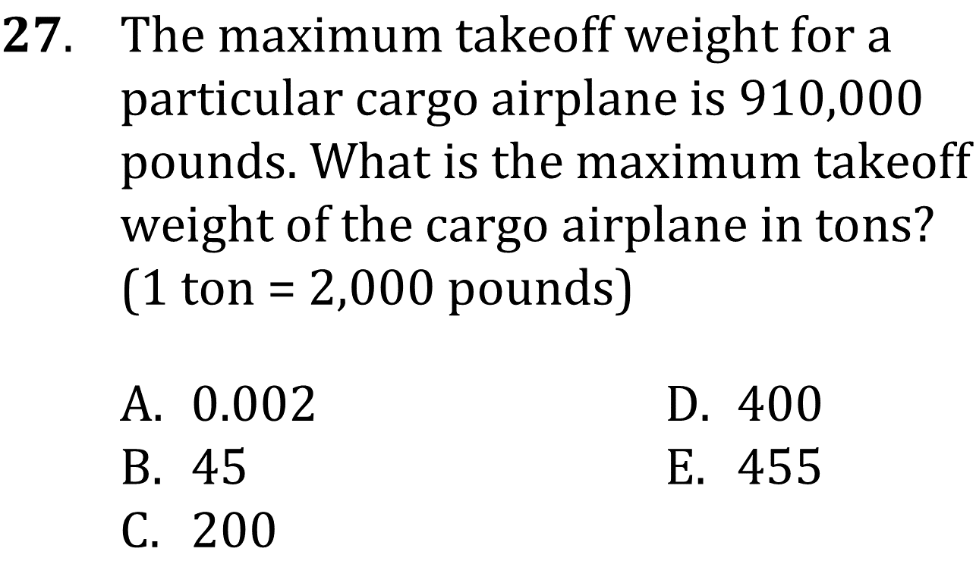
Simple Conversions
Perform simple conversions such as inches to feet or minutes to hours.
Level: Basic Skill Group Geometry

Slide 3
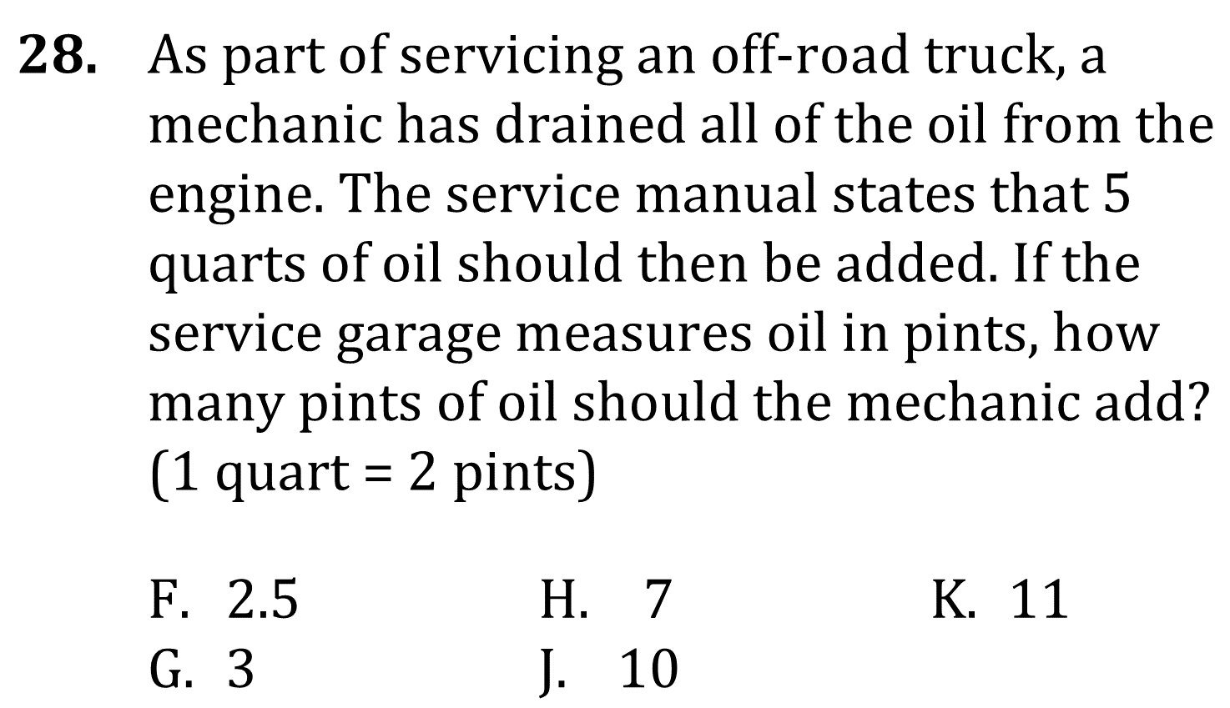
Simple Conversions
Perform simple conversions such as inches to feet or minutes to hours.
Level: Basic Skill Group Geometry

Slide 4
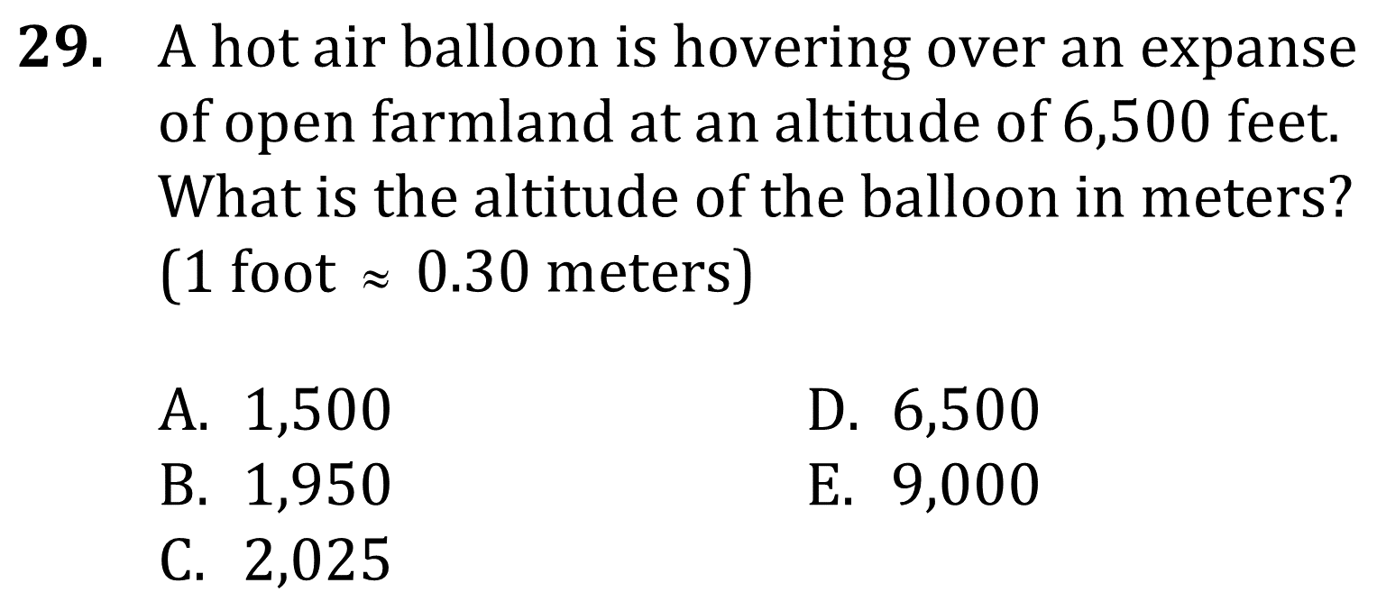
Simple Conversions
Perform simple conversions such as inches to feet or minutes to hours.
Level: Basic Skill Group Geometry

Slide 5
Simple Conversions
Perform simple conversions such as inches to feet or minutes to hours.
Level: Basic Skill Group Geometry

Slide 6
Simple Conversions
Perform simple conversions such as inches to feet or minutes to hours.
Level: Basic Skill Group Geometry

Slide 7
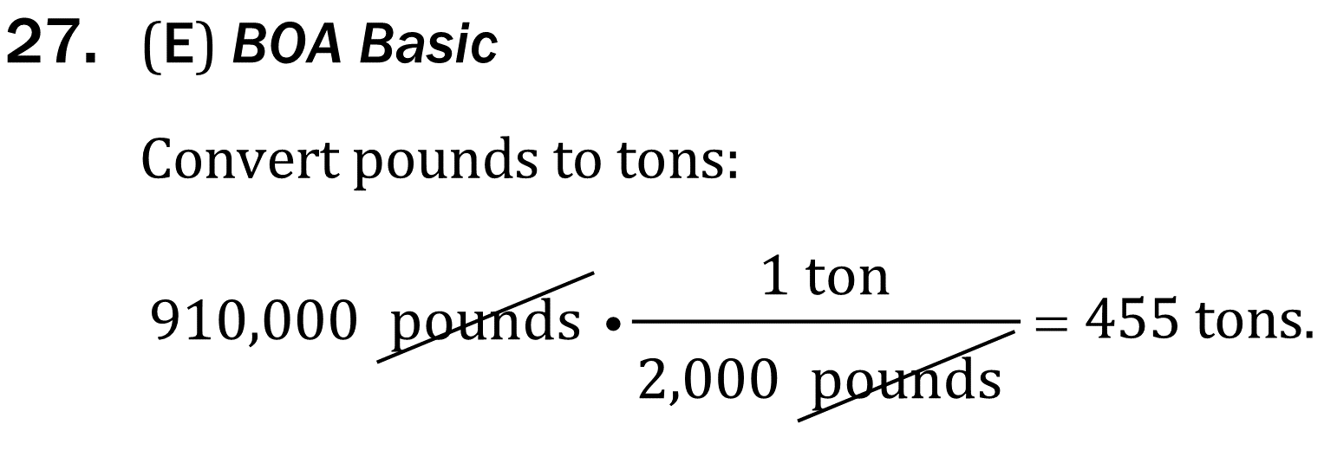
Simple Conversions
Perform simple conversions such as inches to feet or minutes to hours.
Level: Basic Skill Group Geometry

Slide 8
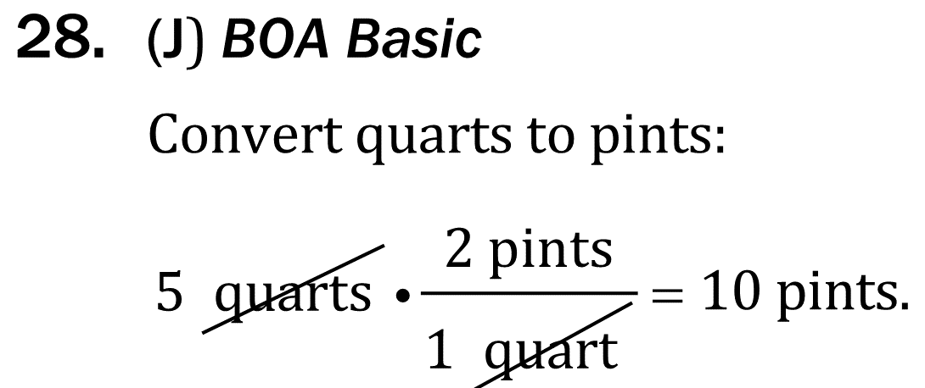
Simple Conversions
Perform simple conversions such as inches to feet or minutes to hours.
Level: Basic Skill Group Geometry

Slide 9
Simple Conversions
Perform simple conversions such as inches to feet or minutes to hours.
Level: Basic Skill Group Geometry

Slide 10
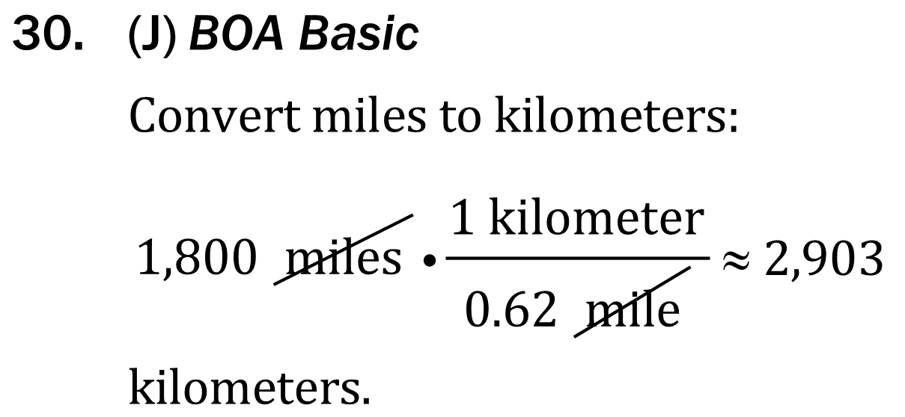
Simple Conversions
Perform simple conversions such as inches to feet or minutes to hours.
Level: Basic Skill Group Geometry

