Slide 1
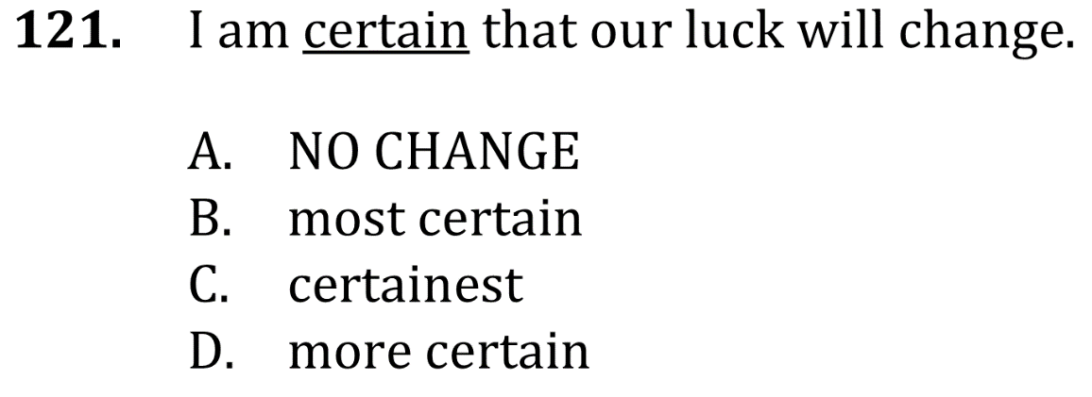
Use the Right Adjective

Slide 2
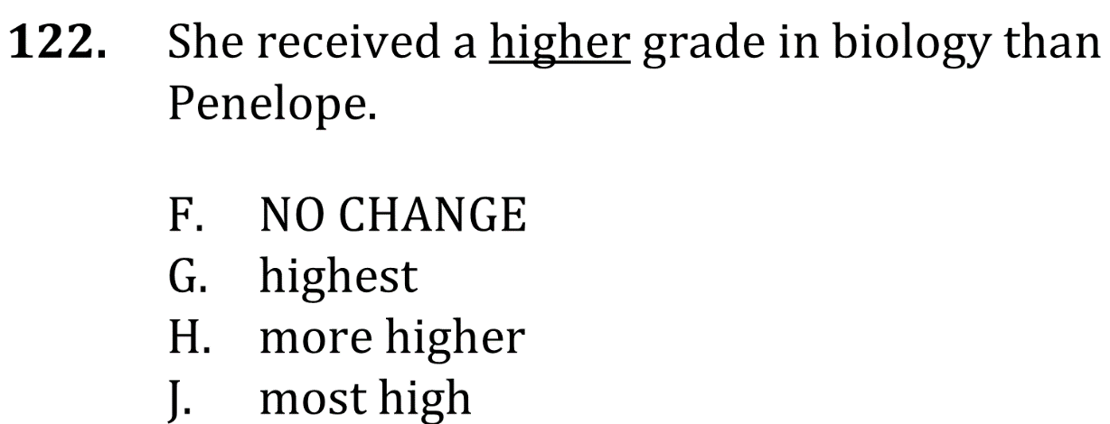
Use the Right Adjective

Slide 3
Use the Right Adjective

Slide 4
Use the Right Adjective

