Slide 1
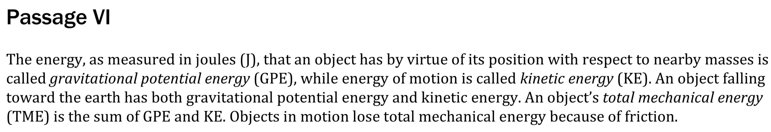

Notes:
Read and interpret data in more complex data presentations. Level: Intermediate Skill Group: Interpretation of Data

Slide 2
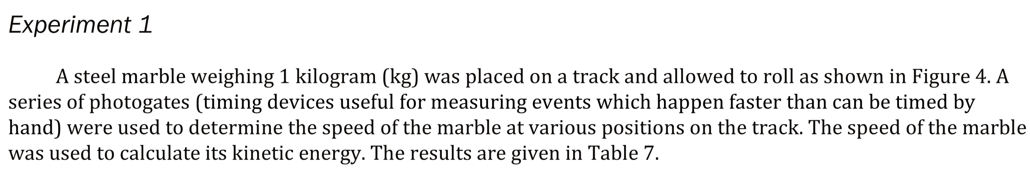
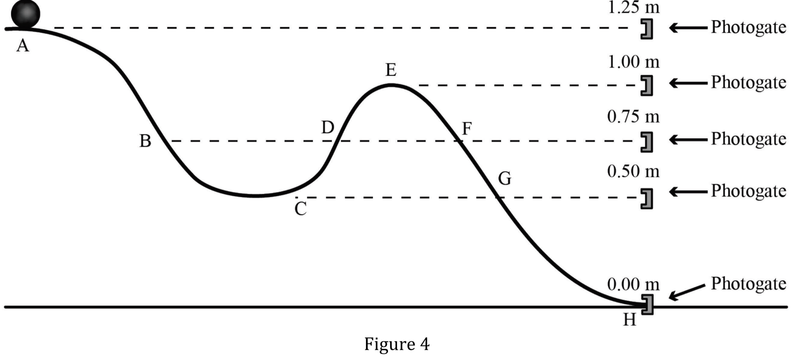
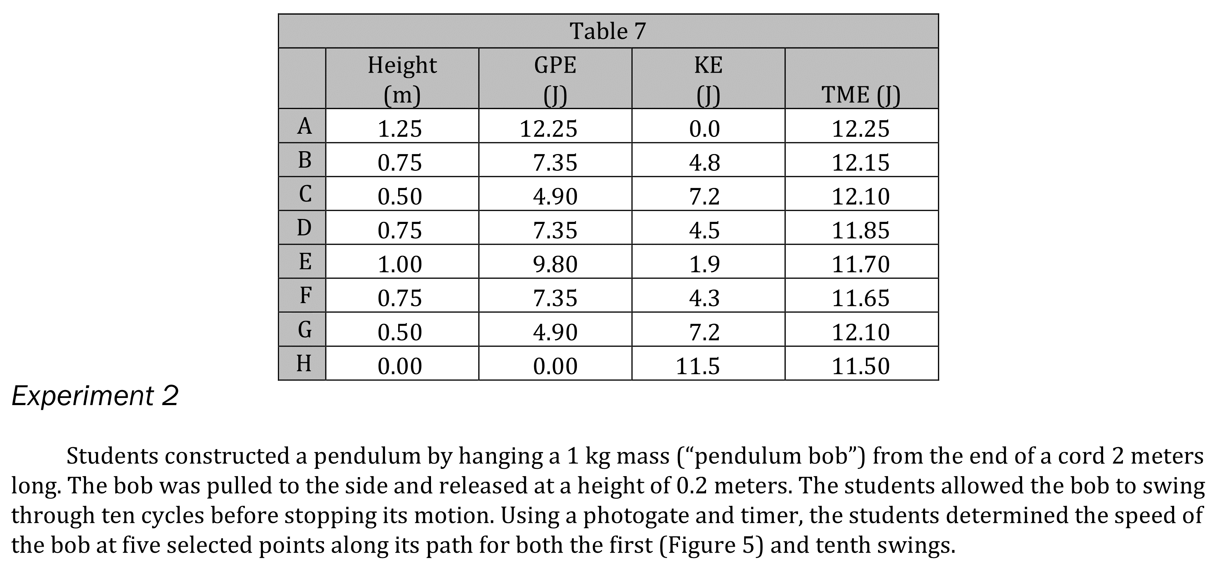
Notes:
Read and interpret data in more complex data presentations. Level: Intermediate Skill Group: Interpretation of Data

Slide 3
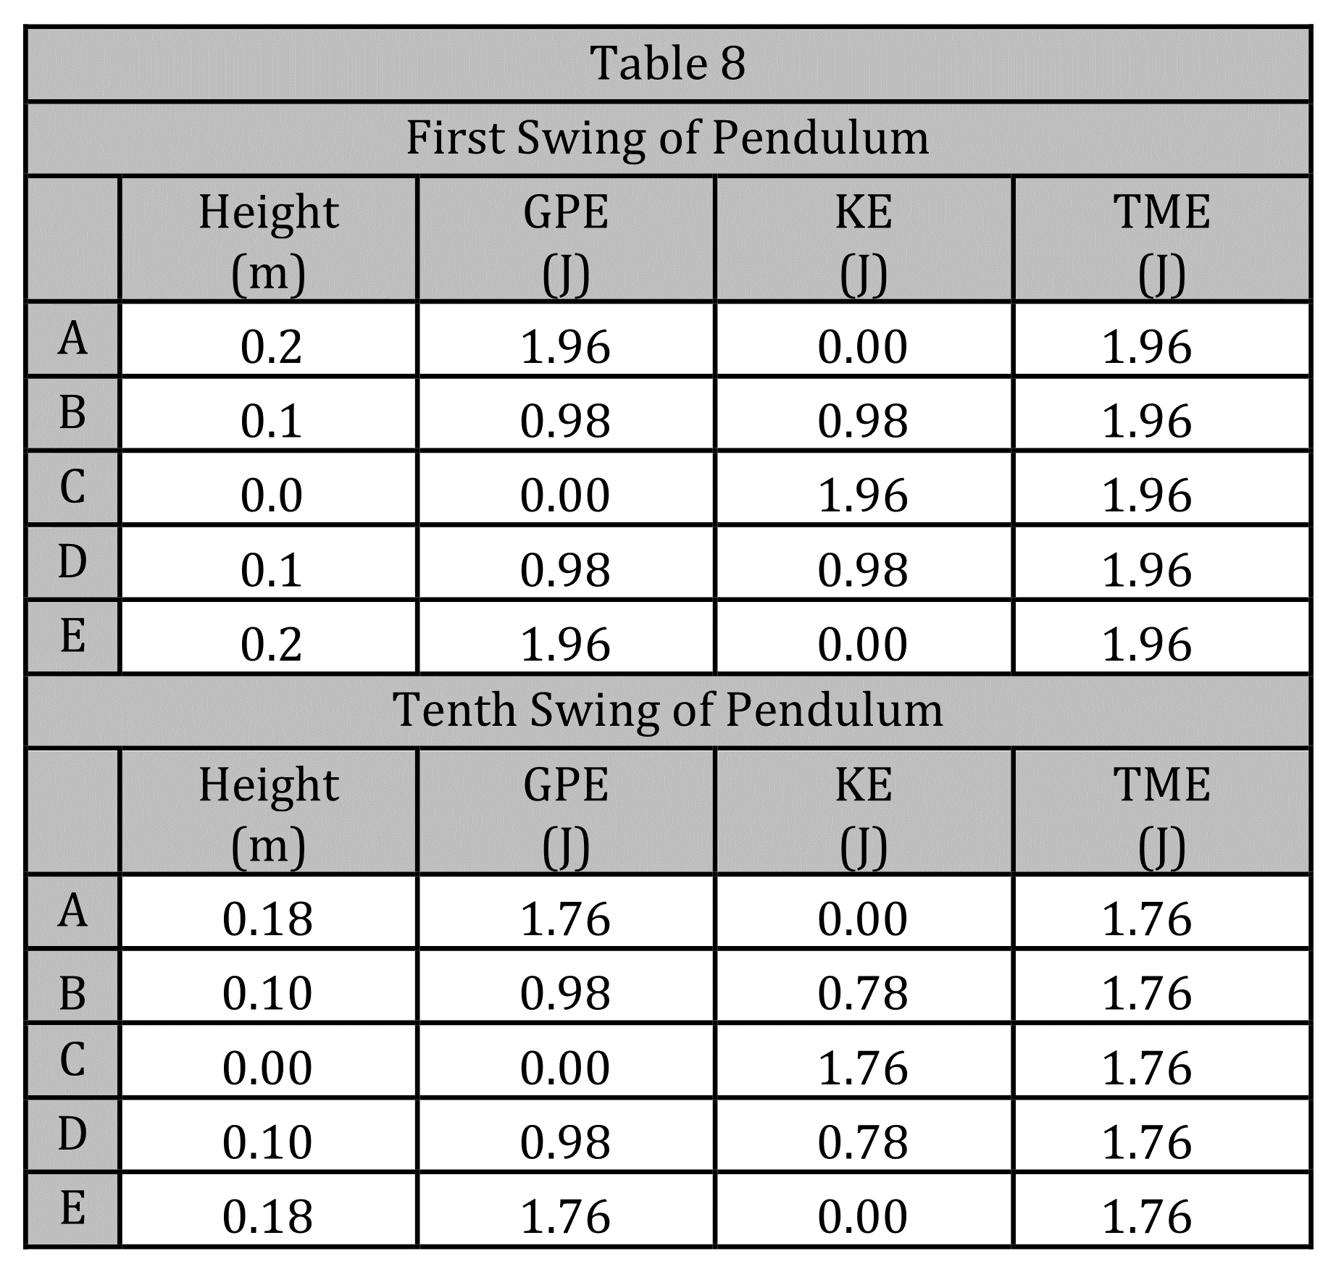
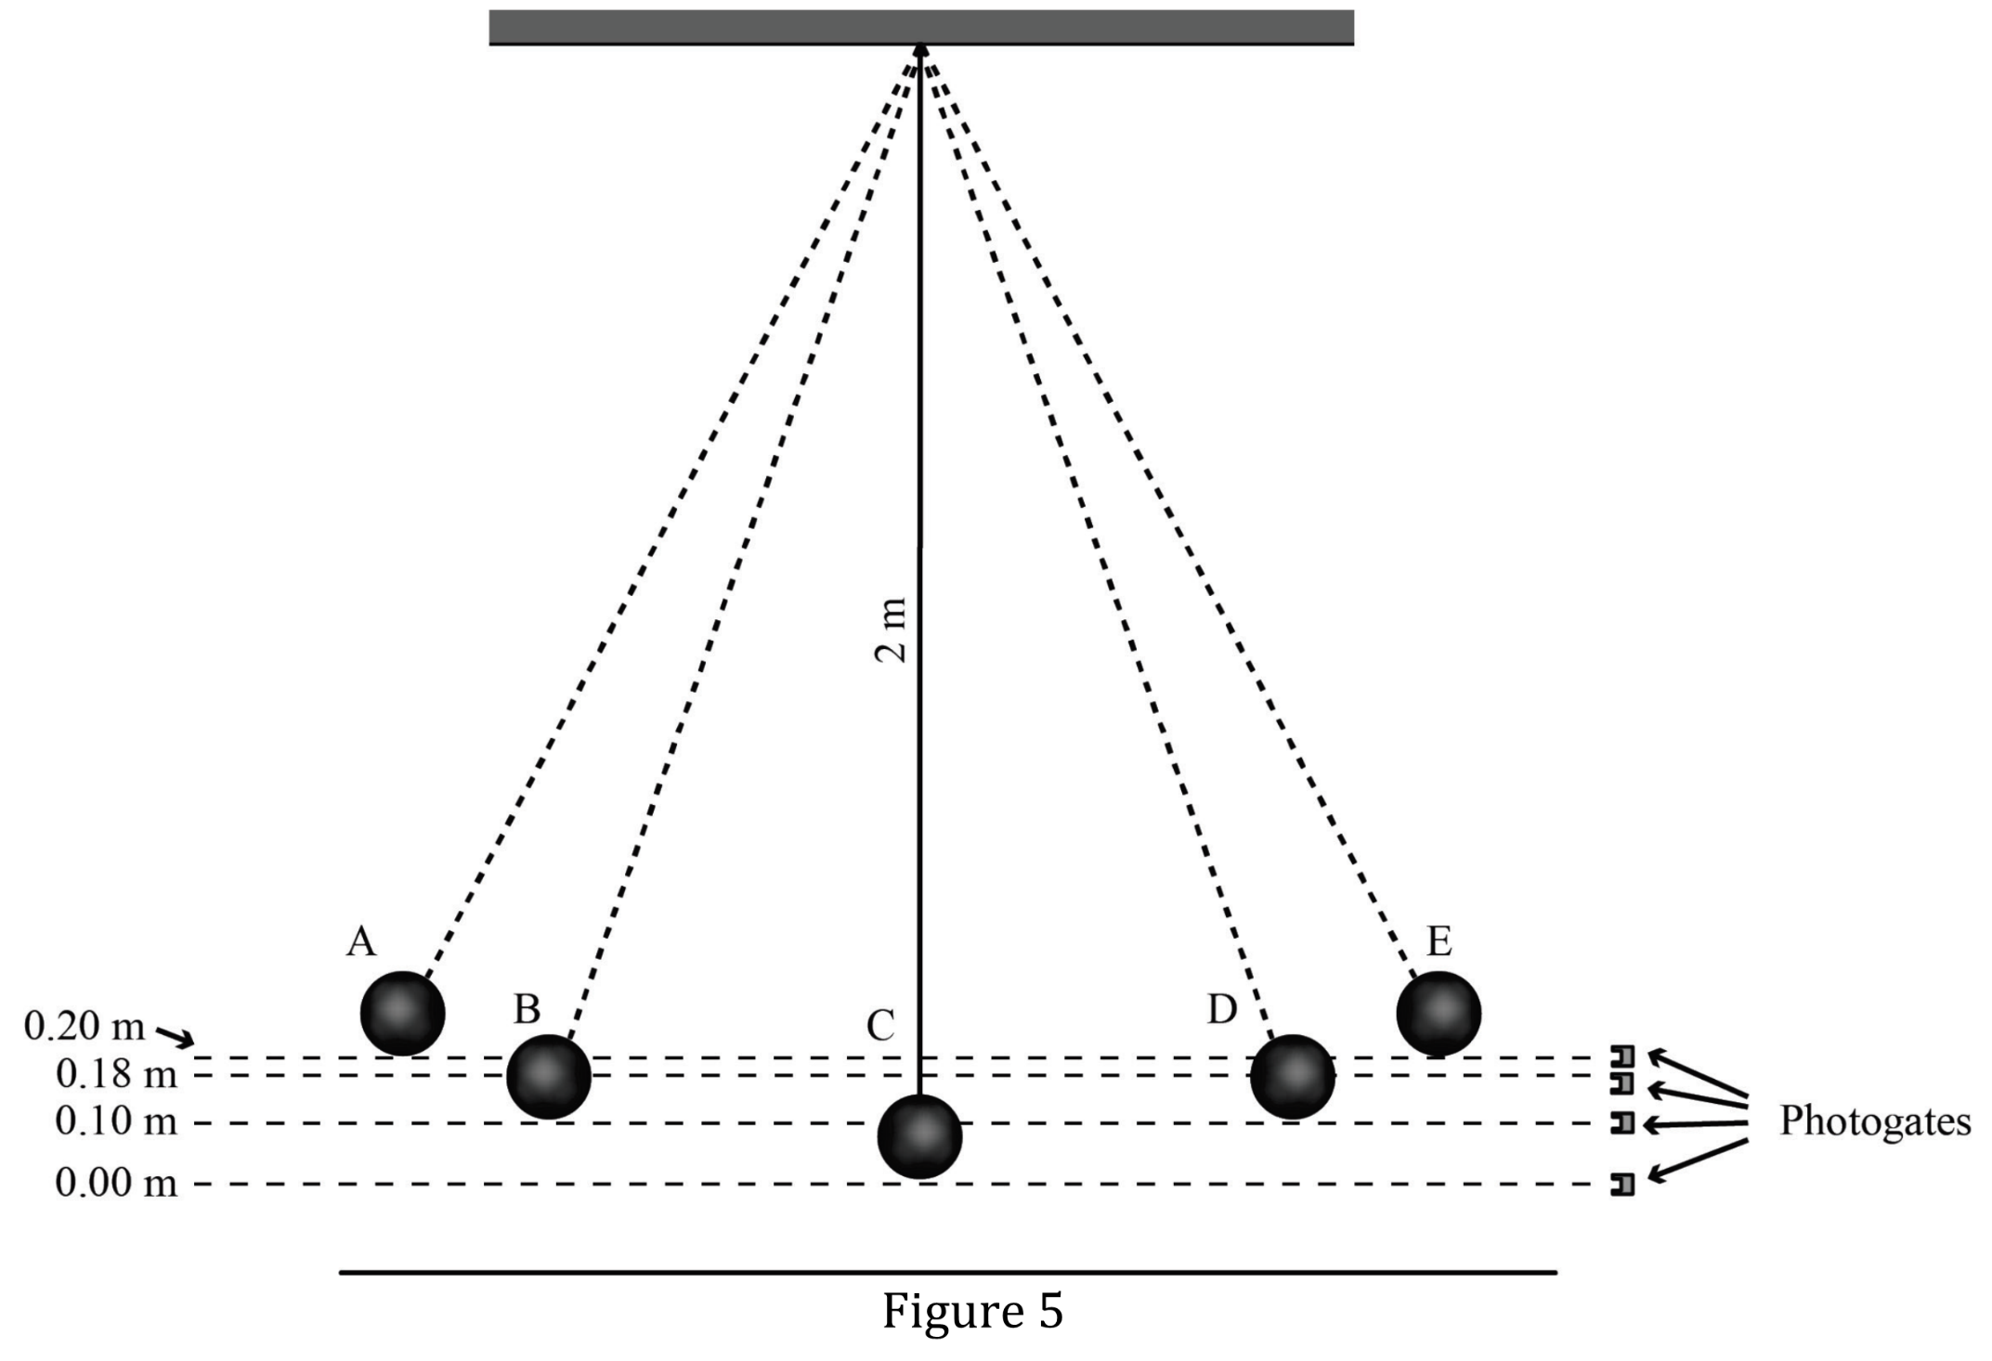
Notes:
Read and interpret data in more complex data presentations. Level: Intermediate Skill Group: Interpretation of Data

Slide 4
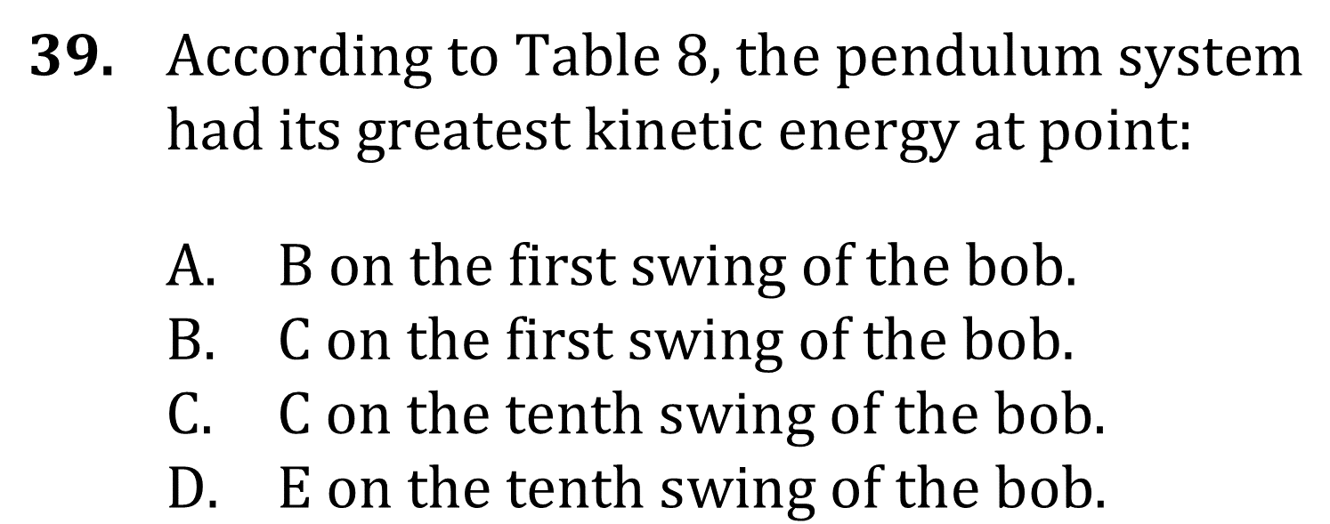
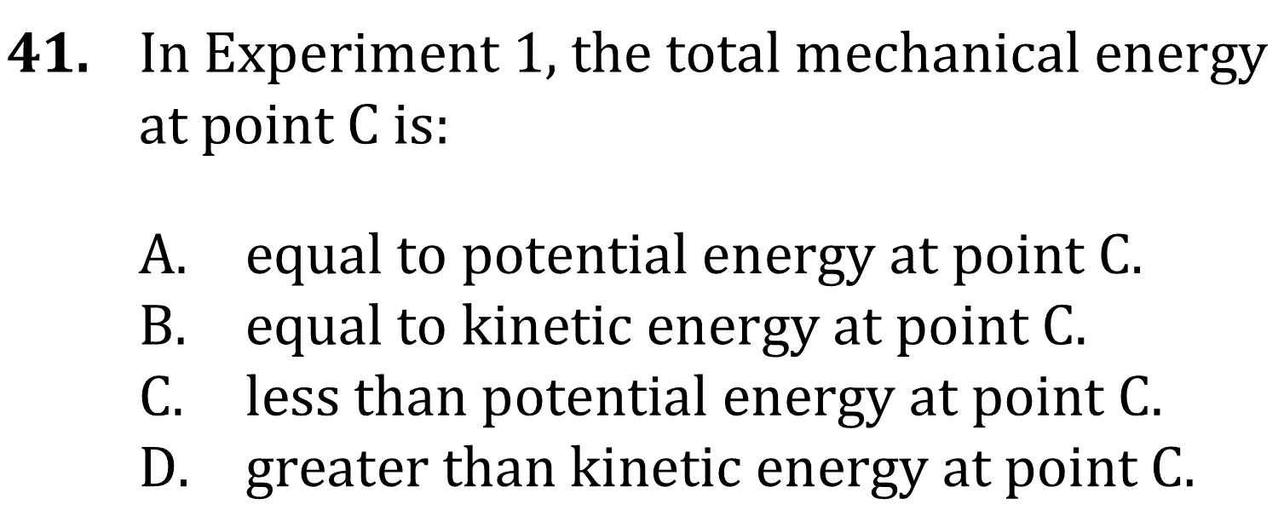
Notes:
Read and interpret data in more complex data presentations. Level: Intermediate Skill Group: Interpretation of Data

Slide 5
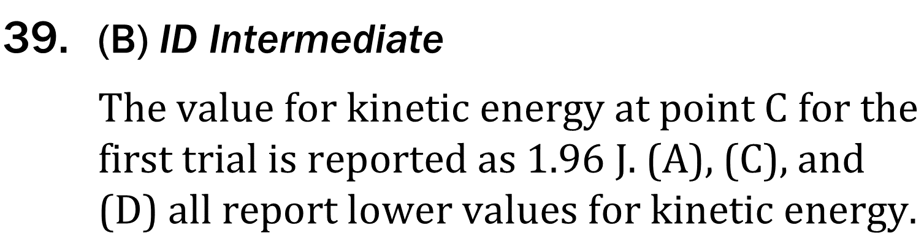
Notes:
Read and interpret data in more complex data presentations. Level: Intermediate Skill Group: Interpretation of Data

Slide 6
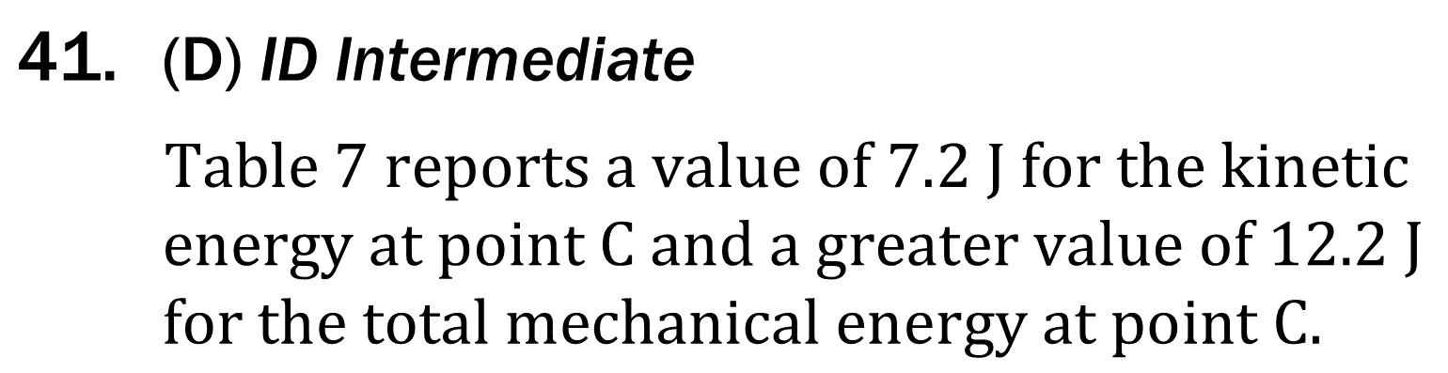
Notes:
Read and interpret data in more complex data presentations. Level: Intermediate Skill Group: Interpretation of Data

