Slide 1
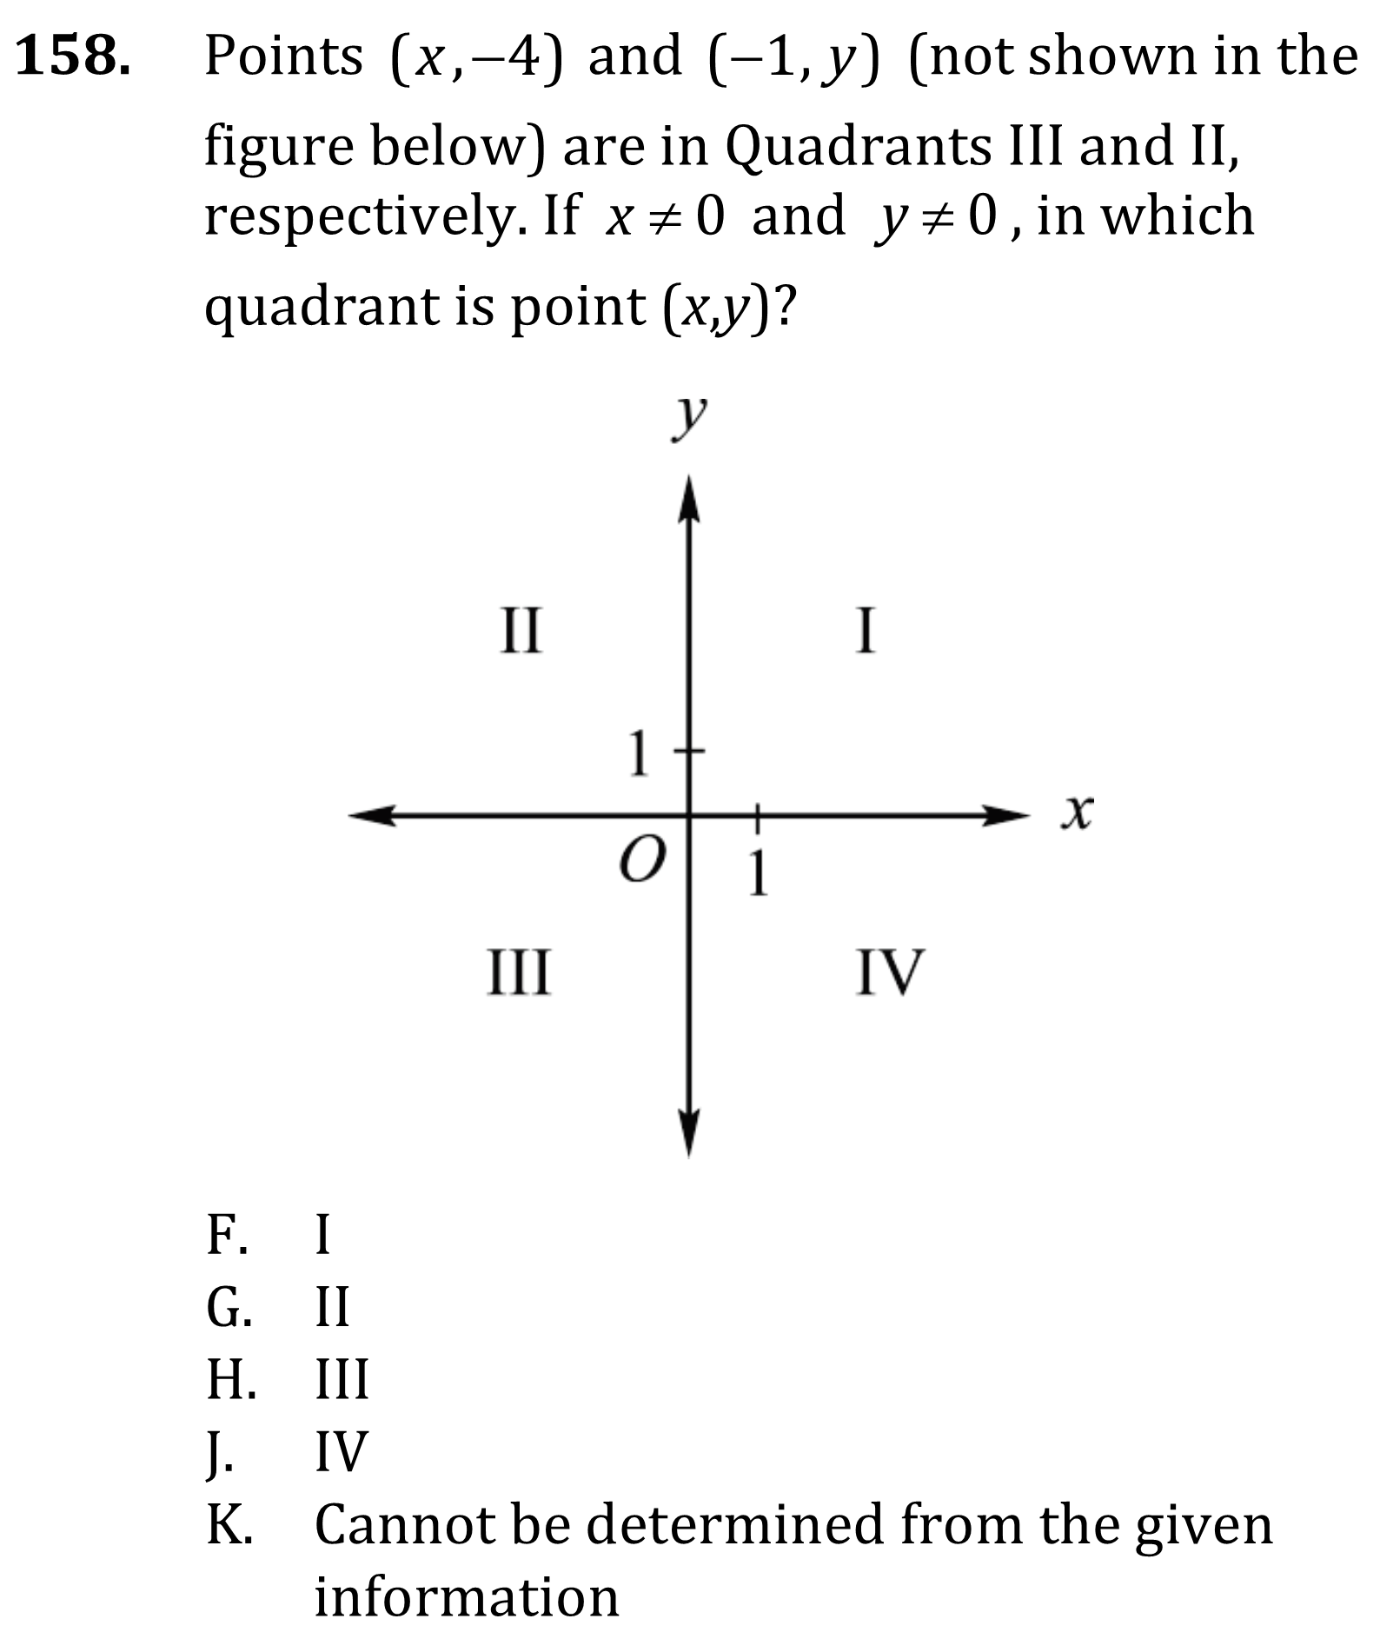

Quadrants, Coordinate Plane, and Length on Number Line

Slide 2
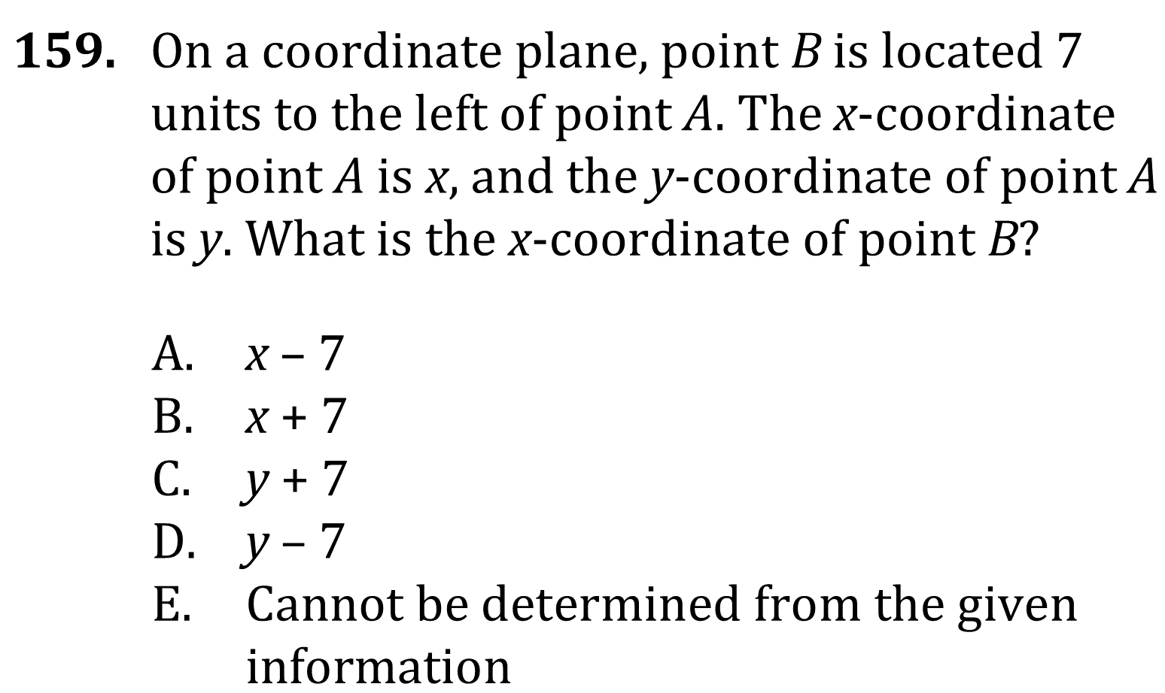
Quadrants, Coordinate Plane, and Length on Number Line

Slide 3
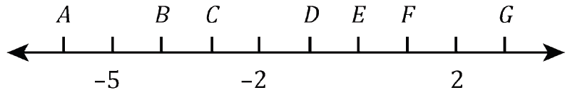
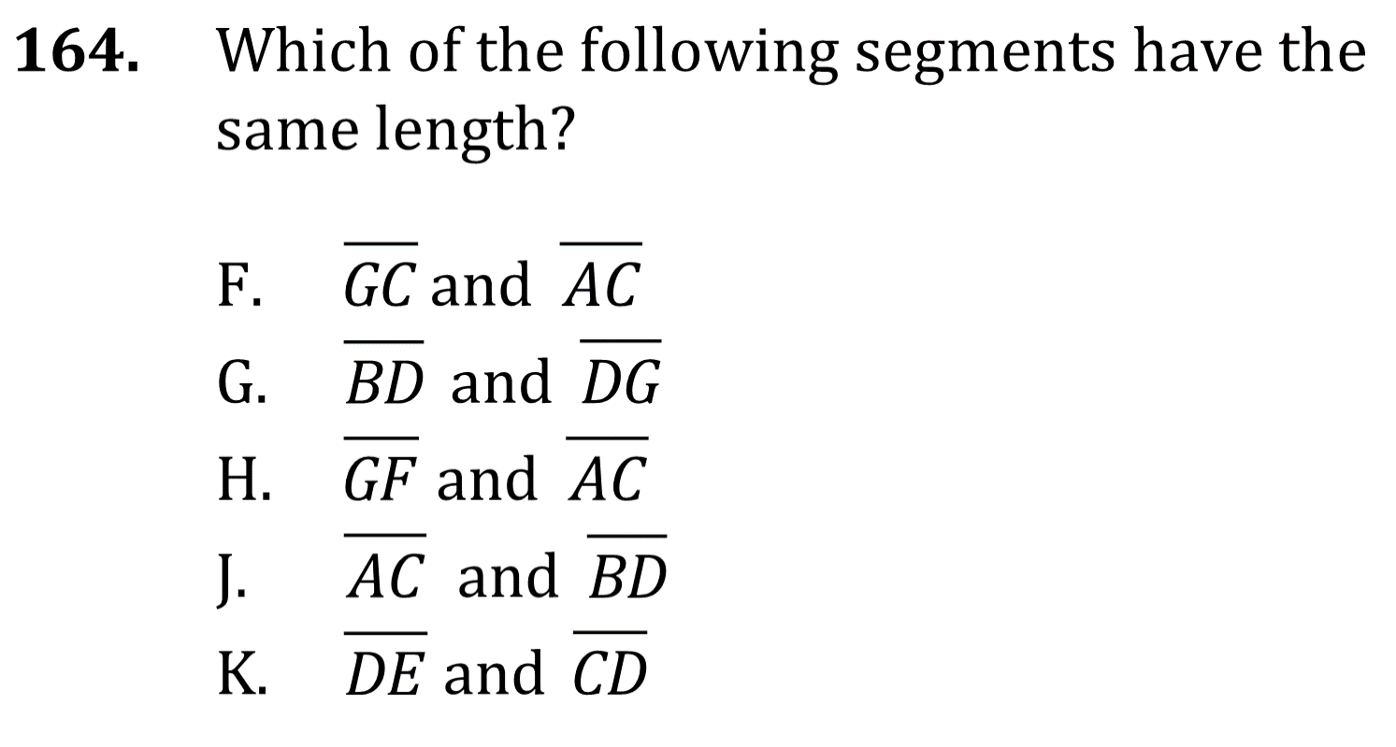
Quadrants, Coordinate Plane, and Length on Number Line

Slide 4
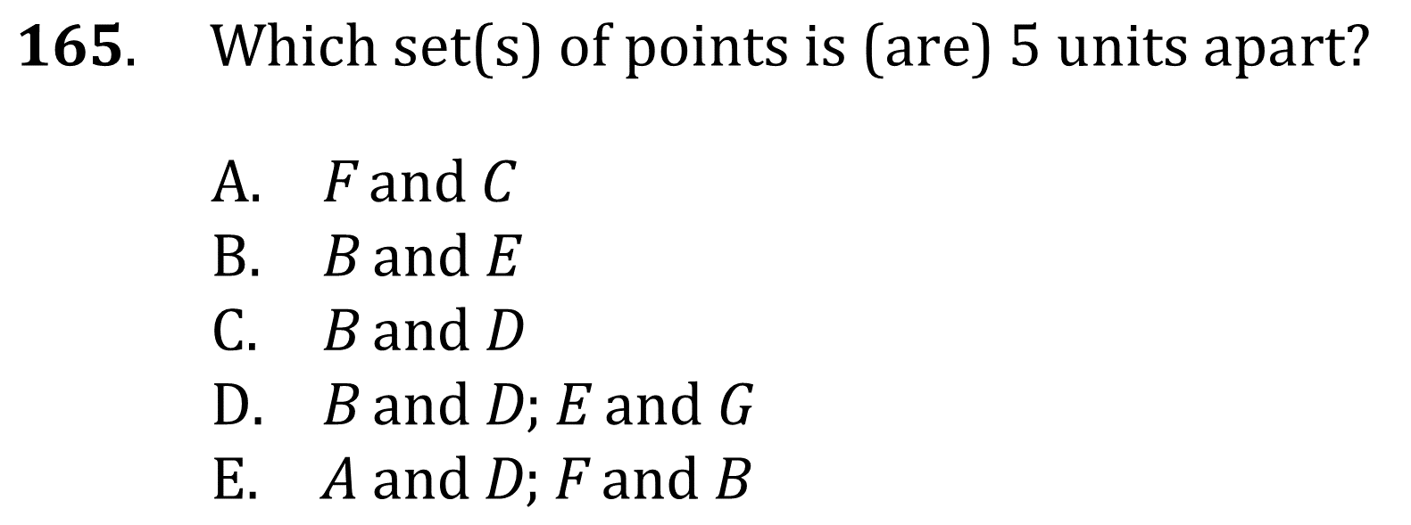
Quadrants, Coordinate Plane, and Length on Number Line

Slide 5
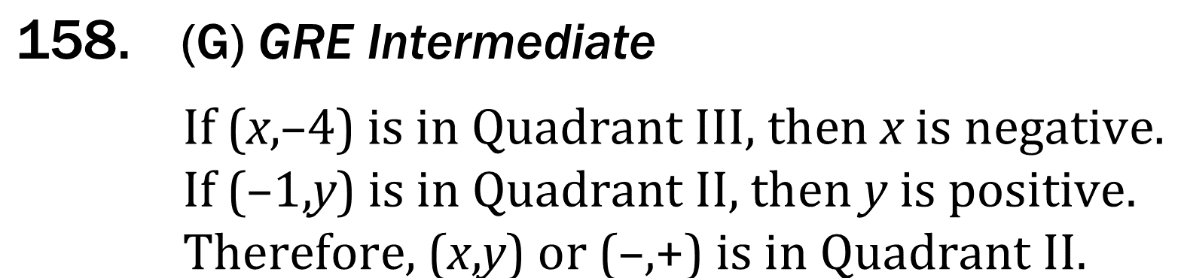
Quadrants, Coordinate Plane, and Length on Number Line

Slide 6
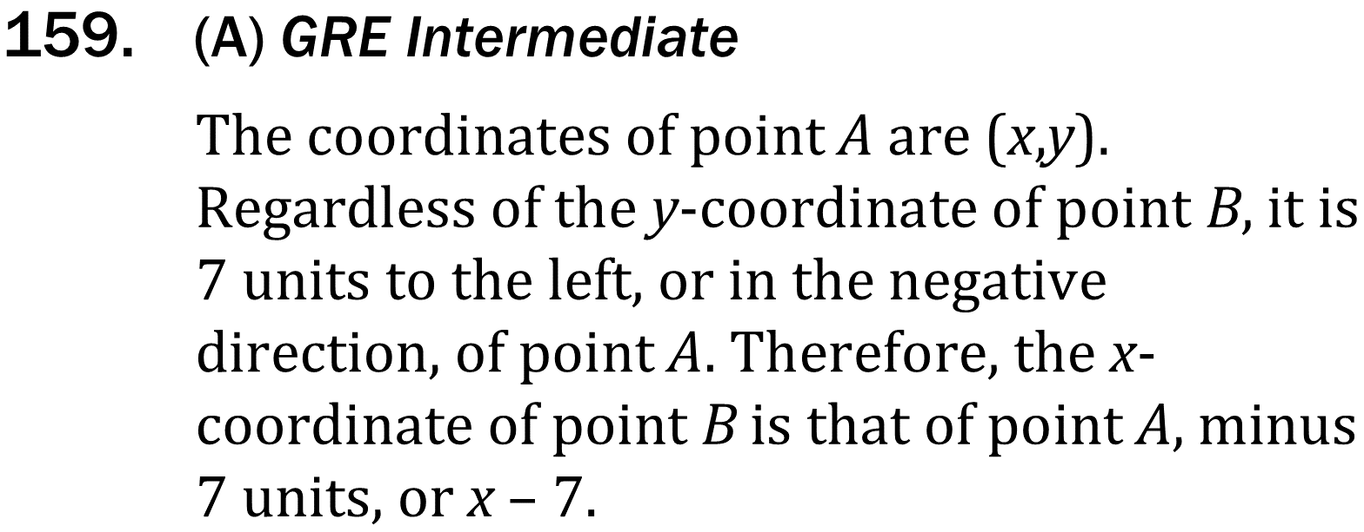
Quadrants, Coordinate Plane, and Length on Number Line

Slide 7
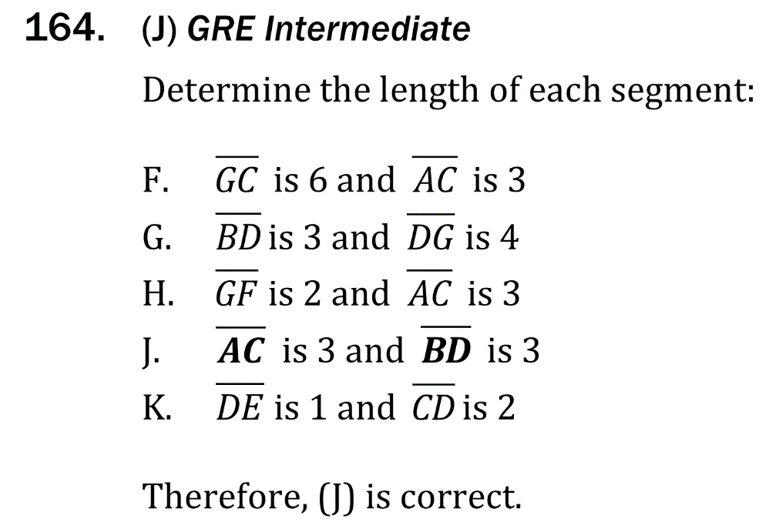
Quadrants, Coordinate Plane, and Length on Number Line

Slide 8
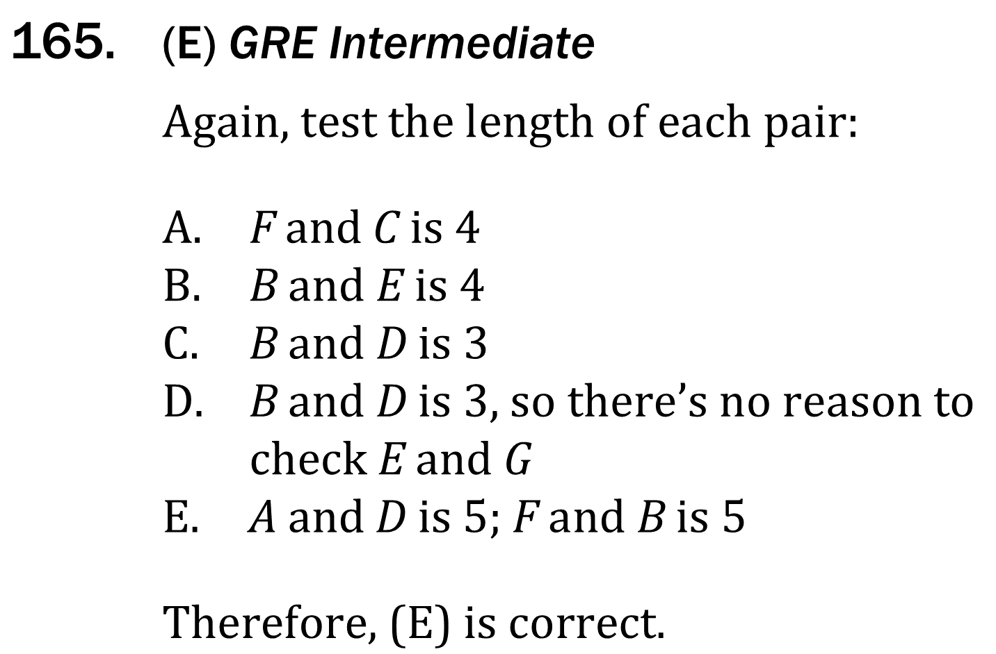
Quadrants, Coordinate Plane, and Length on Number Line

