Slide 1
Inequalities and The number line

Slide 2
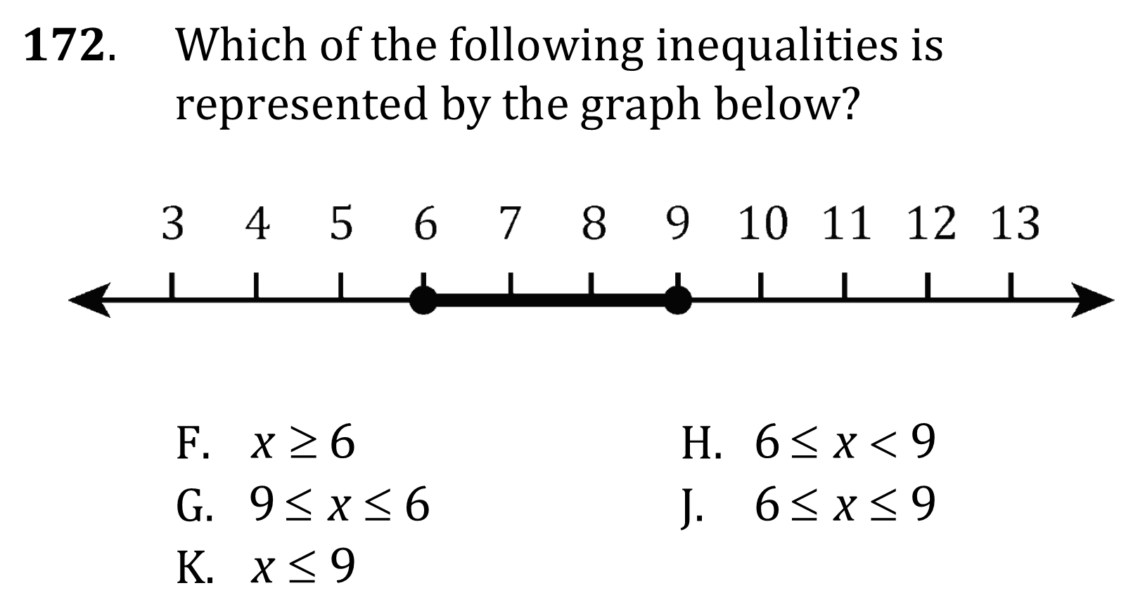
Inequalities and the number line

Slide 3
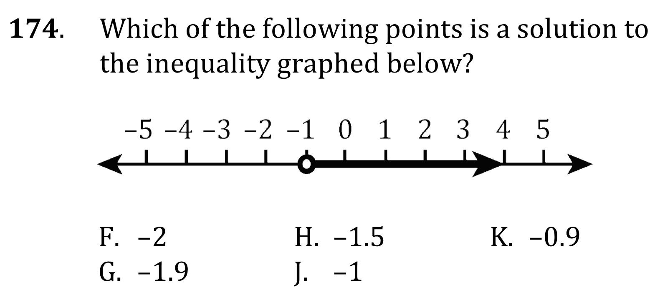
Inequalities and the number line

Slide 4
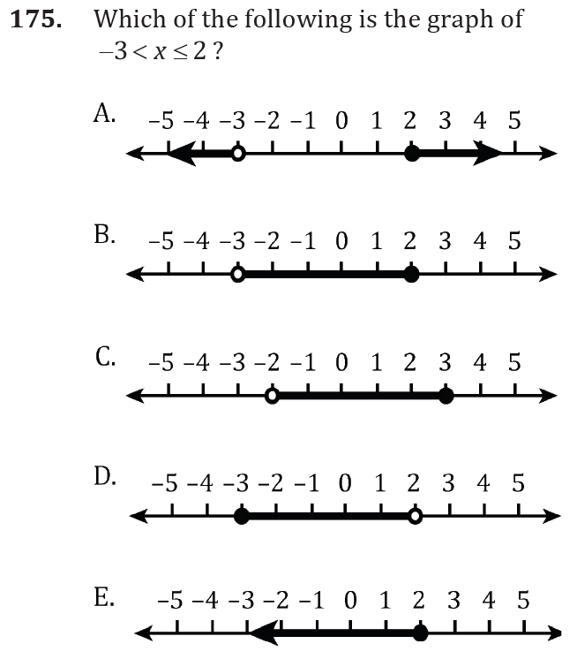
Inequalities and the number line

Slide 5
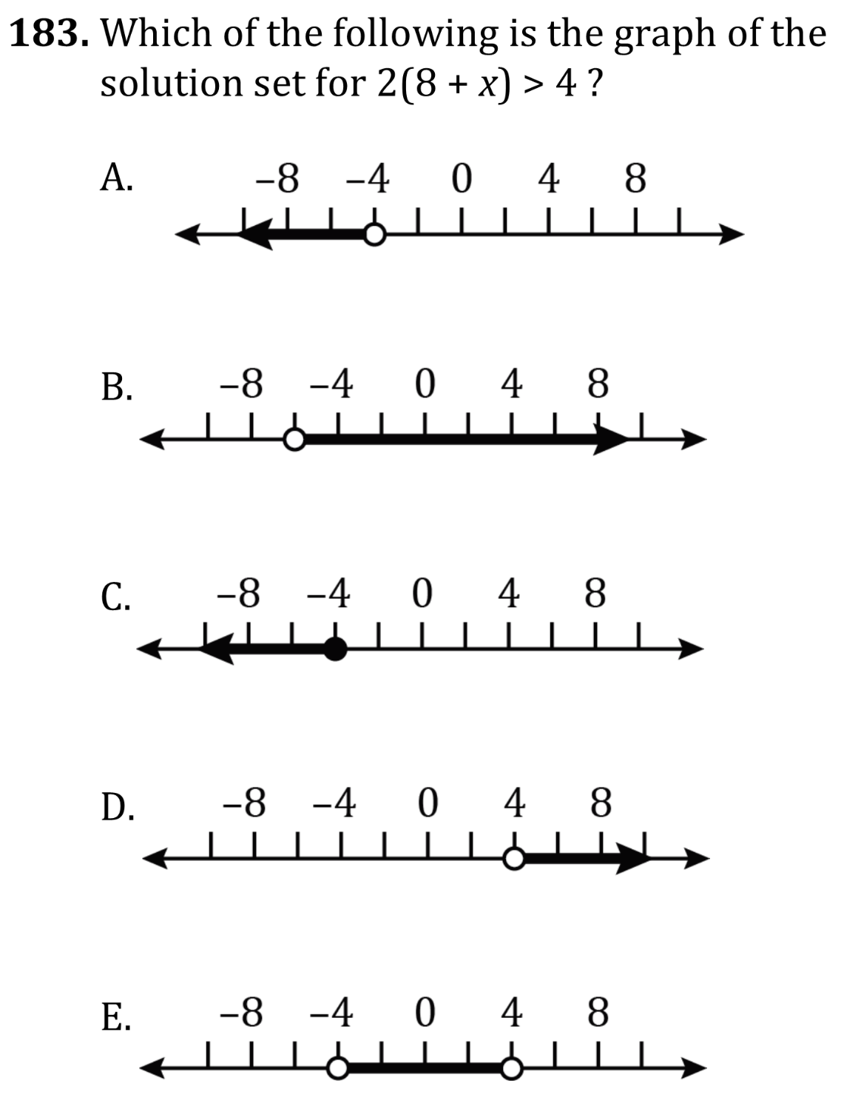
Inequalities and the number line

Slide 6
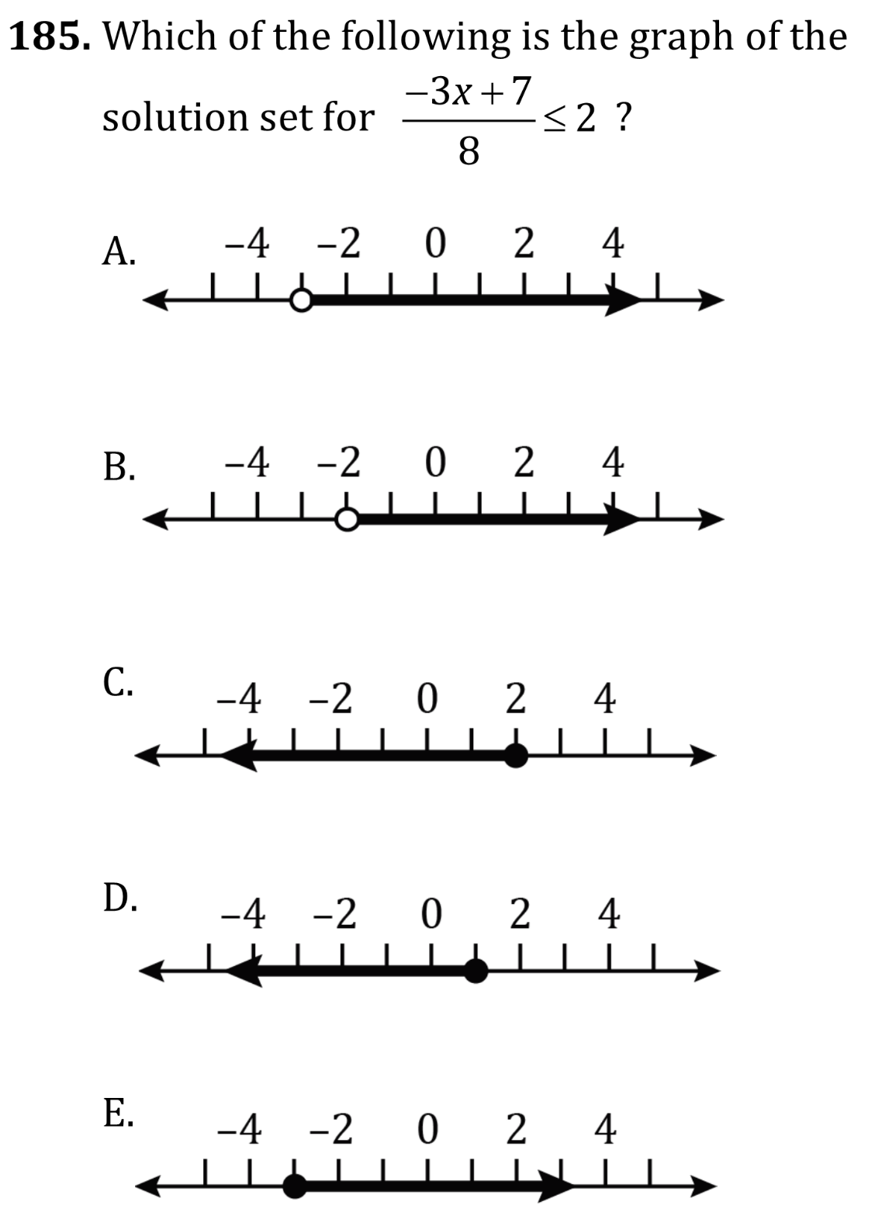
Inequalities and the number line

Slide 7
Inequalities and the number line

Slide 8
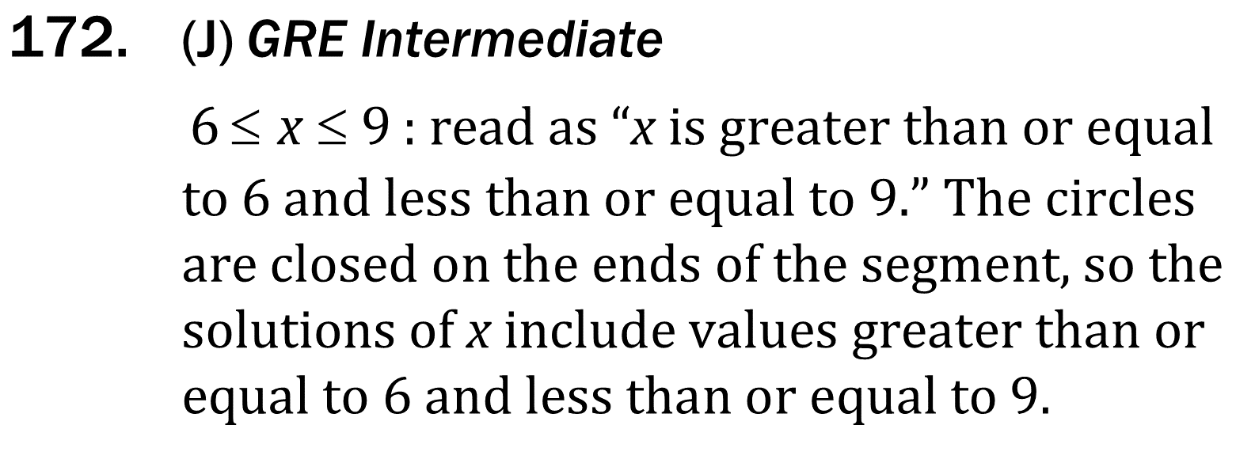
Inequalities and the number line

Slide 9
Inequalities and the number line

Slide 10
Inequalities and the number line

Slide 11
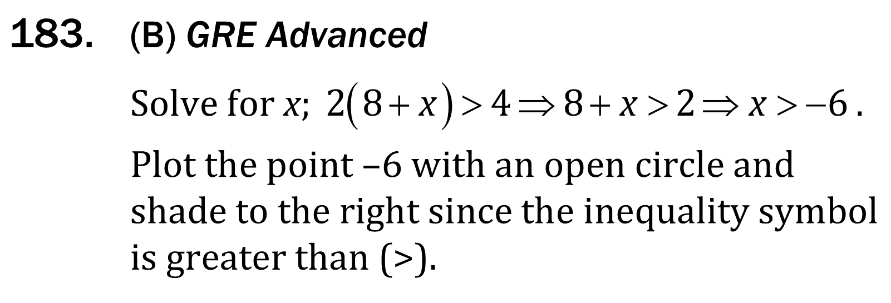
Inequalities and the number line

Slide 12
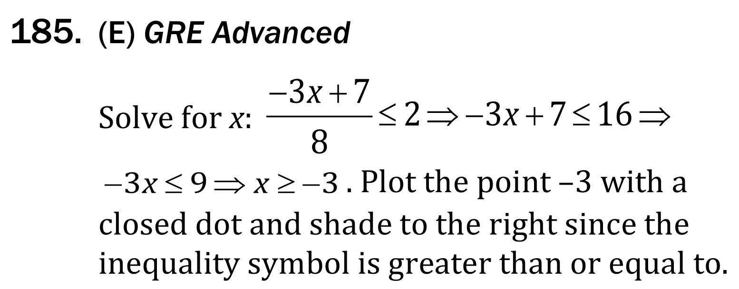
Inequalities and the number line

