Slide 2
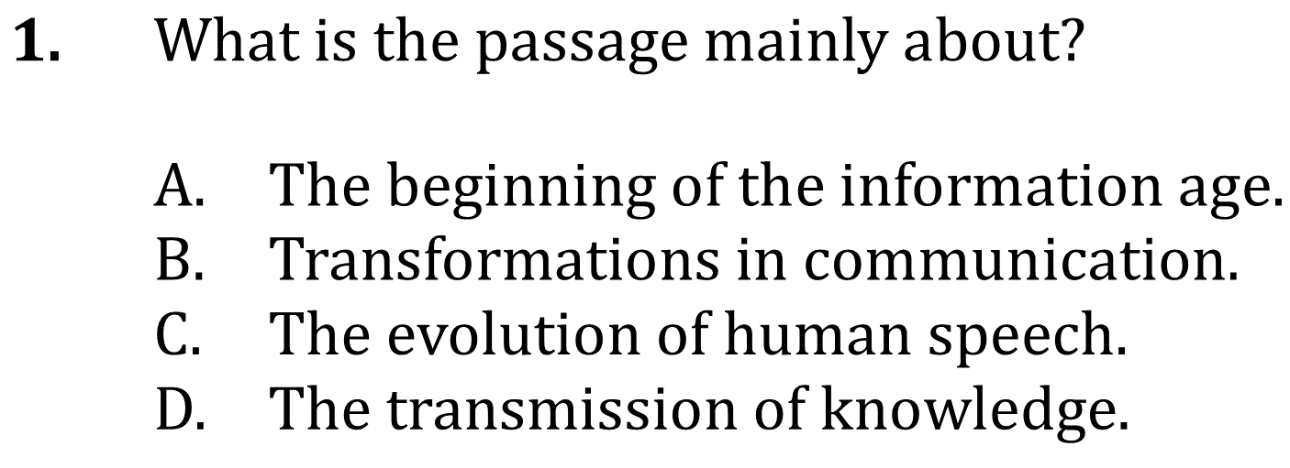
Summarize Events and Ideas

Slide 3
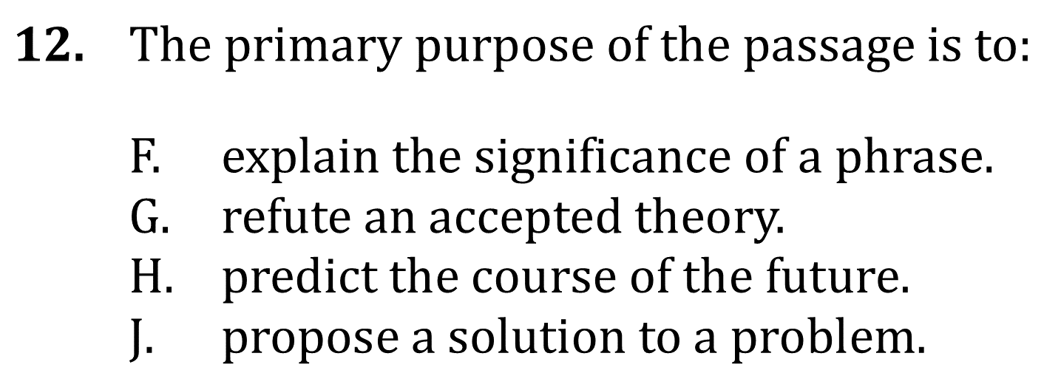
Summarize Events and Ideas

Slide 4
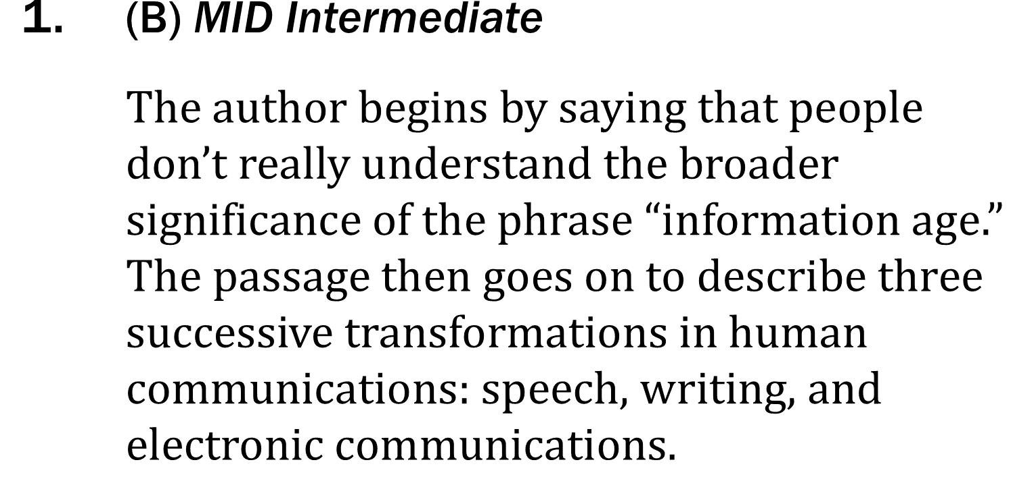
Summarize Events and Ideas

Slide 5
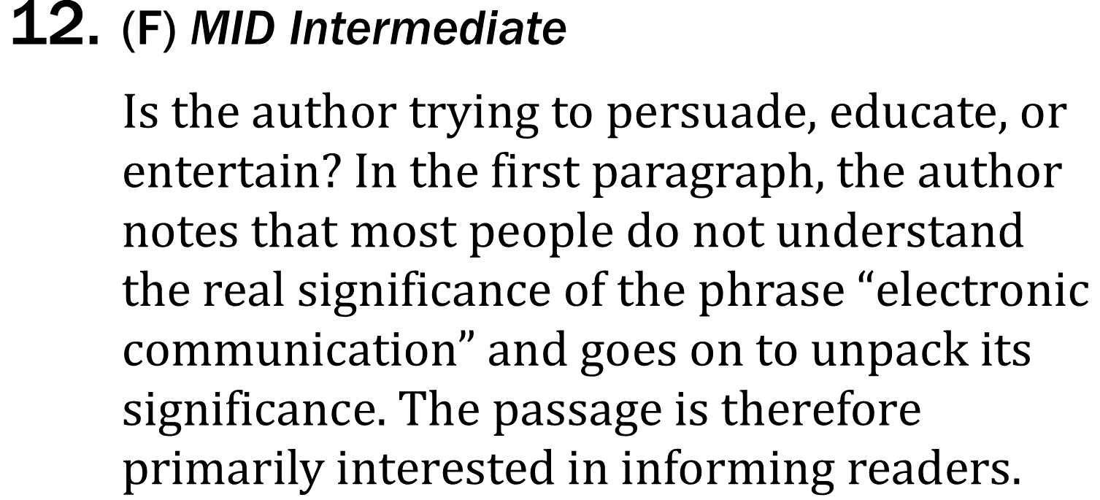
Summarize Events and Ideas

