Slide 1
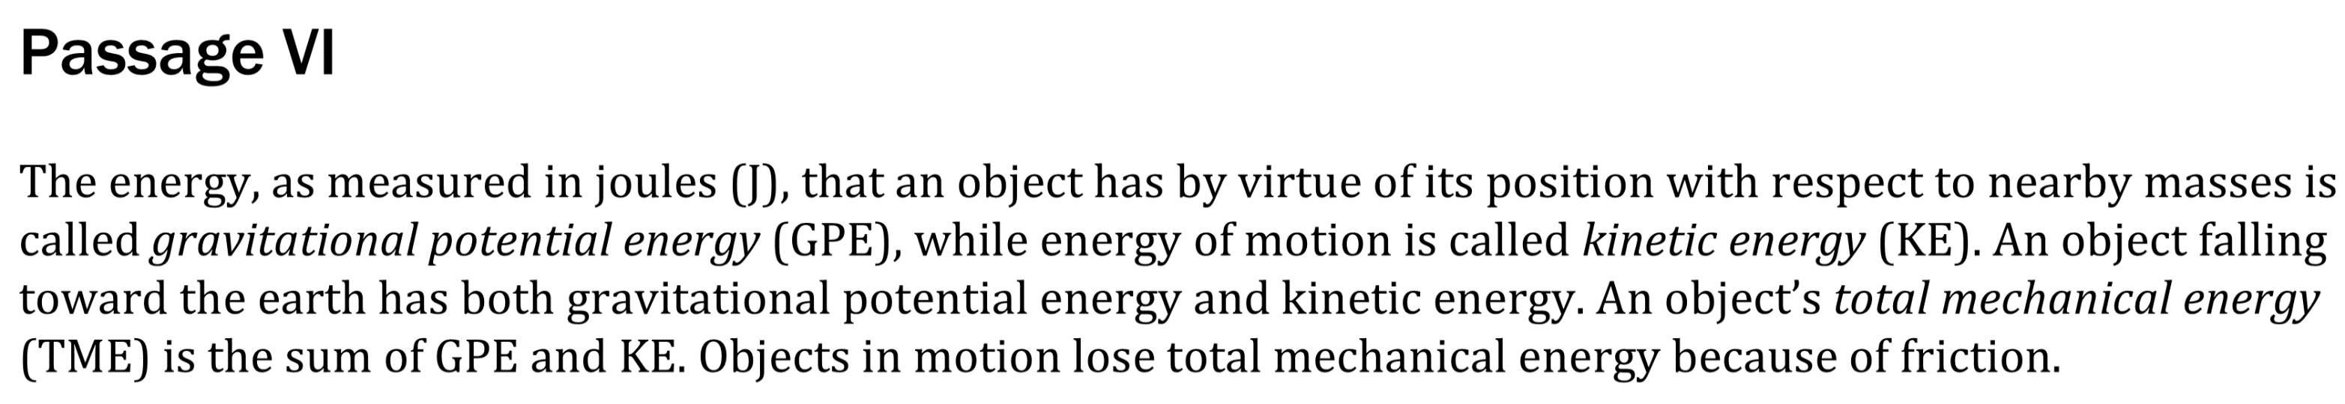

Notes:
Understand the relationship between variable in more complex data presentations; Predict the results of an additional step in an experiment; Determine what would cause a specific result in an experiment. Level: Intermediate Skill Group: Evaluation of Models

Slide 2
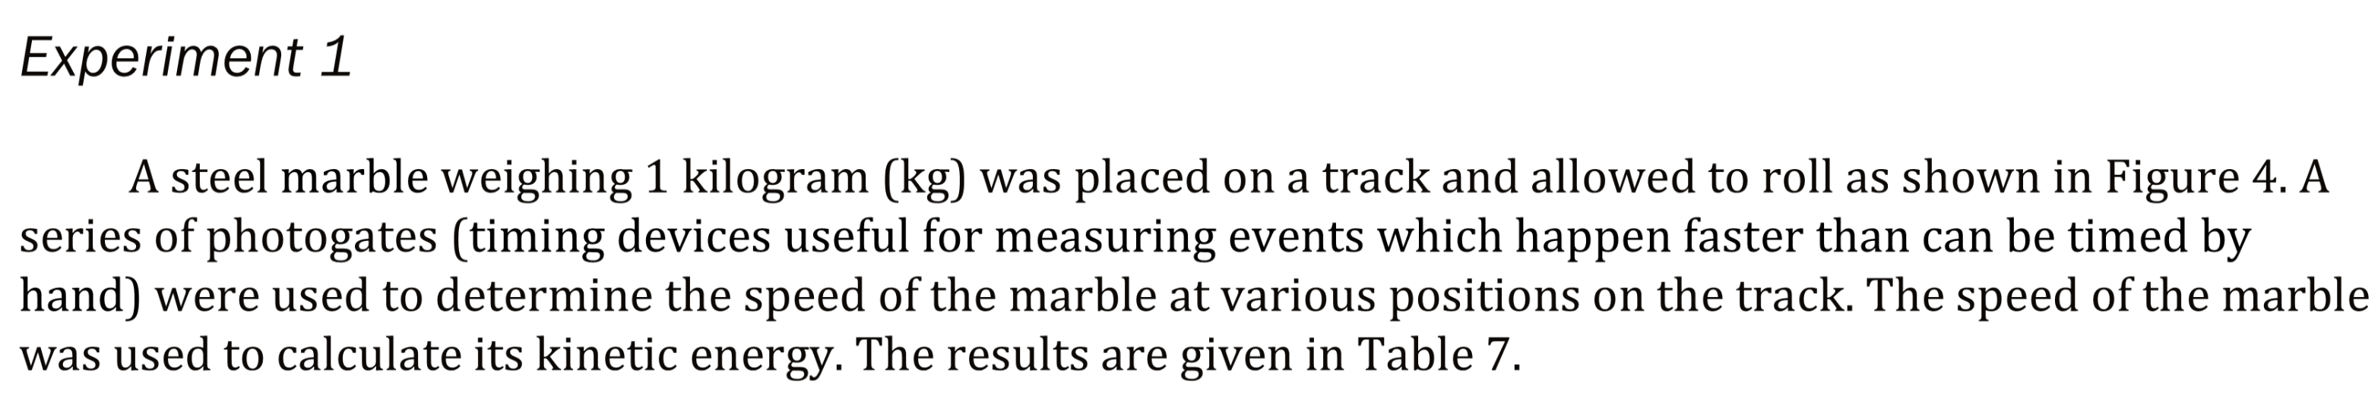
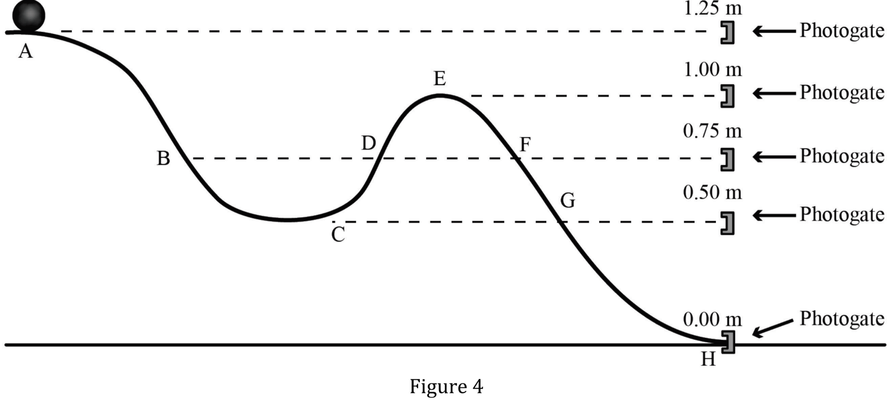
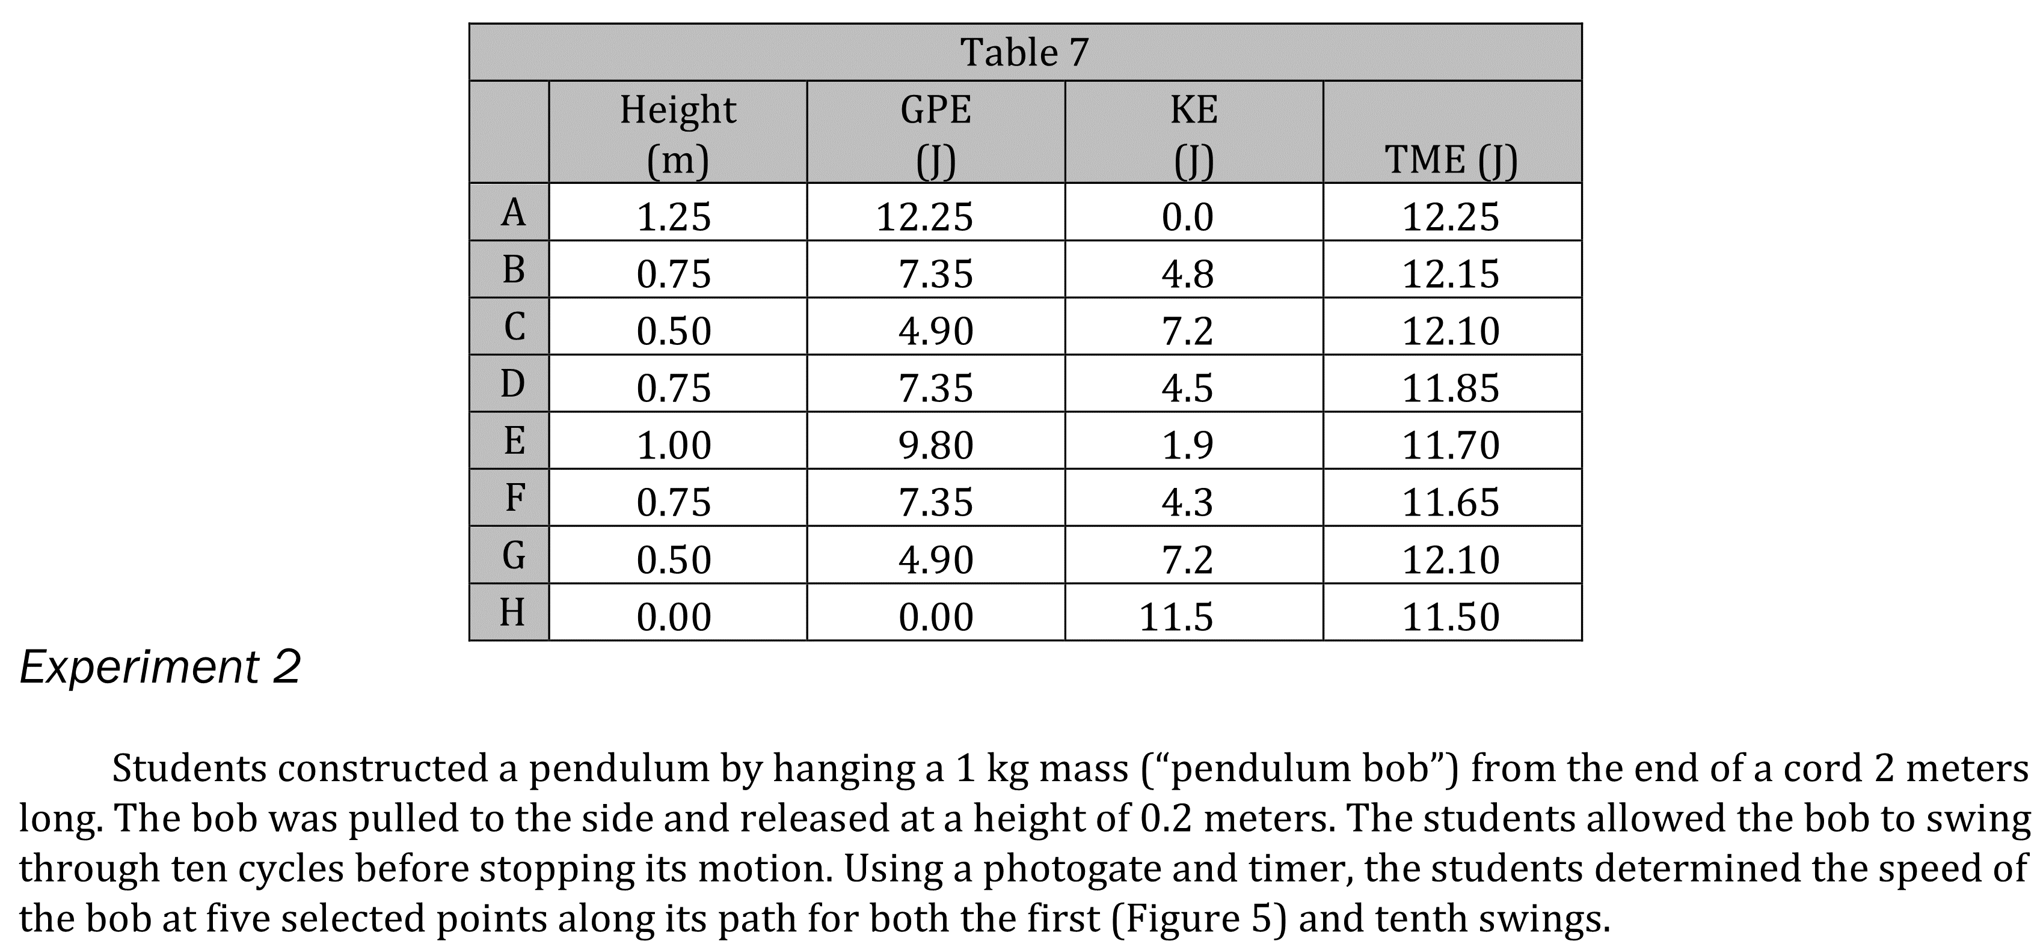
Notes:
Understand the relationship between variable in more complex data presentations; Predict the results of an additional step in an experiment; Determine what would cause a specific result in an experiment. Level: Intermediate Skill Group: Evaluation of Models

Slide 3
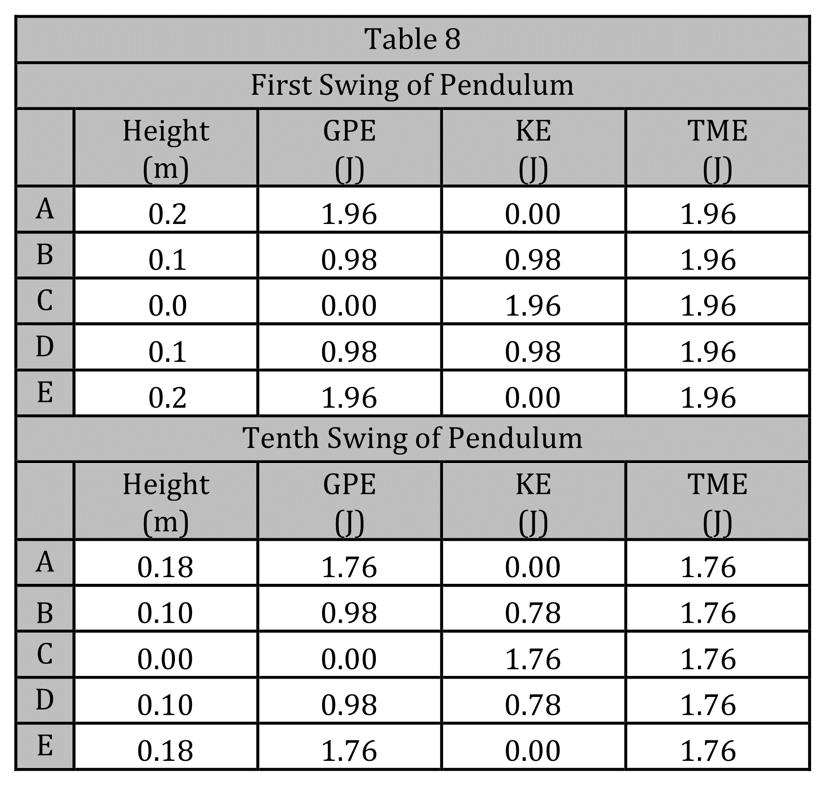
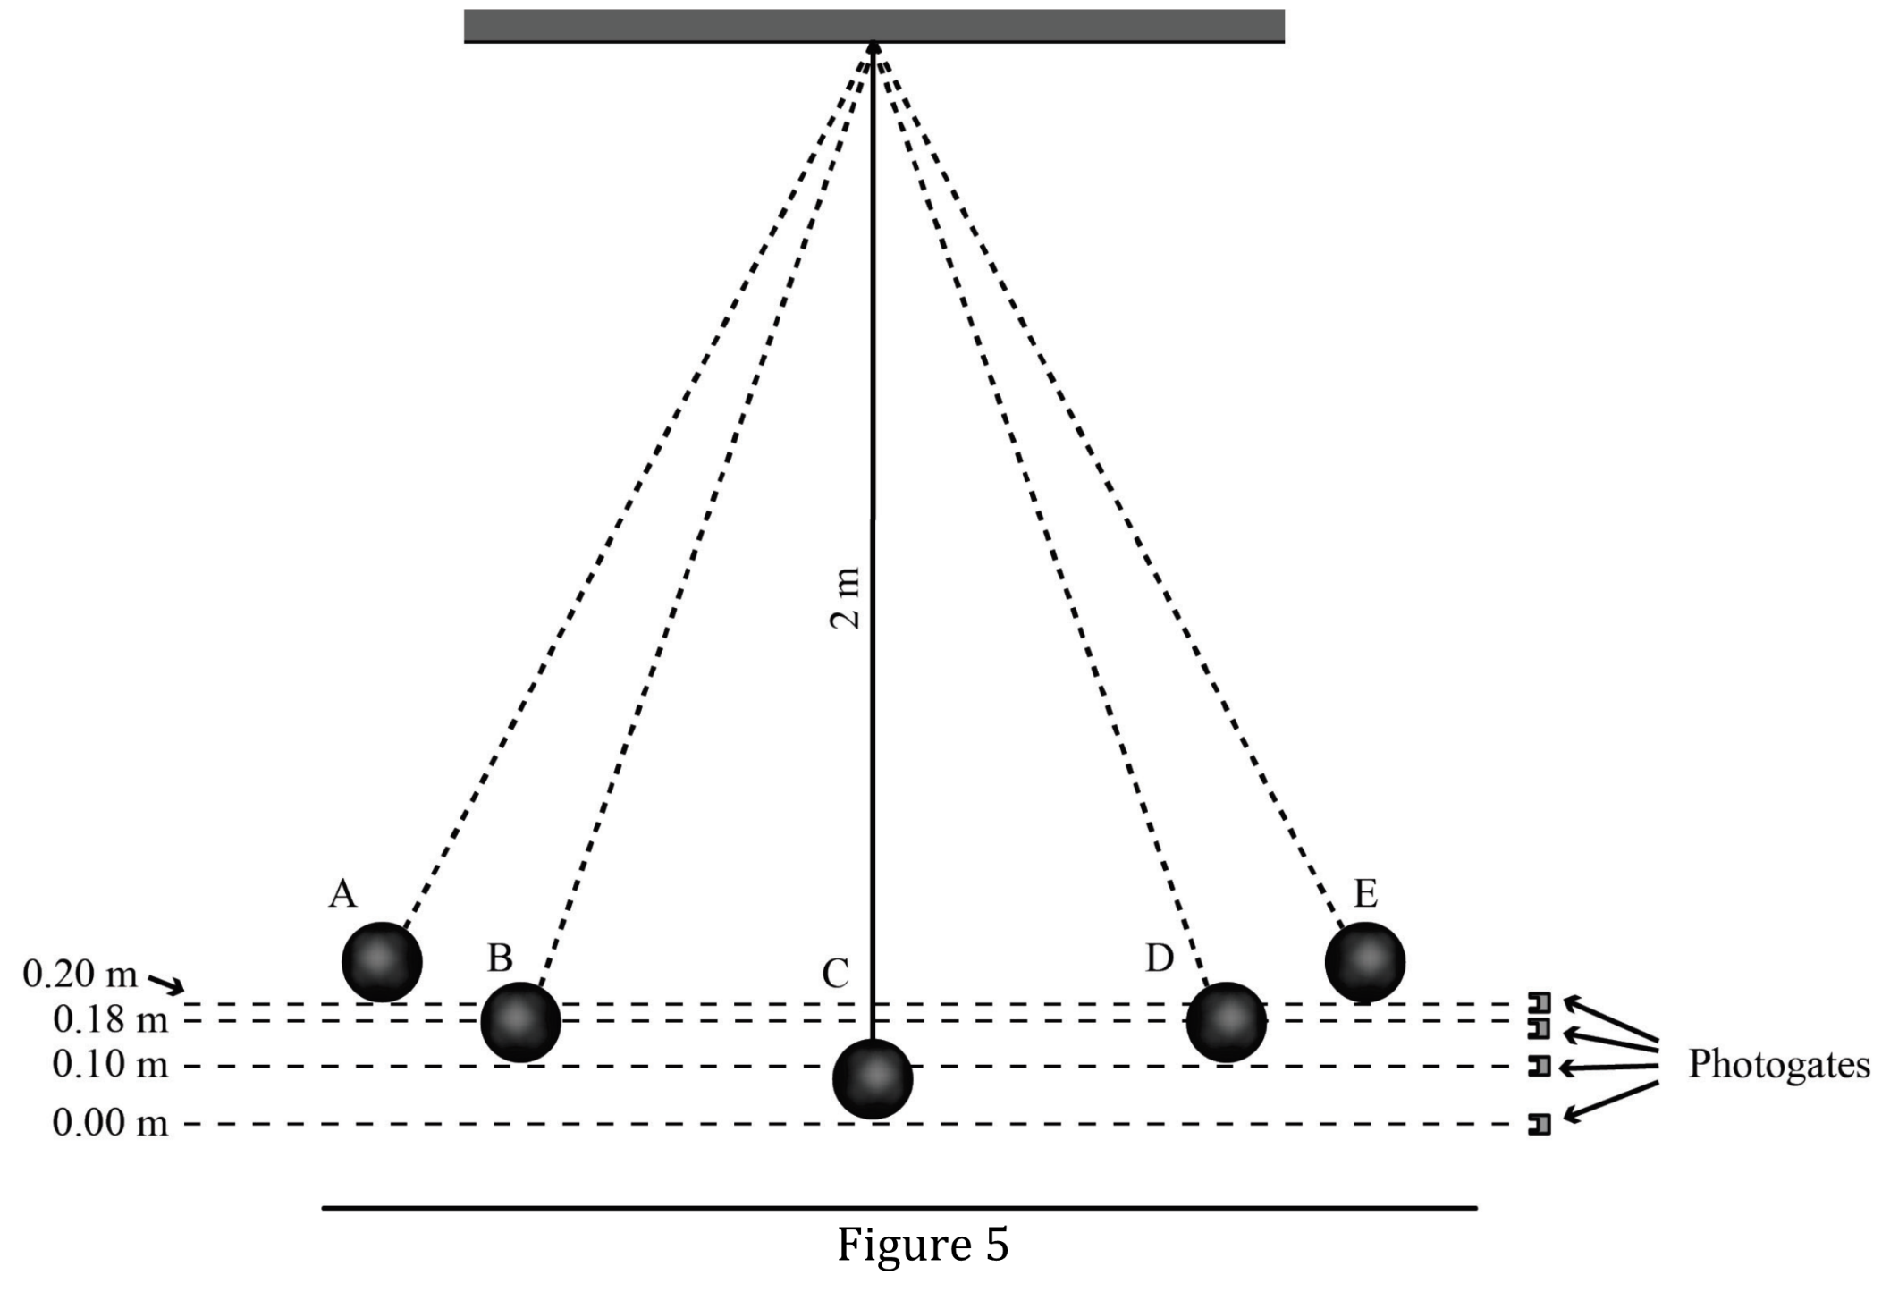
Notes:
Understand the relationship between variable in more complex data presentations; Predict the results of an additional step in an experiment; Determine what would cause a specific result in an experiment. Level: Intermediate Skill Group: Evaluation of Models

Slide 4
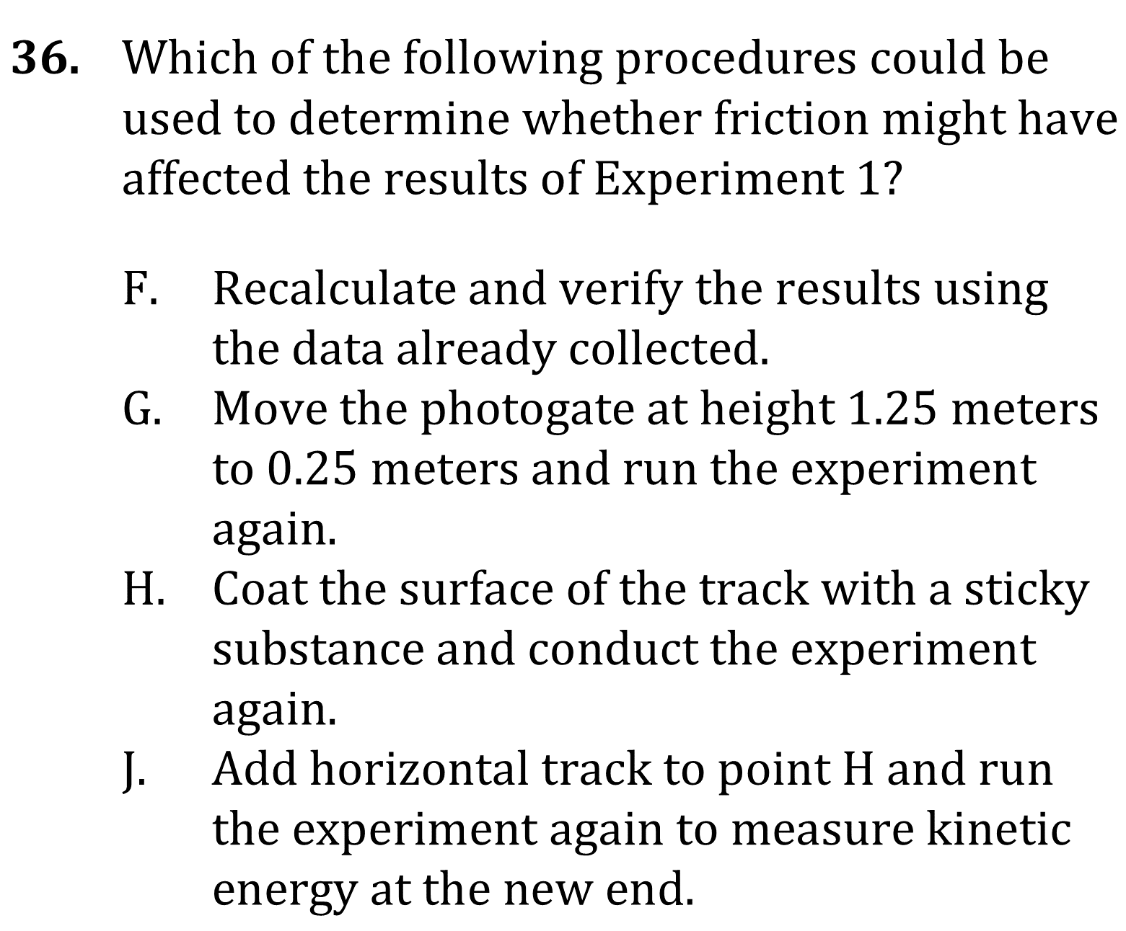
Notes:
Understand the relationship between variable in more complex data presentations; Predict the results of an additional step in an experiment; Determine what would cause a specific result in an experiment. Level: Intermediate Skill Group: Evaluation of Models

Slide 5
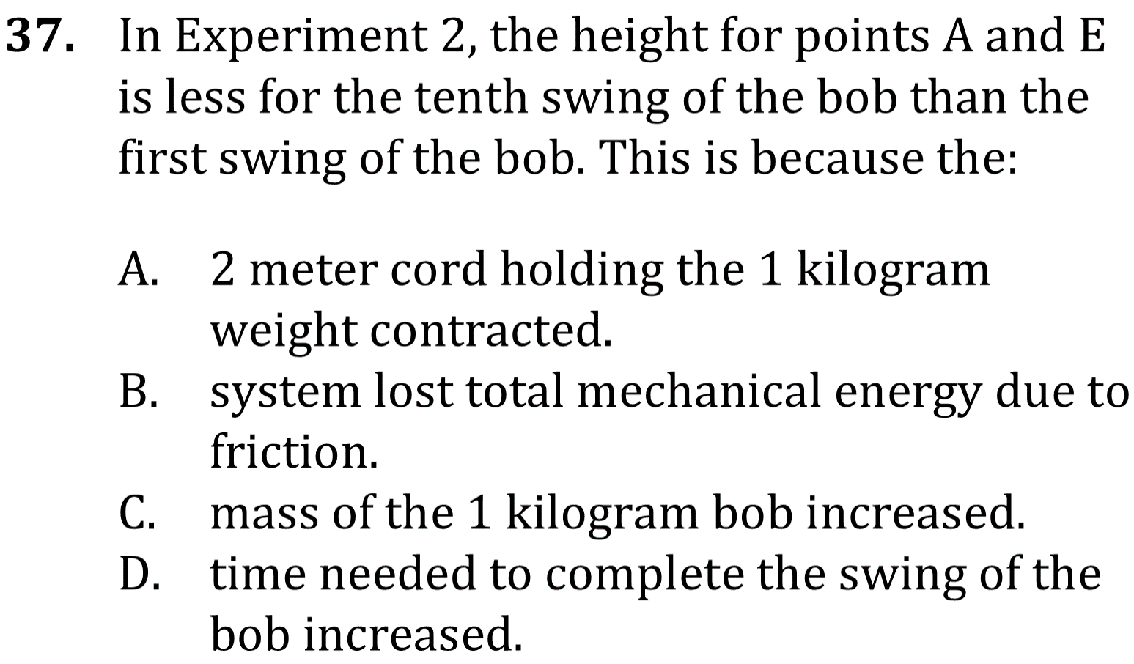
Notes:
Understand the relationship between variable in more complex data presentations; Predict the results of an additional step in an experiment; Determine what would cause a specific result in an experiment. Level: Intermediate Skill Group: Evaluation of Models

Slide 6
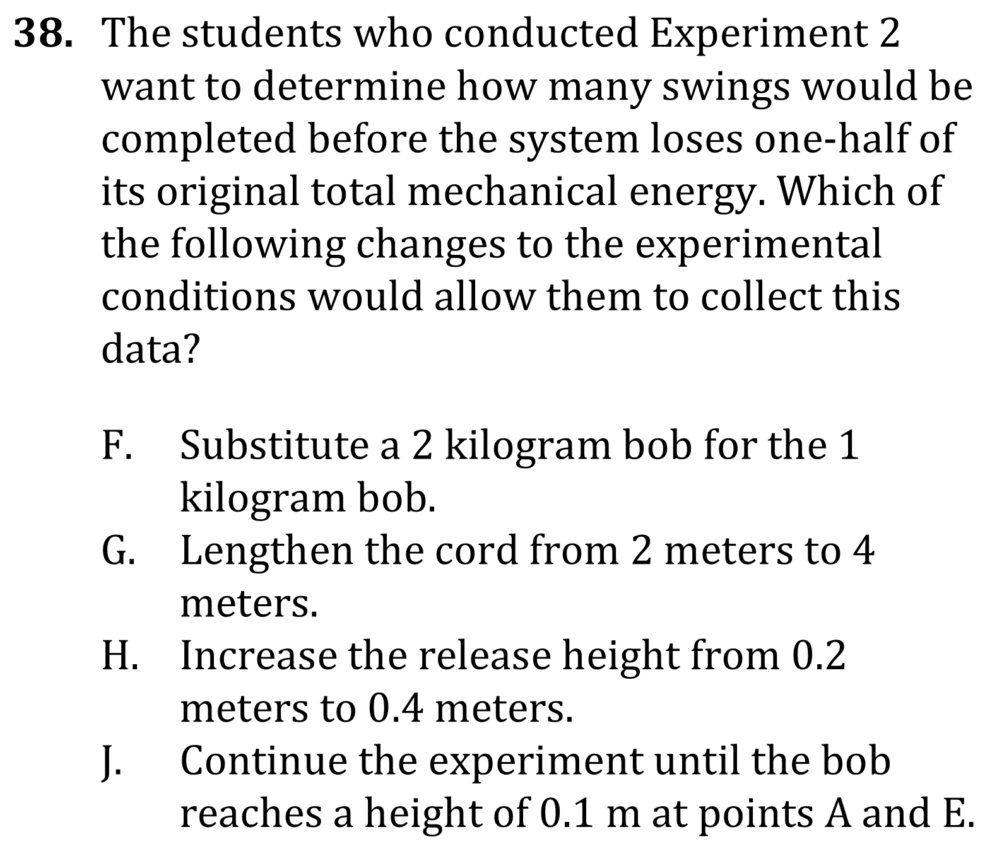
Notes:
Understand the relationship between variable in more complex data presentations; Predict the results of an additional step in an experiment; Determine what would cause a specific result in an experiment. Level: Intermediate Skill Group: Evaluation of Models

Slide 7
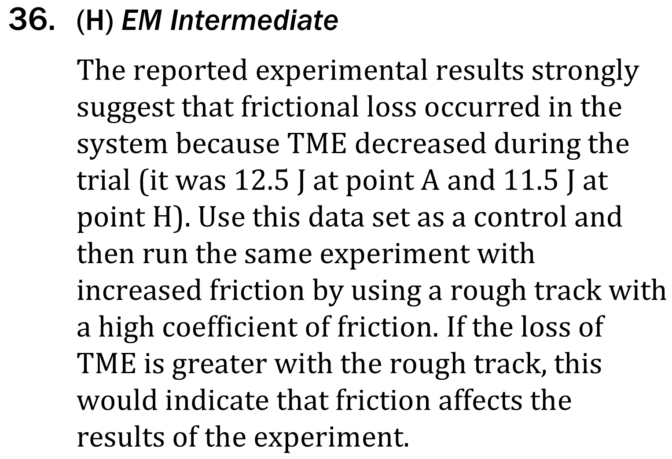
Notes:
Understand the relationship between variable in more complex data presentations; Predict the results of an additional step in an experiment; Determine what would cause a specific result in an experiment. Level: Intermediate Skill Group: Evaluation of Models

Slide 8
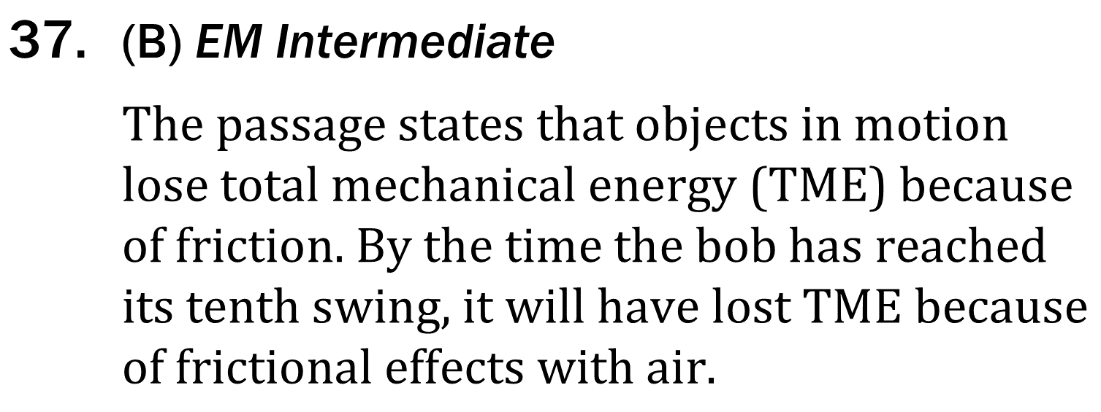
Notes:
Understand the relationship between variable in more complex data presentations; Predict the results of an additional step in an experiment; Determine what would cause a specific result in an experiment. Level: Intermediate Skill Group: Evaluation of Models

Slide 9
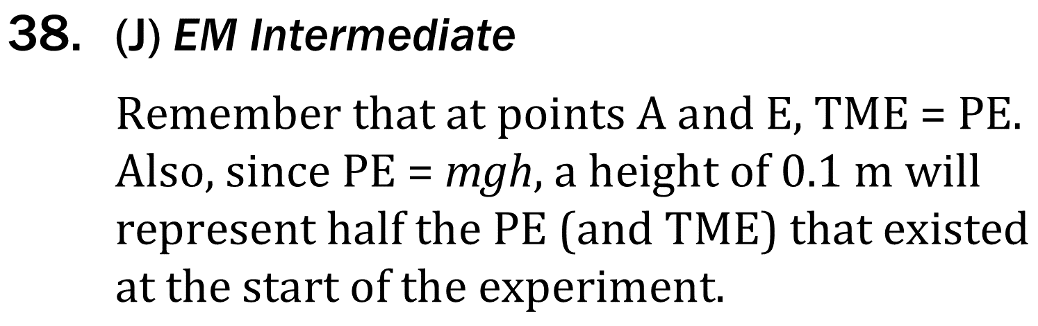
Notes:
Understand the relationship between variable in more complex data presentations; Predict the results of an additional step in an experiment; Determine what would cause a specific result in an experiment. Level: Intermediate Skill Group: Evaluation of Models

