Slide 1
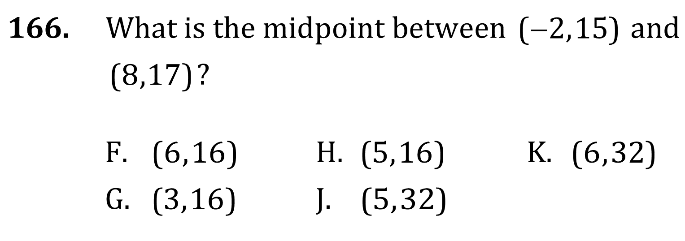

Midpoint and Distance Formulas

Slide 2
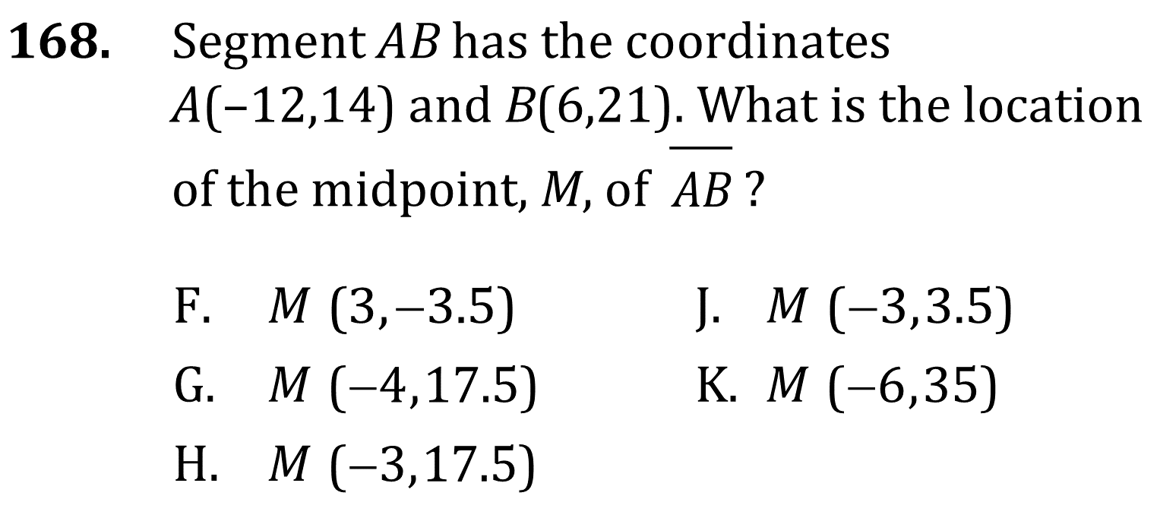
Midpoint and Distance Formulas

Slide 3
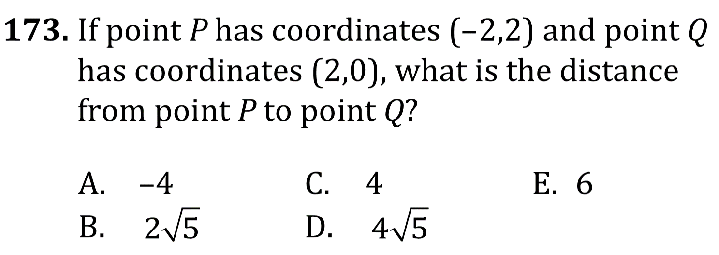
Midpoint and Distance Formulas

Slide 4
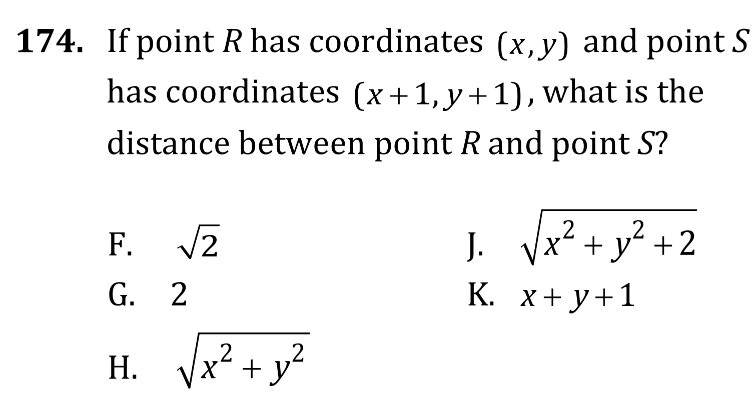
Midpoint and Distance Formulas

Slide 5
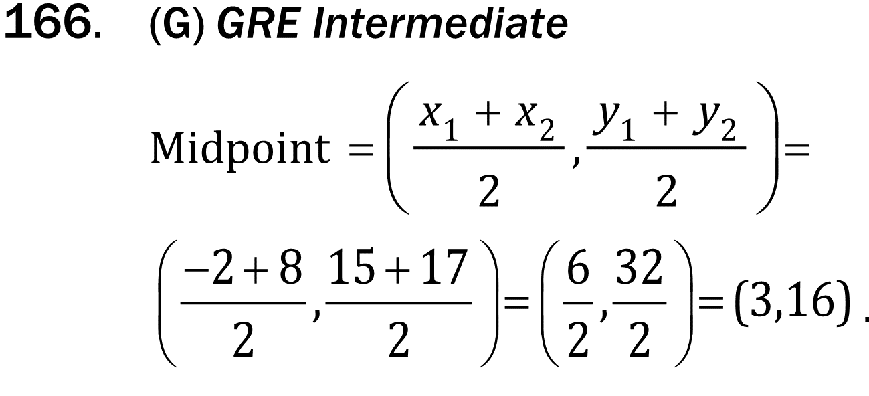
Midpoint and Distance Formulas

Slide 6
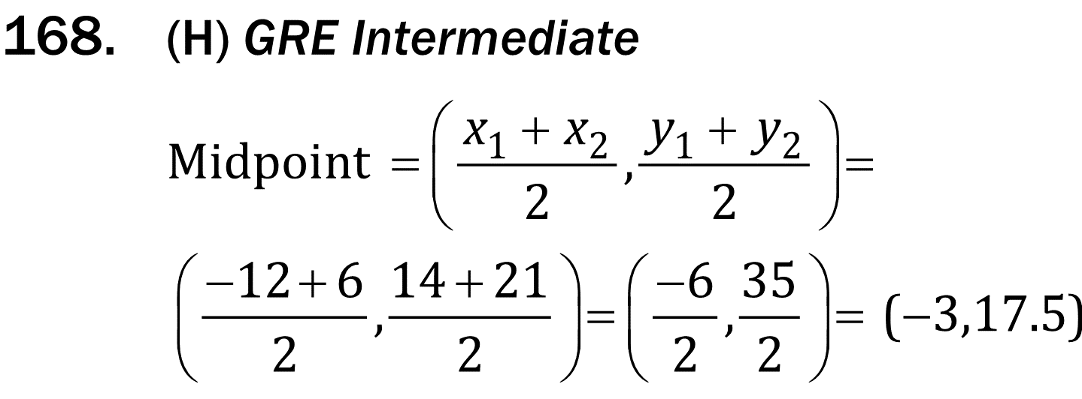
Midpoint and Distance Formulas

Slide 7

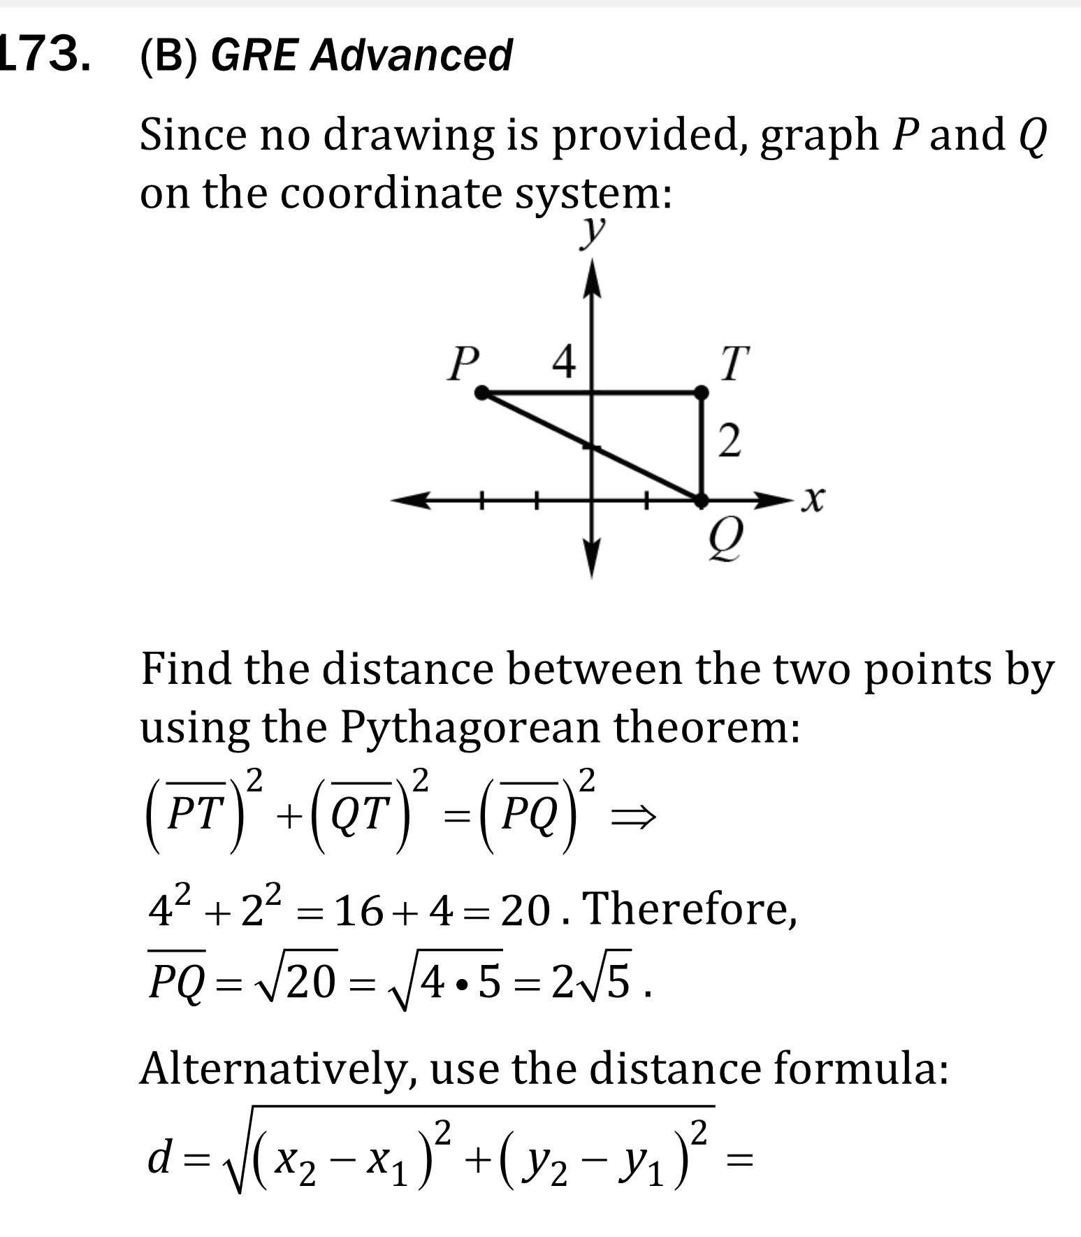

Midpoint and Distance Formulas

Slide 8


Midpoint and Distance Formulas

