Slide 1
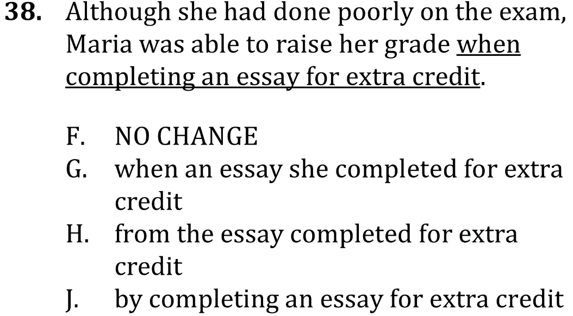

Use Correct Wording

Slide 2
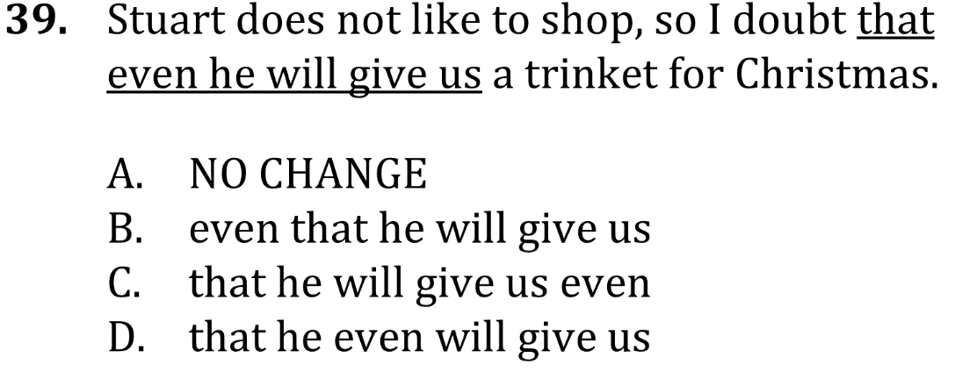
Use Correct Wording

Slide 3

Use Correct Wording

Slide 4

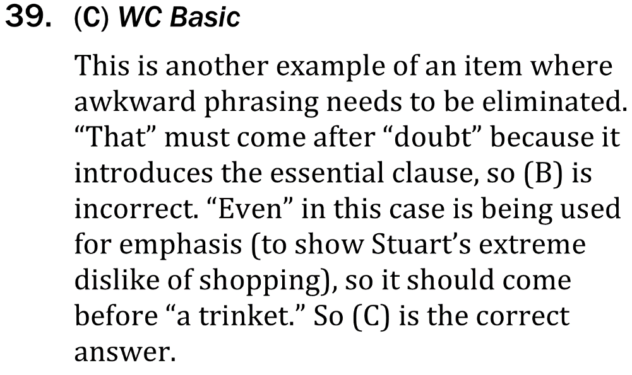
Use Correct Wording

