Slide 1
Notes:
Read and interpret data in more complex data presentations. Level: Intermediate Skill Group: Interpretation of Data

Slide 2
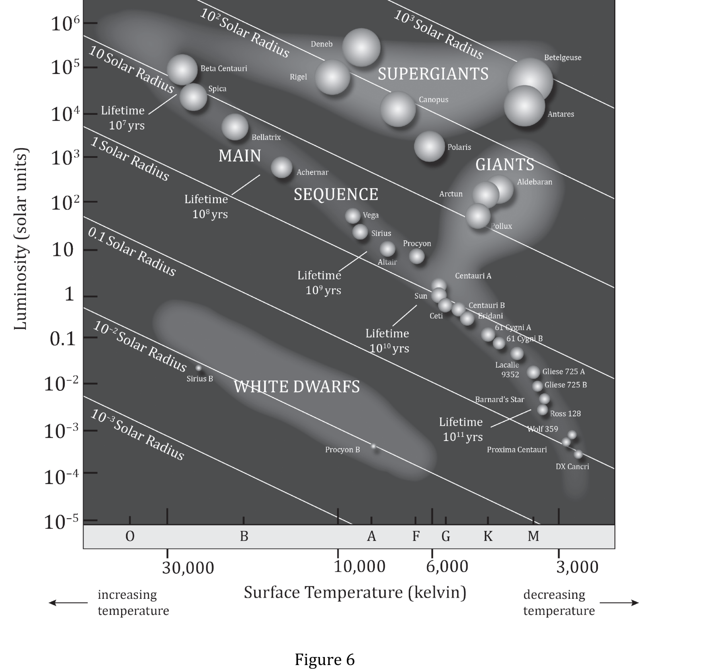
Notes:
Read and interpret data in more complex data presentations. Level: Intermediate Skill Group: Interpretation of Data

Slide 3
Notes:
Read and interpret data in more complex data presentations. Level: Intermediate Skill Group: Interpretation of Data

Slide 4
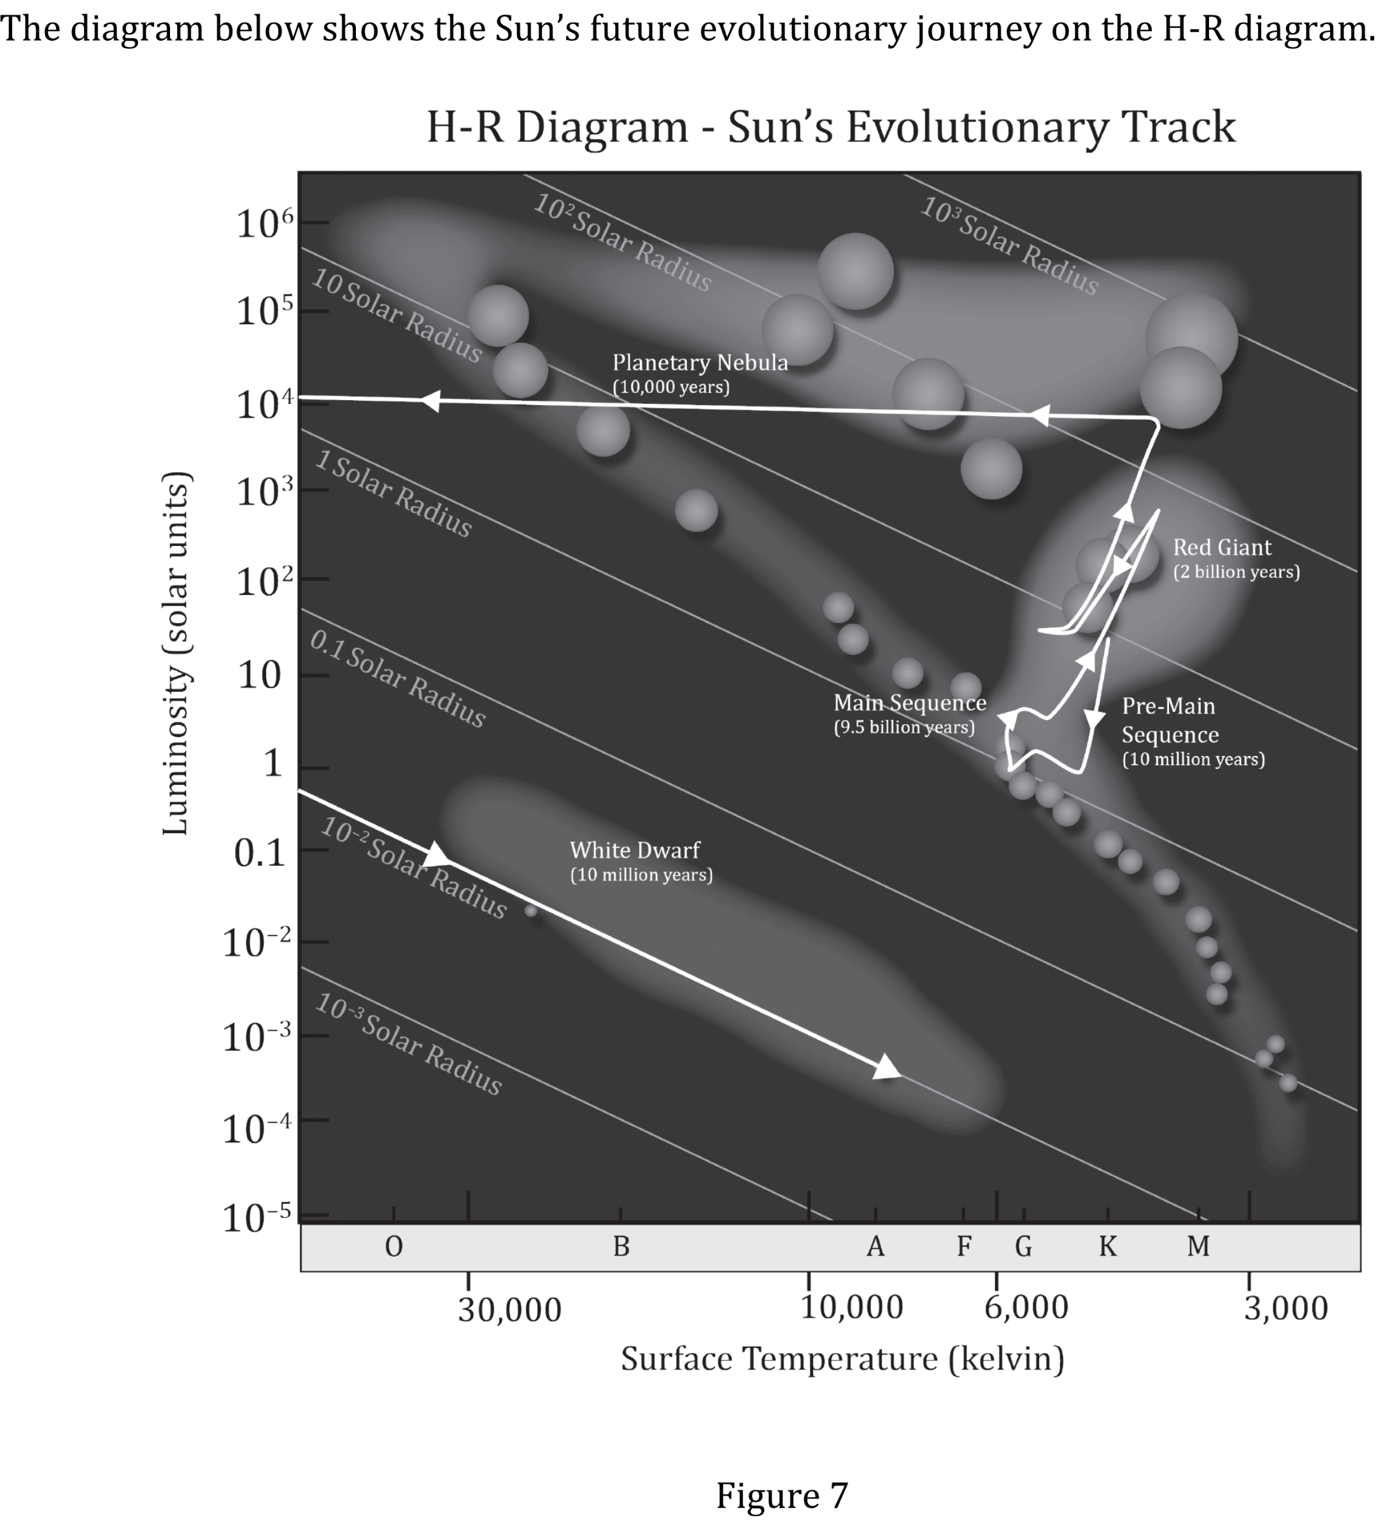
Notes:
Read and interpret data in more complex data presentations. Level: Intermediate Skill Group: Interpretation of Data

Slide 5
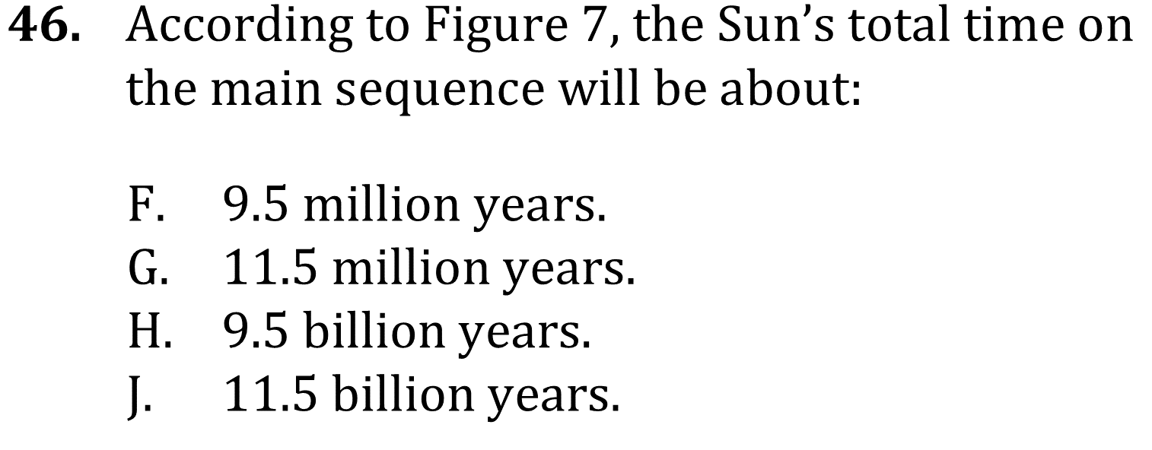
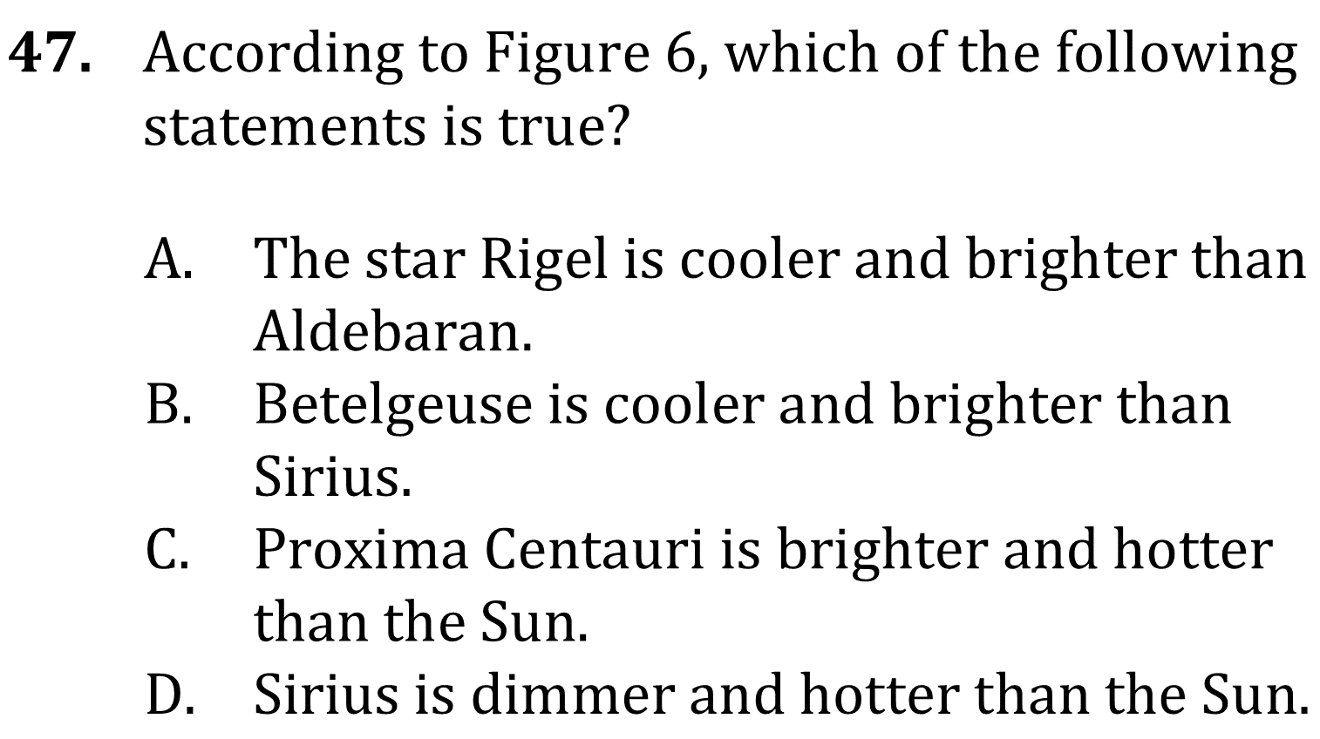
Notes:
Read and interpret data in more complex data presentations. Level: Intermediate Skill Group: Interpretation of Data

Slide 6
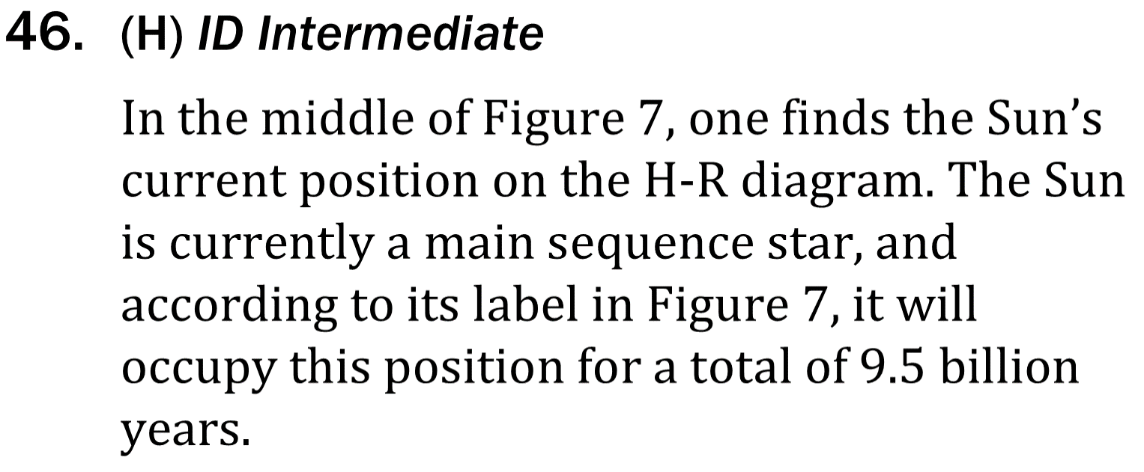
Notes:
Read and interpret data in more complex data presentations. Level: Intermediate Skill Group: Interpretation of Data

Slide 7
Notes:
Read and interpret data in more complex data presentations. Level: Intermediate Skill Group: Interpretation of Data

