Slide 1
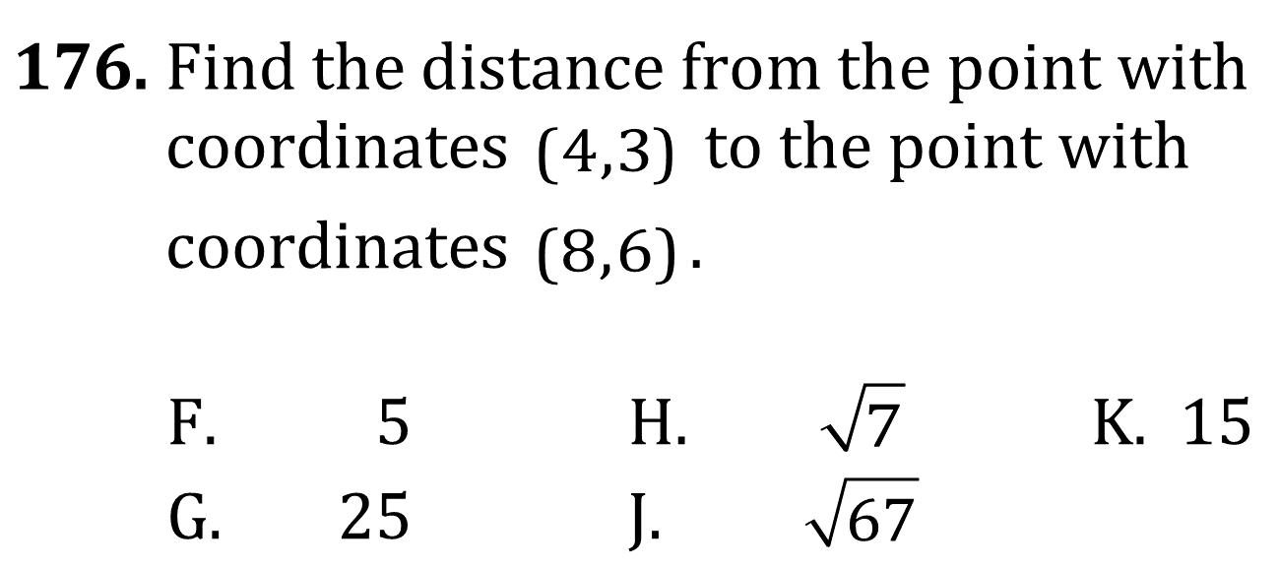

Slope and linear functions

Slide 2
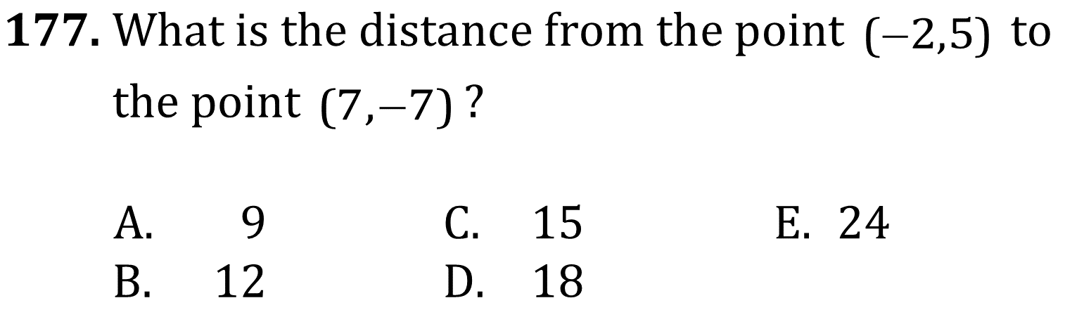
Slope and linear functions

Slide 3
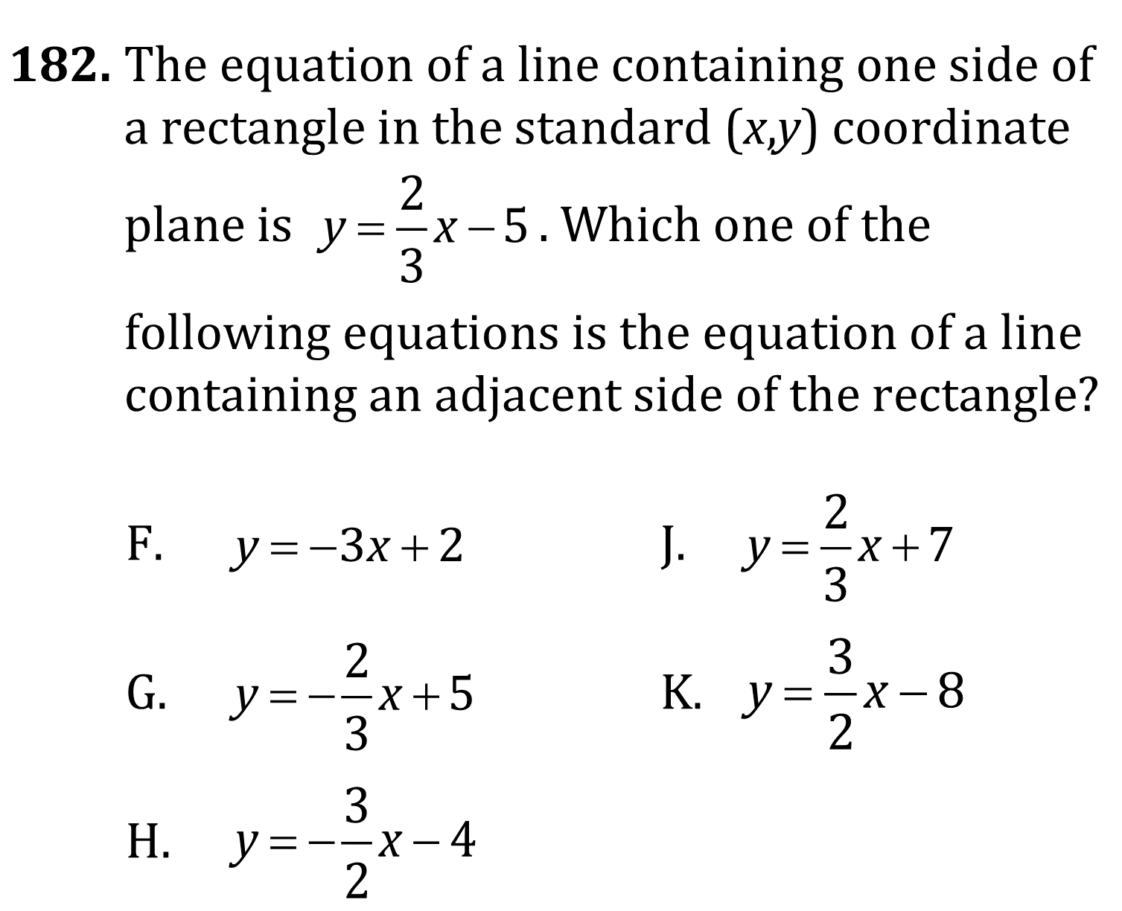
Slope and linear functions

Slide 4
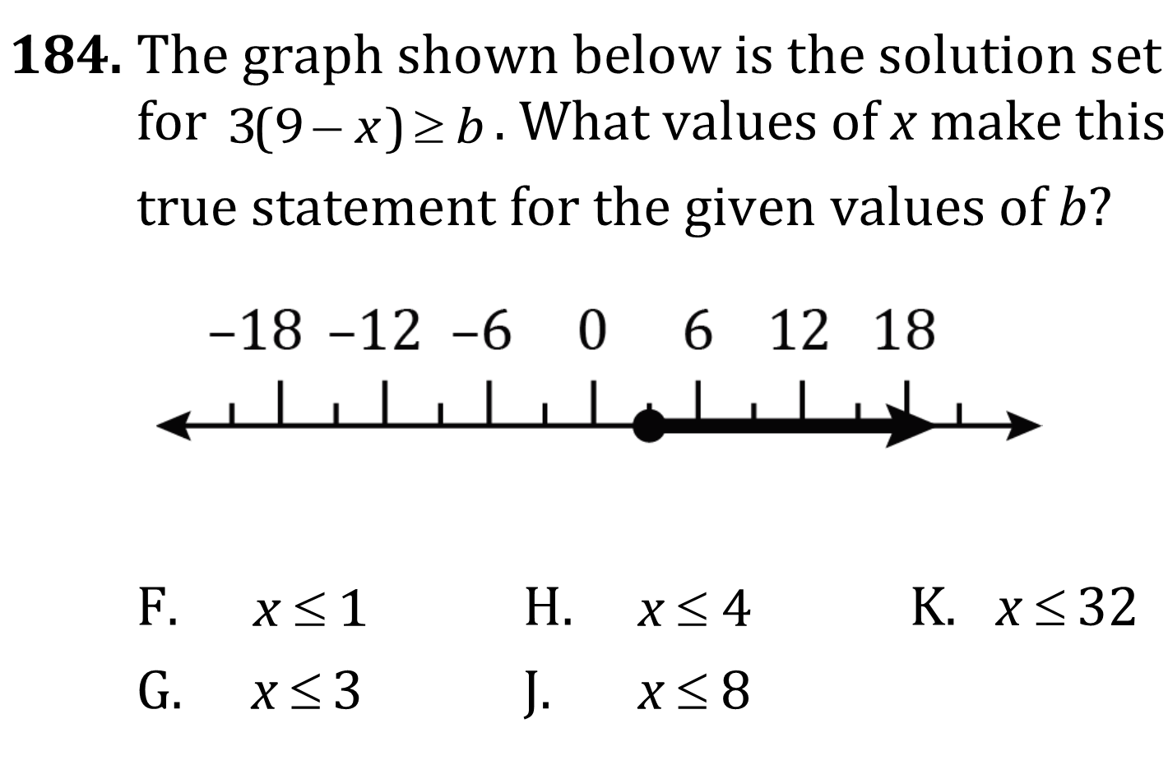
Slope and linear functions

Slide 5
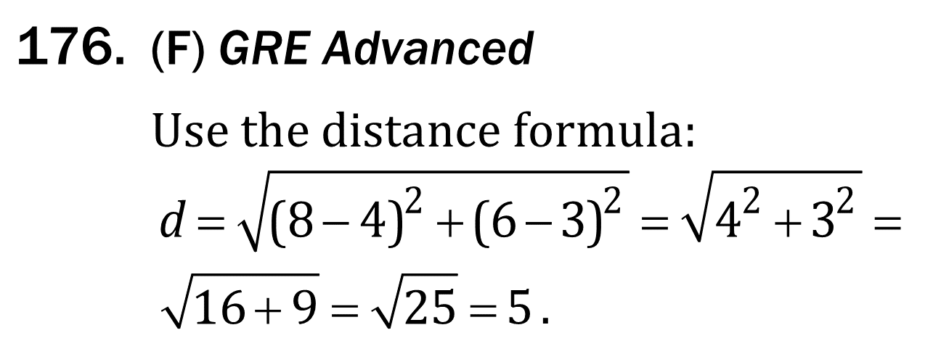
Slope and linear functions

Slide 6
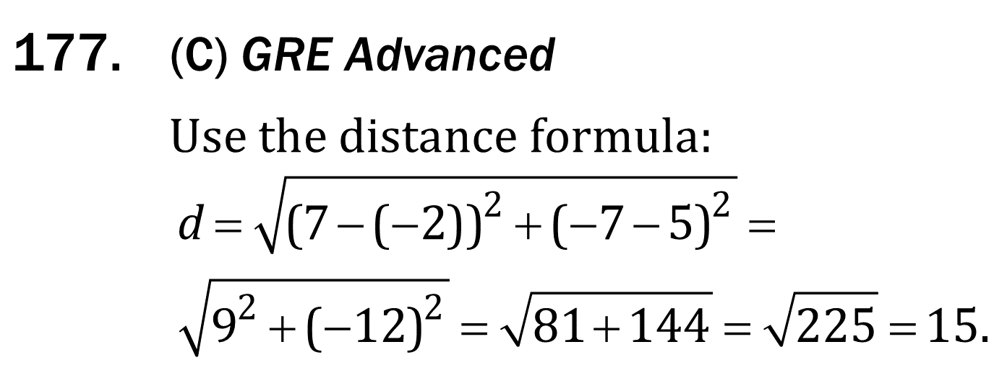
Slope and linear functions

Slide 7
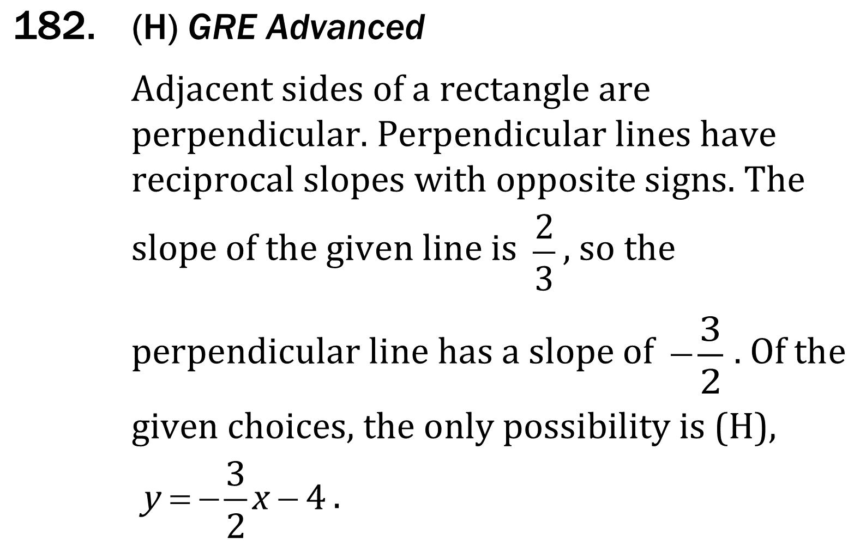
Slope and linear functions

Slide 8
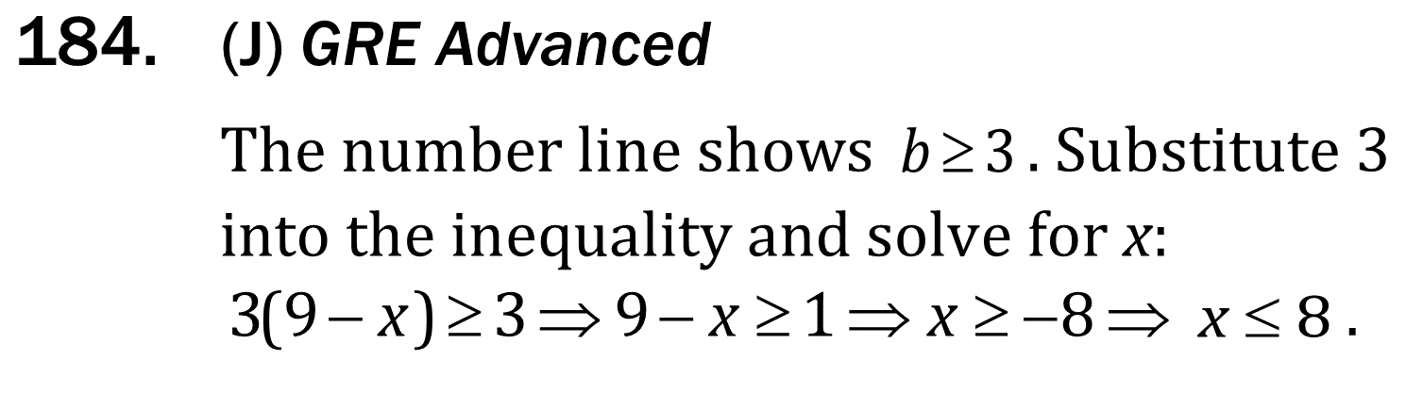
Slope and linear functions

