Slide 1
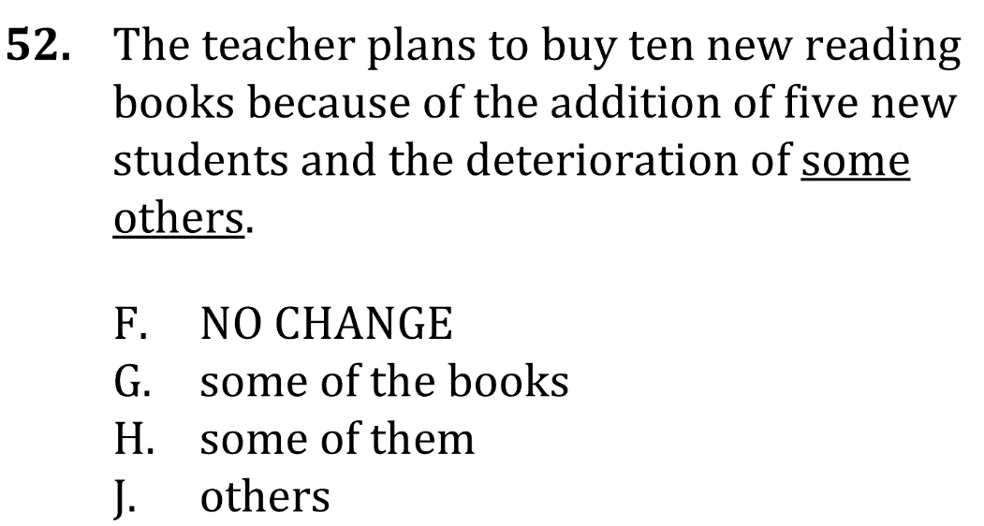
Use clear Nouns and Pronouns

Slide 2
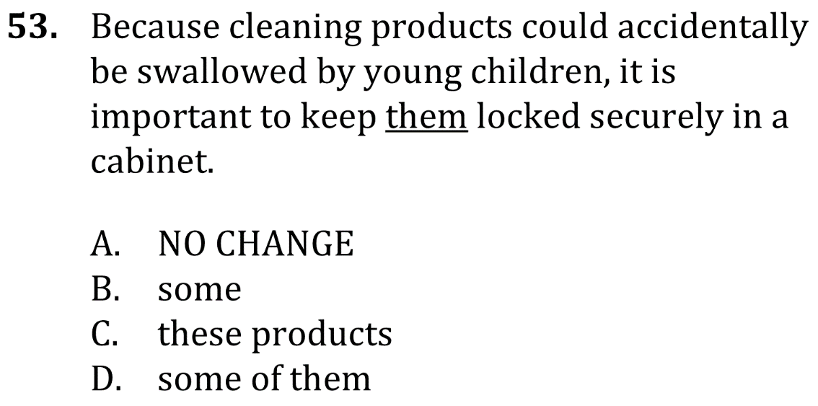
Use clear nouns and pronouns

Slide 3
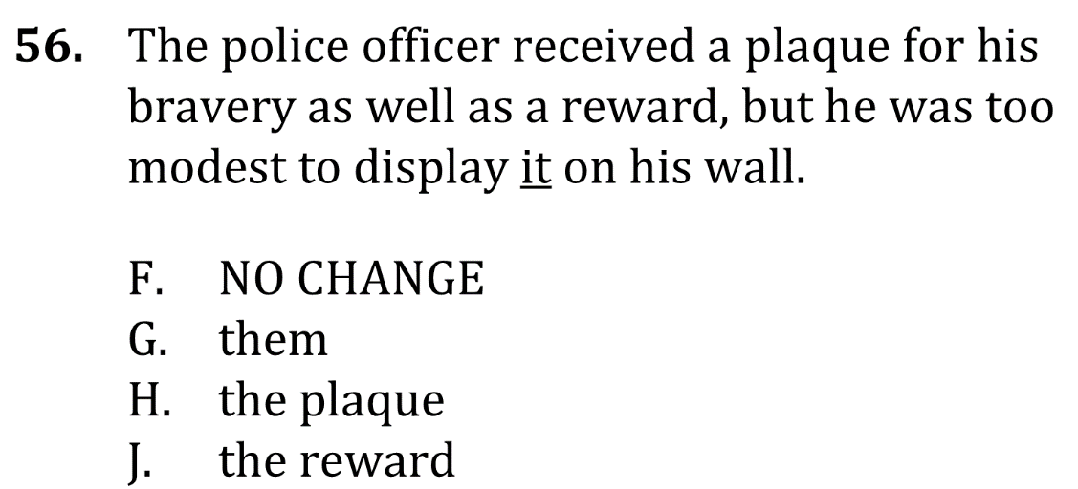
Use clear nouns and pronouns

Slide 4
Use clear nouns and pronouns

Slide 5
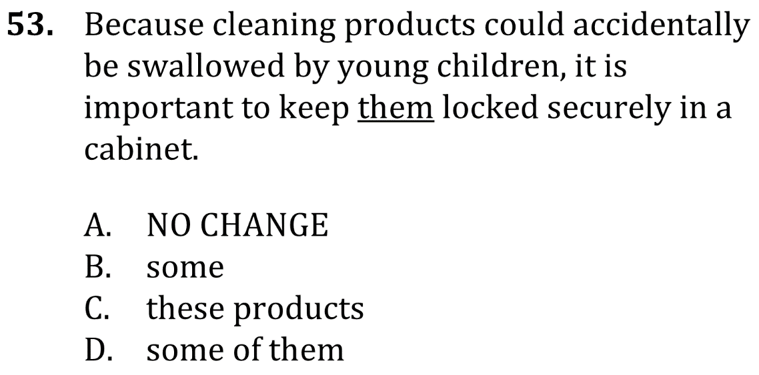
Use clear nouns and pronouns

Slide 6
Use clear nouns and pronouns

