Slide 1
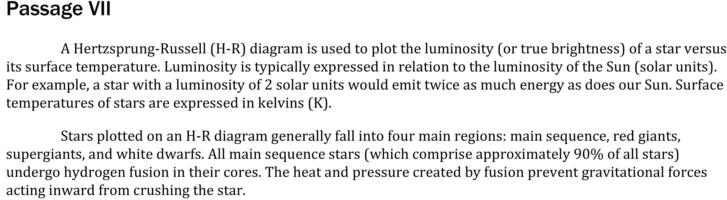

Notes:
Read and interpret data in more complex data presentations. Level: Intermediate Skill Group: Interpretation of Data

Slide 2
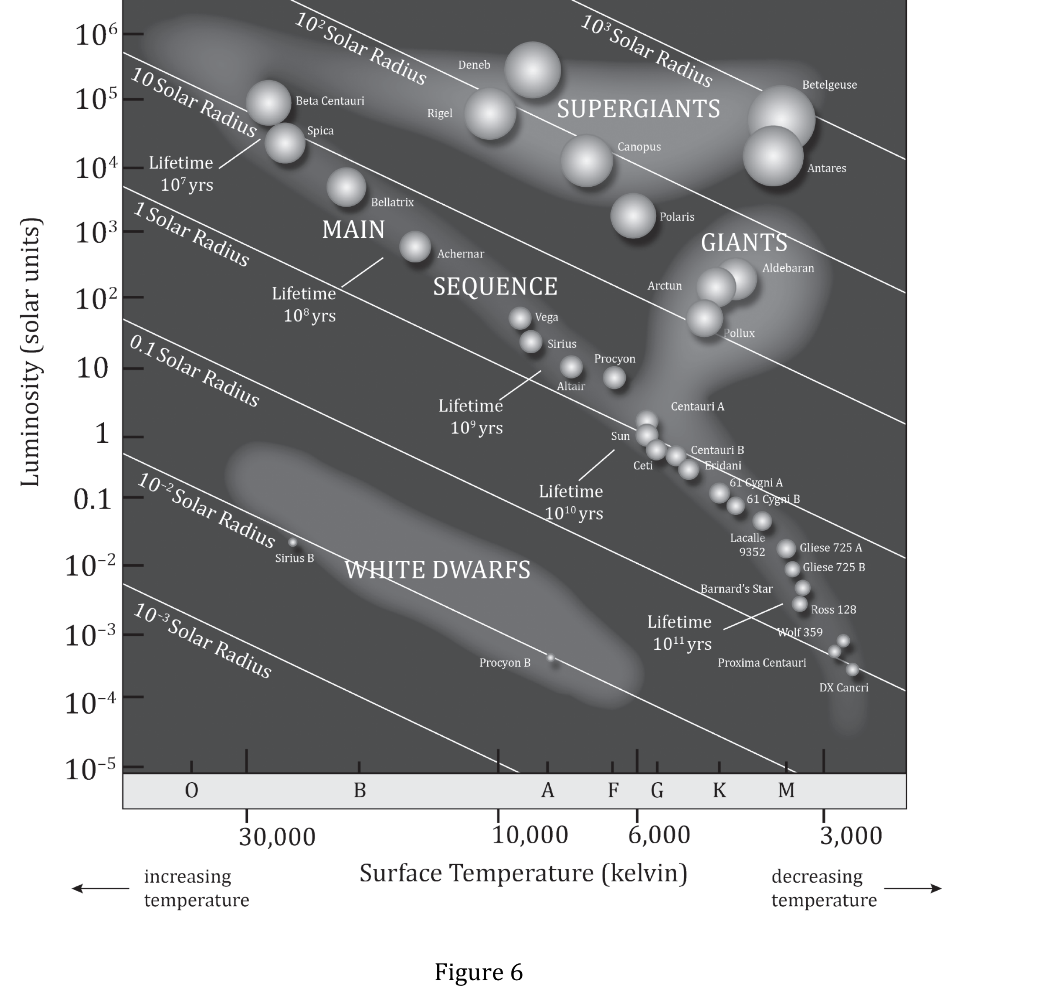
Notes:
Read and interpret data in more complex data presentations. Level: Intermediate Skill Group: Interpretation of Data

Slide 3
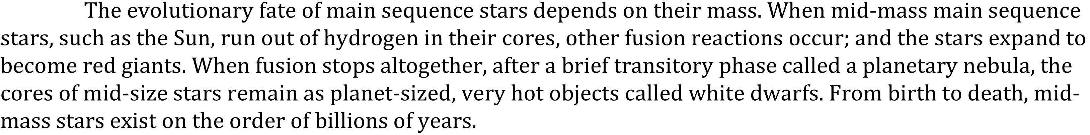
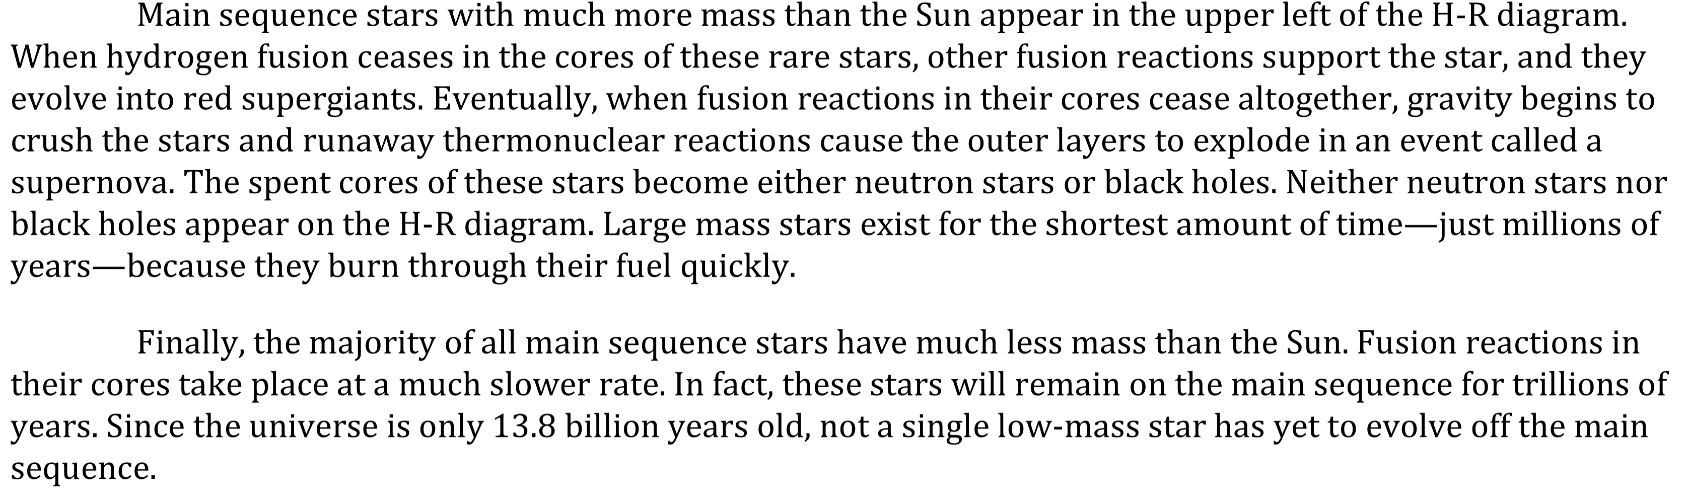
Notes:
Read and interpret data in more complex data presentations. Level: Intermediate Skill Group: Interpretation of Data

Slide 4
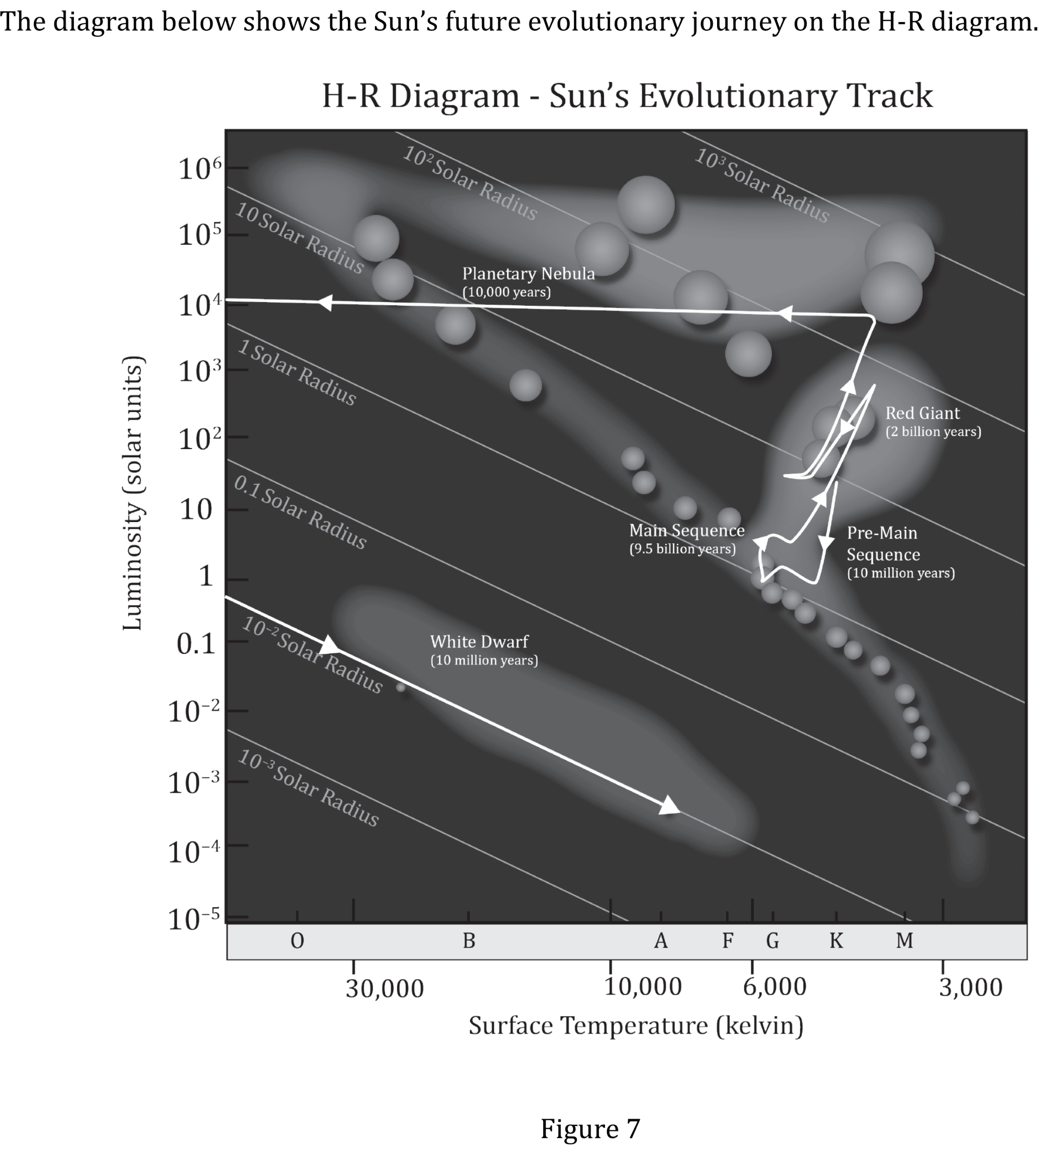
Notes:
Read and interpret data in more complex data presentations. Level: Intermediate Skill Group: Interpretation of Data

Slide 5
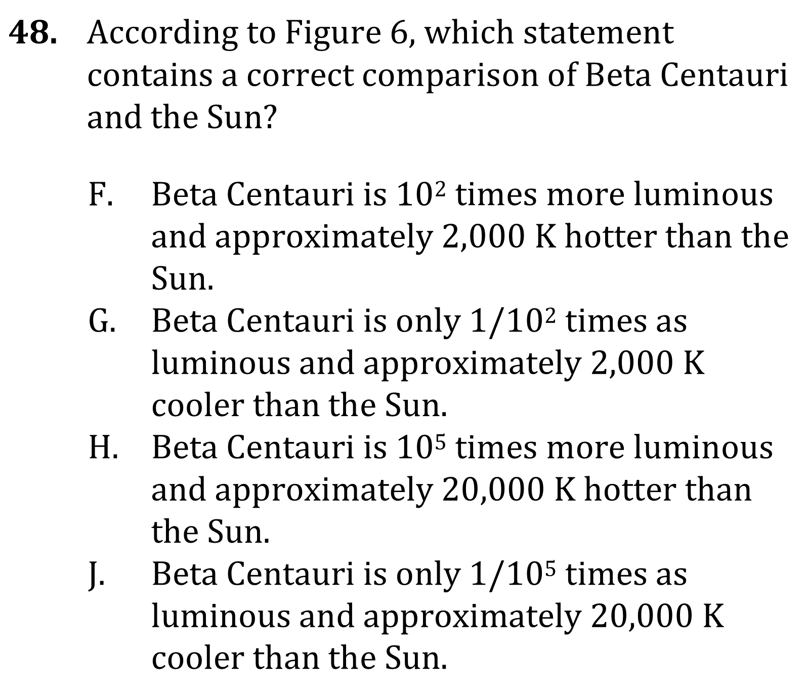
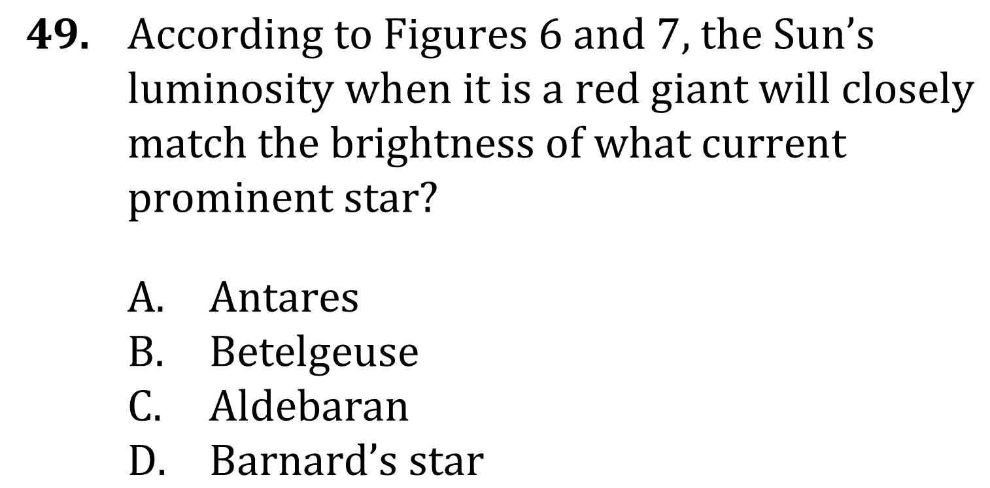
Notes:
Read and interpret data in more complex data presentations. Level: Intermediate Skill Group: Interpretation of Data

Slide 6
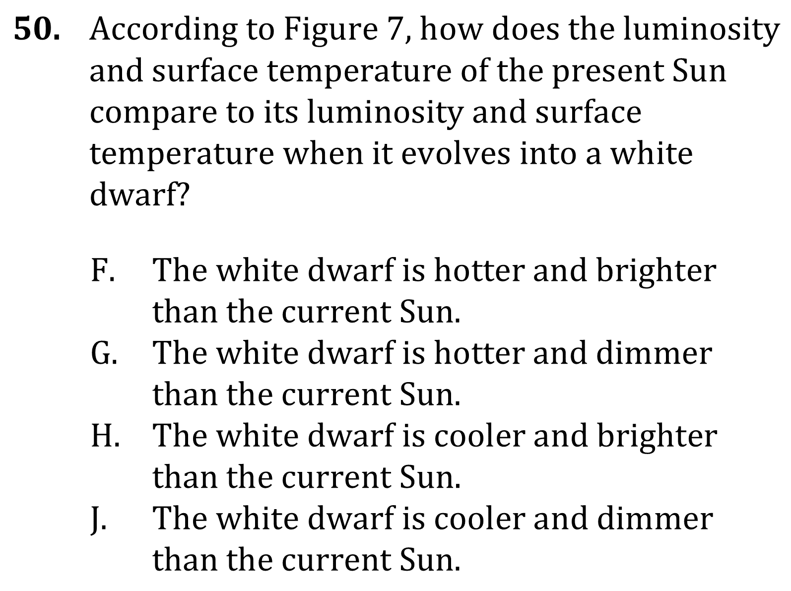
Notes:
Read and interpret data in more complex data presentations. Level: Intermediate Skill Group: Interpretation of Data

Slide 7
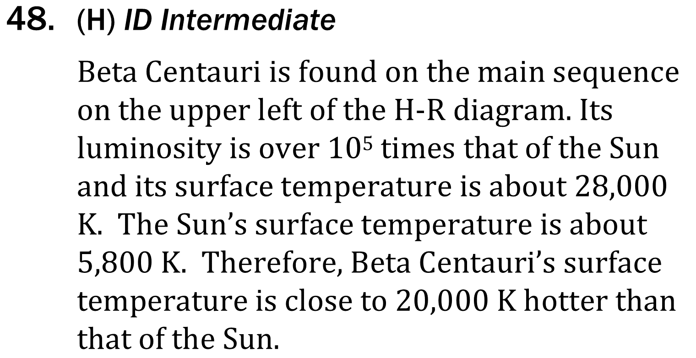
Notes:
Read and interpret data in more complex data presentations. Level: Intermediate Skill Group: Interpretation of Data

Slide 8
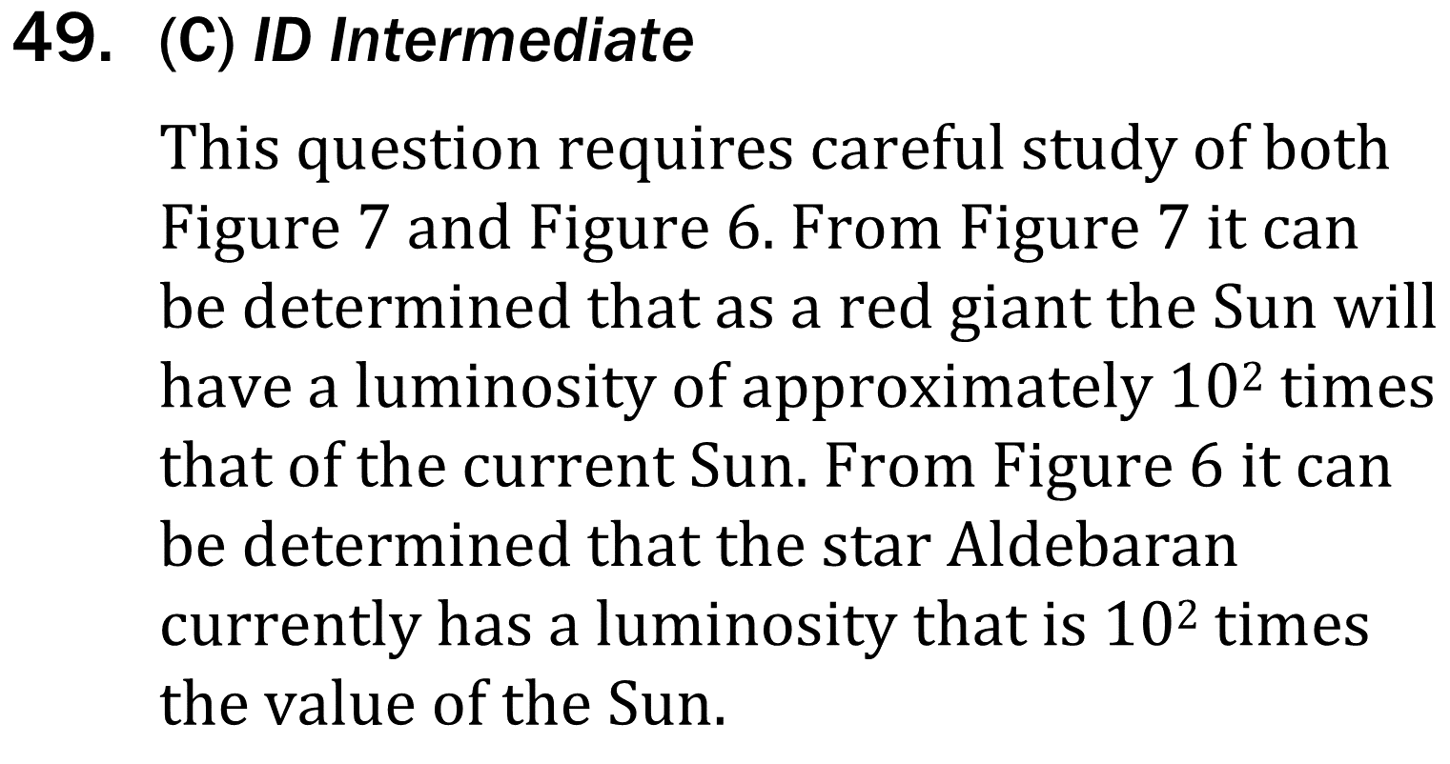
Notes:
Read and interpret data in more complex data presentations. Level: Intermediate Skill Group: Interpretation of Data

Slide 9
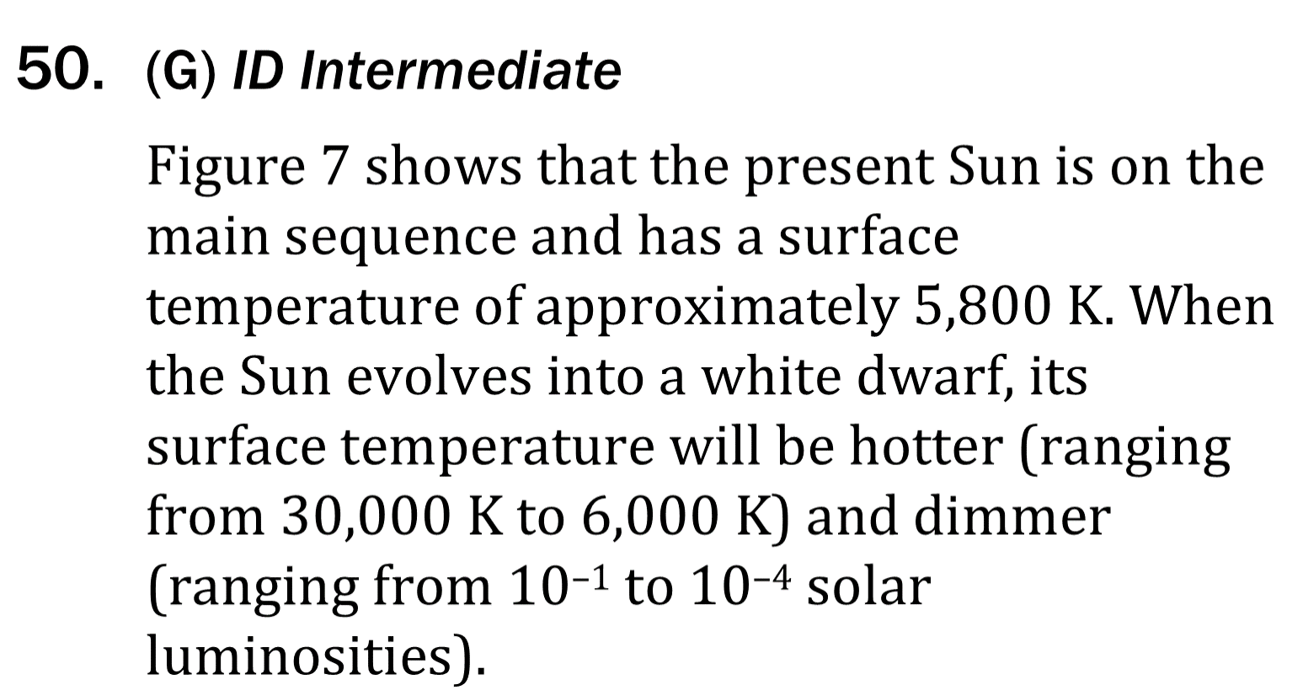
Notes:
Read and interpret data in more complex data presentations. Level: Intermediate Skill Group: Interpretation of Data

