Slide 1
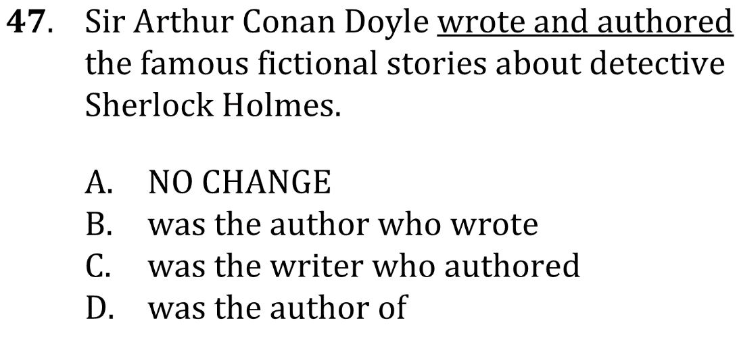
Simplify redundant phrasings

Slide 2
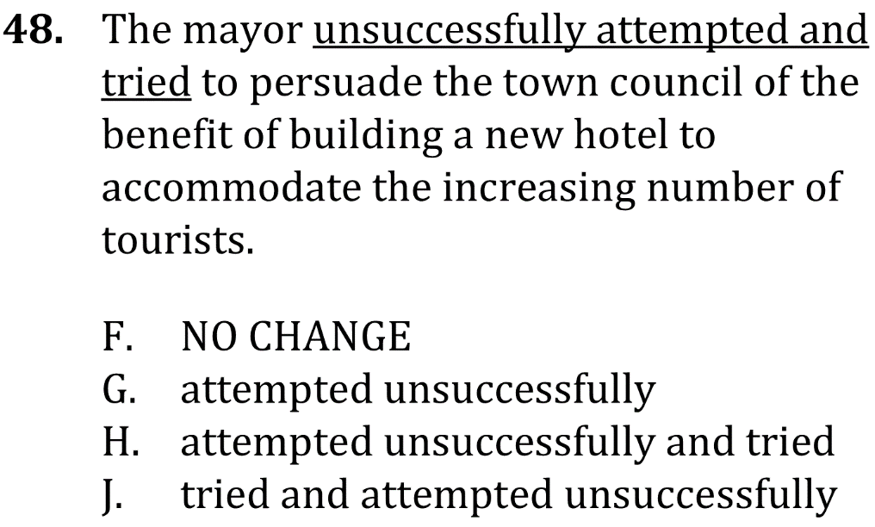
Simplify redundant phrasings

Slide 3
Simplify redundant phrasings

Slide 4
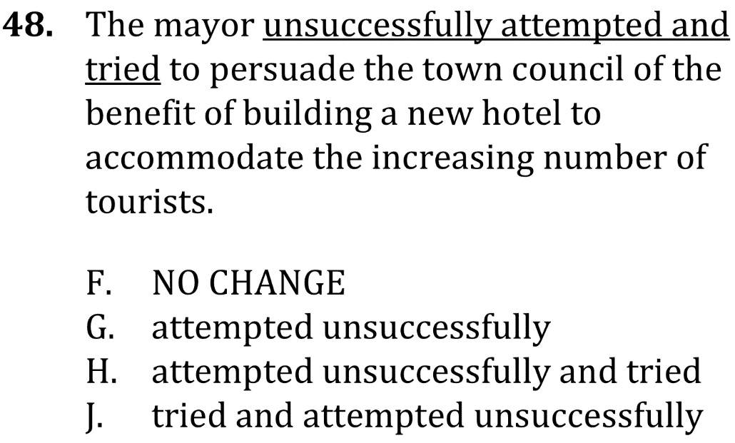
Simplify redundant phrasings

