Slide 2
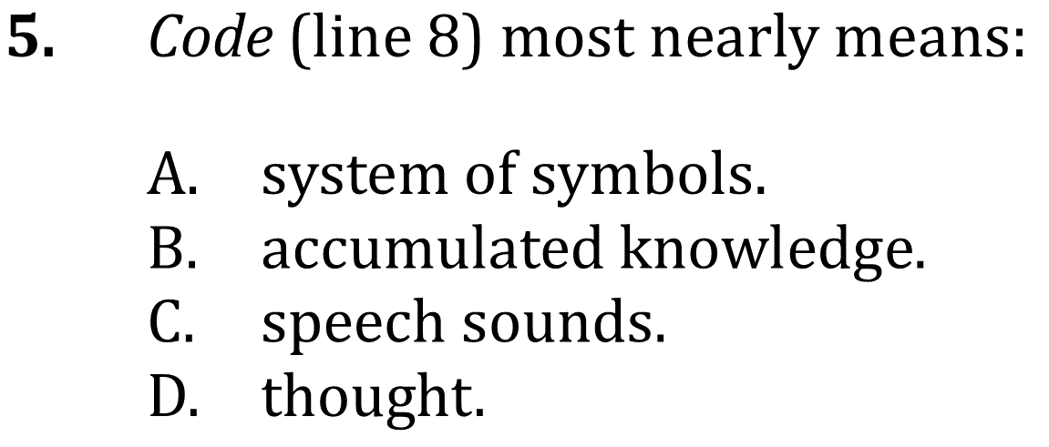
Use Context Clues

Slide 3
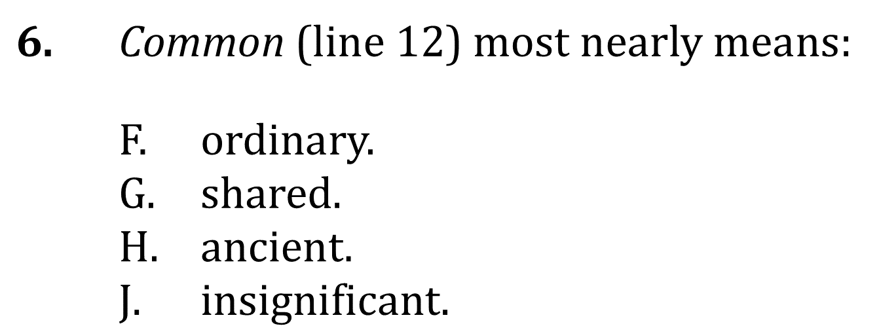
Use Context Clues

Slide 5
