Slide 2
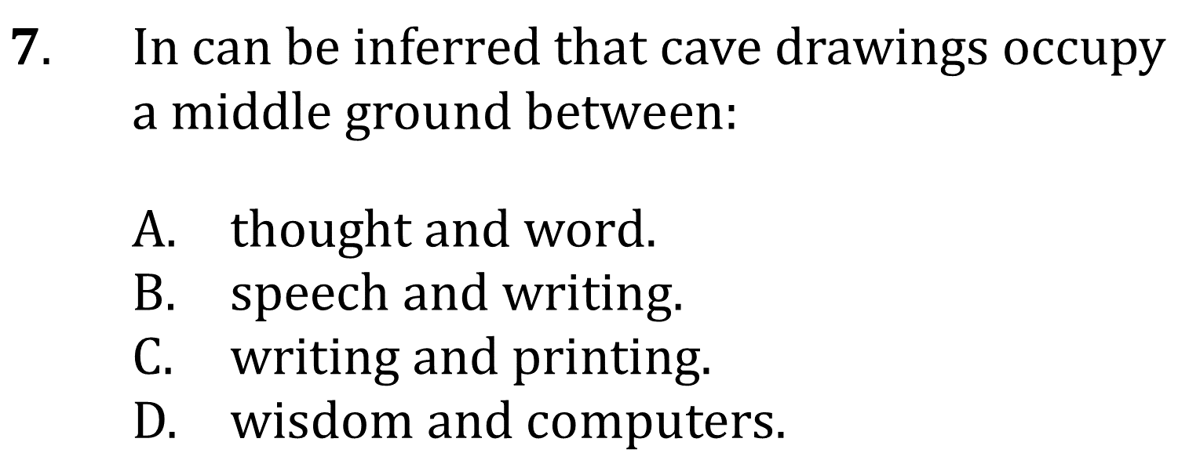
Draw Conclusions

Slide 3
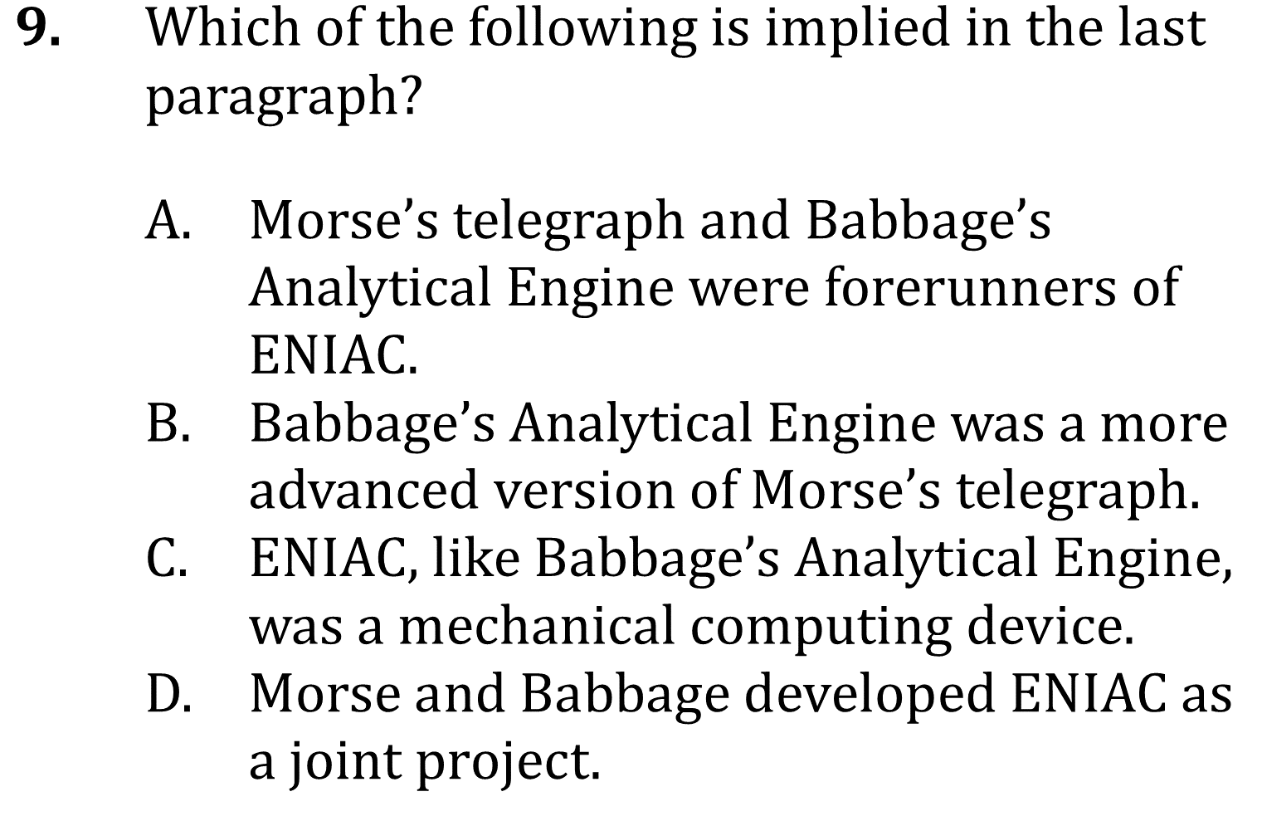
Draw Conclusions

Slide 4
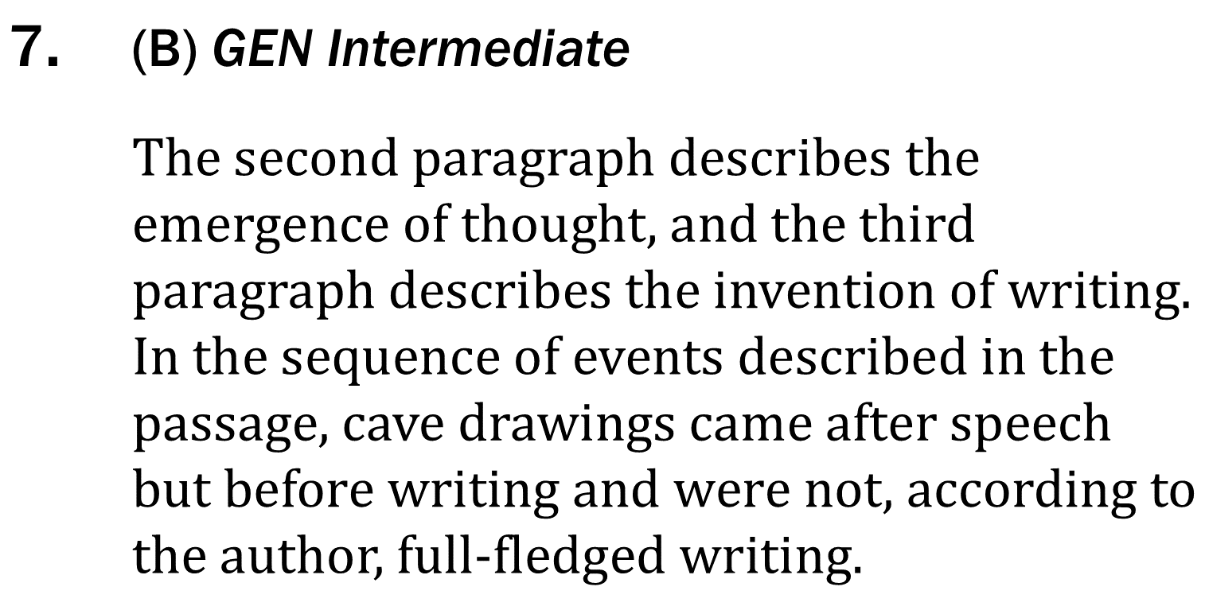
Draw Conclusions

Slide 5
Draw Conclusions

