Slide 1
Notes:
Understand basic scientific terms; Read and interpret data in more complex data presentations. Level: Intermediate Skill Group: Scientific Investigation

Slide 2
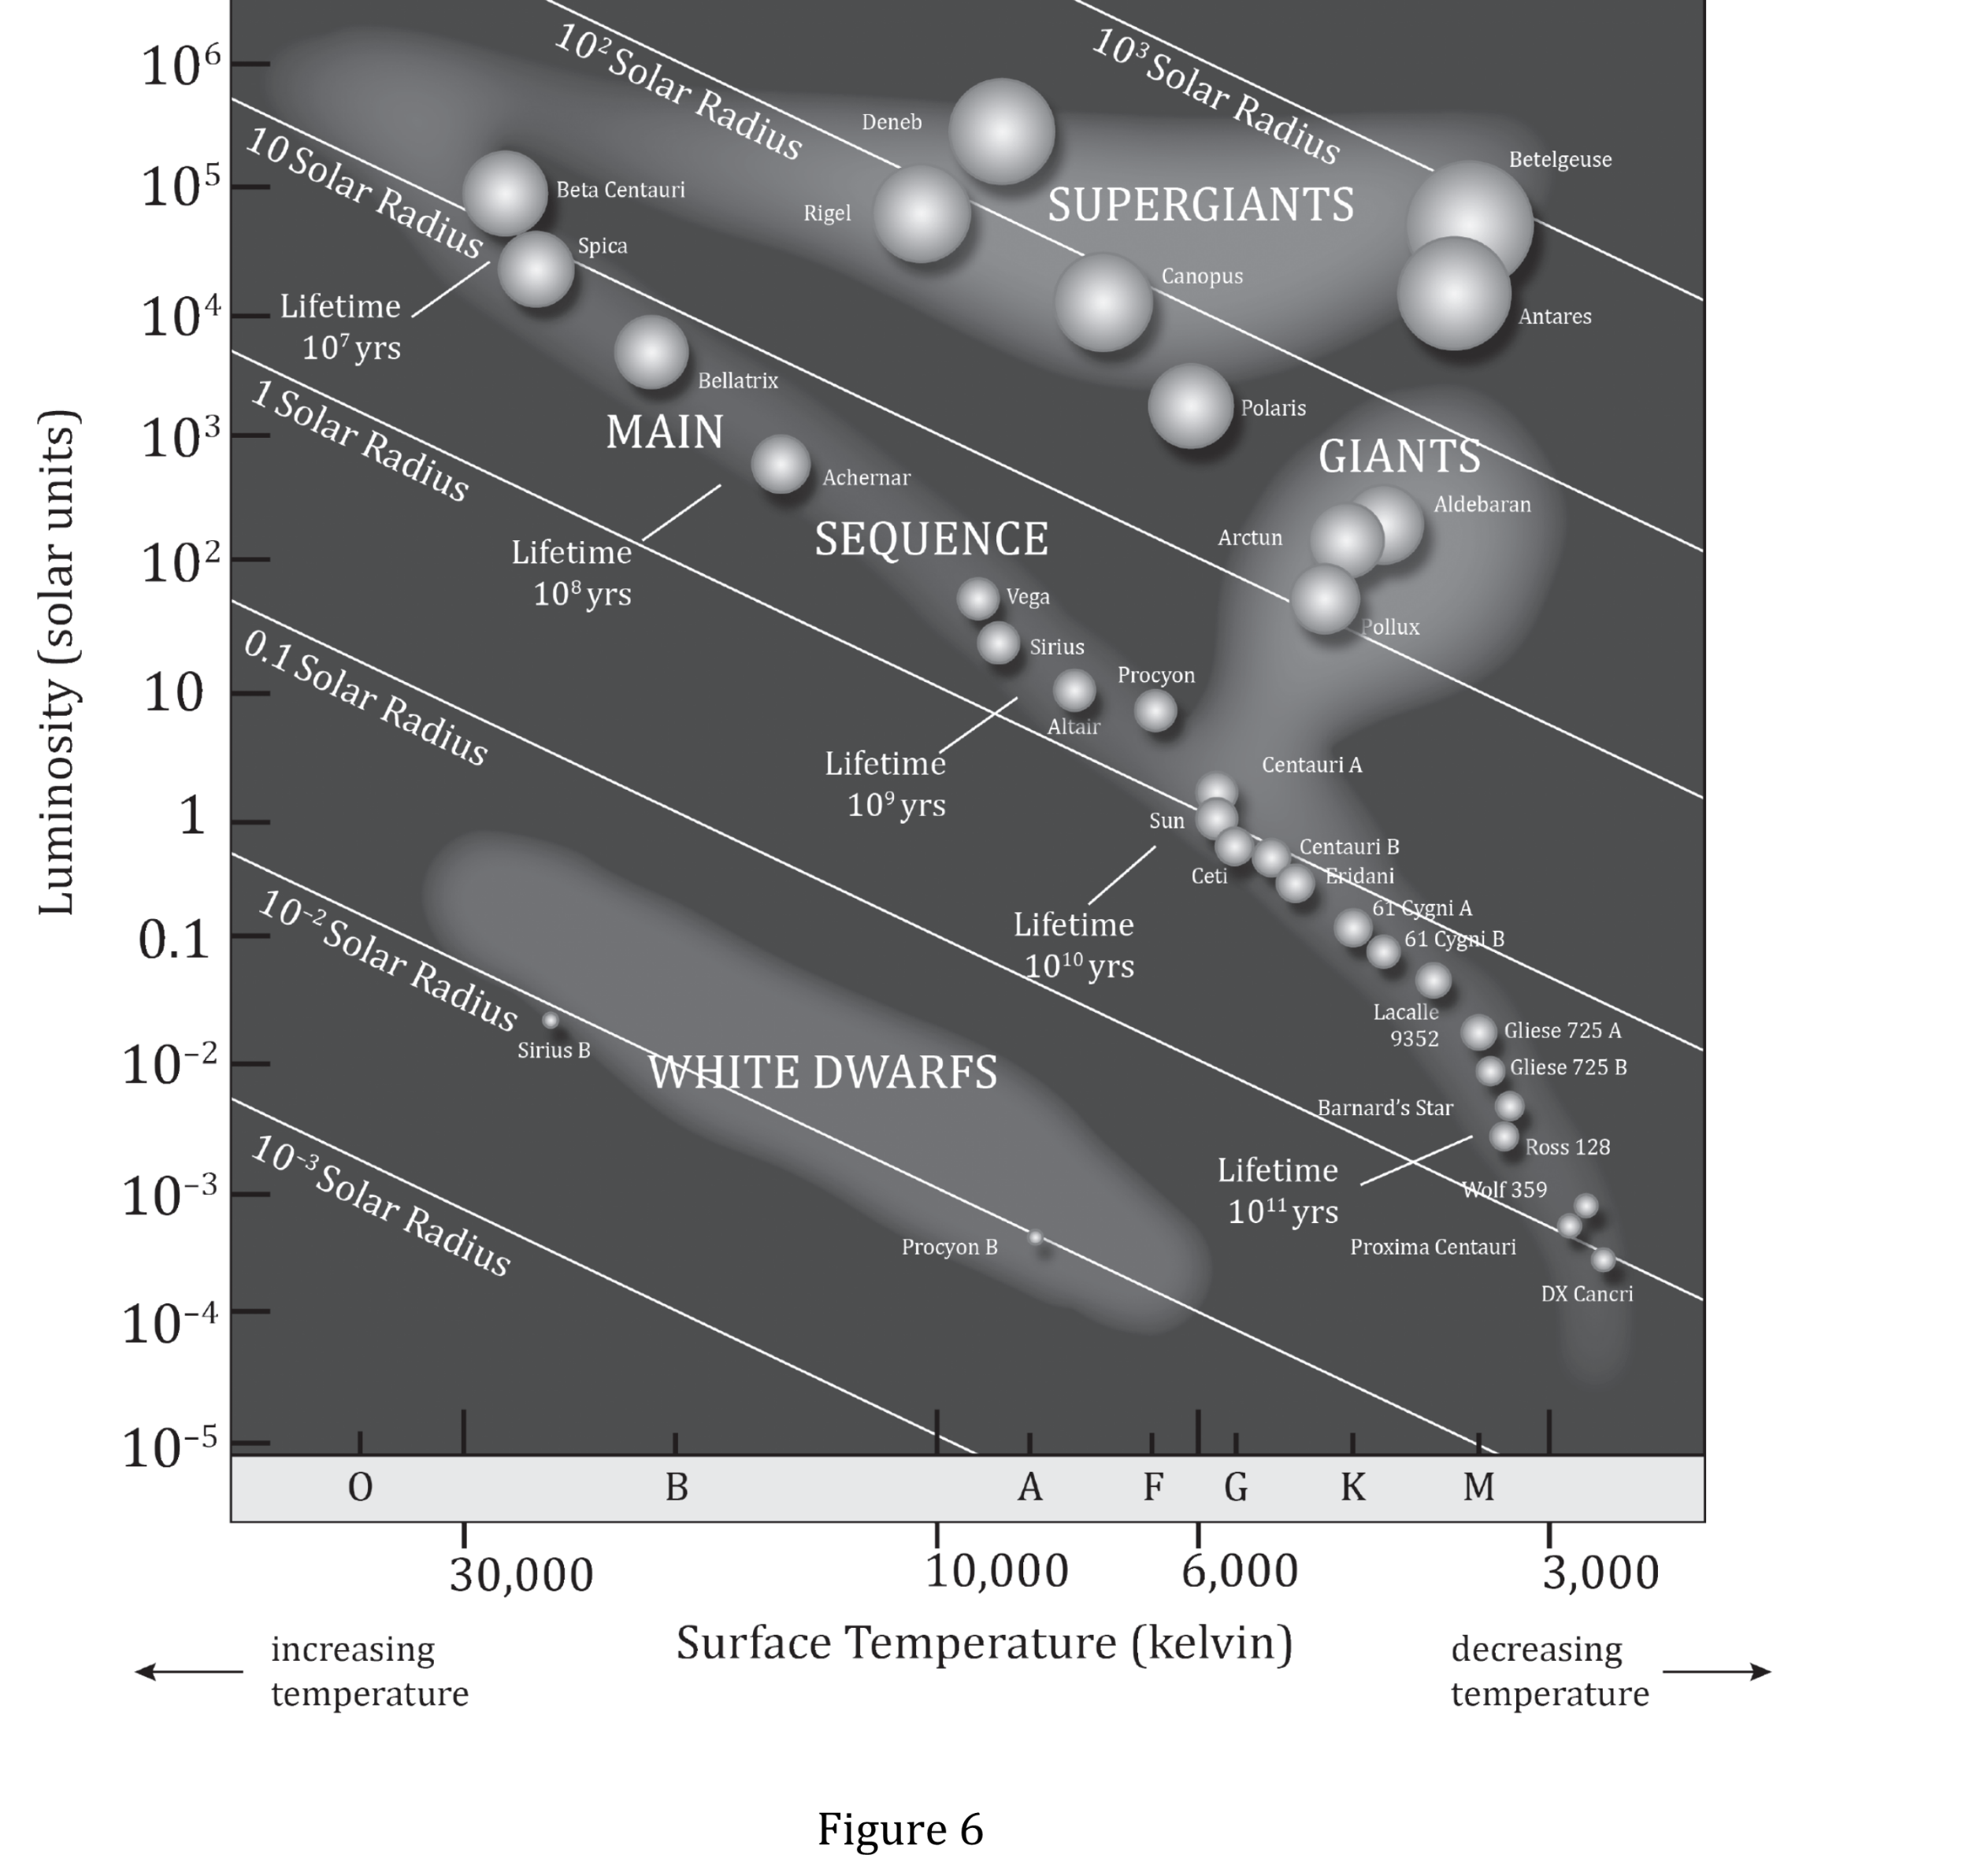
Notes:
Understand basic scientific terms; Read and interpret data in more complex data presentations. Level: Intermediate Skill Group: Scientific Investigation

Slide 3
Notes:
Understand basic scientific terms; Read and interpret data in more complex data presentations. Level: Intermediate Skill Group: Scientific Investigation

Slide 4
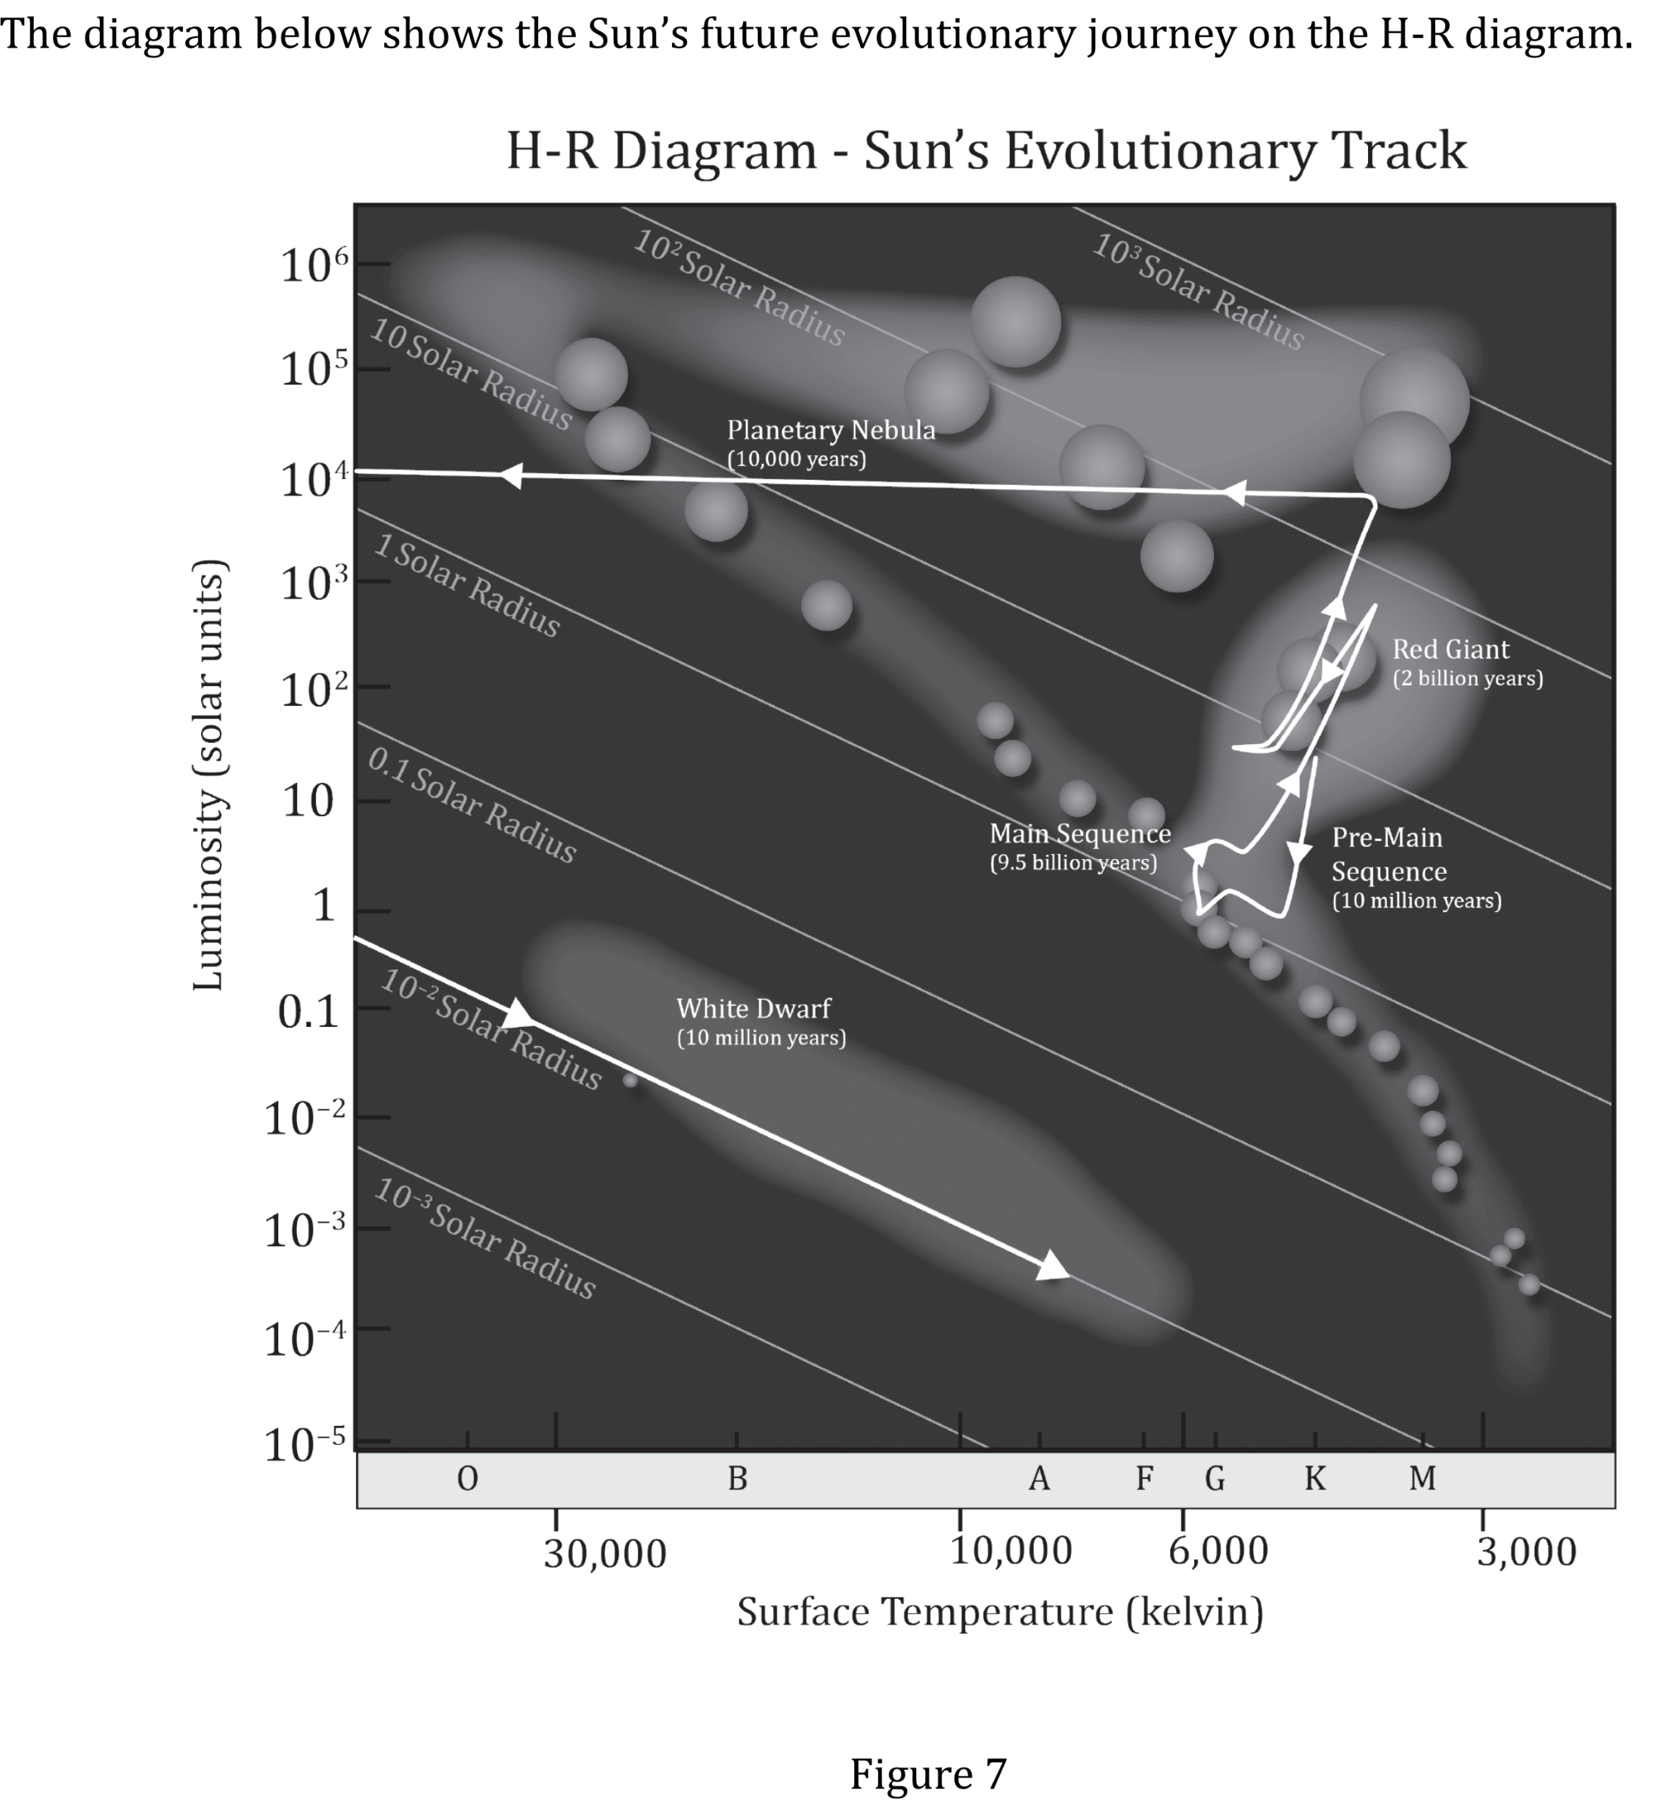
Notes:
Understand basic scientific terms; Read and interpret data in more complex data presentations. Level: Intermediate Skill Group: Scientific Investigation

Slide 5
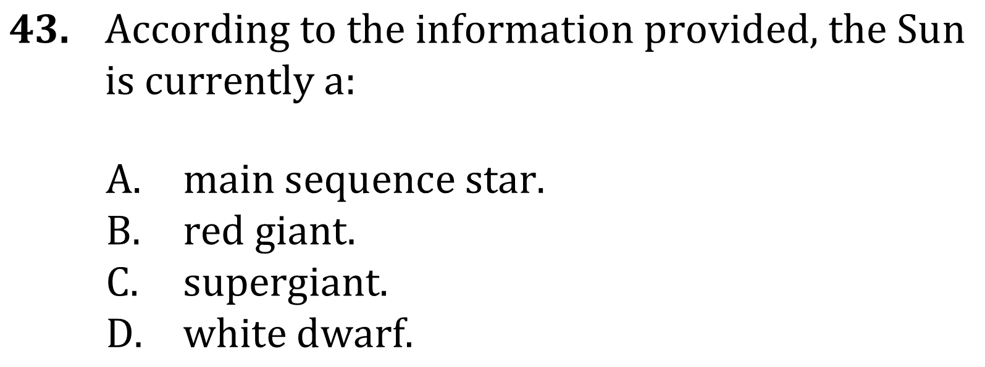
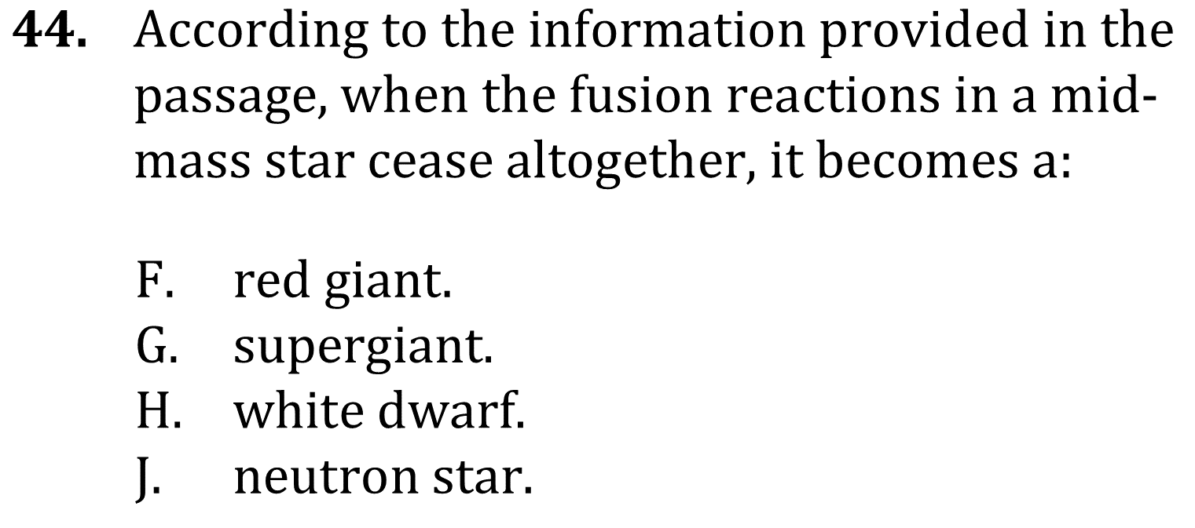
Notes:
Understand basic scientific terms; Read and interpret data in more complex data presentations. Level: Intermediate Skill Group: Scientific Investigation

Slide 6
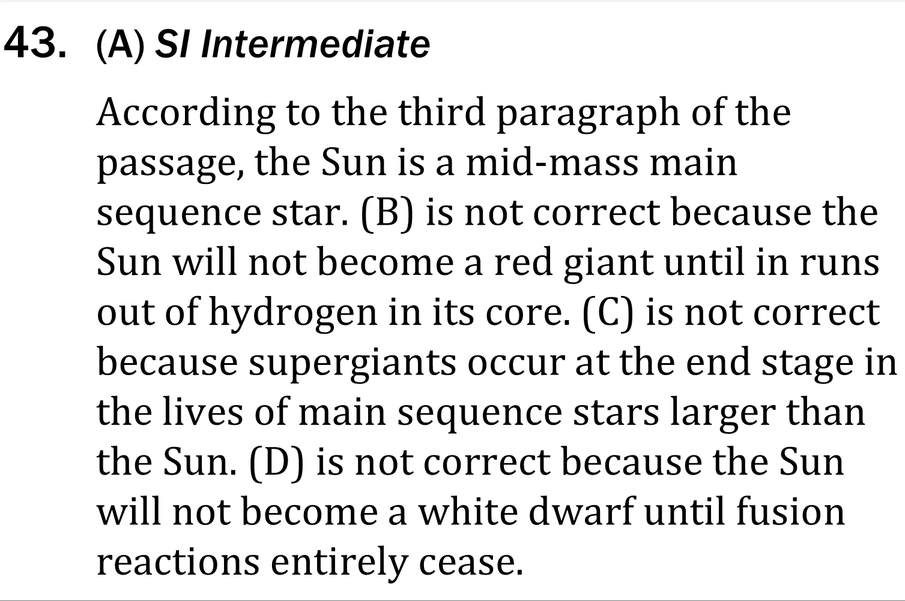
Notes:
Understand basic scientific terms; Read and interpret data in more complex data presentations. Level: Intermediate Skill Group: Scientific Investigation

Slide 7
Notes:
Understand basic scientific terms; Read and interpret data in more complex data presentations. Level: Intermediate Skill Group: Scientific Investigation

