Slide 1
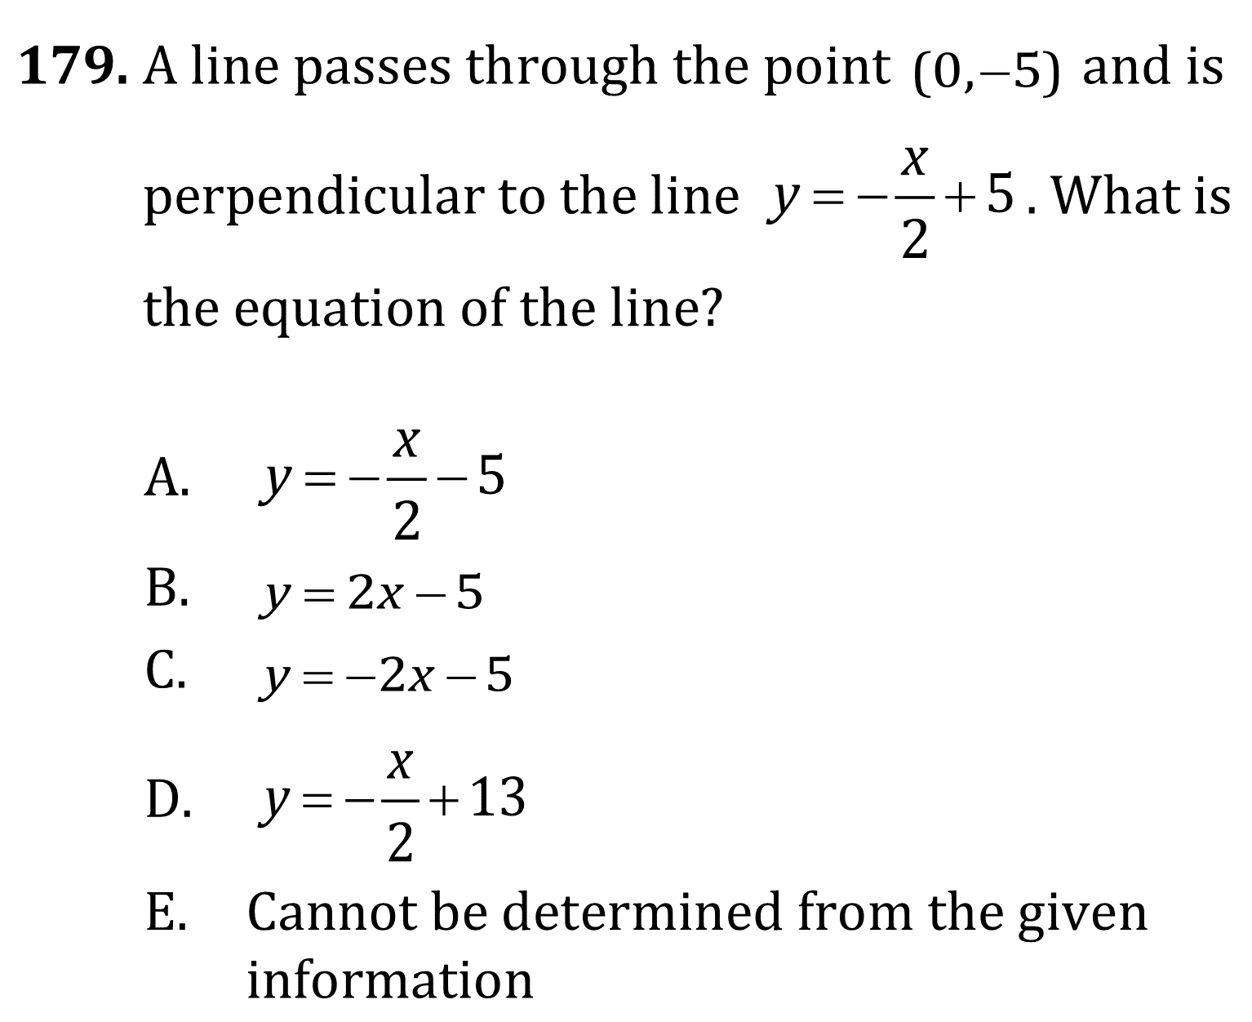

Parallel and Perpendicular Lines

Slide 2
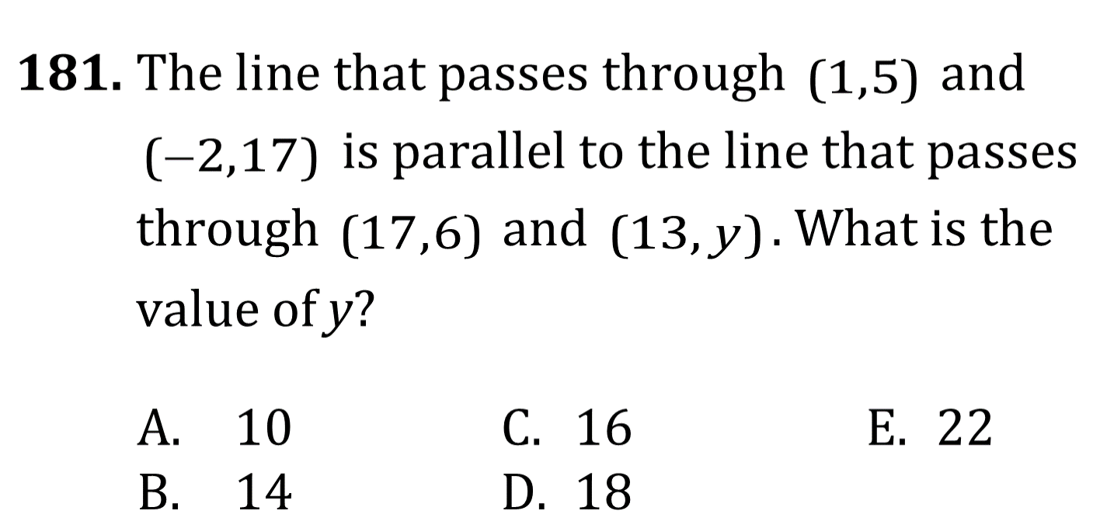
Parallel and Perpendicular Lines

Slide 3
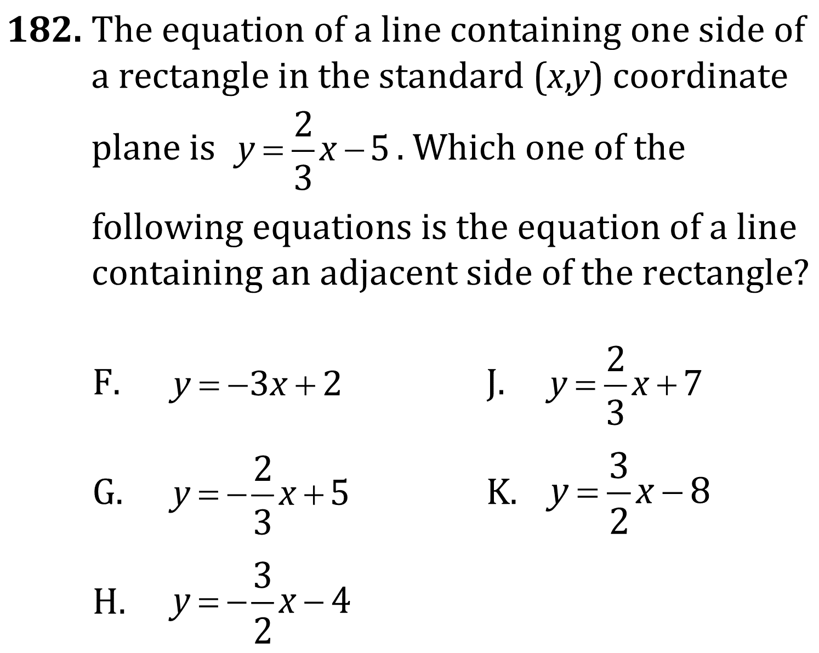
Parallel and Perpendicular Lines

Slide 4
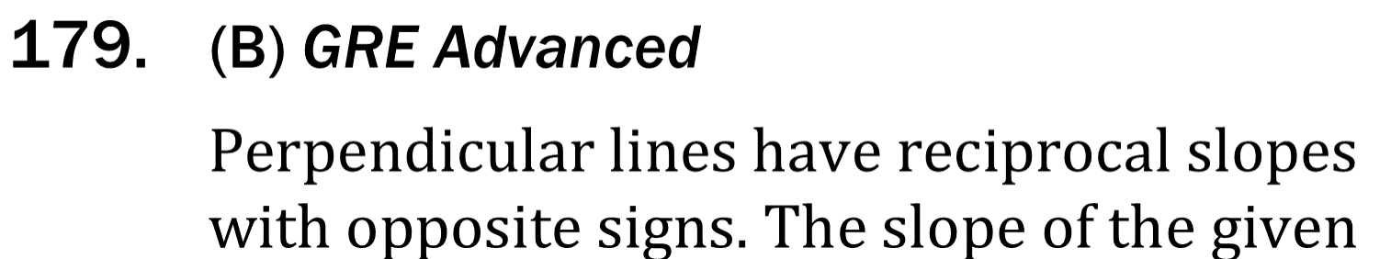
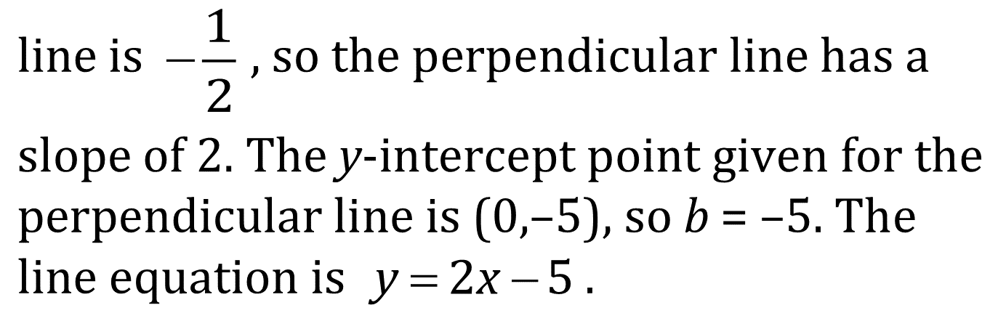
Parallel and Perpendicular Lines

Slide 5

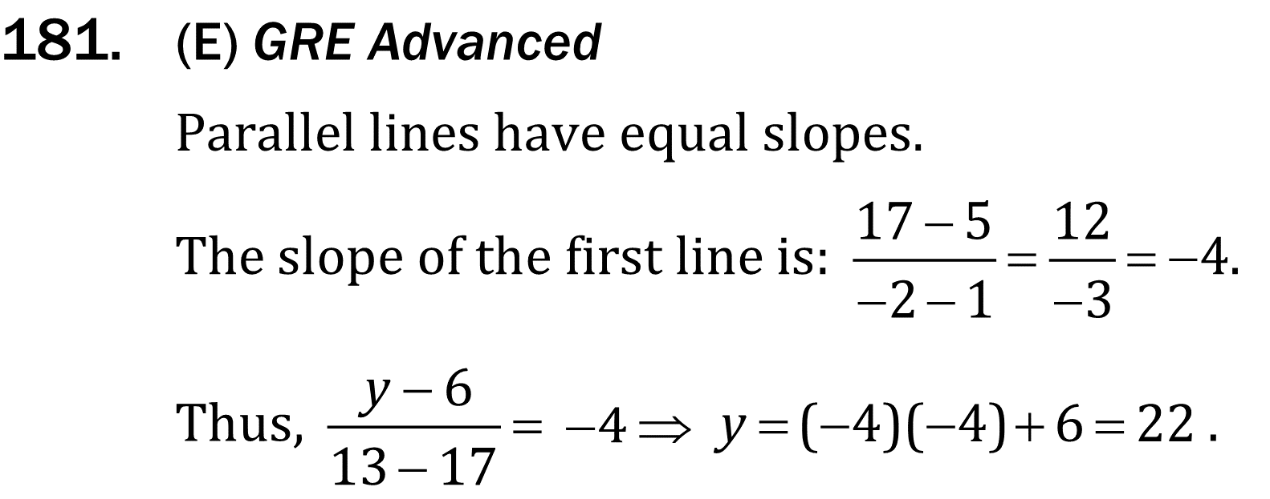
Parallel and Perpendicular Lines

Slide 6
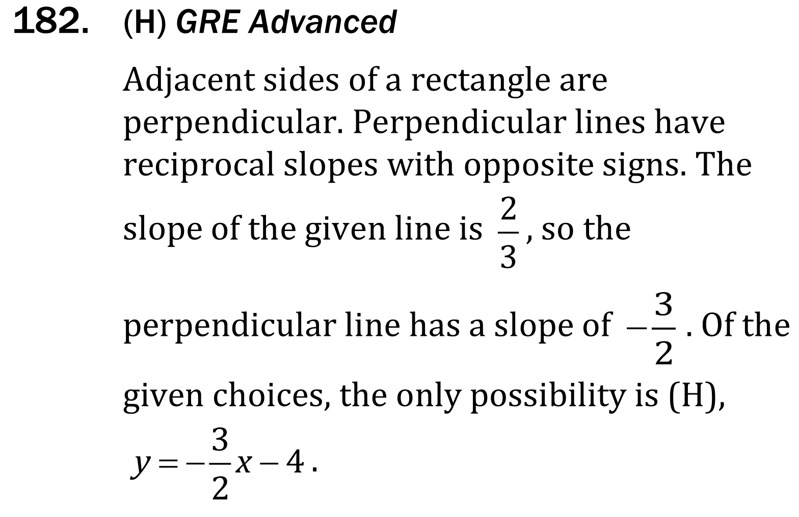
Parallel and Perpendicular Lines

