Slide 1
Simplify redundant phrasings

Slide 2
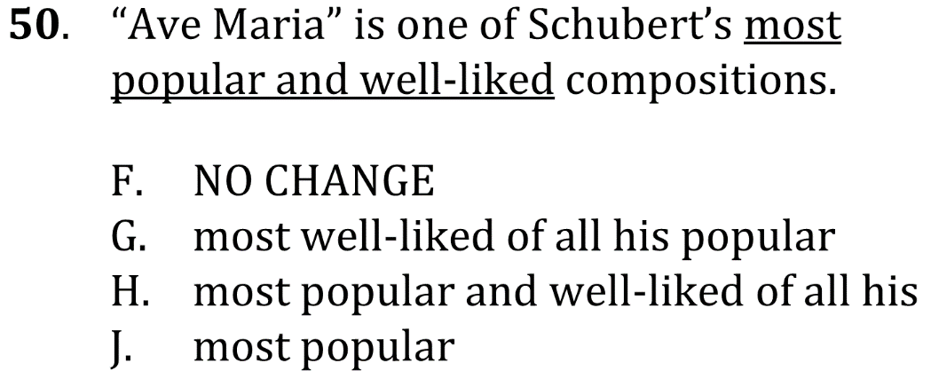
Simplify redundant phrasings

Slide 3
Simplify redundant phrasings

Slide 4
Simplify redundant phrasings

