Slide 1
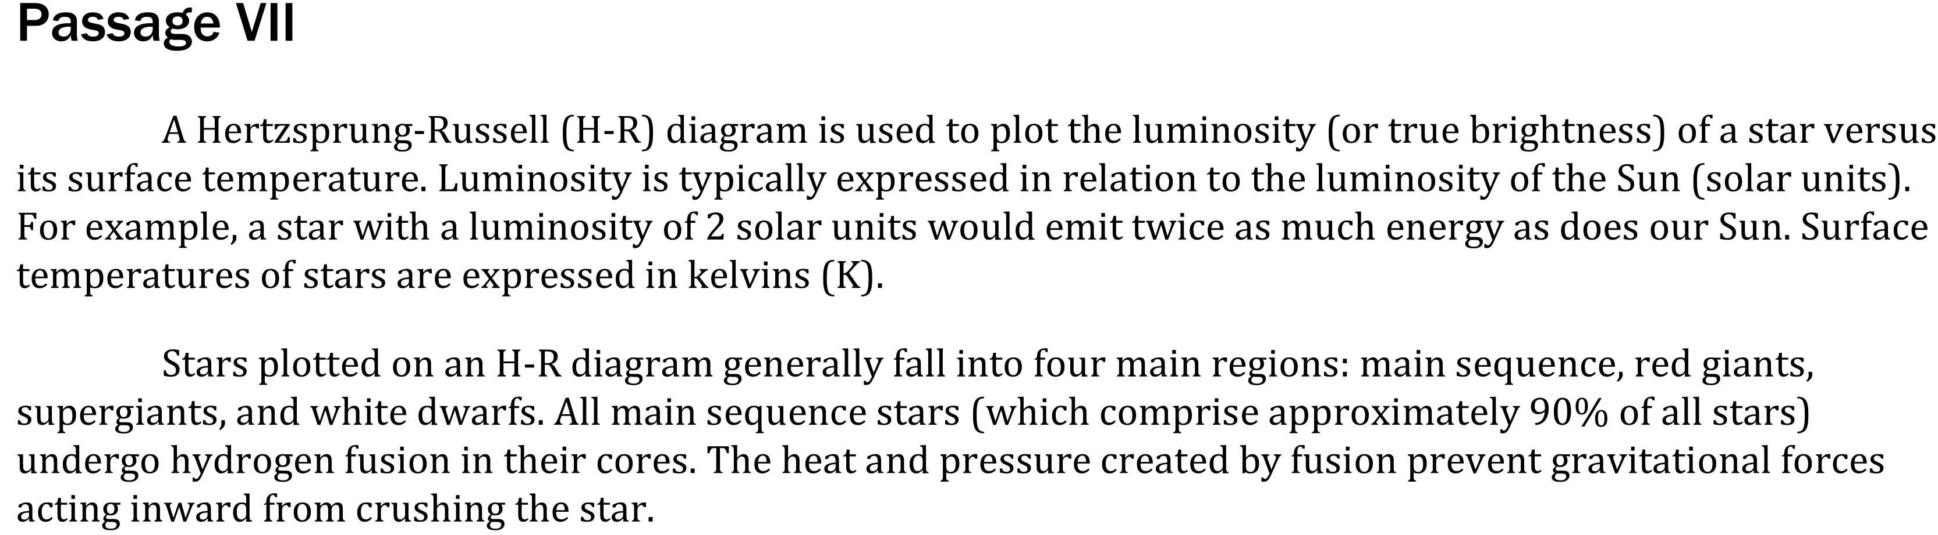

Notes:
Read and interpret data in more complex data presentations. Level: Intermediate Skill Group: Scientific Investigation

Slide 2
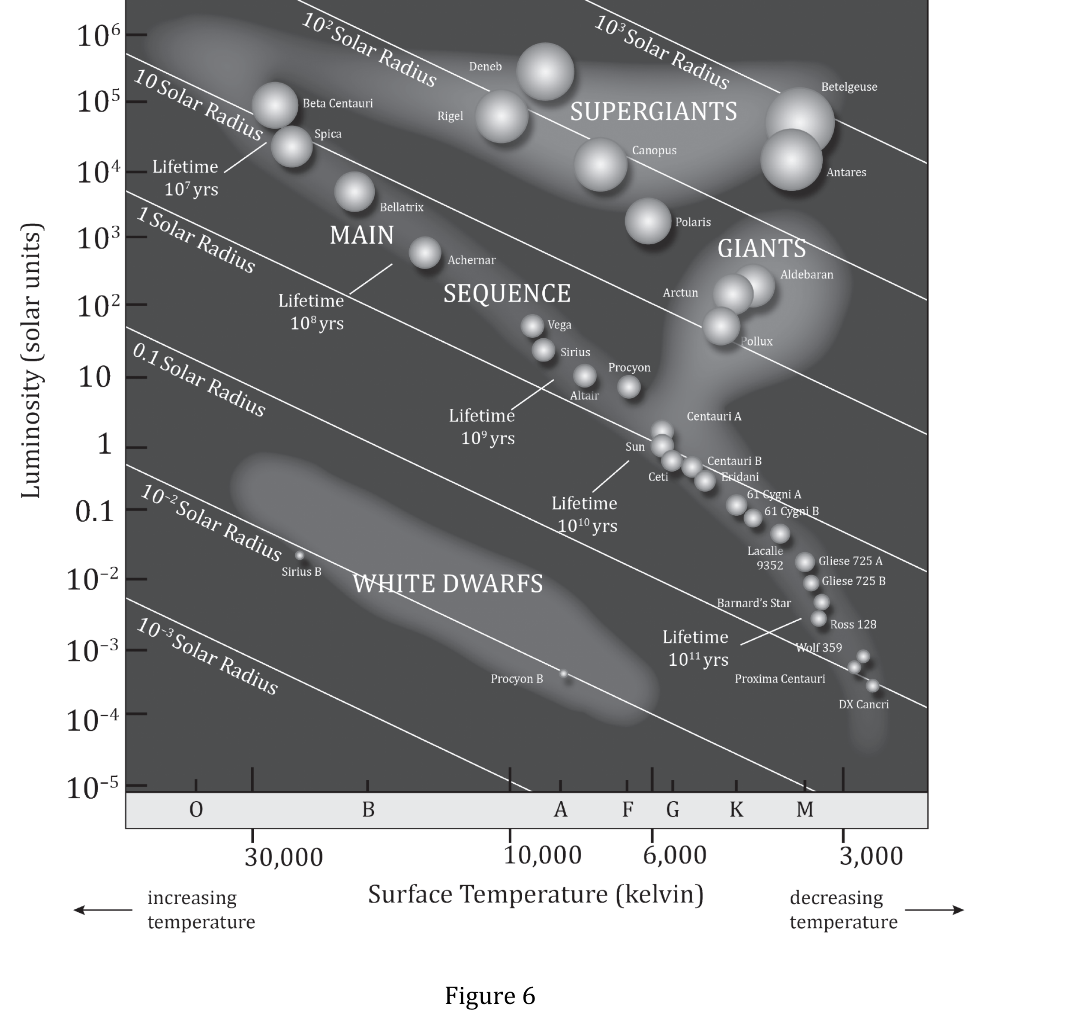
Notes:
Read and interpret data in more complex data presentations. Level: Intermediate Skill Group: Scientific Investigation

Slide 3
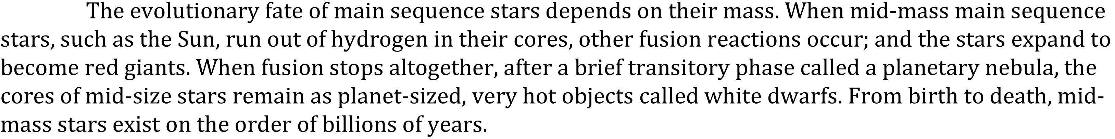
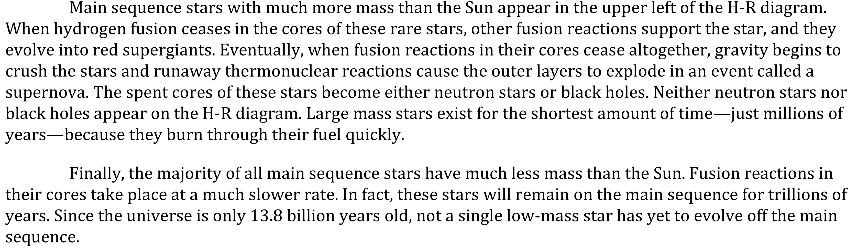
Notes:
Read and interpret data in more complex data presentations. Level: Intermediate Skill Group: Scientific Investigation

Slide 4
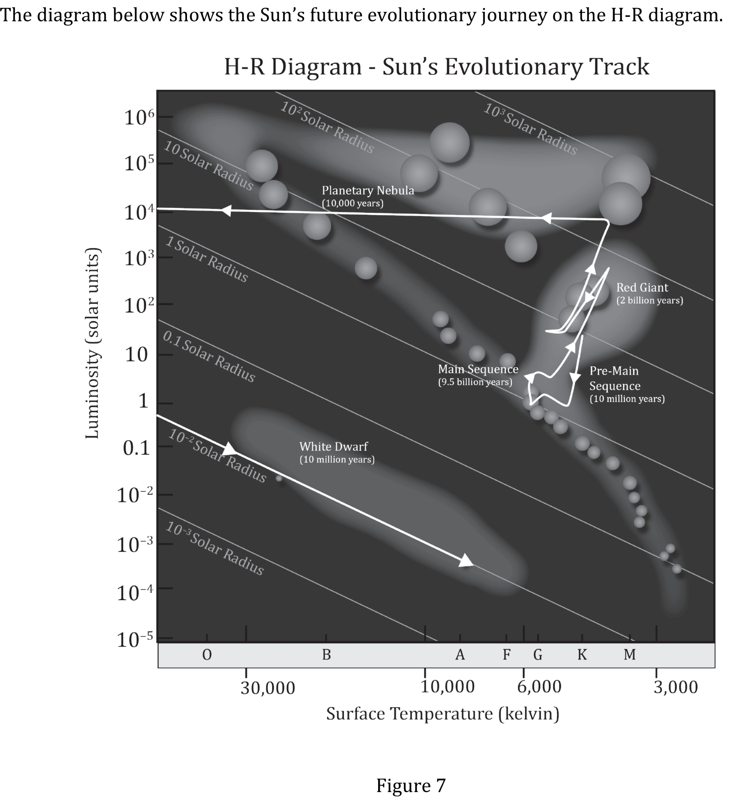
Notes:
Read and interpret data in more complex data presentations. Level: Intermediate Skill Group: Scientific Investigation

Slide 5
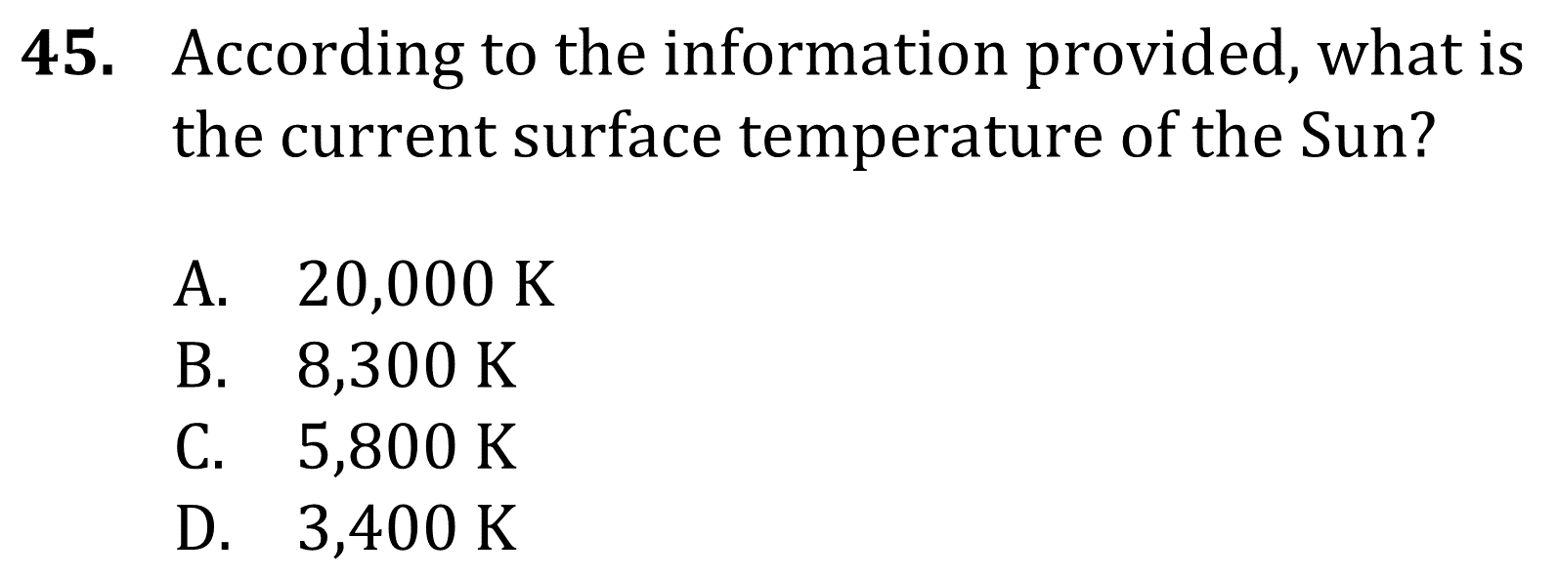
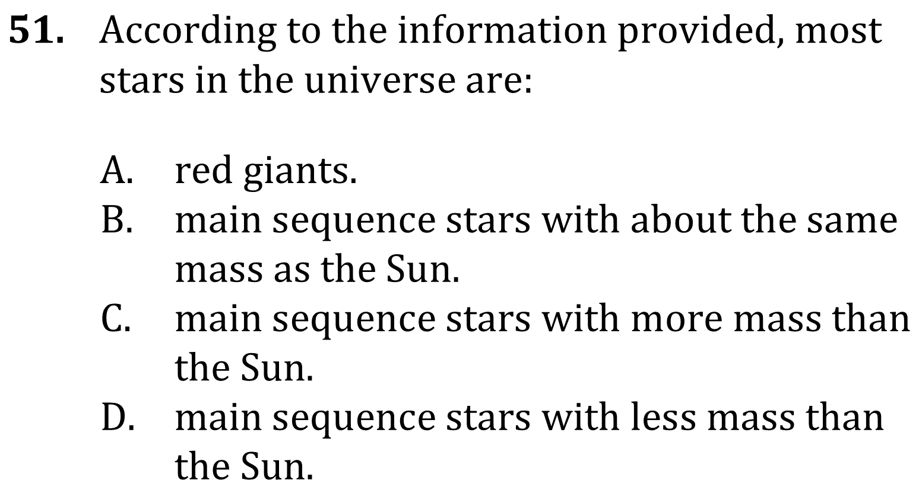
Notes:
Read and interpret data in more complex data presentations. Level: Intermediate Skill Group: Scientific Investigation

Slide 6
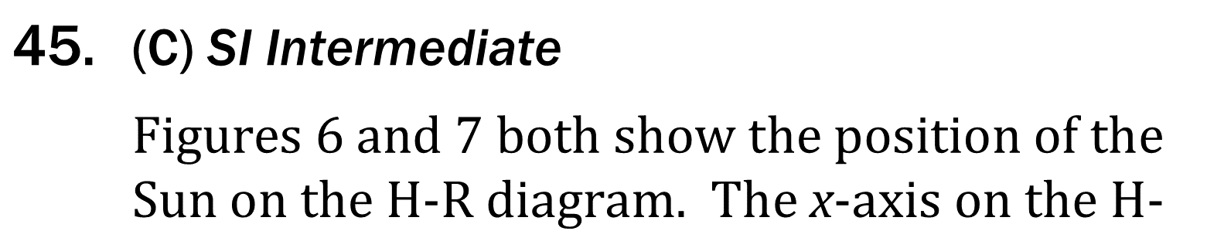
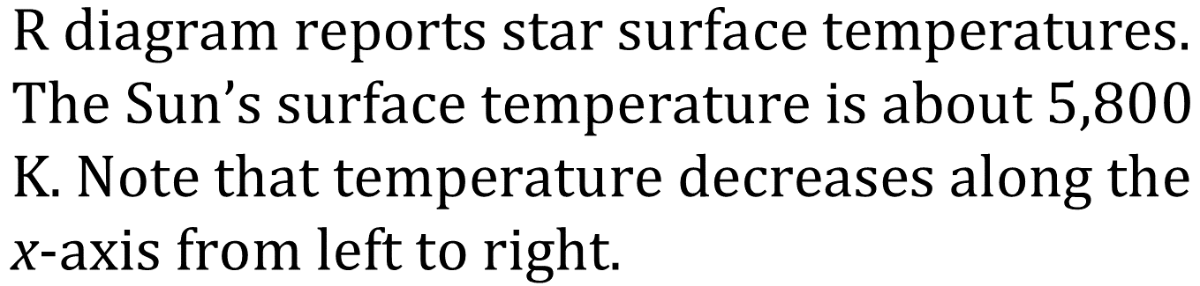
Notes:
Read and interpret data in more complex data presentations. Level: Intermediate Skill Group: Scientific Investigation

Slide 7
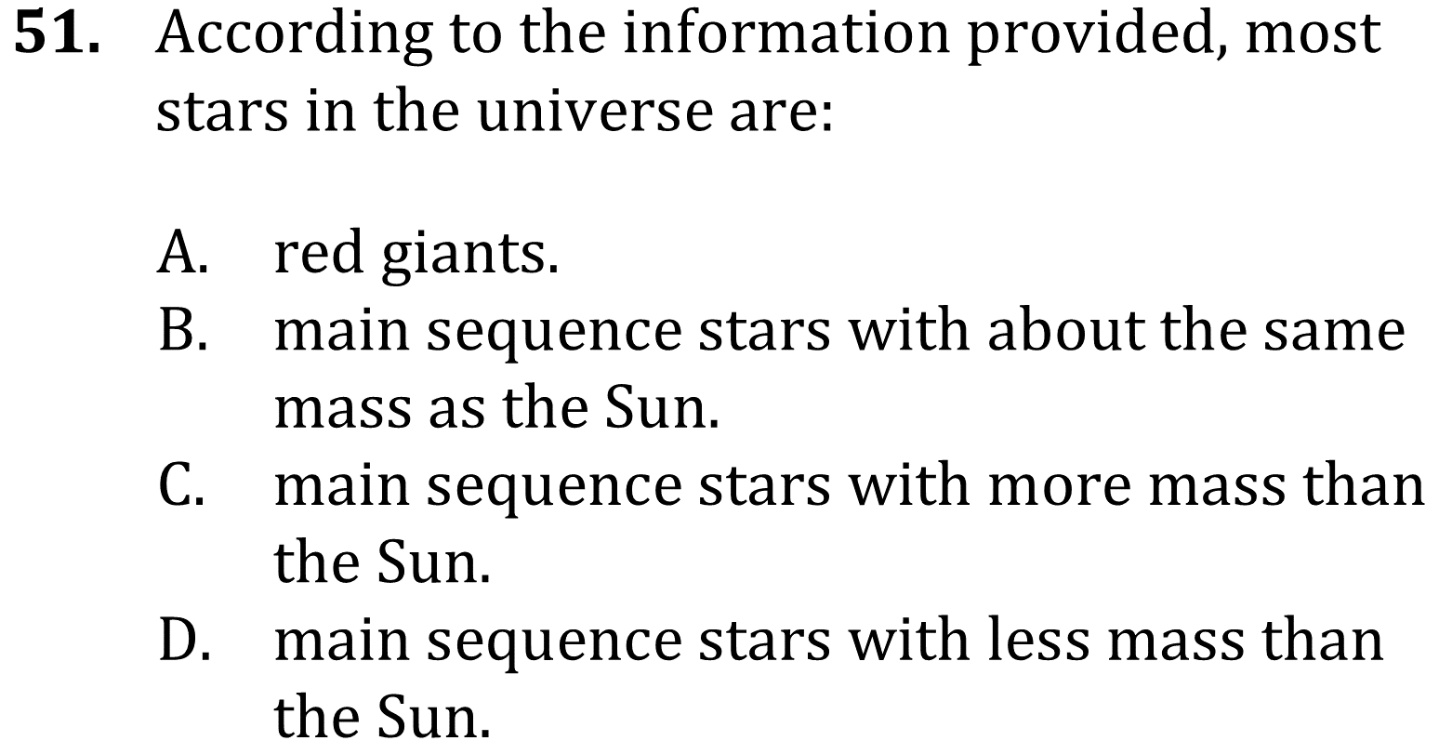
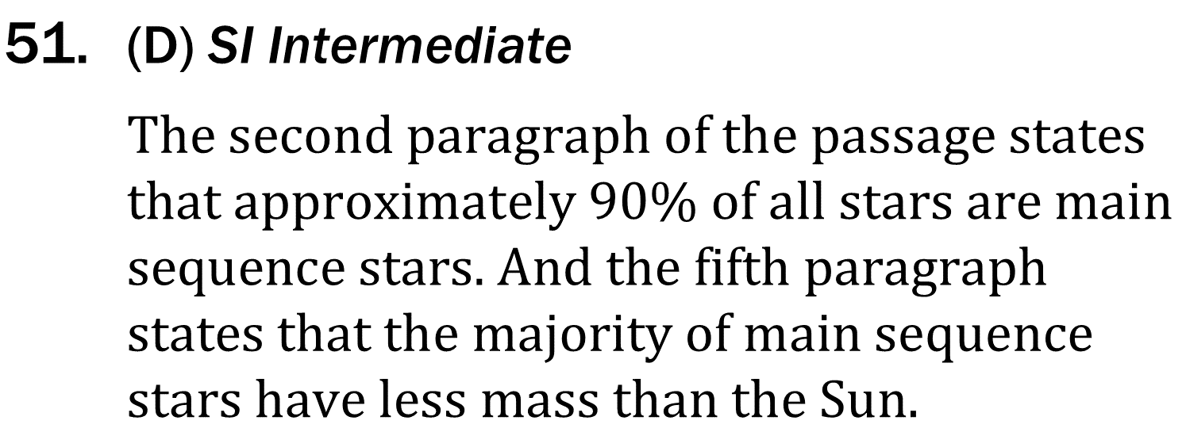
Notes:
Read and interpret data in more complex data presentations. Level: Intermediate Skill Group: Scientific Investigation

