Slide 1
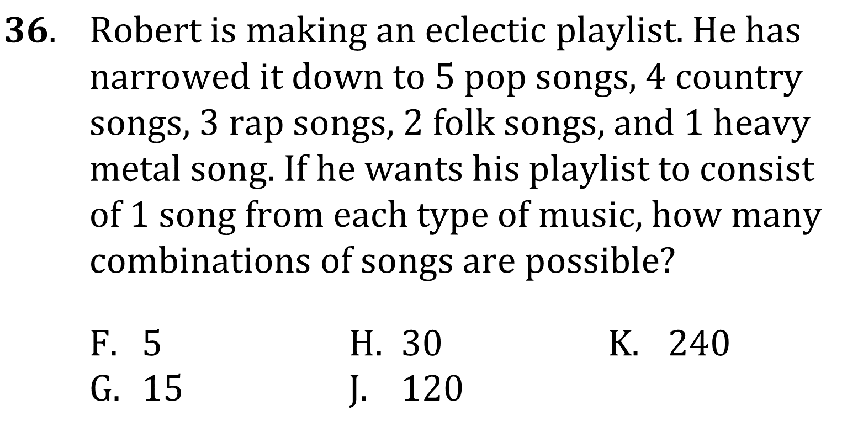
Counting and Venn Diagrams

Slide 2
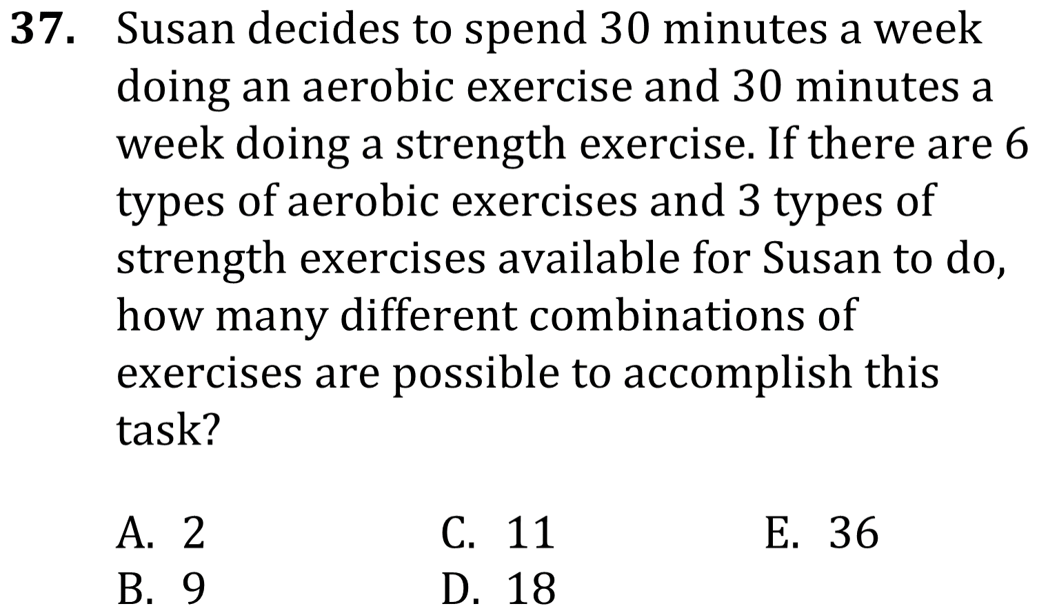
Counting and Venn Diagrams

Slide 3
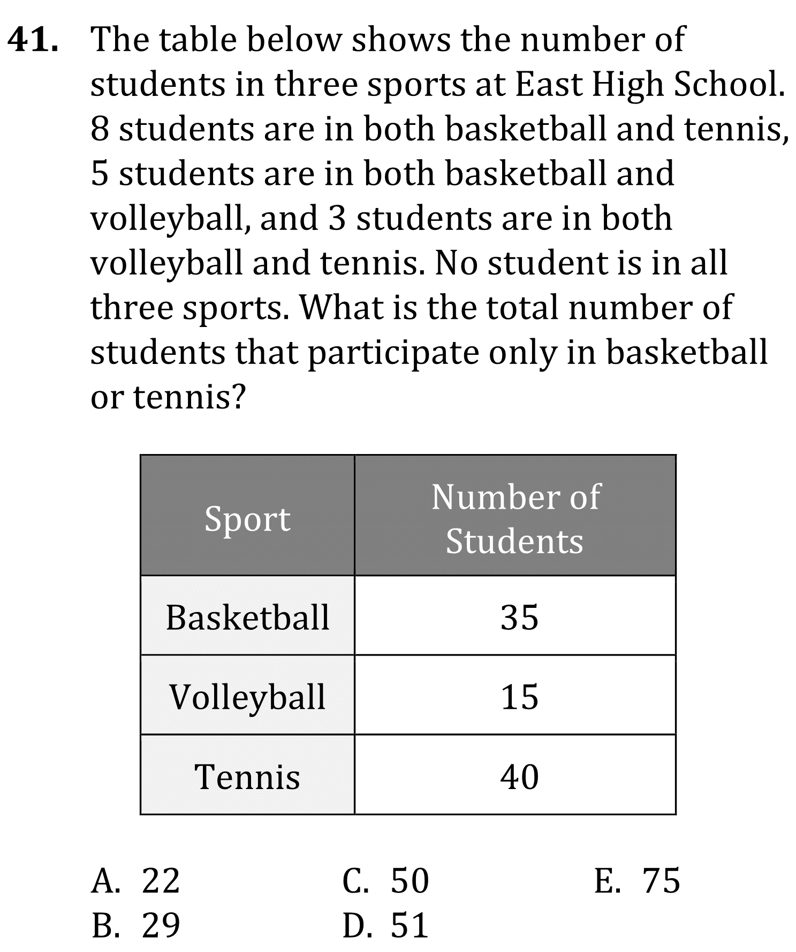
Counting and Venn Diagrams

Slide 4
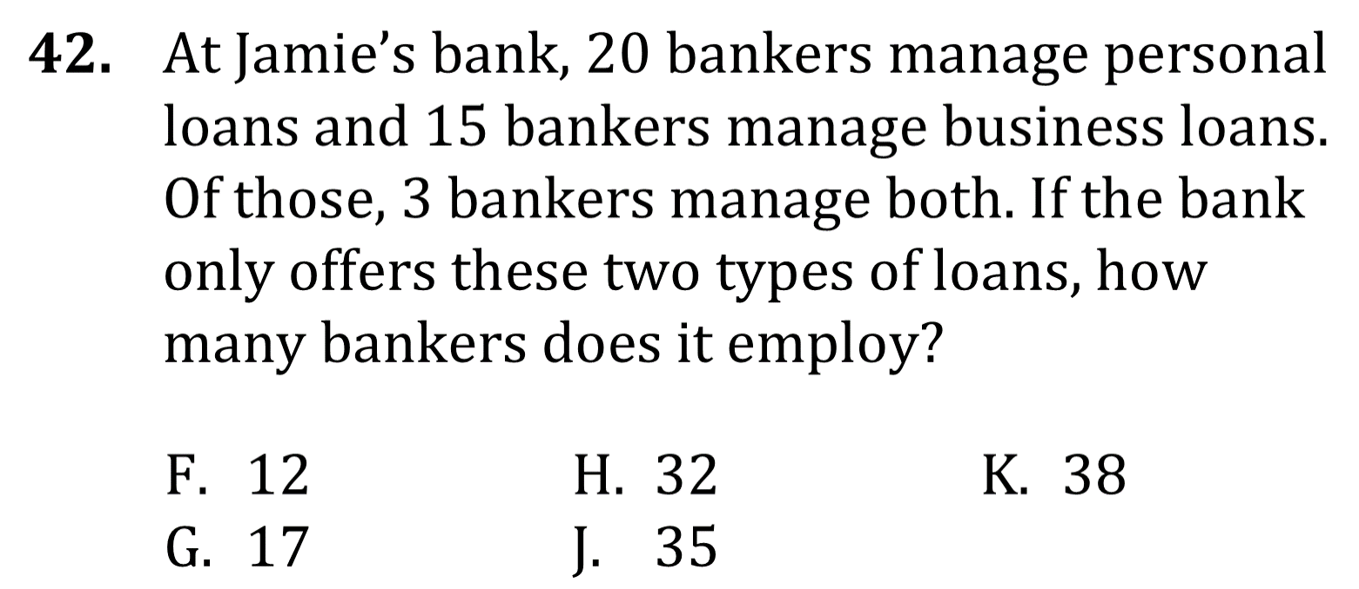
Counting and Venn Diagrams

Slide 5
Counting and Venn Diagrams

Slide 6
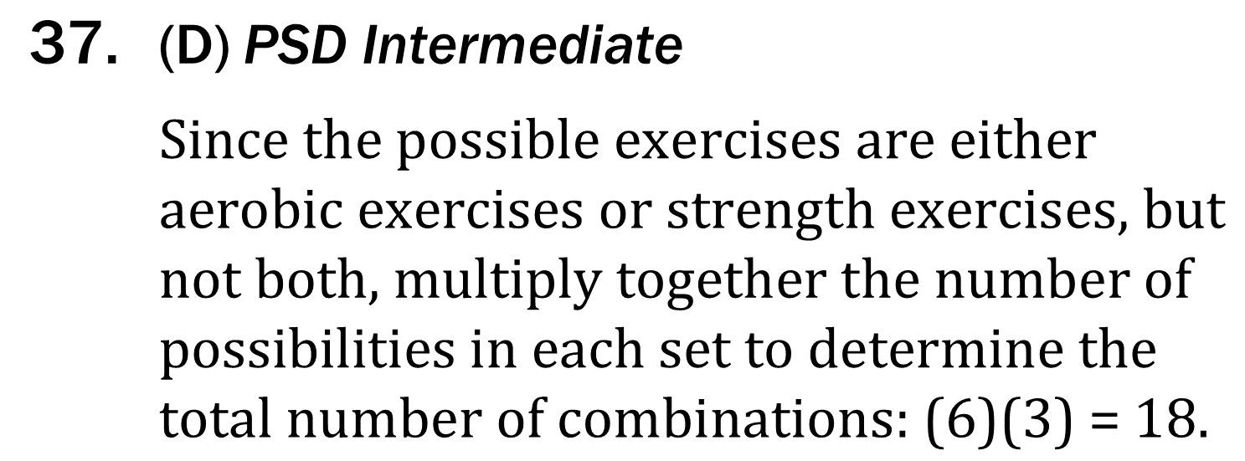
Counting and Venn Diagrams

Slide 7
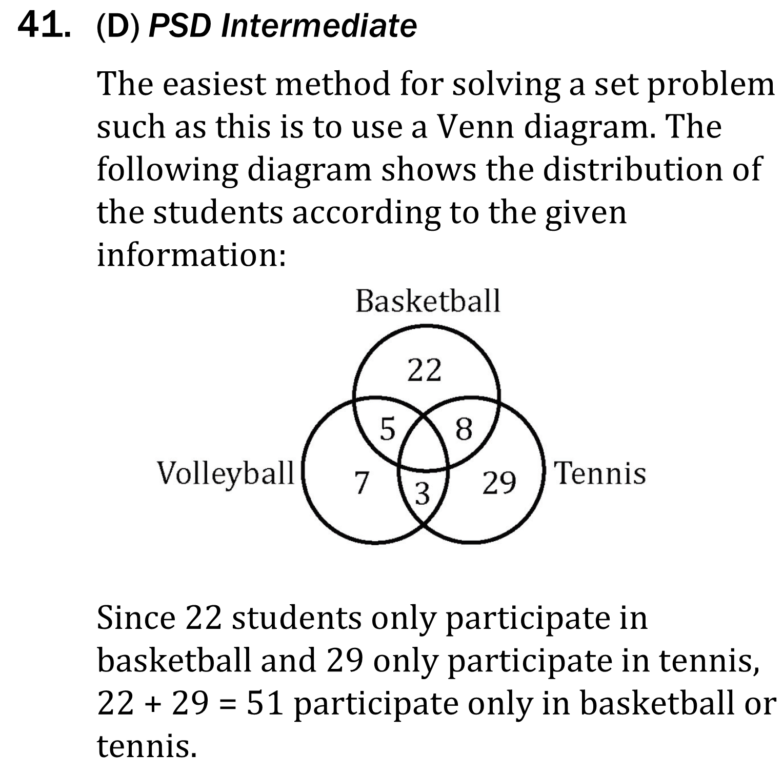
Counting and Venn Diagrams

Slide 8
Counting and Venn Diagrams

