Slide 1
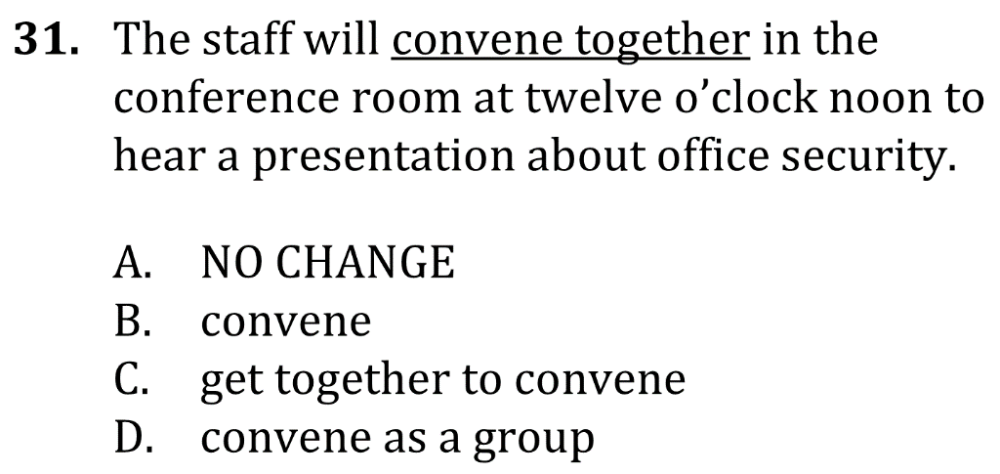

Eliminate unnecessary words

Slide 2
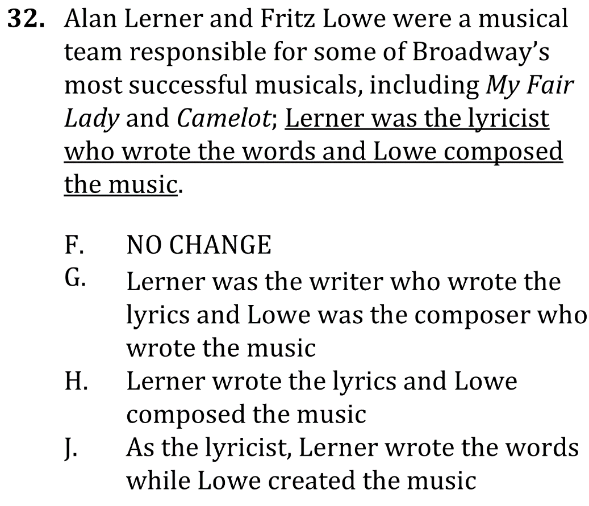
Eliminate unnecessary words

Slide 3
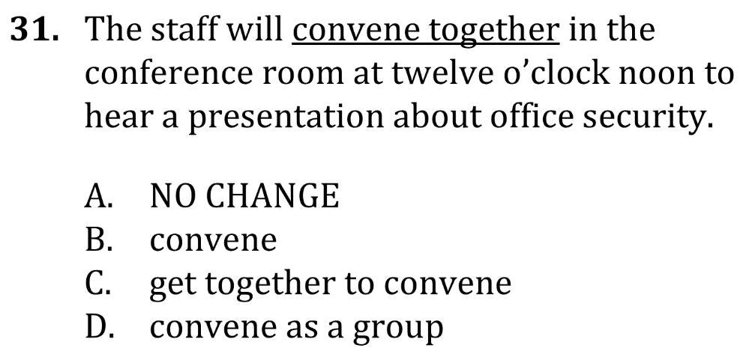
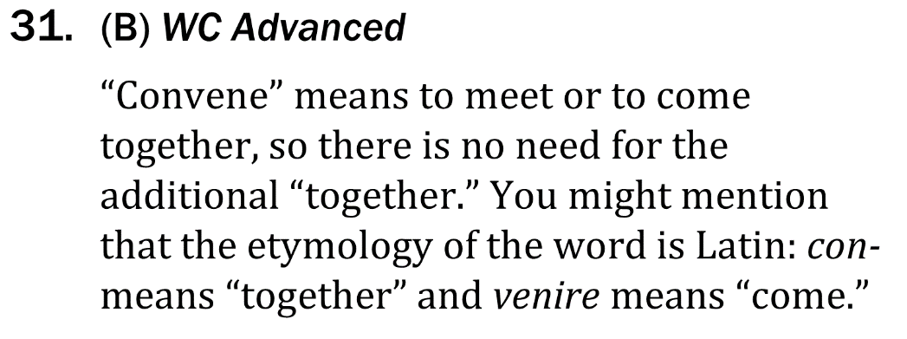
Eliminate unnecessary words

Slide 4


Eliminate unnecessary words

