Slide 1
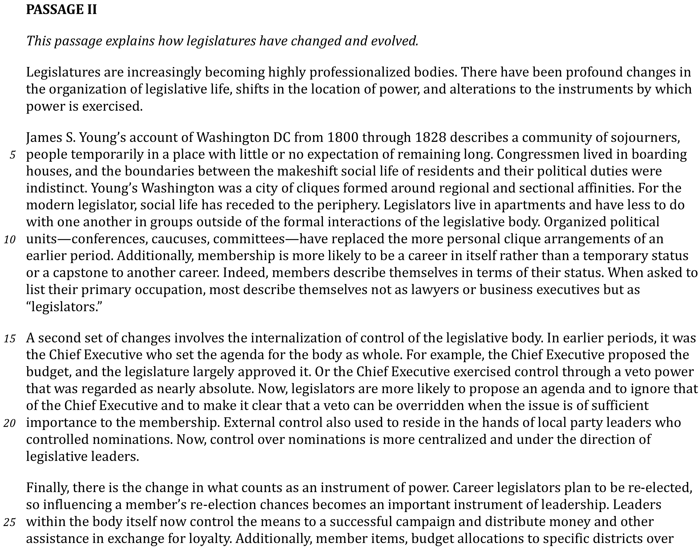

Slide 2
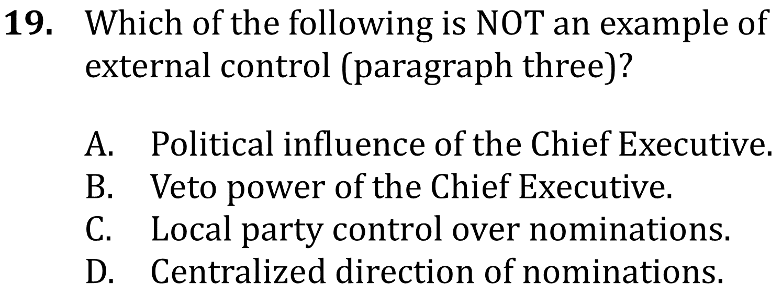
Identify Details

Slide 3
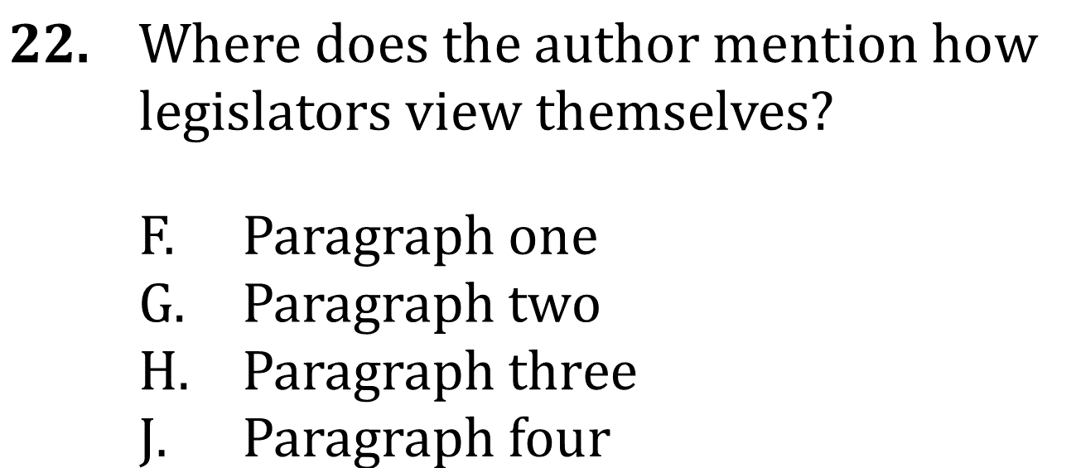
Identify Details

Slide 4
Identify Details

Slide 5
Identify Details

