Slide 1
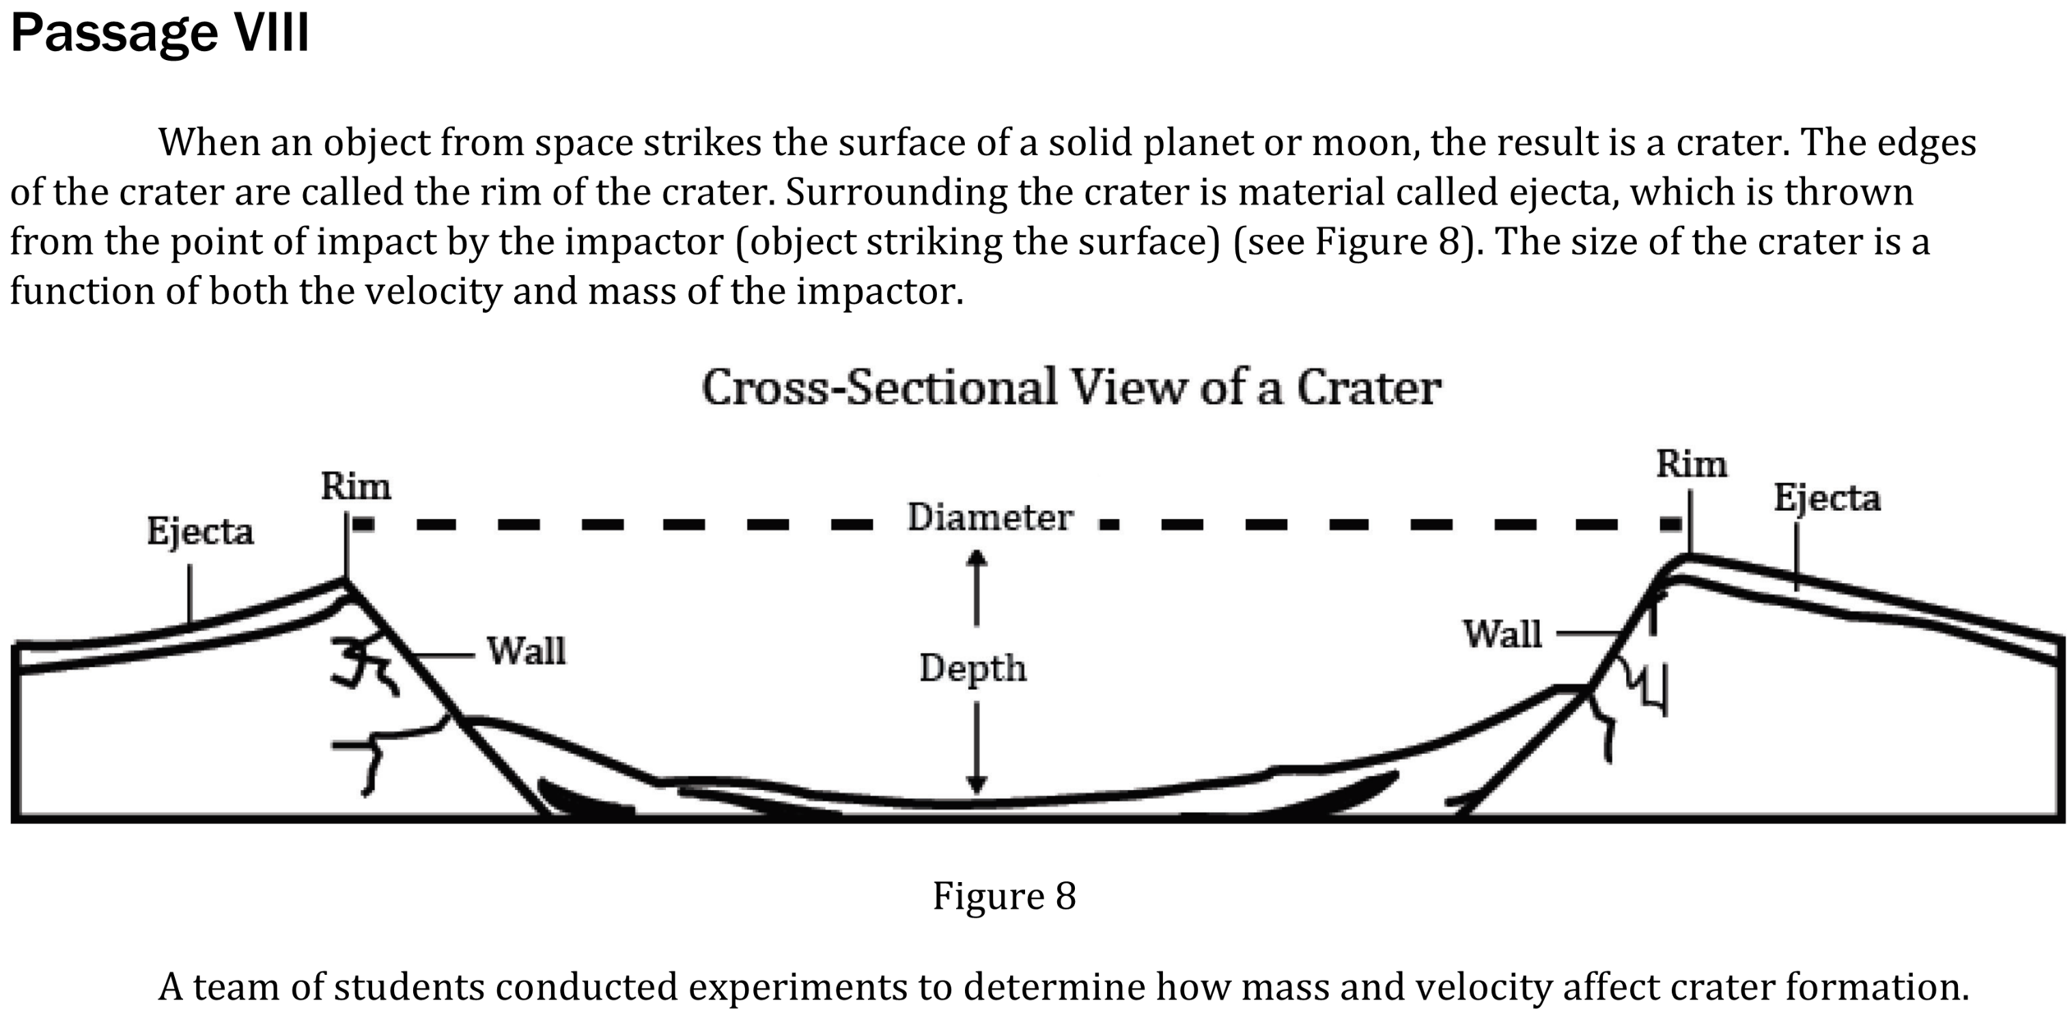
Notes:
Understand basic scientific terms; Read and interpret data in more complex data presentations. Level: Intermediate Skill Group: Scientific Investigation

Slide 2
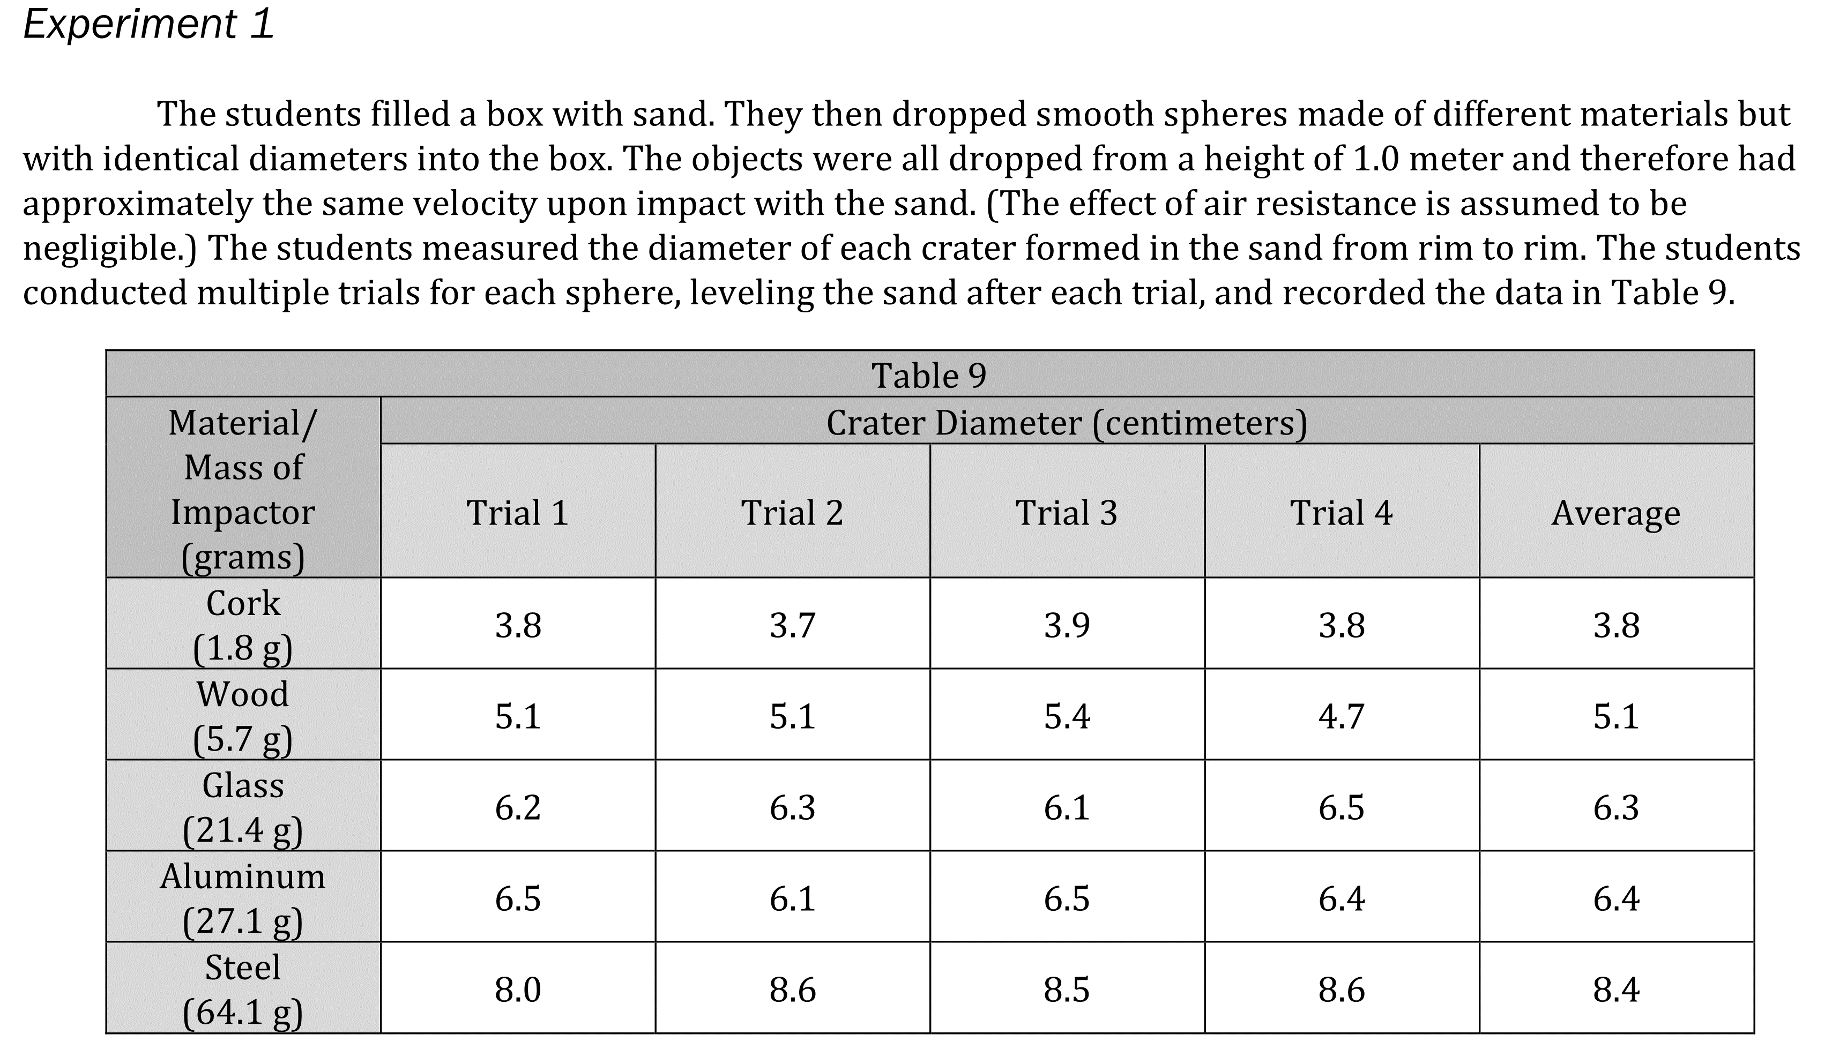
Notes:
Understand basic scientific terms; Read and interpret data in more complex data presentations. Level: Intermediate Skill Group: Scientific Investigation

Slide 3
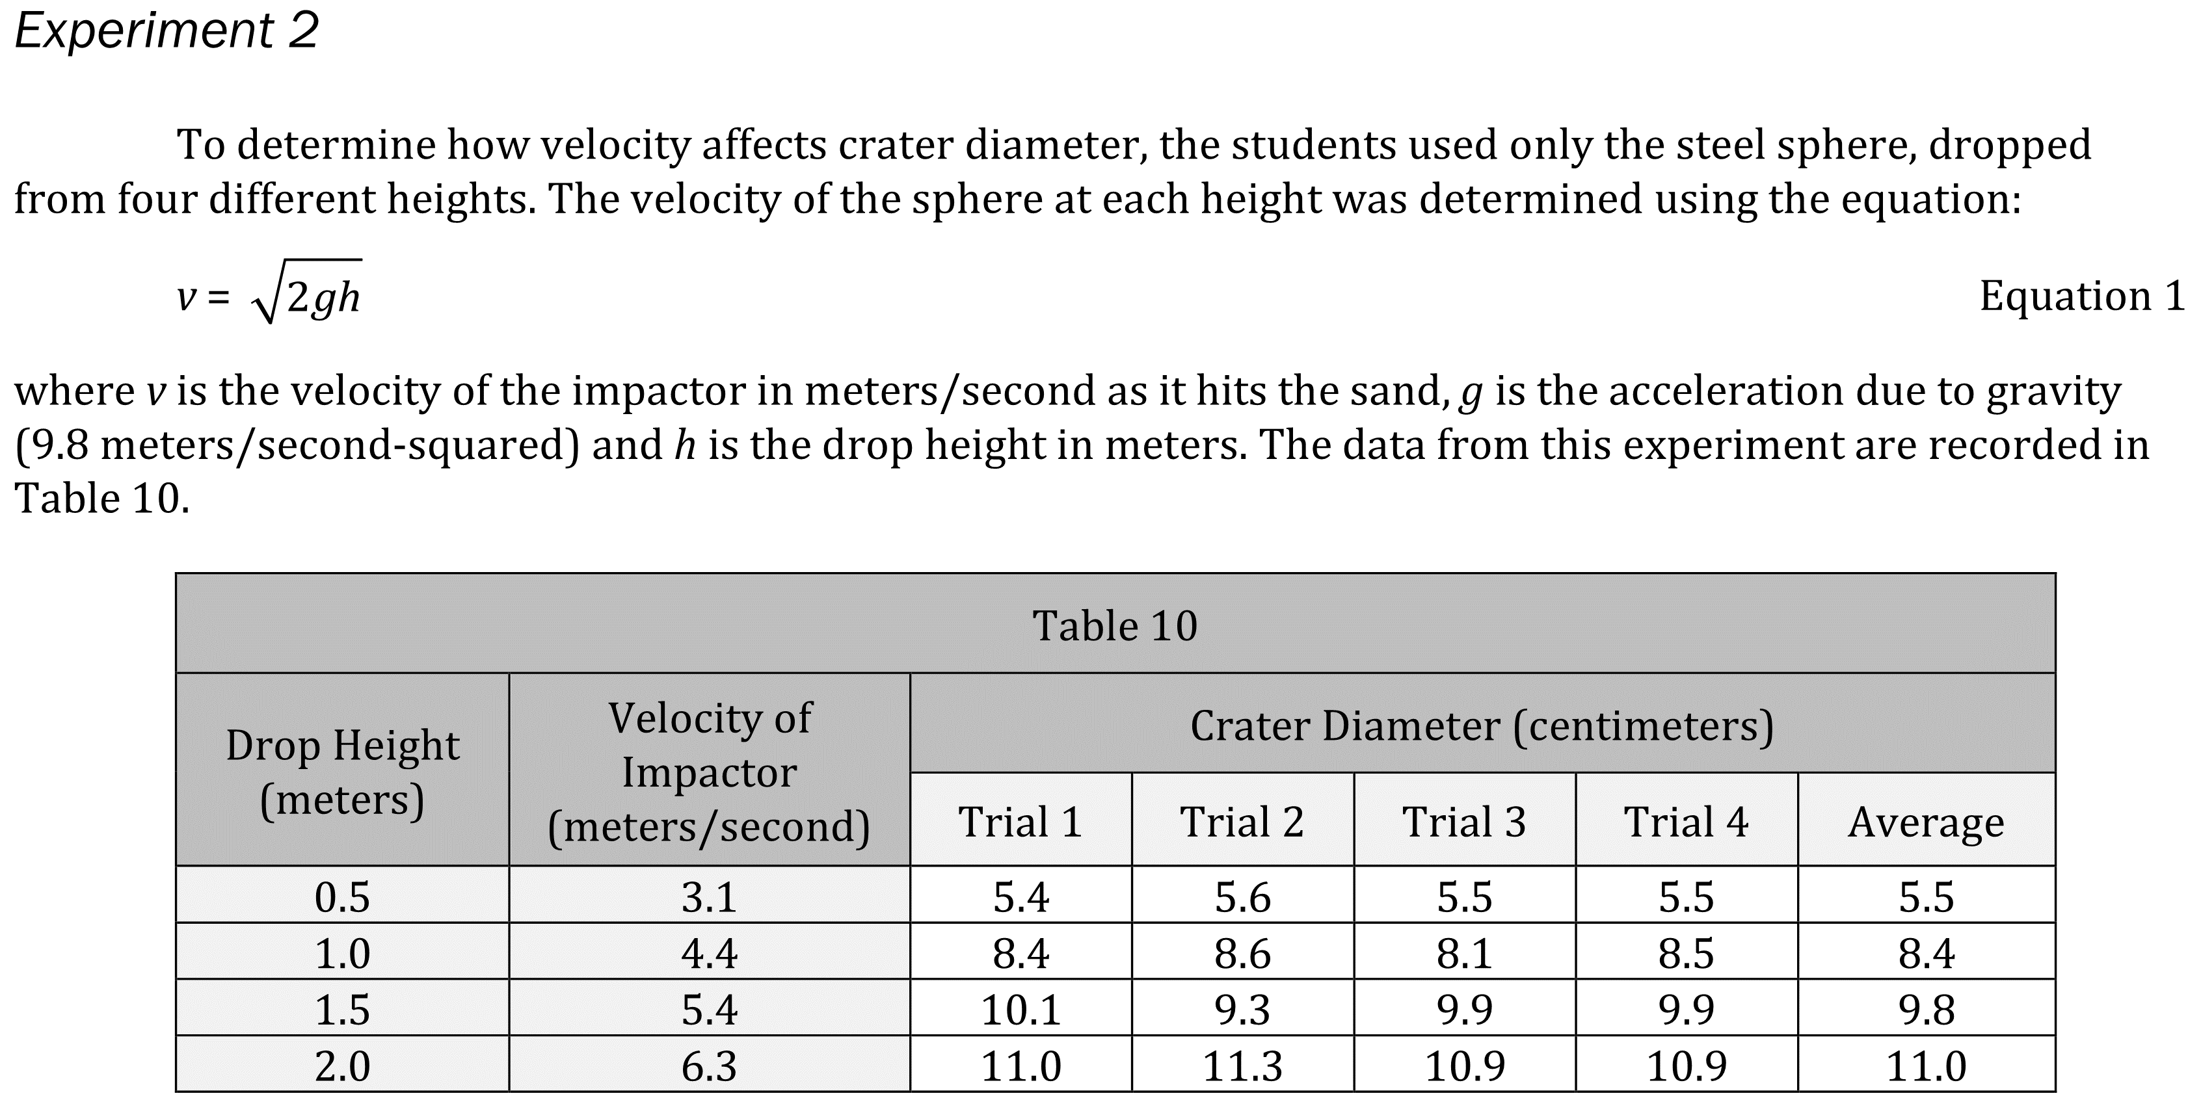
Notes:
Understand basic scientific terms; Read and interpret data in more complex data presentations. Level: Intermediate Skill Group: Scientific Investigation

Slide 4
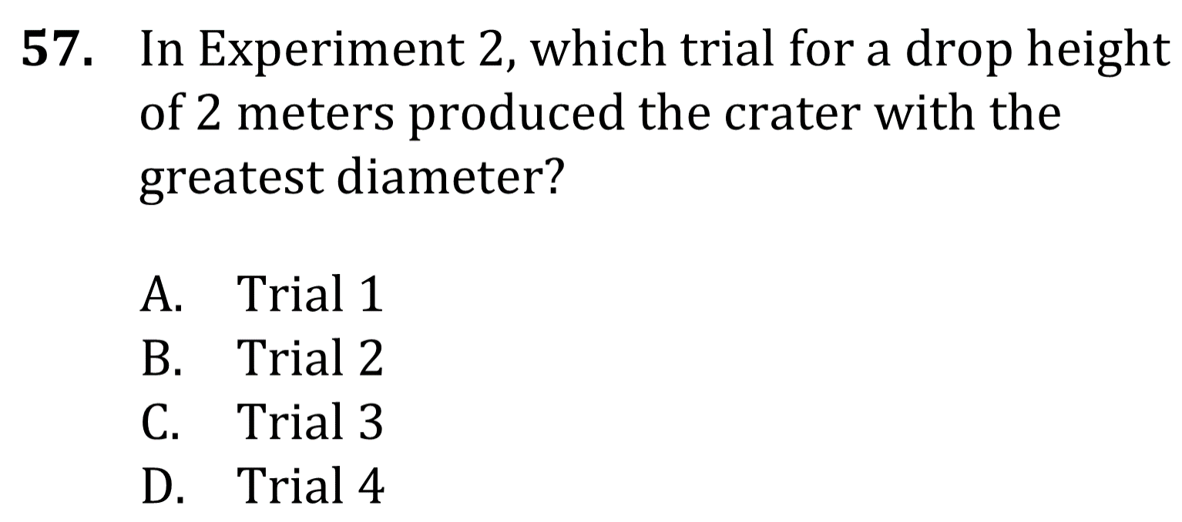
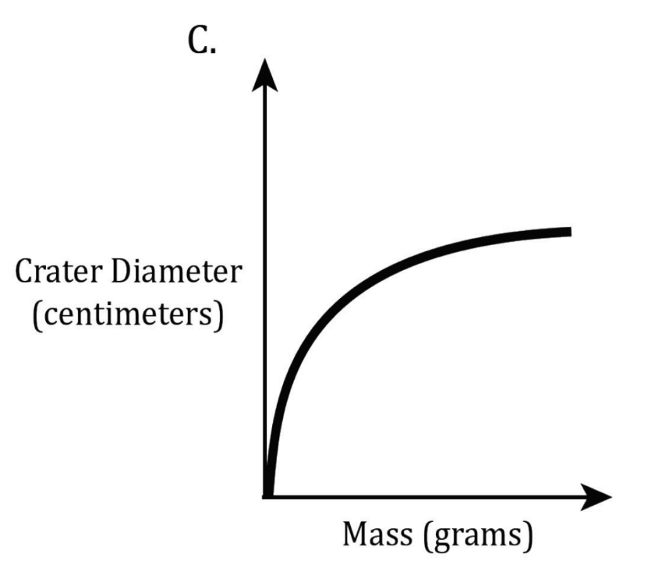
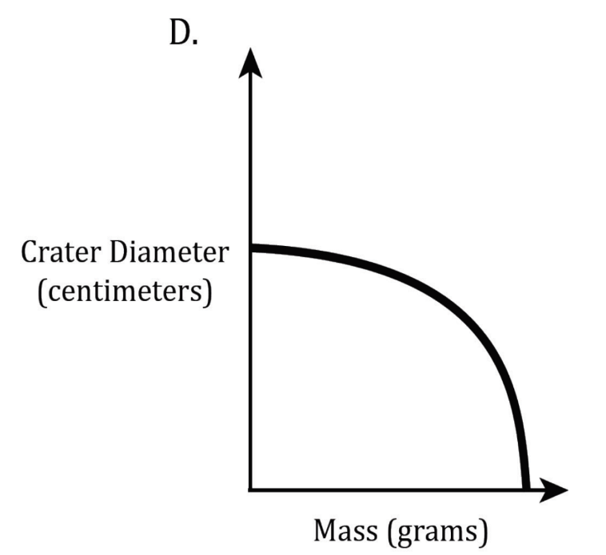
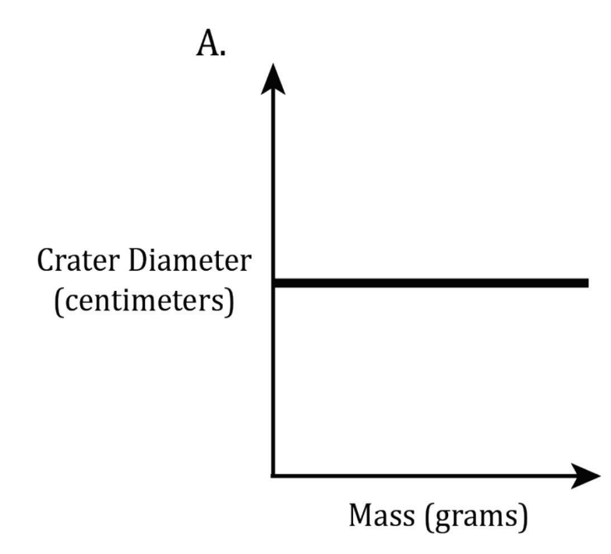
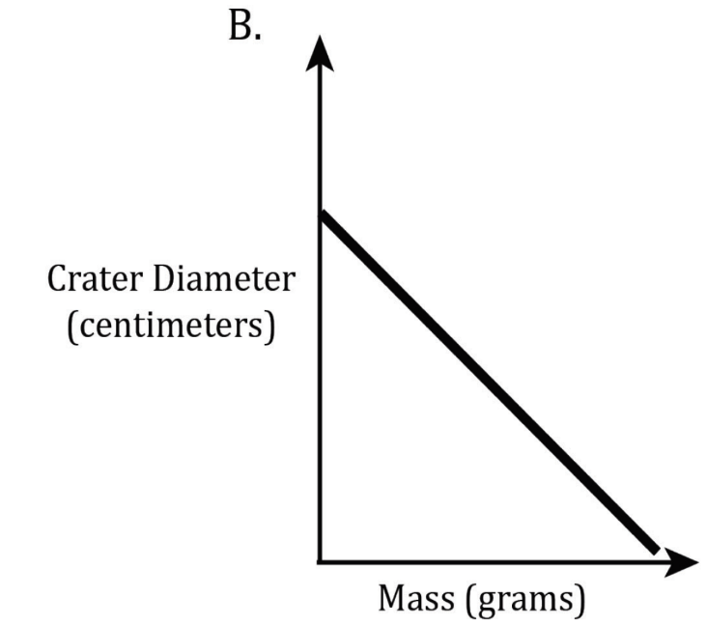
Notes:
Understand basic scientific terms; Read and interpret data in more complex data presentations. Level: Intermediate Skill Group: Scientific Investigation

Slide 5
Notes:
Understand basic scientific terms; Read and interpret data in more complex data presentations. Level: Intermediate Skill Group: Scientific Investigation

Slide 6
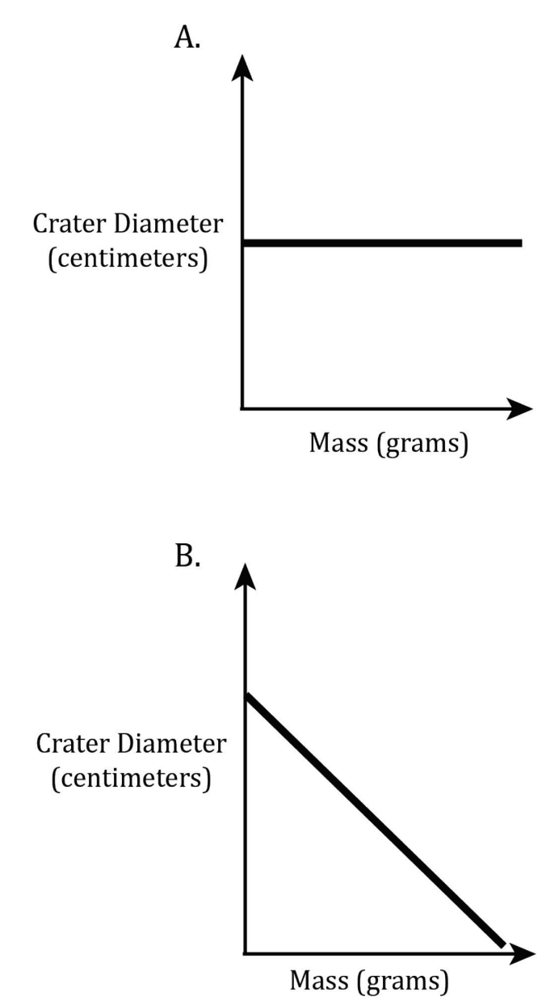
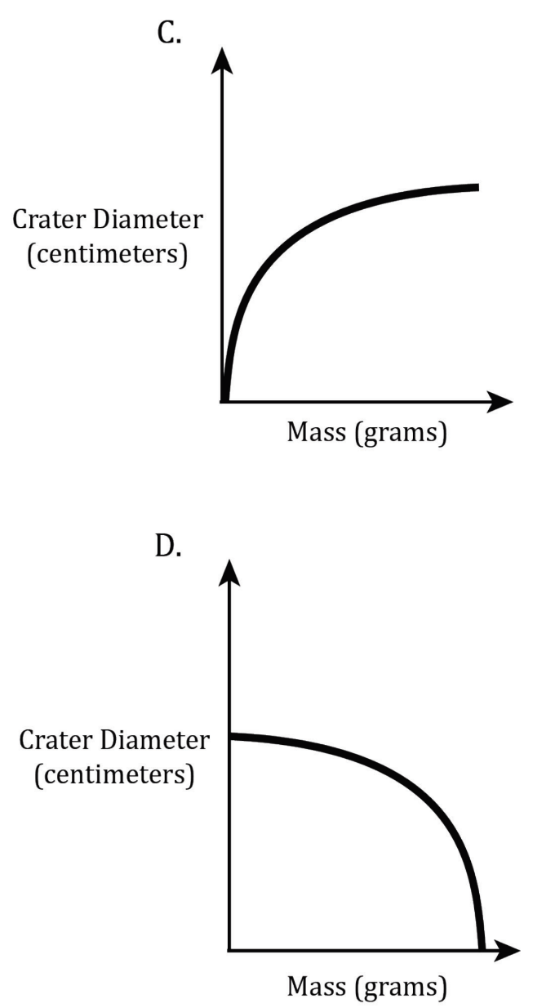
Notes:
Understand basic scientific terms; Read and interpret data in more complex data presentations. Level: Intermediate Skill Group: Scientific Investigation

