Slide 1
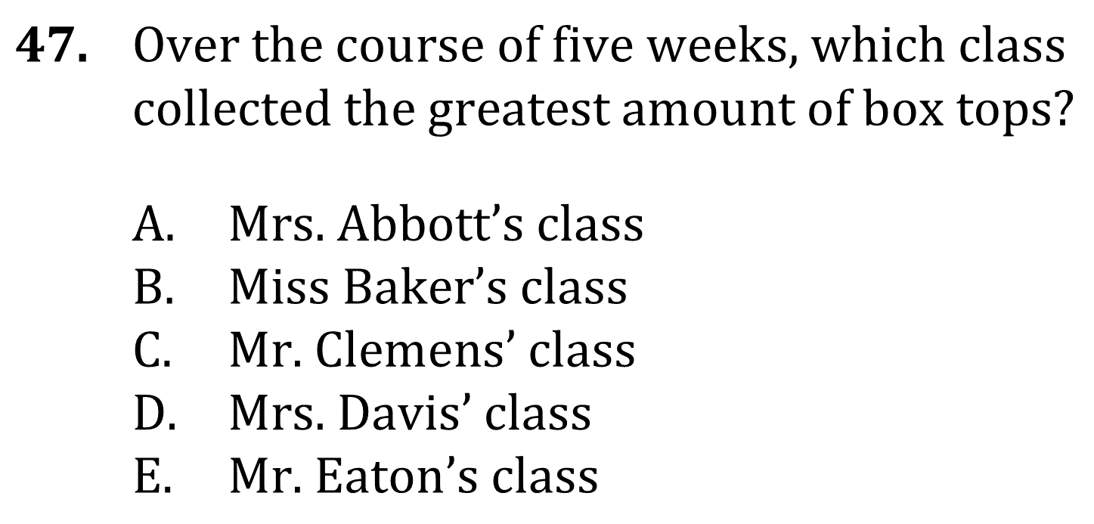
Tables and Graphs

Slide 2
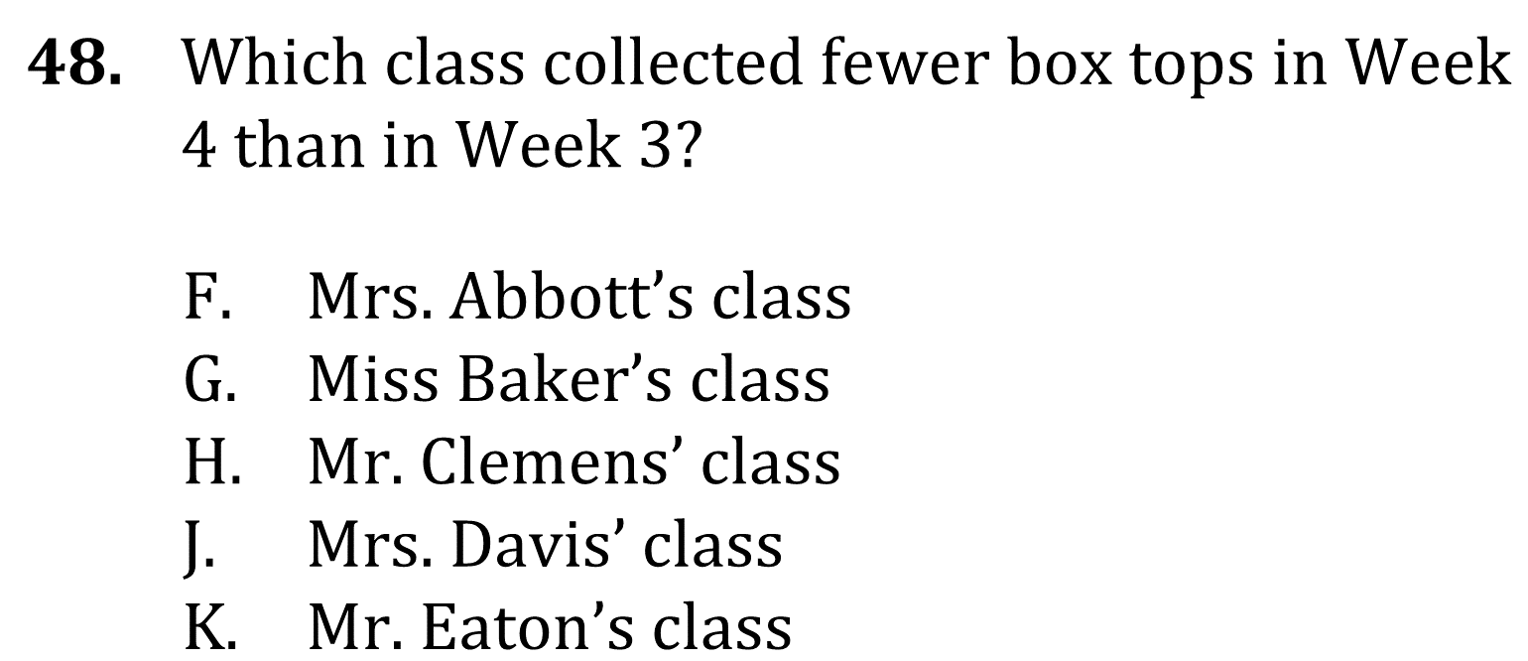
Tables and Graphs

Slide 3
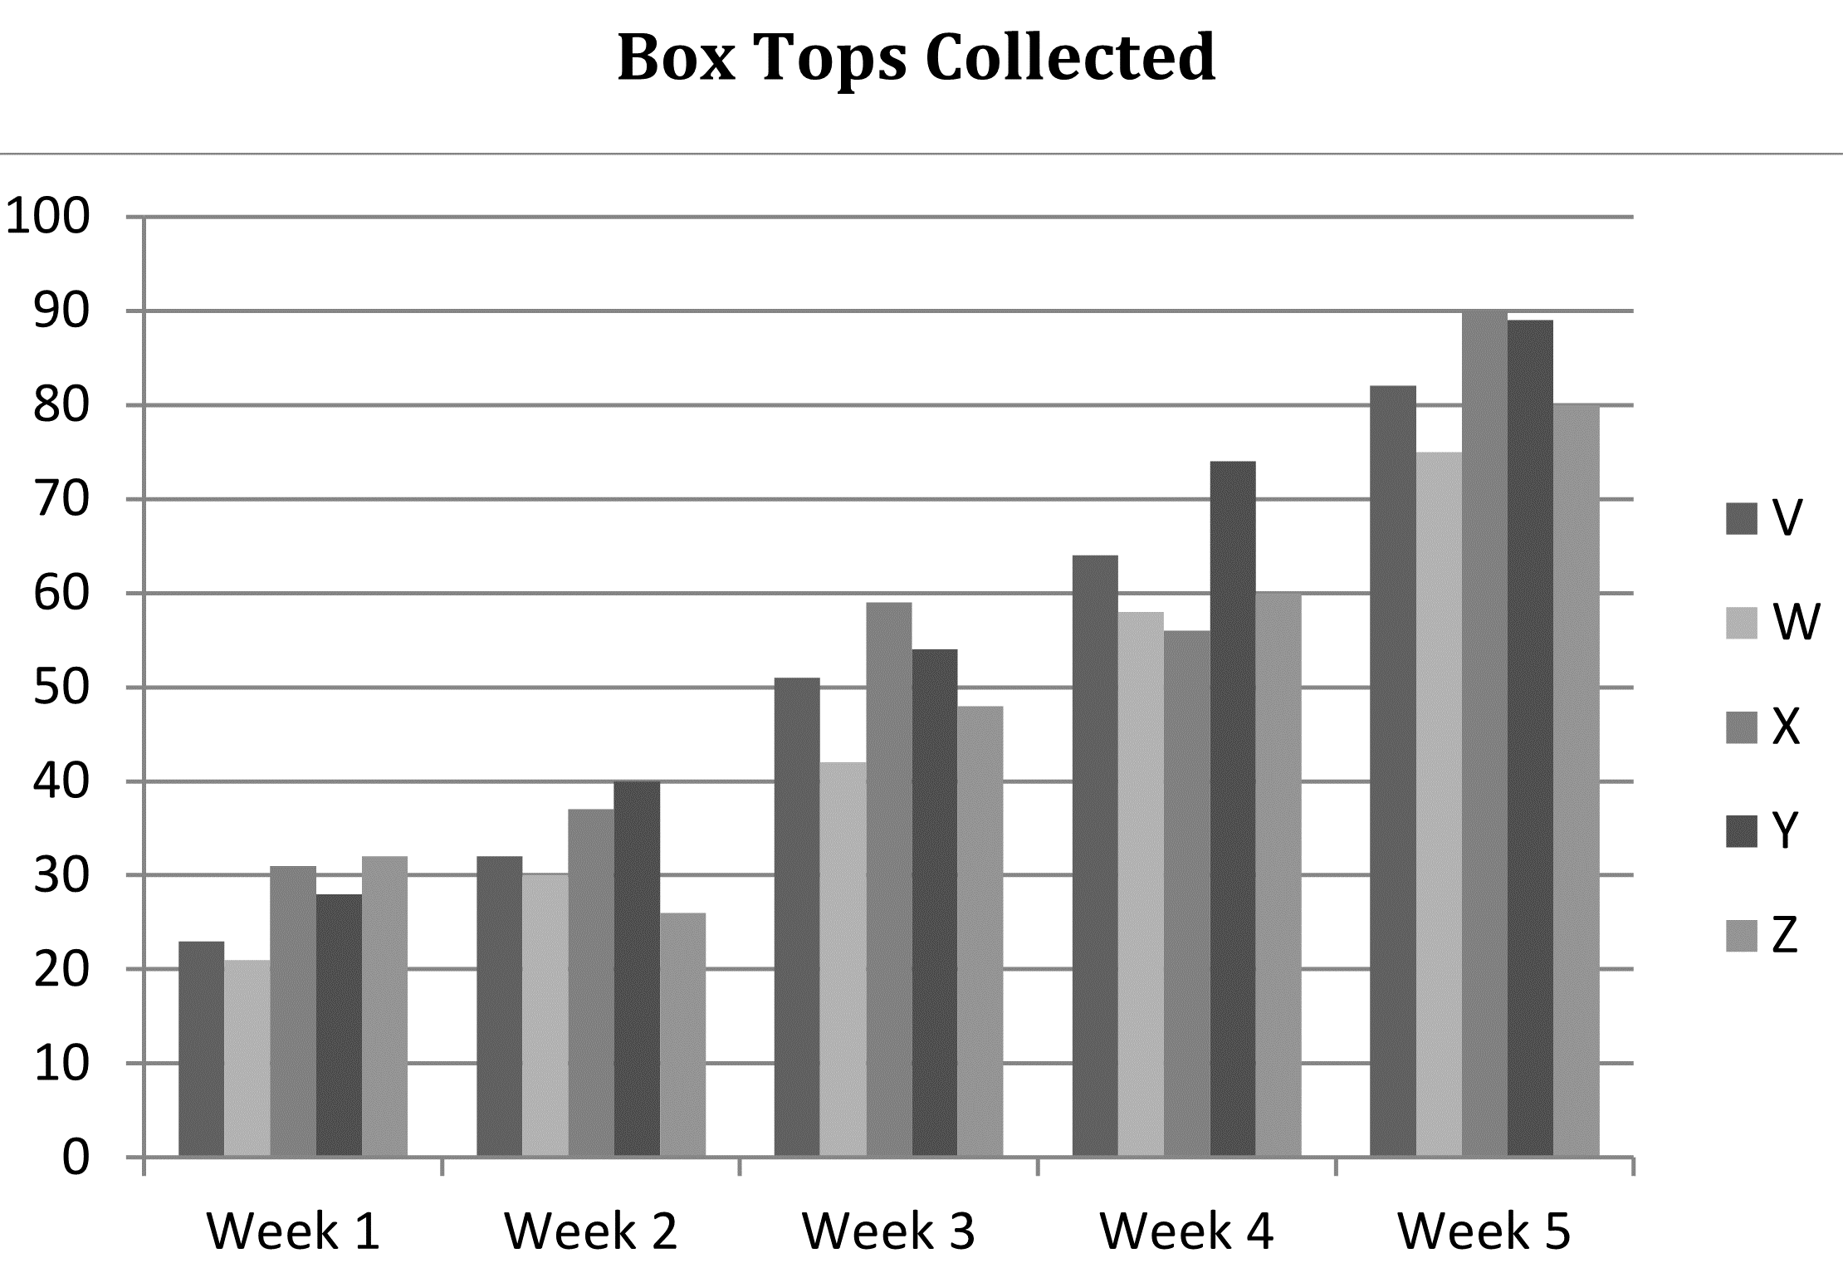
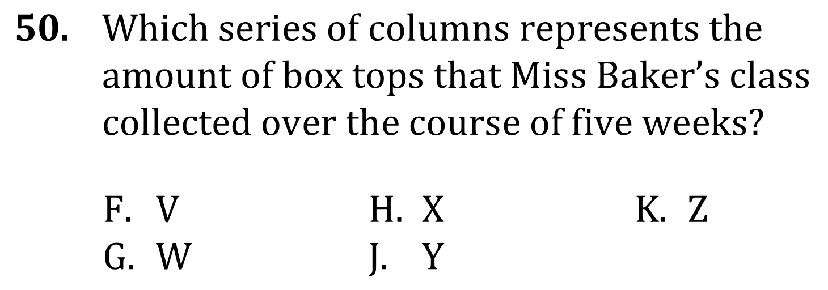
Tables and Graphs

Slide 4
Tables and Graphs

Slide 5
Tables and Graphs

Slide 6
Tables and Graphs

