Slide 1
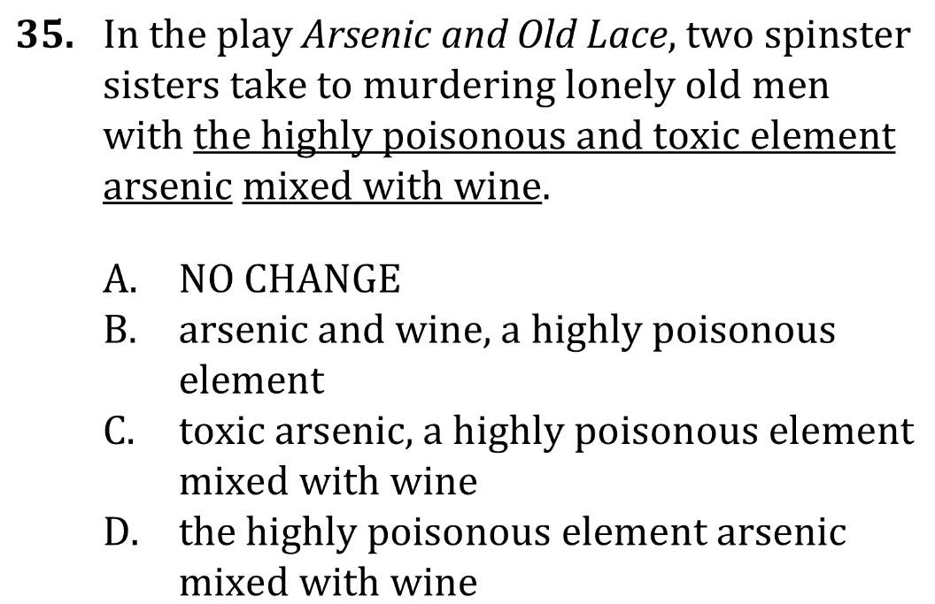
Eliminate Unnecessary Words

Slide 2
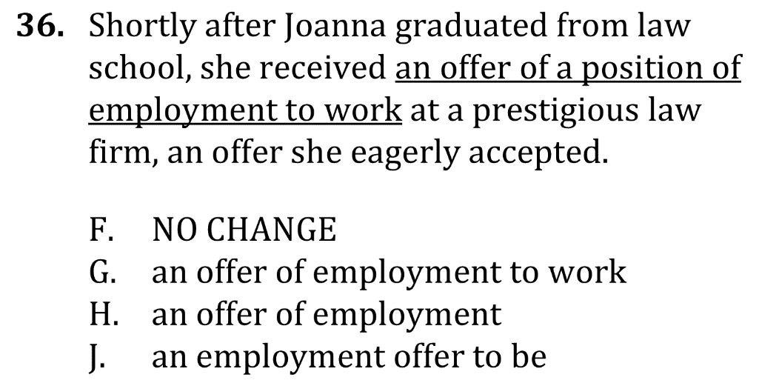
Eliminate Unnecessary Words

Slide 3
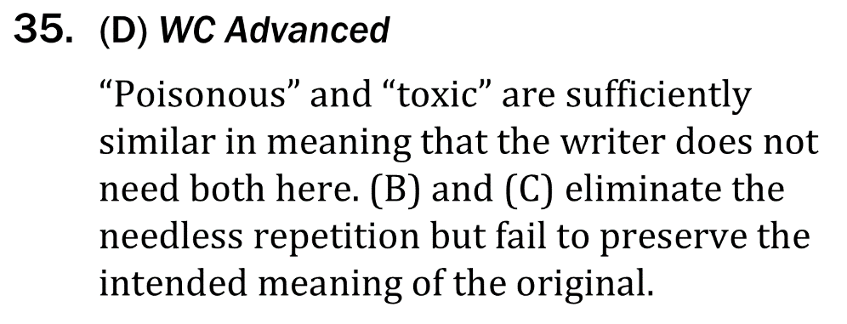
Eliminate Unnecessary Words

Slide 4
Eliminate Unnecessary Words

