Slide 1
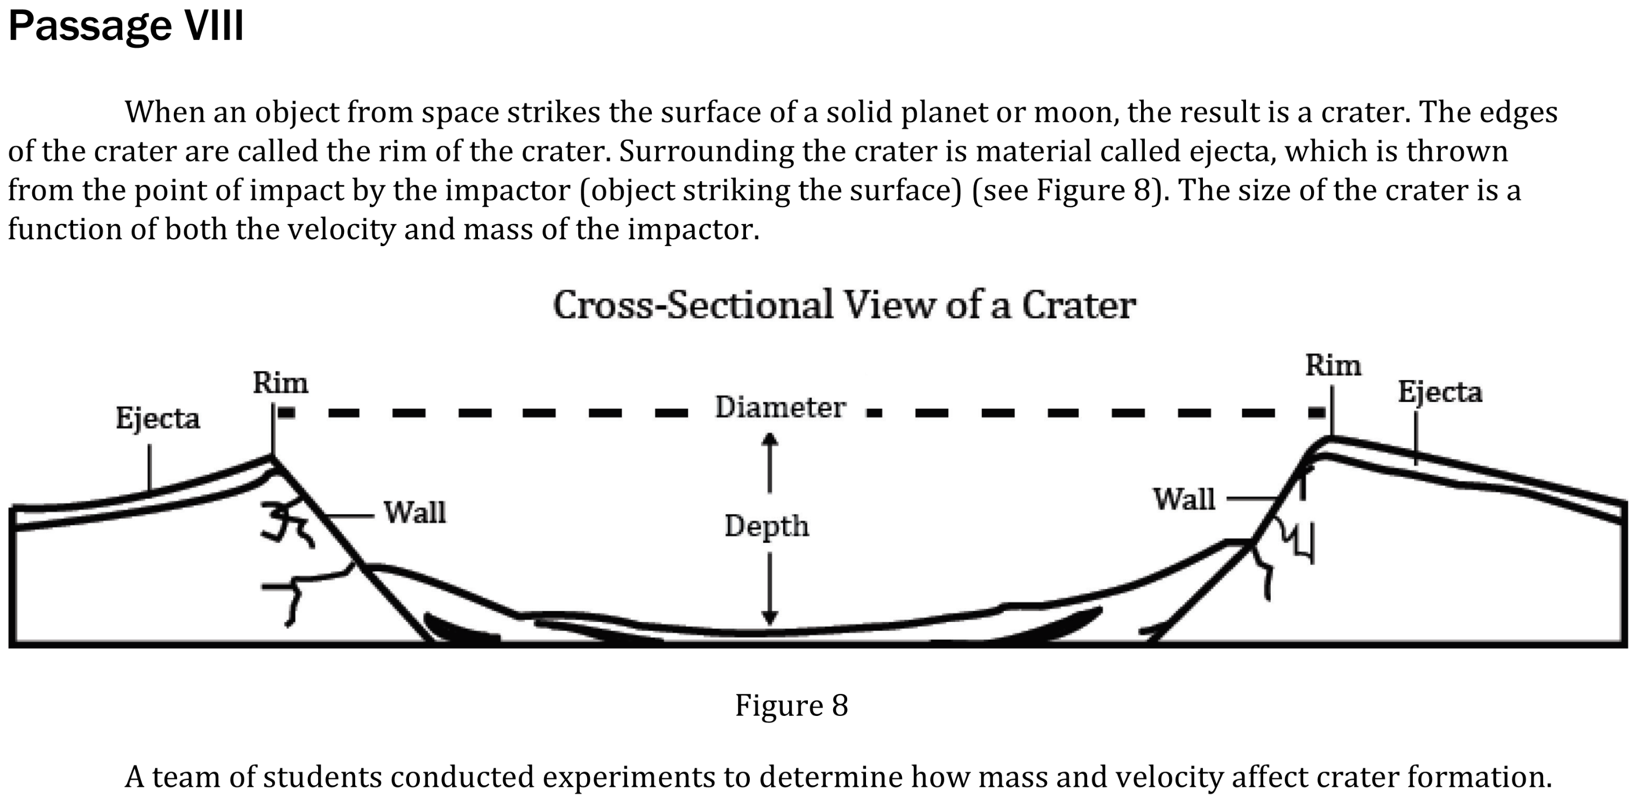
Notes:
Read and interpret data in more complex data presentations; Understand the relationship between variable in more complex data presentations. Level: Intermediate Skill Group: Scientific Investigation

Slide 2
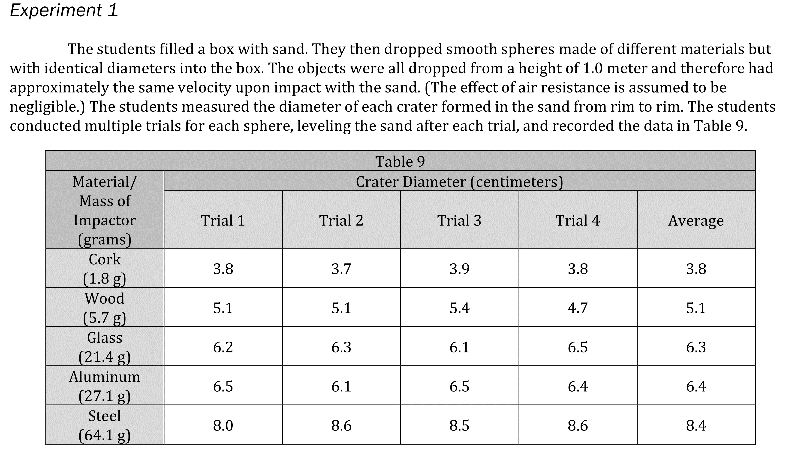
Notes:
Read and interpret data in more complex data presentations; Understand the relationship between variable in more complex data presentations. Level: Intermediate Skill Group: Scientific Investigation

Slide 3
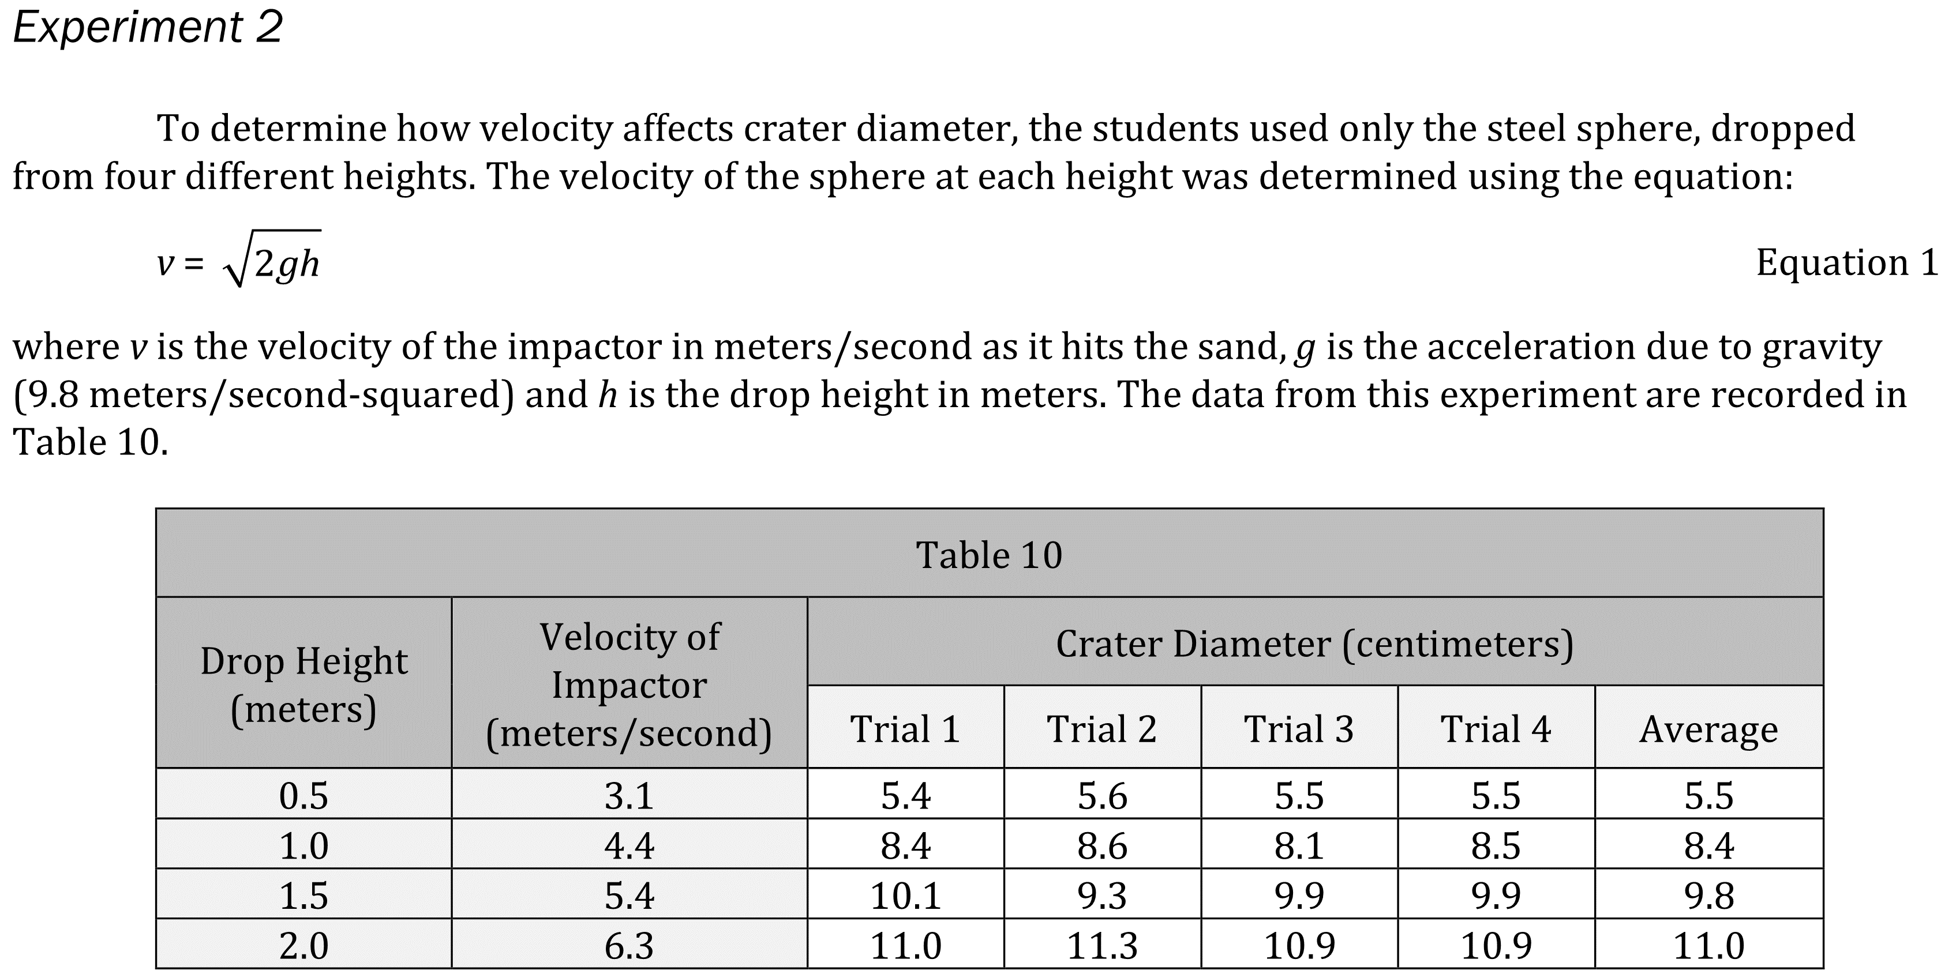
Notes:
Read and interpret data in more complex data presentations; Understand the relationship between variable in more complex data presentations. Level: Intermediate Skill Group: Scientific Investigation

Slide 4
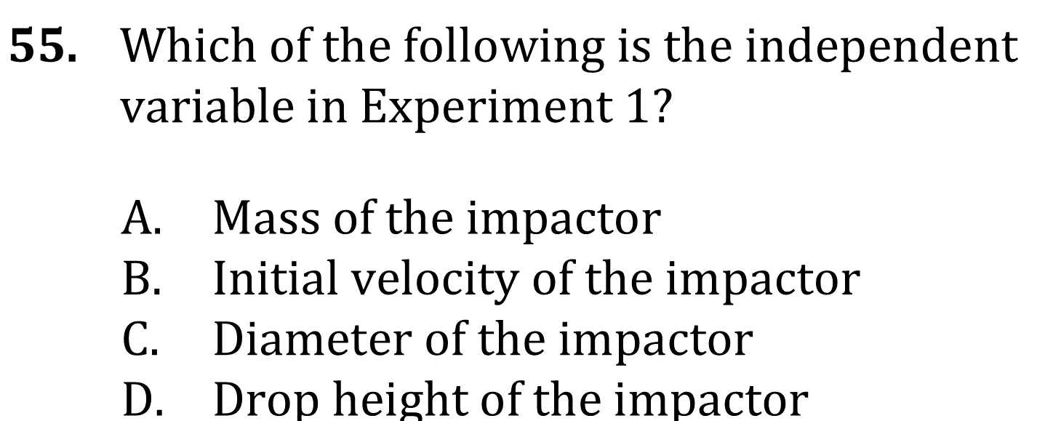
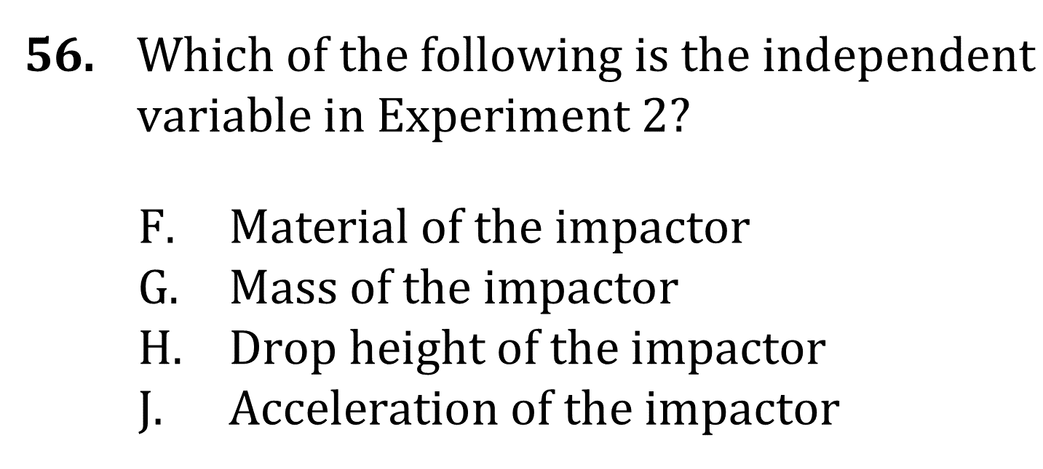
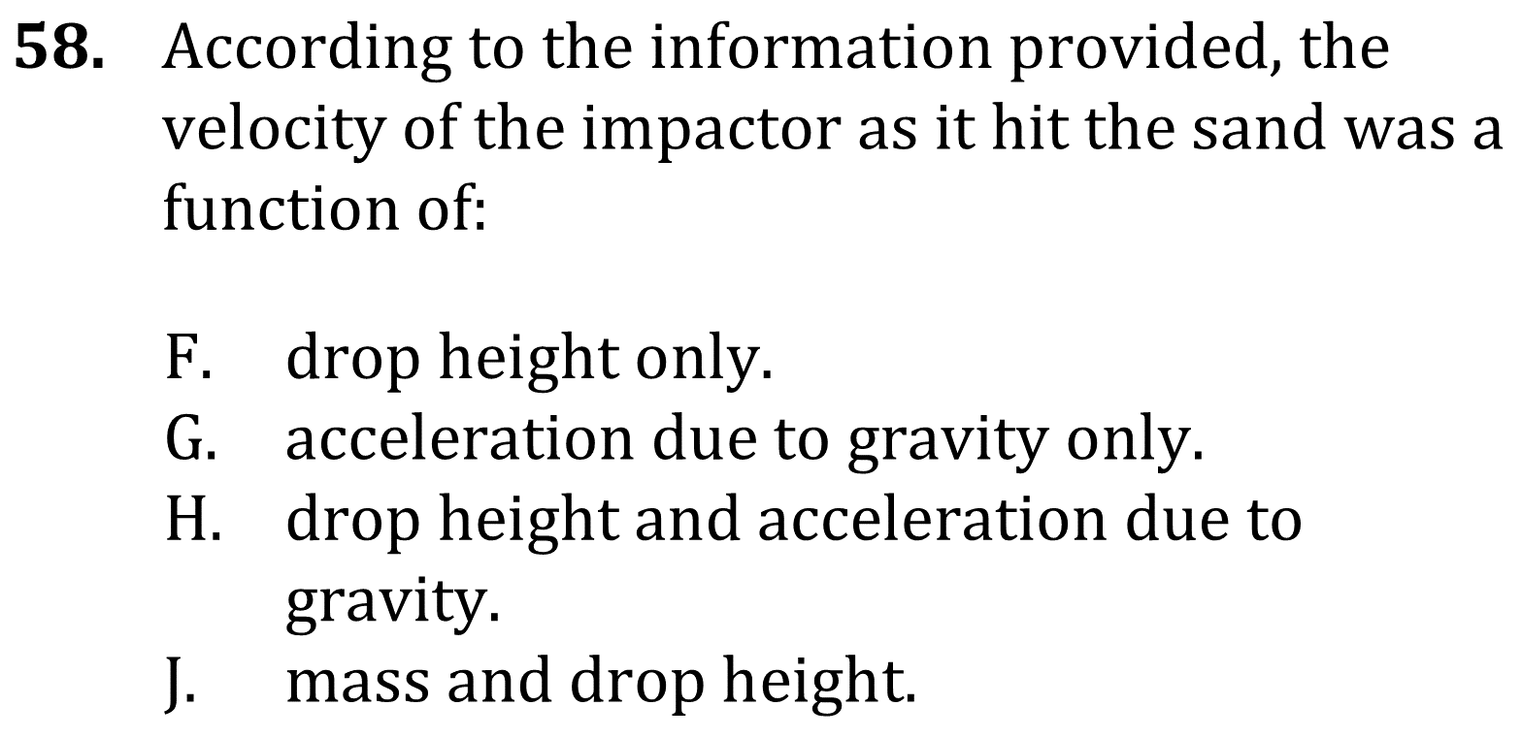
Notes:
Read and interpret data in more complex data presentations; Understand the relationship between variable in more complex data presentations. Level: Intermediate Skill Group: Scientific Investigation

Slide 5
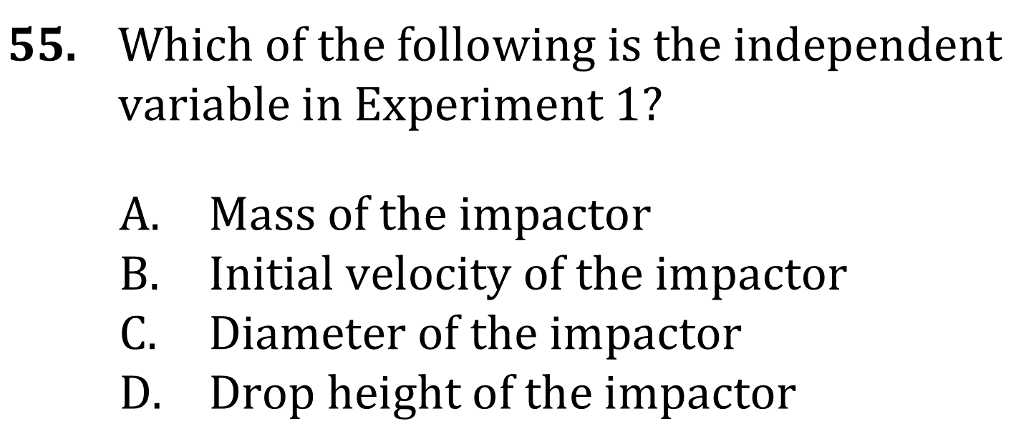
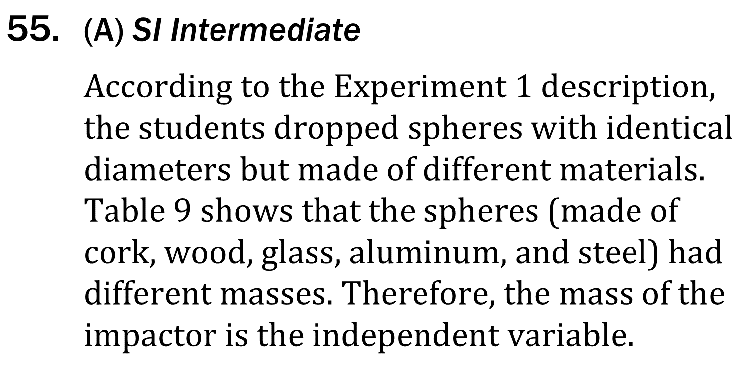
Notes:
Read and interpret data in more complex data presentations; Understand the relationship between variable in more complex data presentations. Level: Intermediate Skill Group: Scientific Investigation

Slide 6
Notes:
Read and interpret data in more complex data presentations; Understand the relationship between variable in more complex data presentations. Level: Intermediate Skill Group: Scientific Investigation

Slide 7
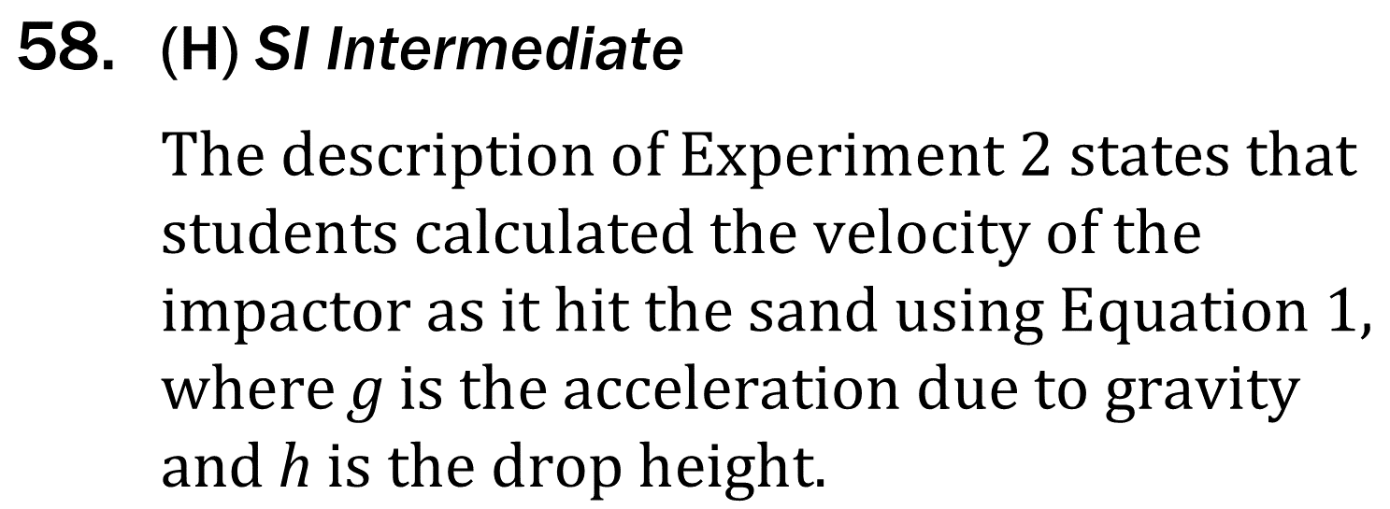
Notes:
Read and interpret data in more complex data presentations; Understand the relationship between variable in more complex data presentations. Level: Intermediate Skill Group: Scientific Investigation

