Slide 1
Rounding, Ordering, & absolute value

Slide 2
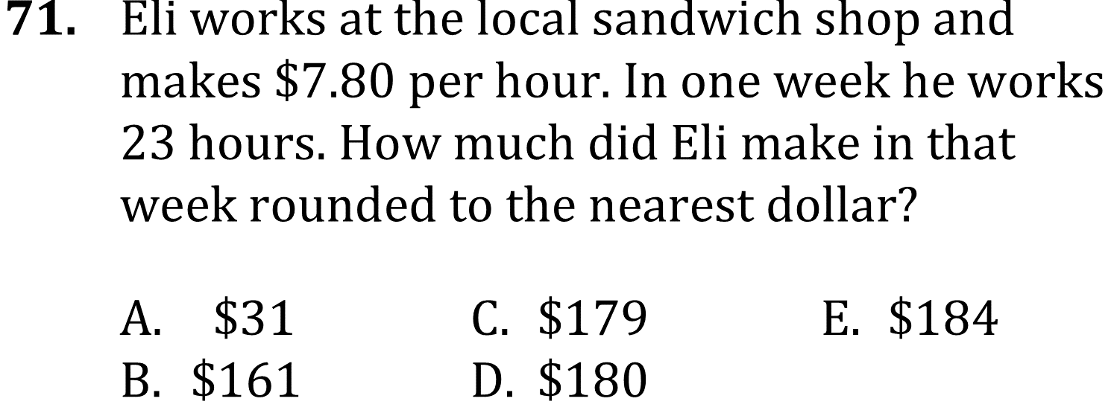
Rounding, Ordering, & absolute value

Slide 3
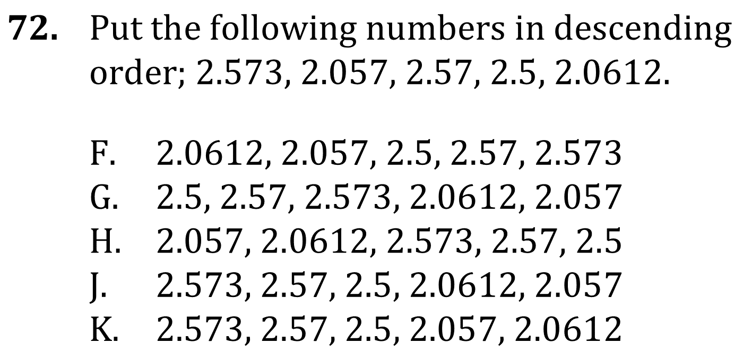
ROUNDING, Ordering, & Absolute Value

Slide 4
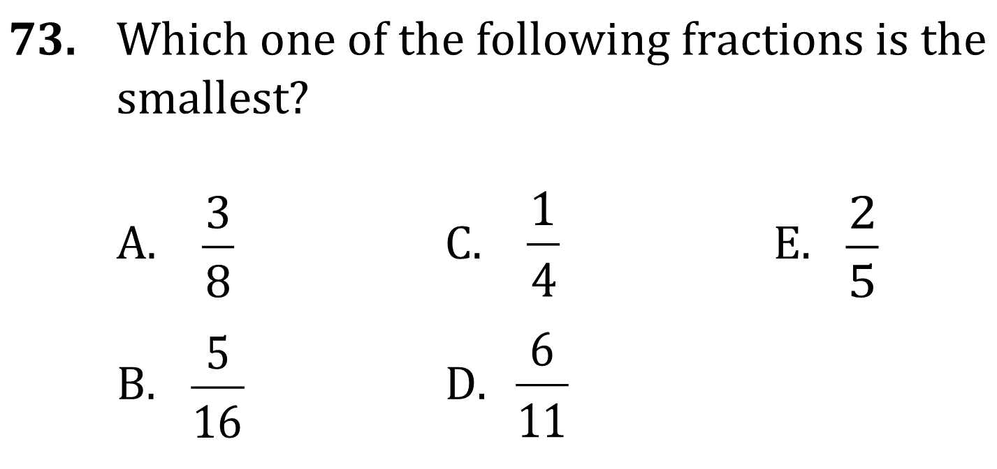
ROUNDING, Ordering, & Absolute Value

Slide 5
ROUNDING, Ordering, & Absolute Value

Slide 6
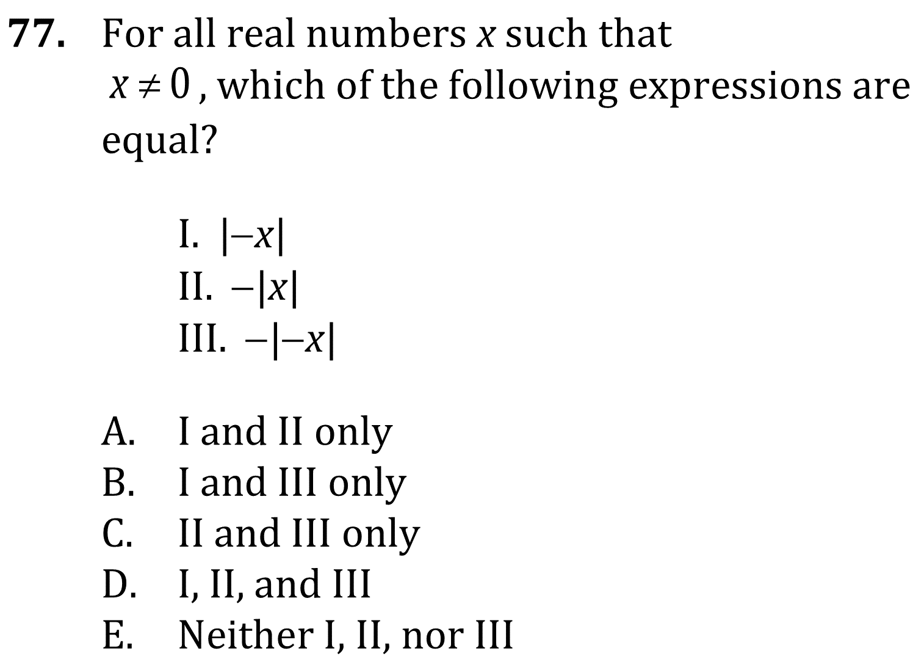
ROUNDING, Ordering, & Absolute Value

Slide 7
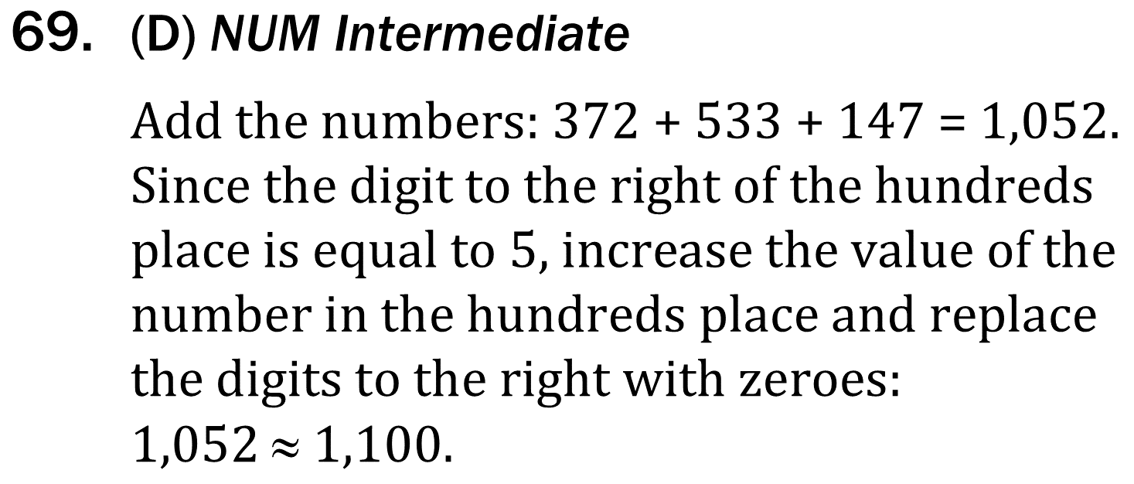
ROUNDING, Ordering, & Absolute Value

Slide 8
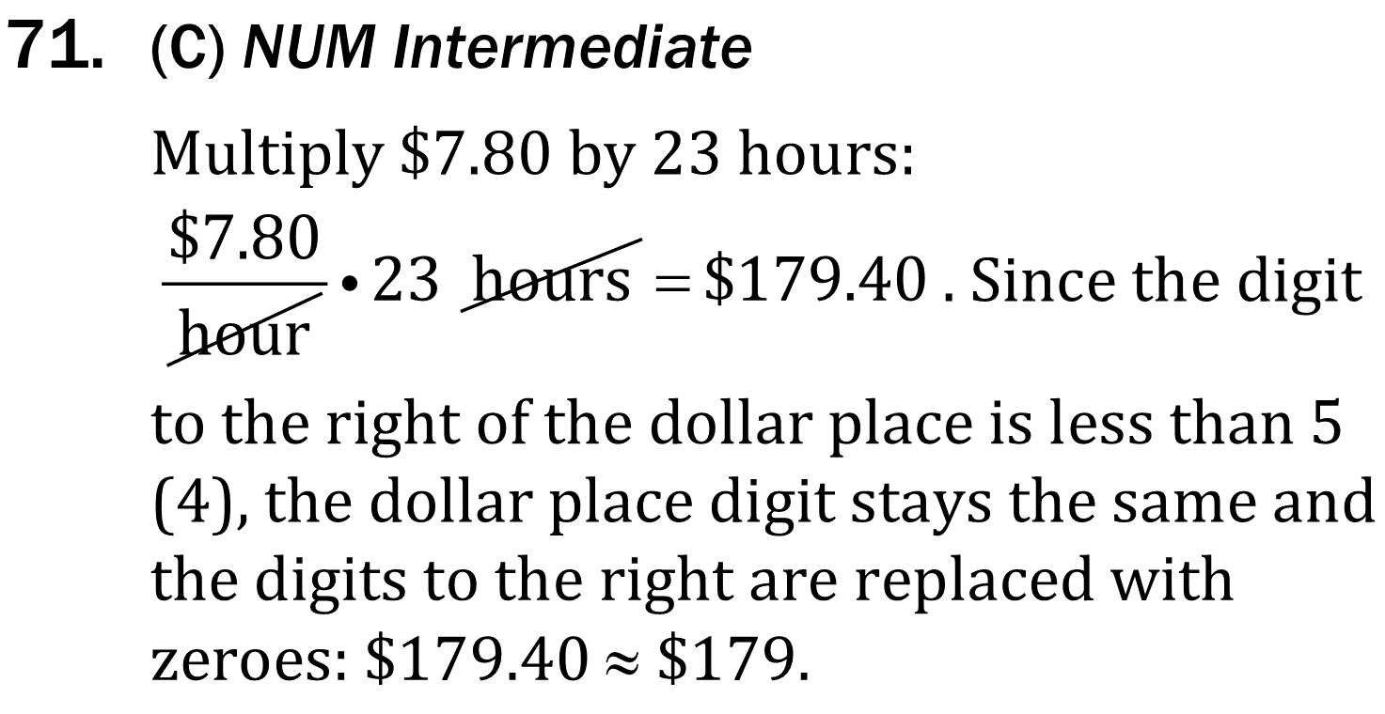
ROUNDING, Ordering, & Absolute Value

Slide 9
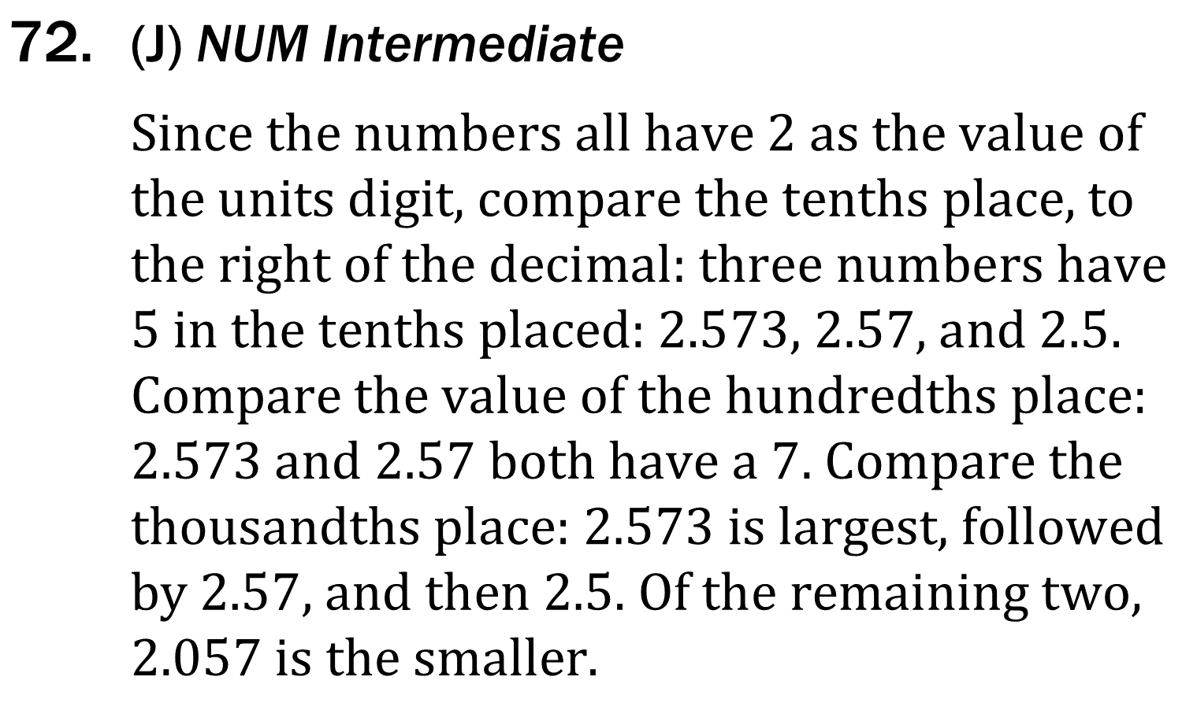
ROUNDING, Ordering, & Absolute Value

Slide 10
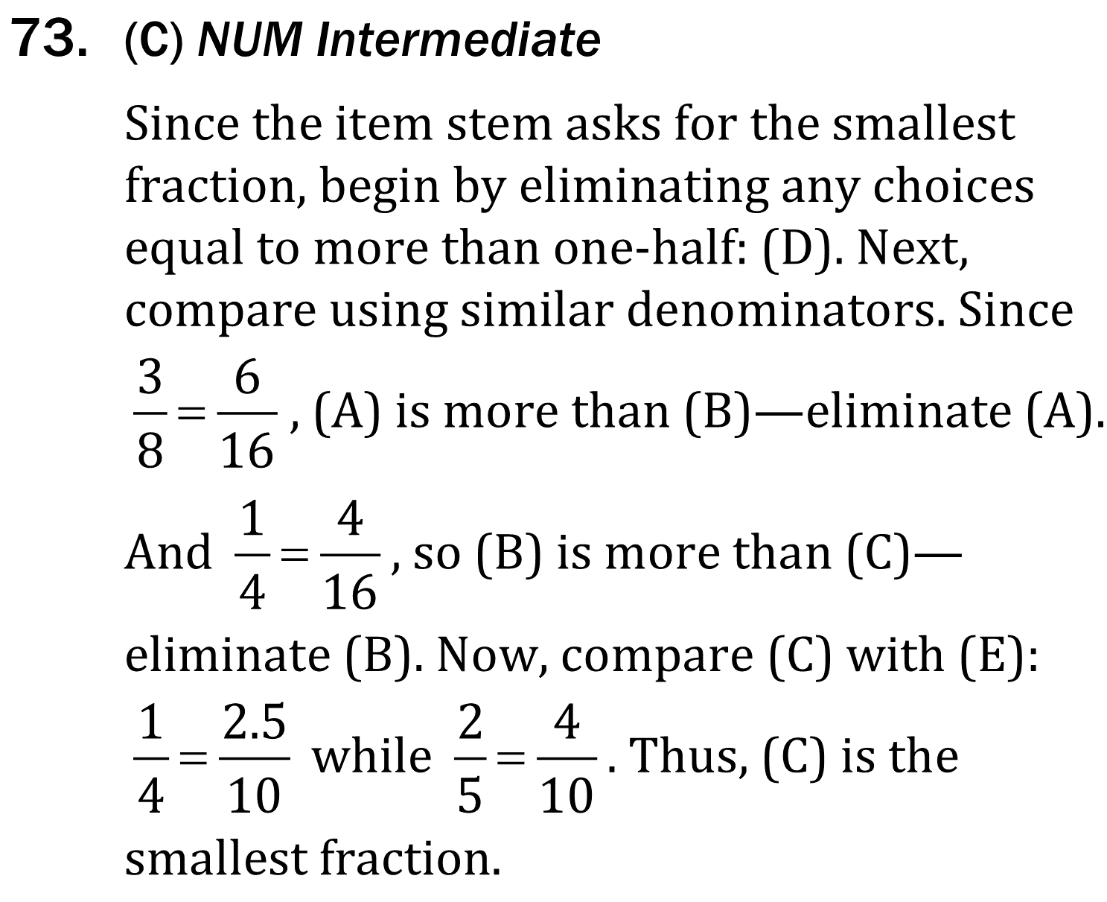
ROUNDING, Ordering, & Absolute Value

Slide 11
ROUNDING, Ordering, & Absolute Value

Slide 12
ROUNDING, Ordering, & Absolute Value

