Slide 1
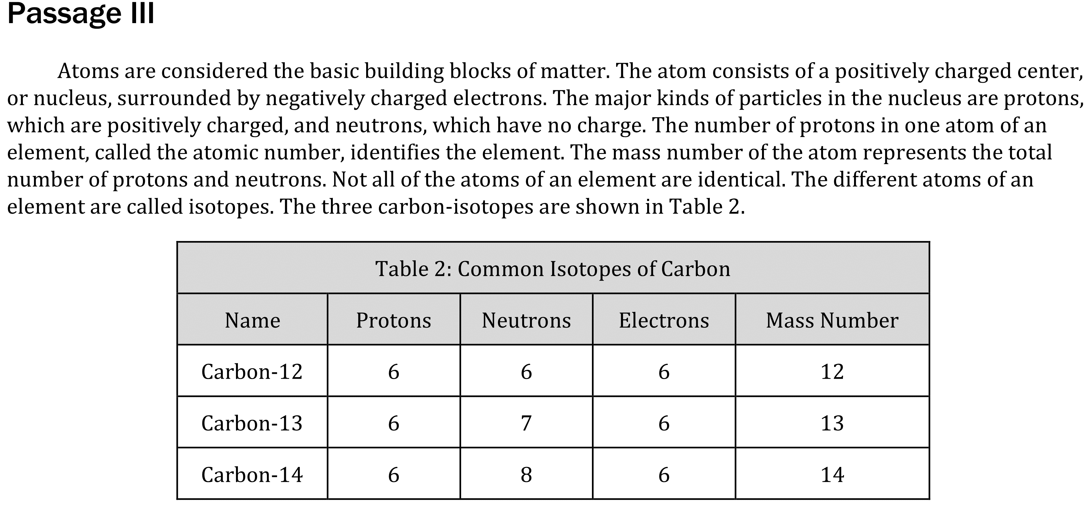
Notes:
Recognize features of basic data presentations such as headings and units; Use a simple presentation of data to identify one two or more pieces of data either numerical of non-numerical; Find information in a body of scientific text. Level: Basic Skill Group: Interpretation of Data

Slide 2
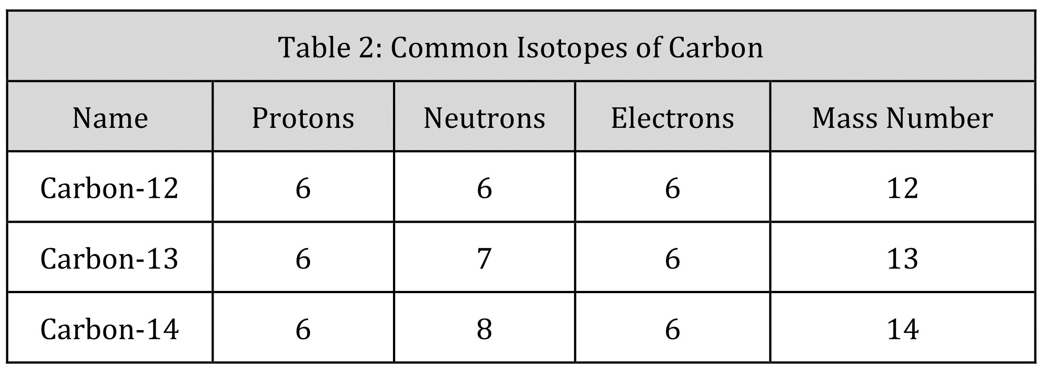
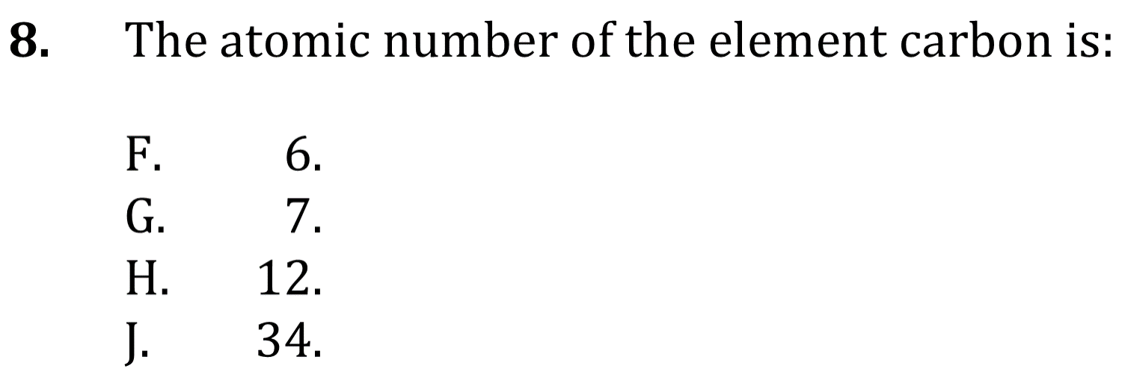
Notes:
Recognize features of basic data presentations such as headings and units; Use a simple presentation of data to identify one two or more pieces of data either numerical of non-numerical; Find information in a body of scientific text. Level: Basic Skill Group: Interpretation of Data

Slide 3
Notes:
Recognize features of basic data presentations such as headings and units; Use a simple presentation of data to identify one two or more pieces of data either numerical of non-numerical; Find information in a body of scientific text. Level: Basic Skill Group: Interpretation of Data

Slide 4
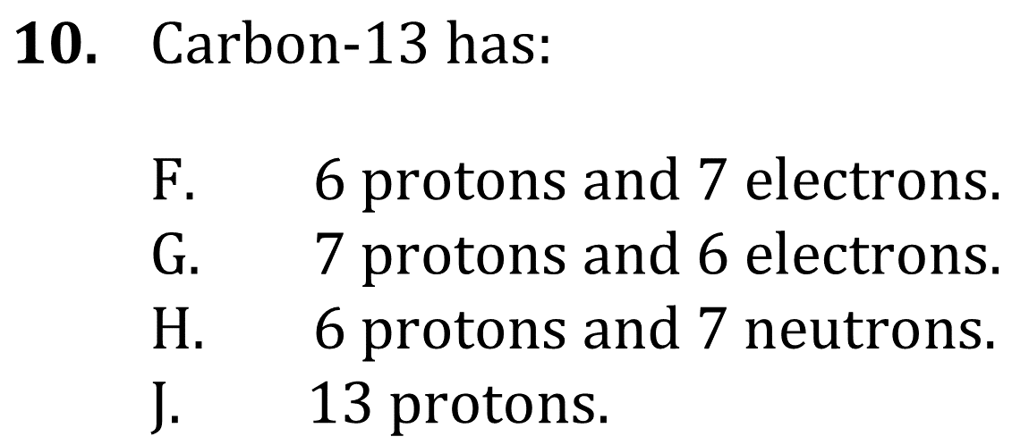
Notes:
Recognize features of basic data presentations such as headings and units; Use a simple presentation of data to identify one two or more pieces of data either numerical of non-numerical; Find information in a body of scientific text. Level: Basic Skill Group: Interpretation of Data

Slide 5
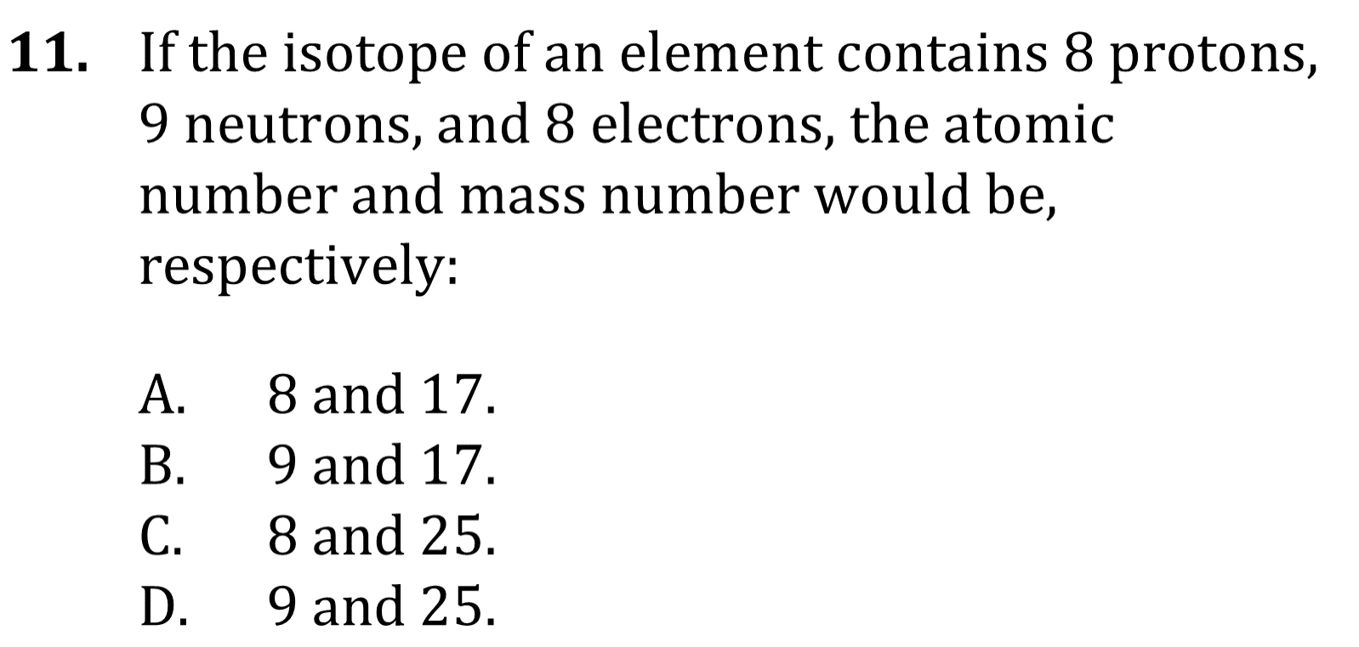
Notes:
Recognize features of basic data presentations such as headings and units; Use a simple presentation of data to identify one two or more pieces of data either numerical of non-numerical; Find information in a body of scientific text. Level: Basic Skill Group: Interpretation of Data

Slide 6
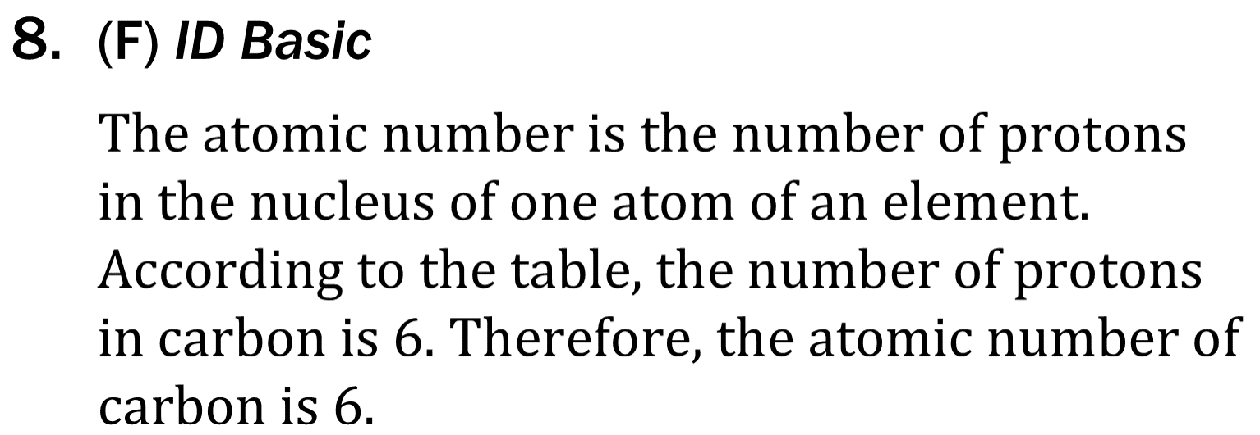
Notes:
Recognize features of basic data presentations such as headings and units; Use a simple presentation of data to identify one two or more pieces of data either numerical of non-numerical; Find information in a body of scientific text. Level: Basic Skill Group: Interpretation of Data

Slide 7
Notes:
Recognize features of basic data presentations such as headings and units; Use a simple presentation of data to identify one two or more pieces of data either numerical of non-numerical; Find information in a body of scientific text. Level: Basic Skill Group: Interpretation of Data

Slide 8
Notes:
Recognize features of basic data presentations such as headings and units; Use a simple presentation of data to identify one two or more pieces of data either numerical of non-numerical; Find information in a body of scientific text. Level: Basic Skill Group: Interpretation of Data

Slide 9
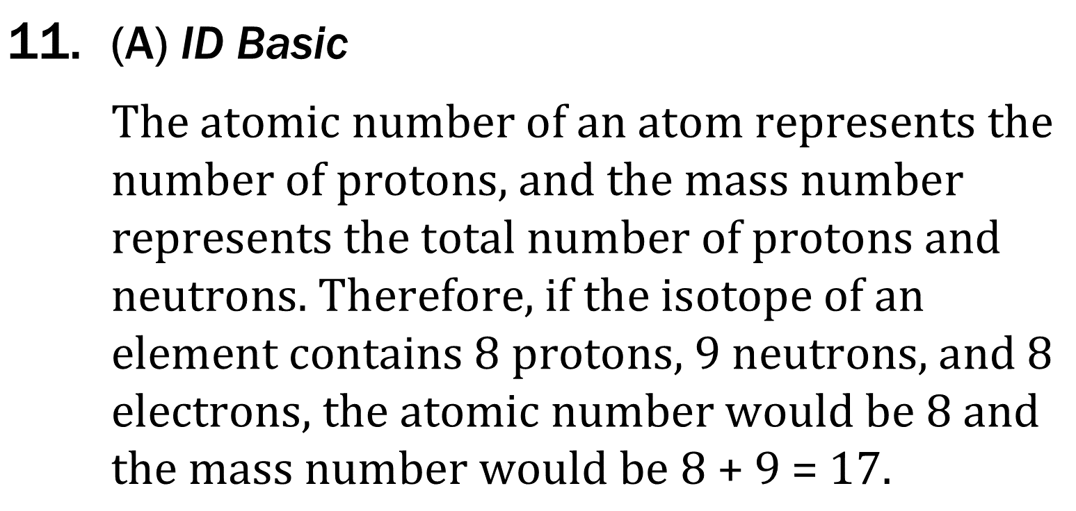
Notes:
Recognize features of basic data presentations such as headings and units; Use a simple presentation of data to identify one two or more pieces of data either numerical of non-numerical; Find information in a body of scientific text. Level: Basic Skill Group: Interpretation of Data

