Slide 1
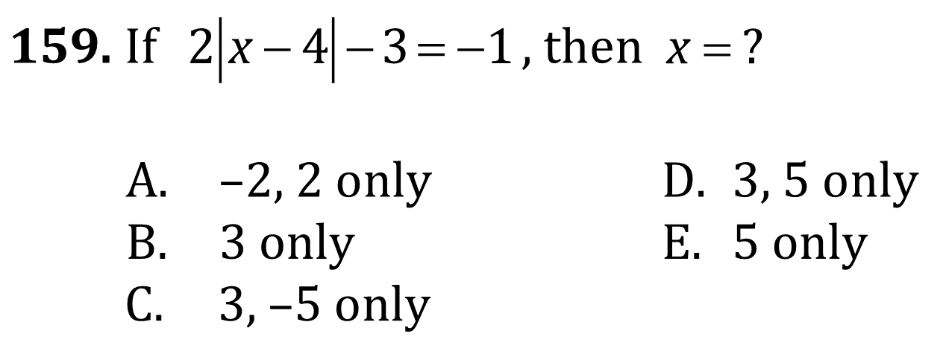
Absolute Value Equations and Simultaneous Linear Equations

Slide 2
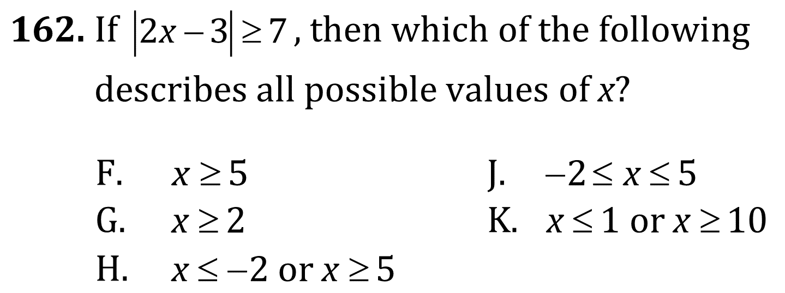
Absolute Value Equations and Simultaneous Linear Equations

Slide 3
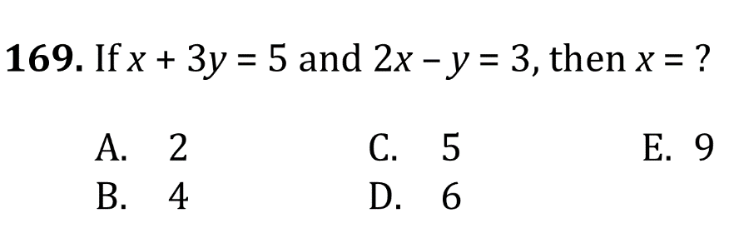
Absolute Value Equations and Simultaneous Linear Equations

Slide 4
Absolute Value Equations and Simultaneous Linear Equations

Slide 5
Absolute Value Equations and Simultaneous Linear Equations

Slide 6
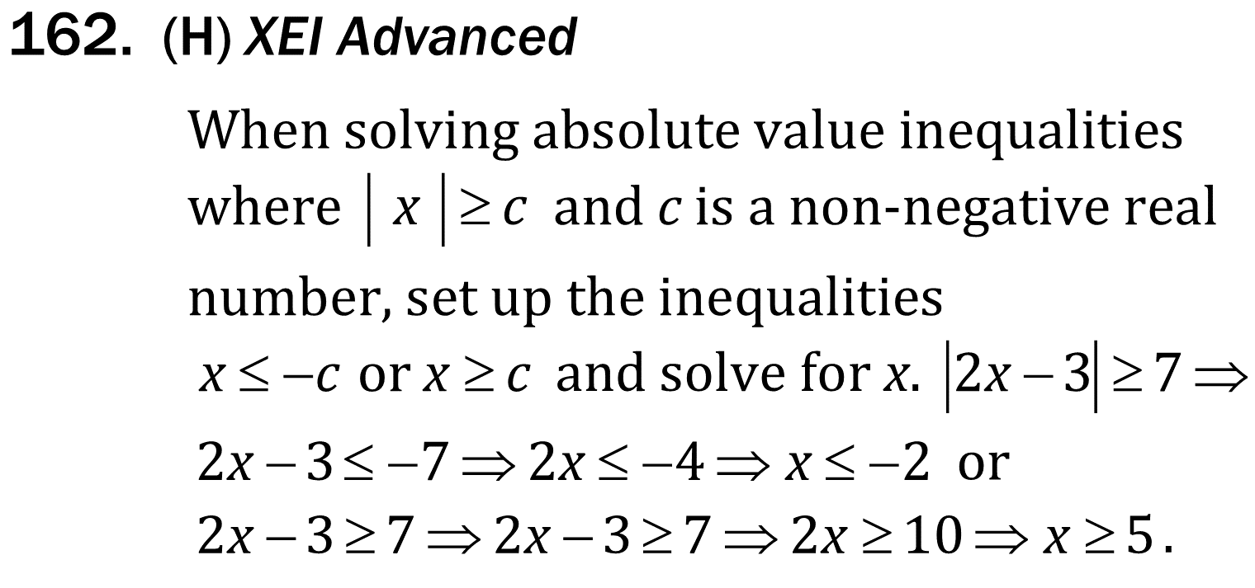
Absolute Value Equations and Simultaneous Linear Equations

Slide 7
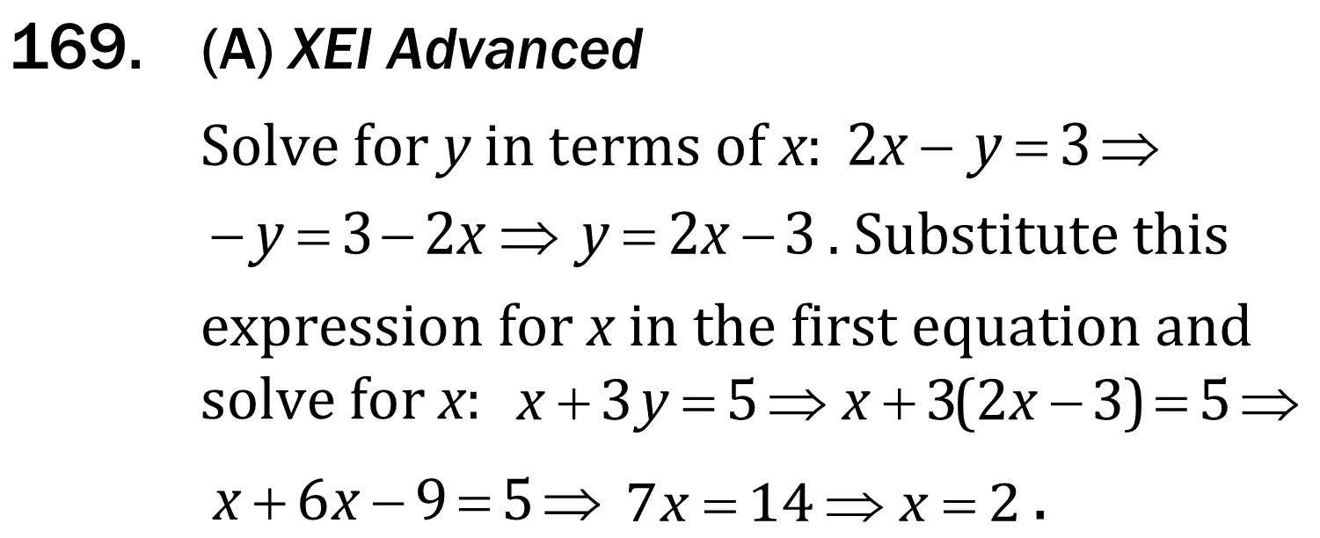
Absolute Value Equations and Simultaneous Linear Equations

Slide 8
Absolute Value Equations and Simultaneous Linear Equations

