Slide 1
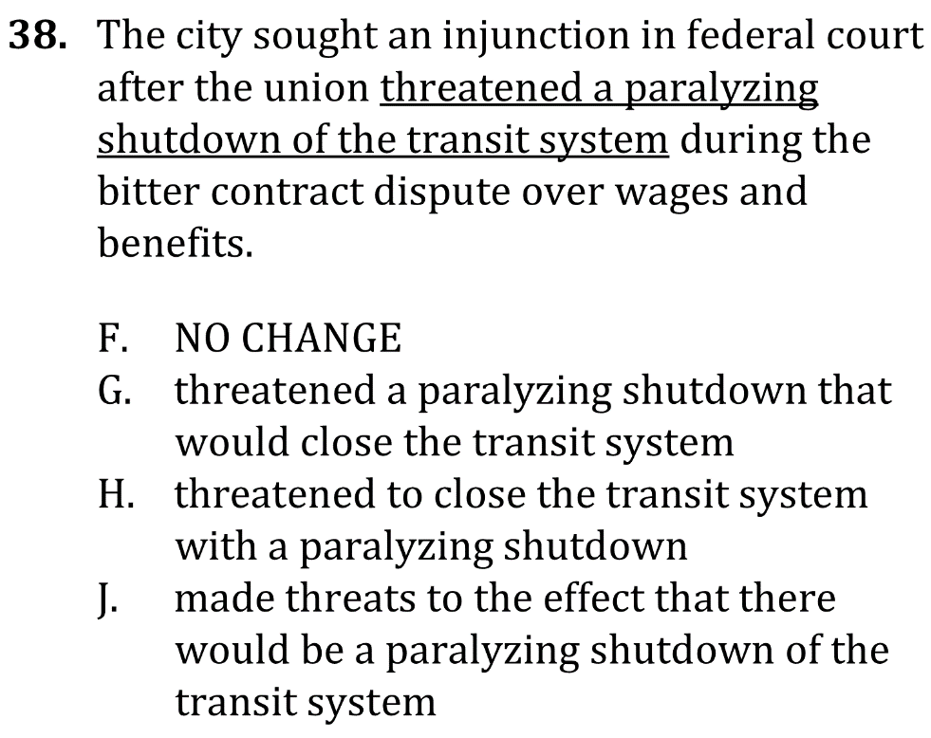

Eliminate Unnecessary Words

Slide 2
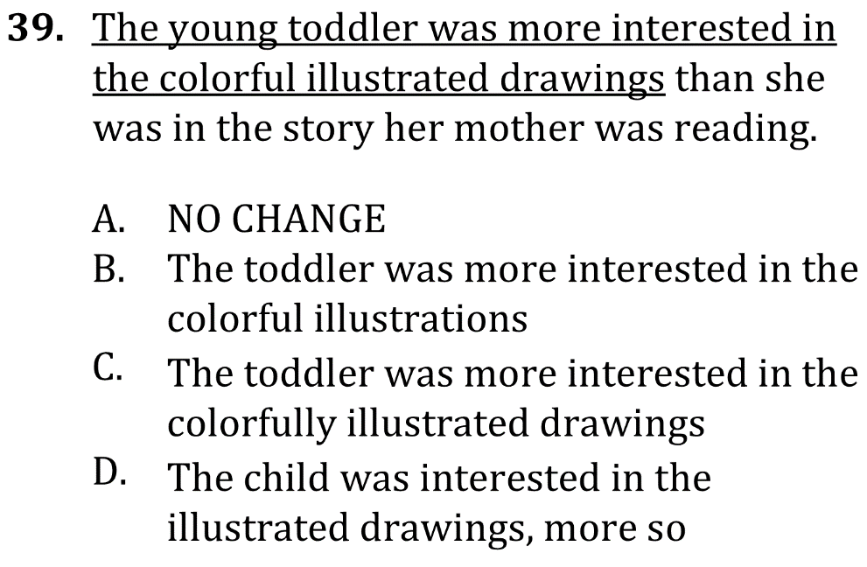
Eliminate Unnecessary Words

Slide 3

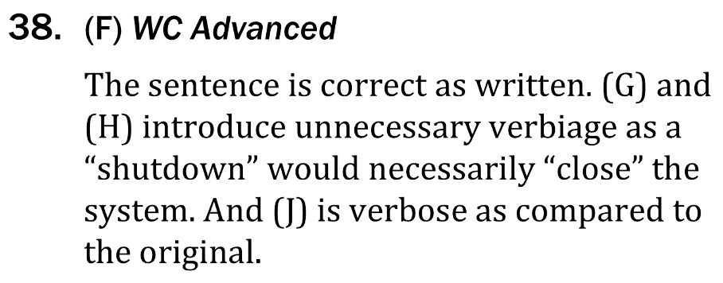
Eliminate Unnecessary Words

Slide 4

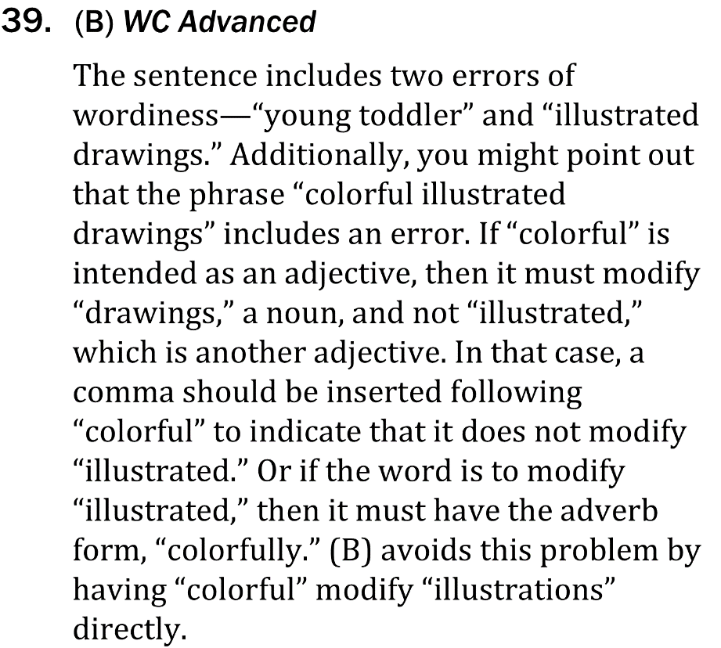
Eliminate Unnecessary Words

