Slide 1
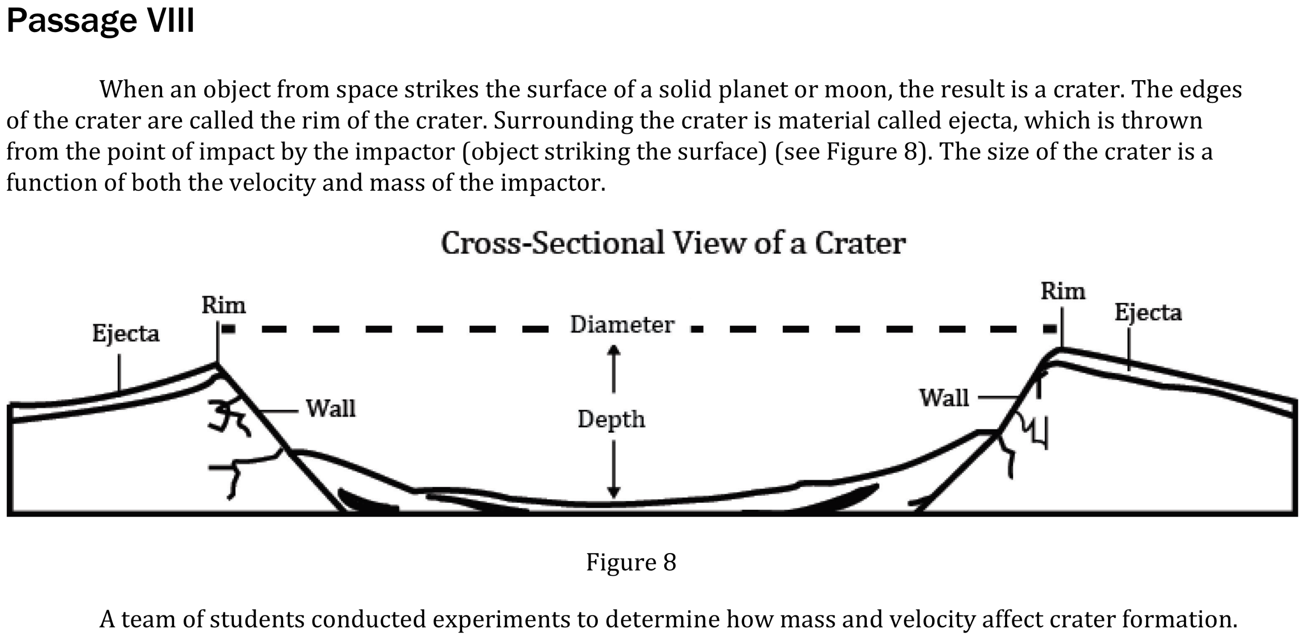
Notes:
Predict the results of an additional step in an experiment. Level: Intermediate Skill Group: Evaluation of Models

Slide 2
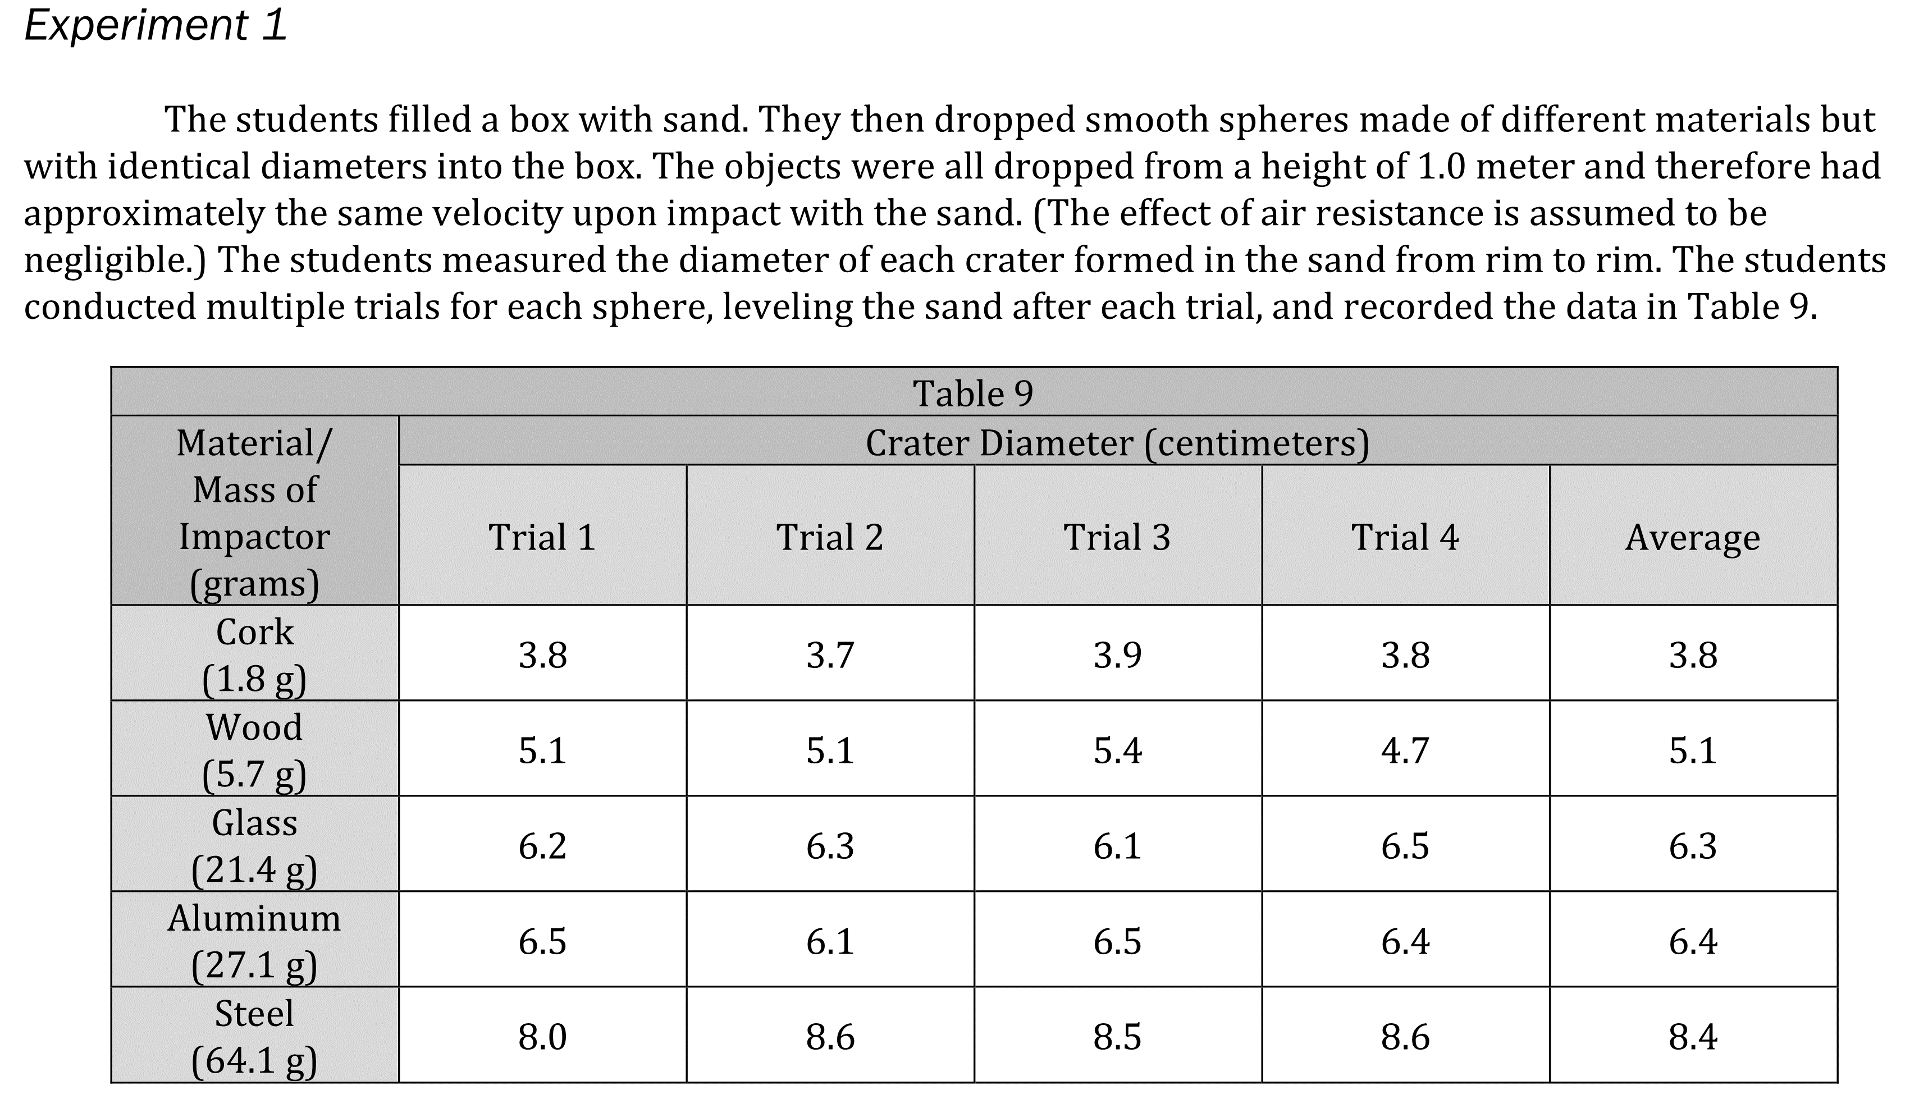
Notes:
Predict the results of an additional step in an experiment. Level: Intermediate Skill Group: Evaluation of Models

Slide 3
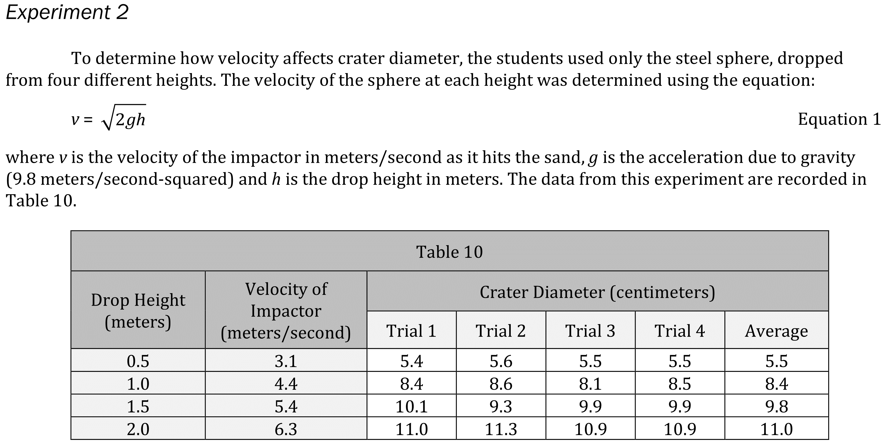
Notes:
Predict the results of an additional step in an experiment. Level: Intermediate Skill Group: Evaluation of Models

Slide 4
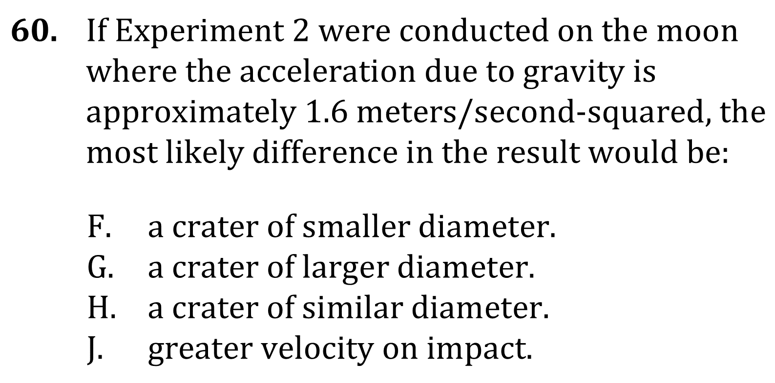
Notes:
Predict the results of an additional step in an experiment. Level: Intermediate Skill Group: Evaluation of Models

Slide 5
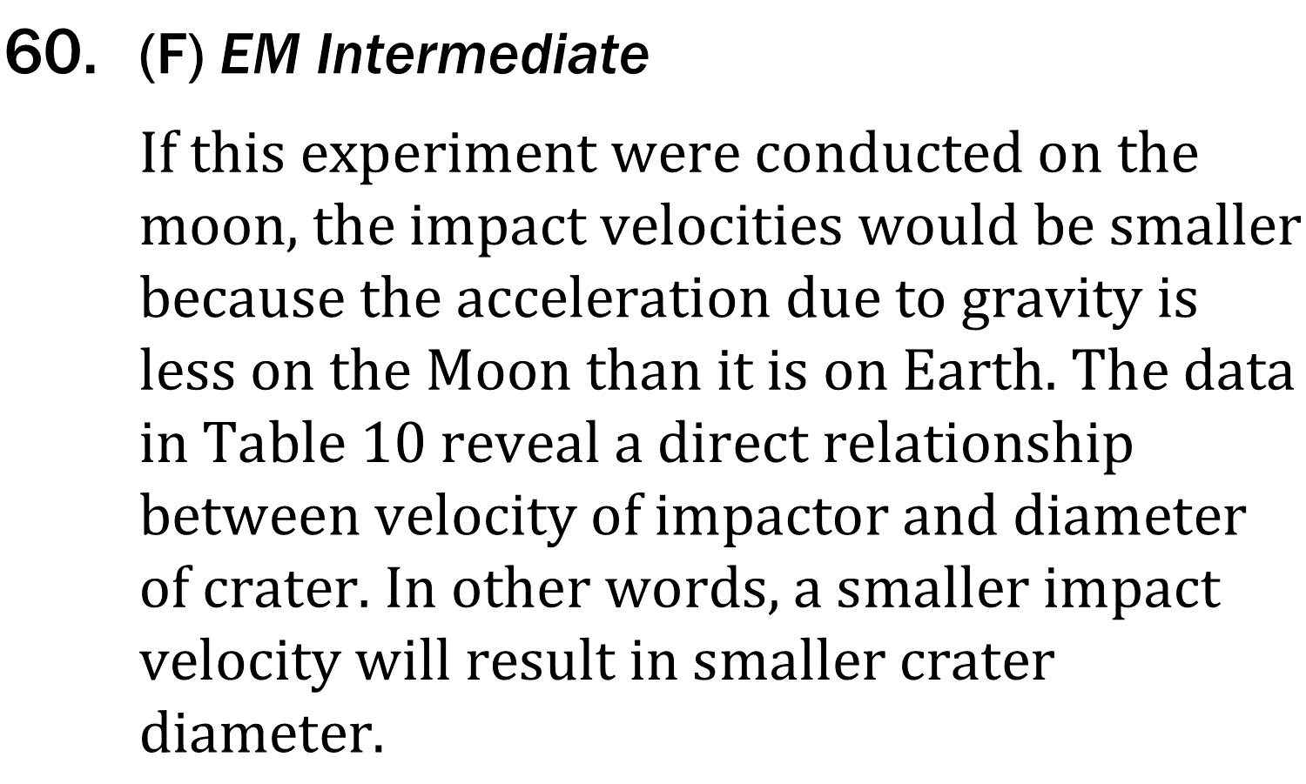
Notes:
Predict the results of an additional step in an experiment. Level: Intermediate Skill Group: Evaluation of Models

