Slide 1
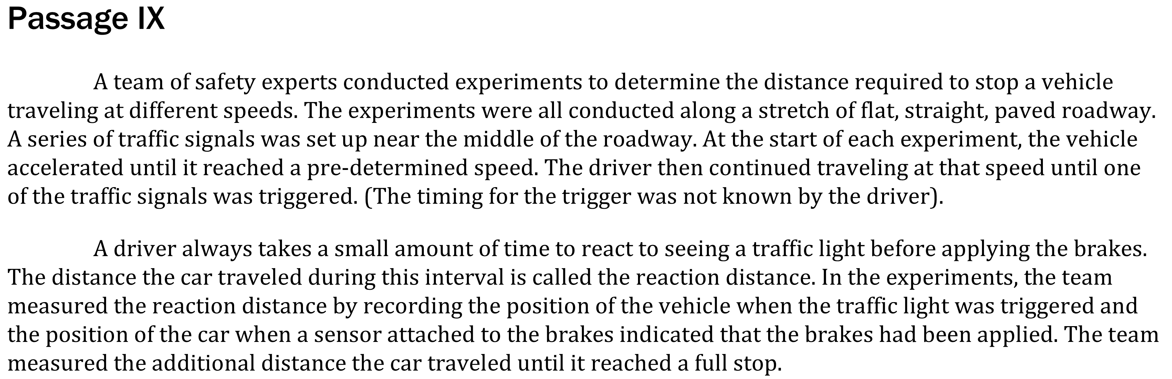
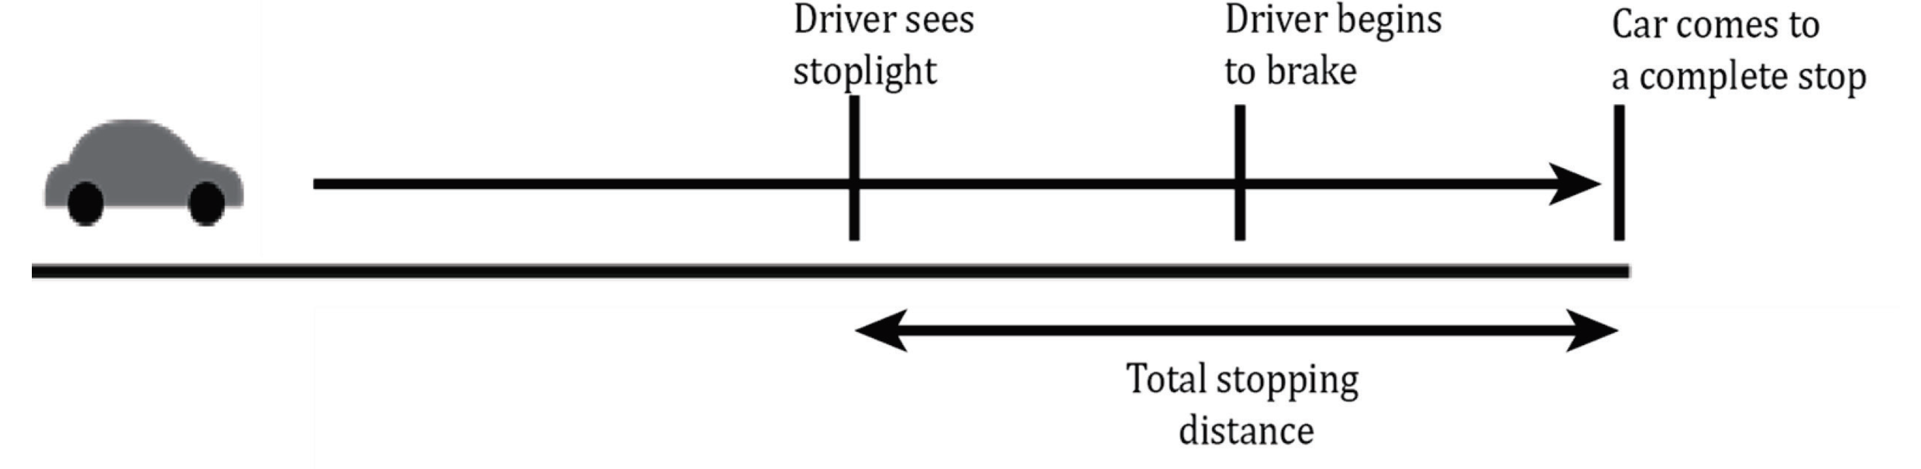

Notes:
Read and interpret data in more complex data presentations. Level: Intermediate Skill Group: Interpretation of Data

Slide 2
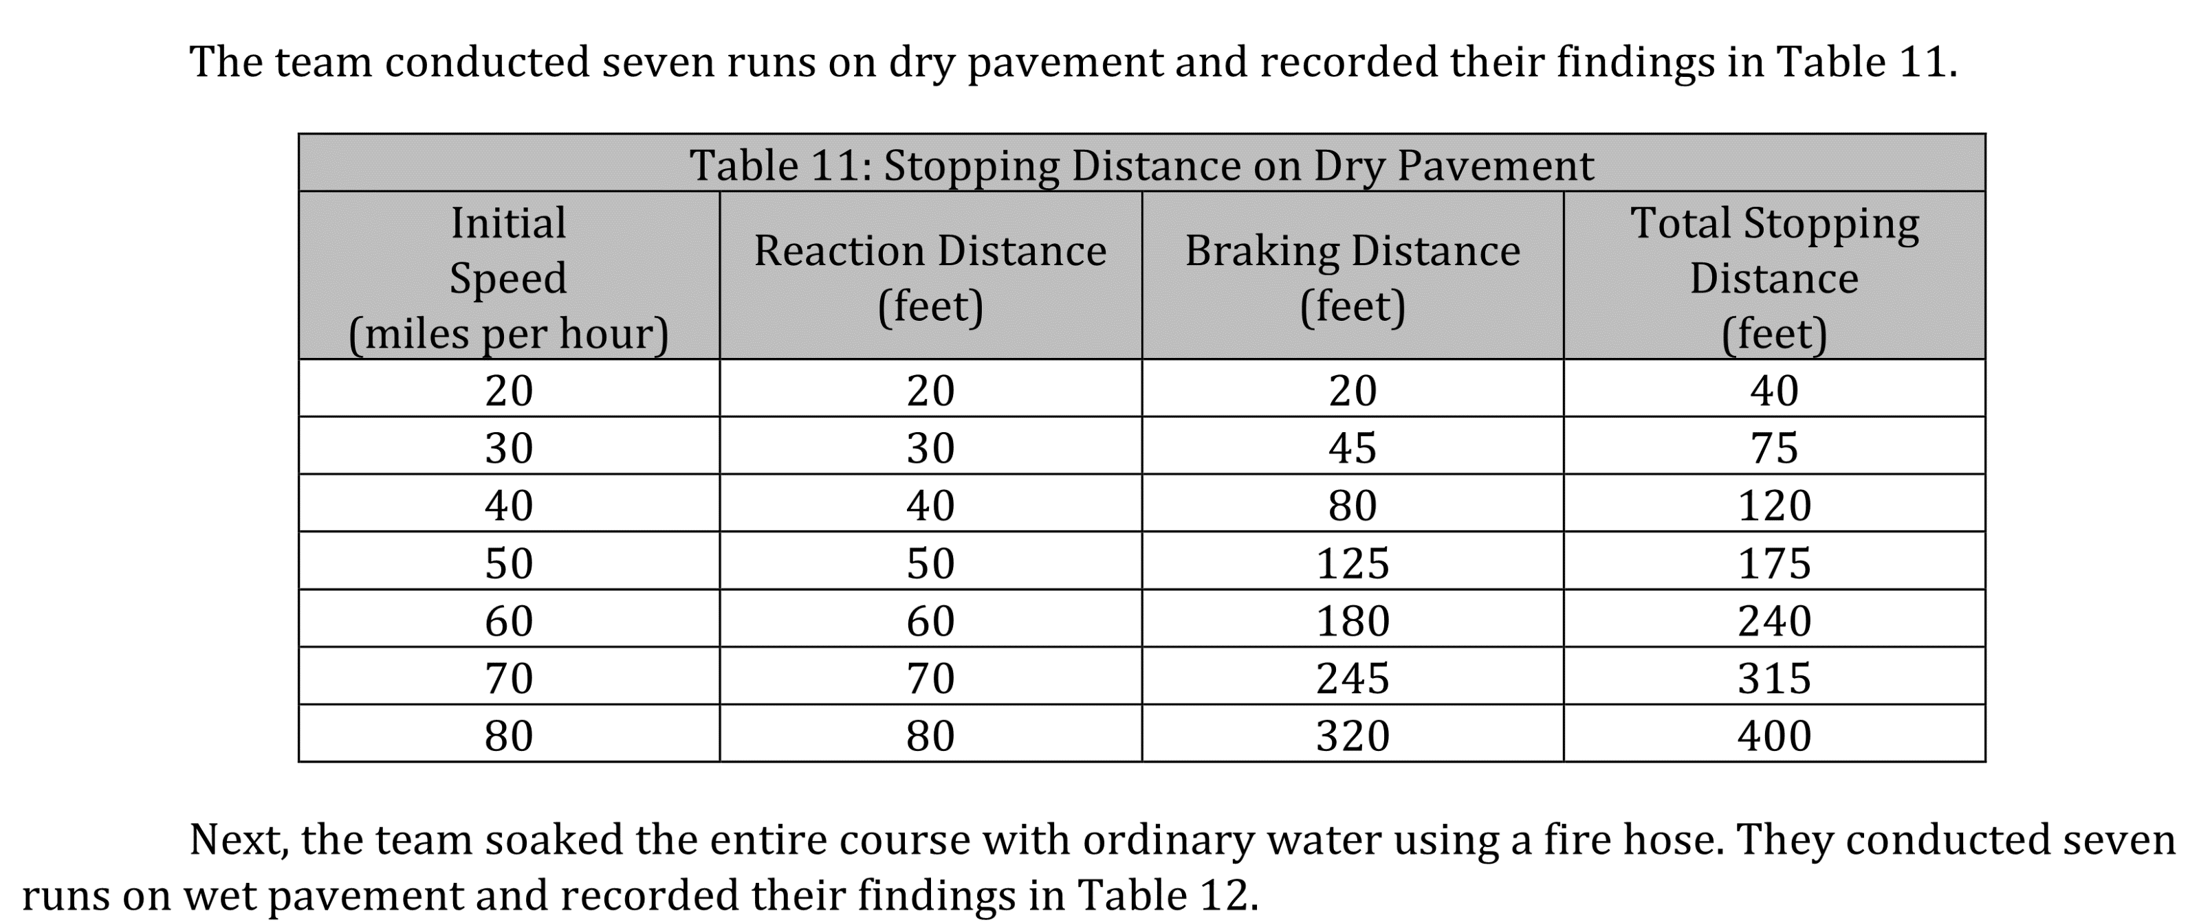
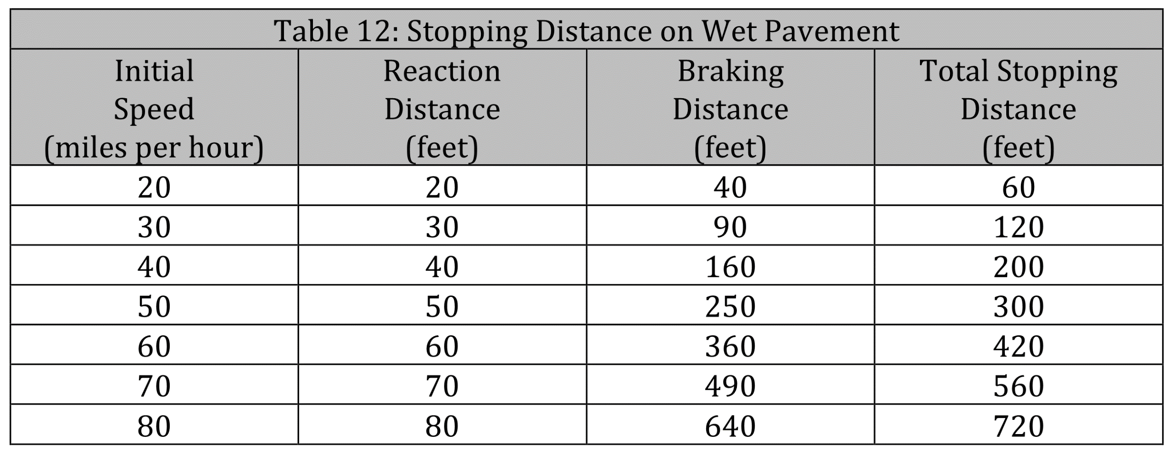
Notes:
Read and interpret data in more complex data presentations. Level: Intermediate Skill Group: Interpretation of Data

Slide 3
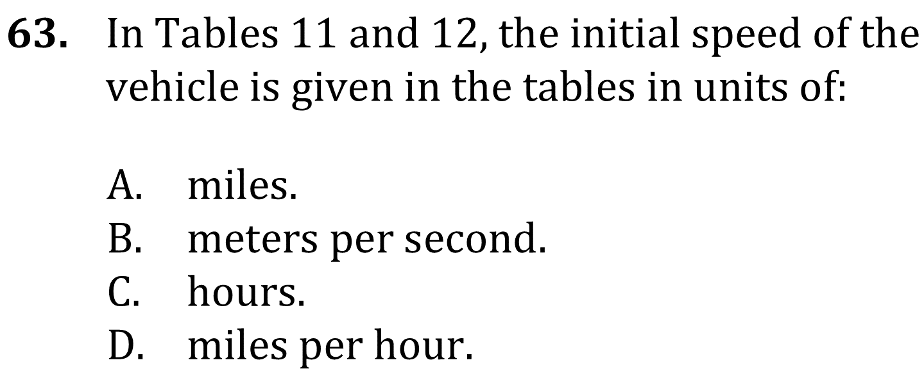
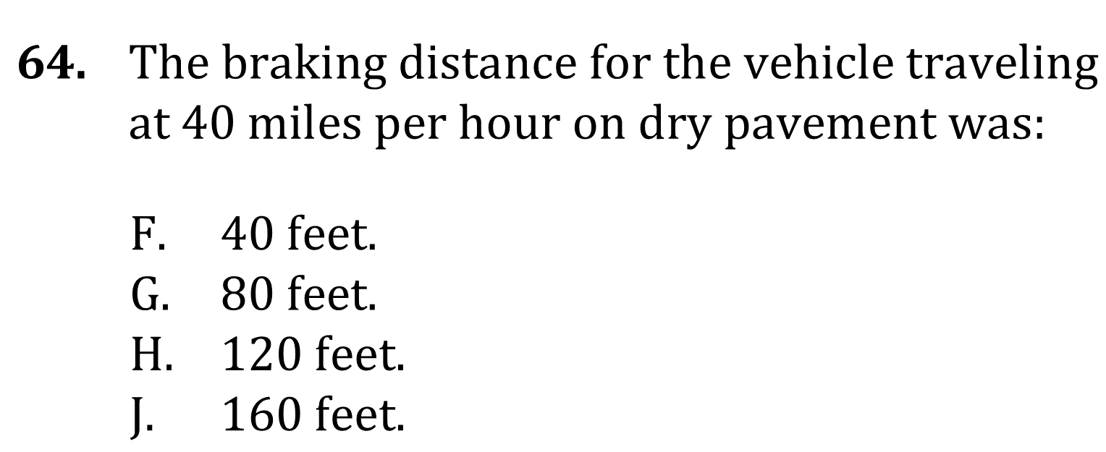
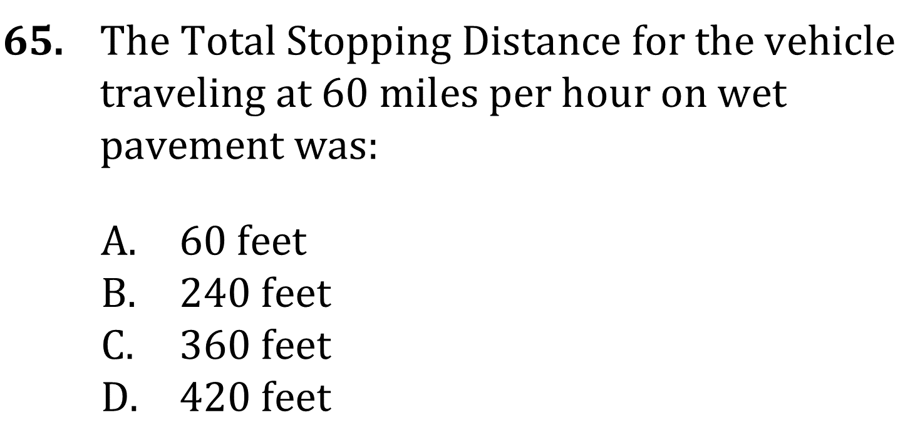
Notes:
Read and interpret data in more complex data presentations. Level: Intermediate Skill Group: Interpretation of Data

Slide 4
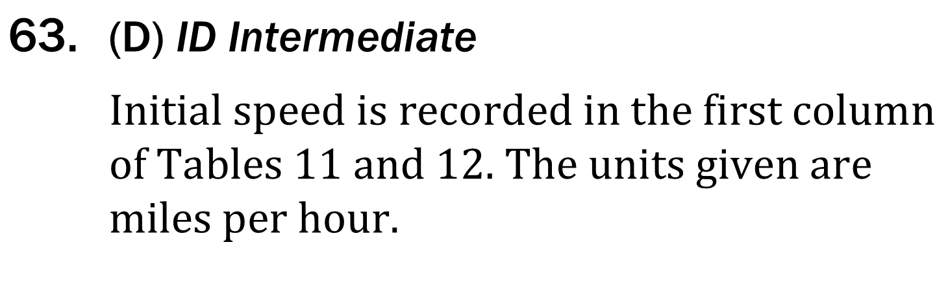
Notes:
Read and interpret data in more complex data presentations. Level: Intermediate Skill Group: Interpretation of Data

Slide 5
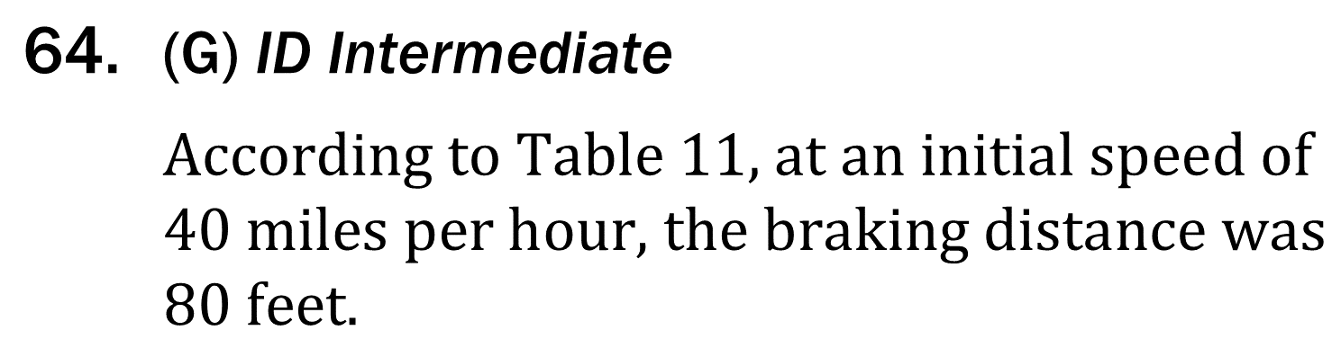
Notes:
Read and interpret data in more complex data presentations. Level: Intermediate Skill Group: Interpretation of Data

Slide 6
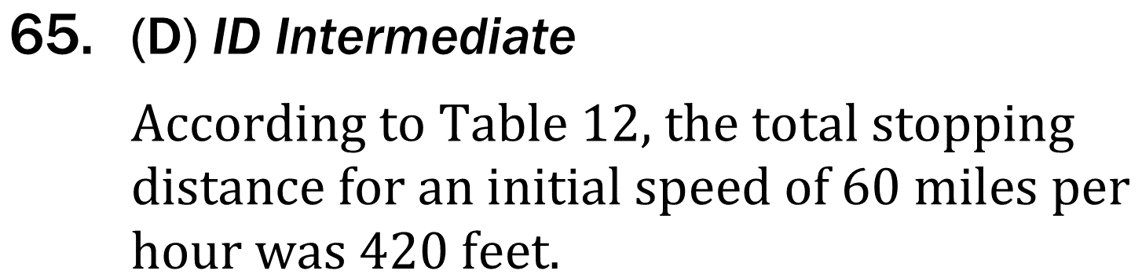
Notes:
Read and interpret data in more complex data presentations. Level: Intermediate Skill Group: Interpretation of Data

