Slide 1
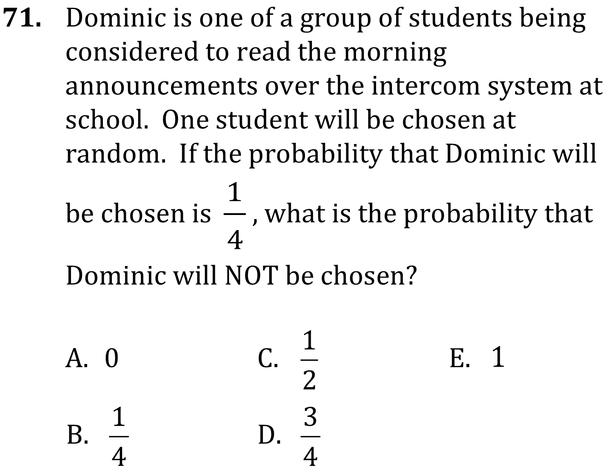

Probability

Slide 2
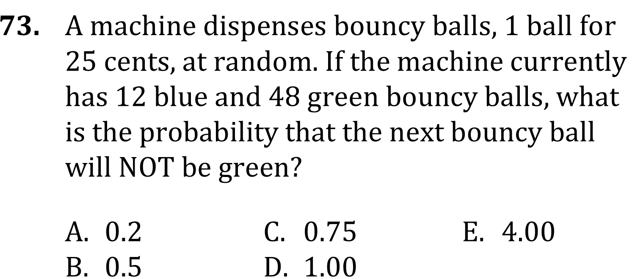
Probability

Slide 3
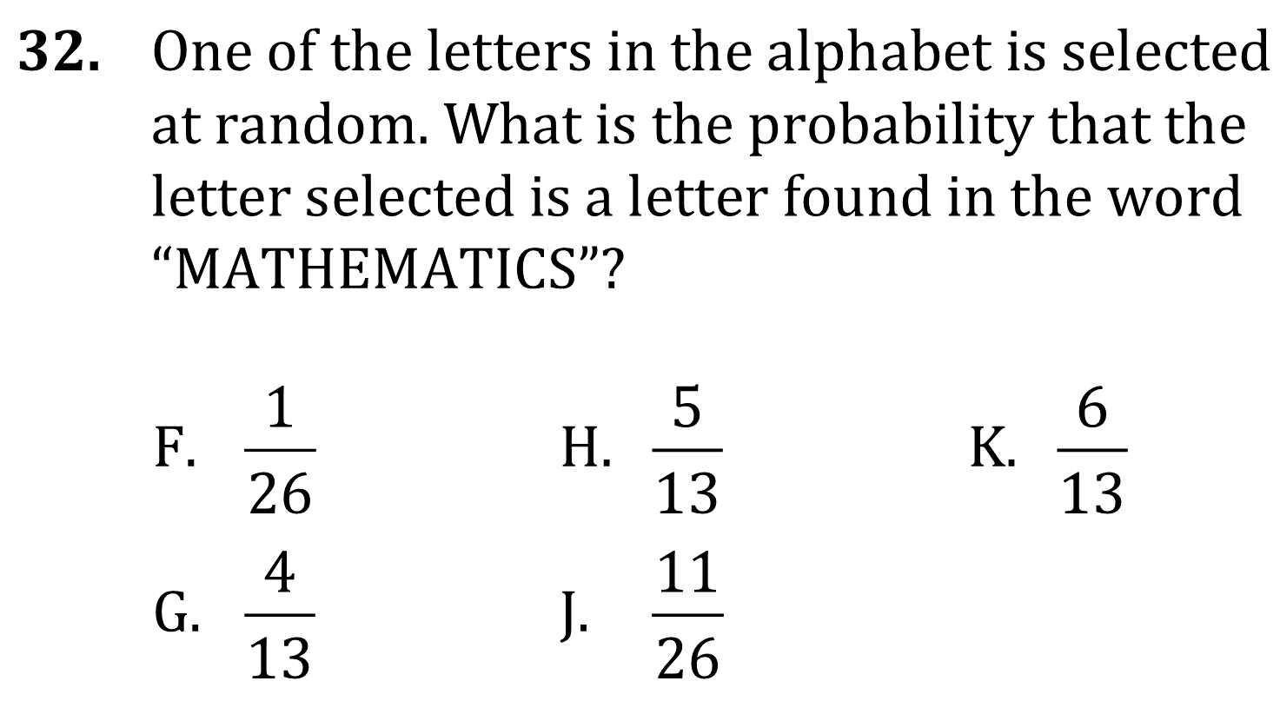
Probability

Slide 4

Probability

Slide 5
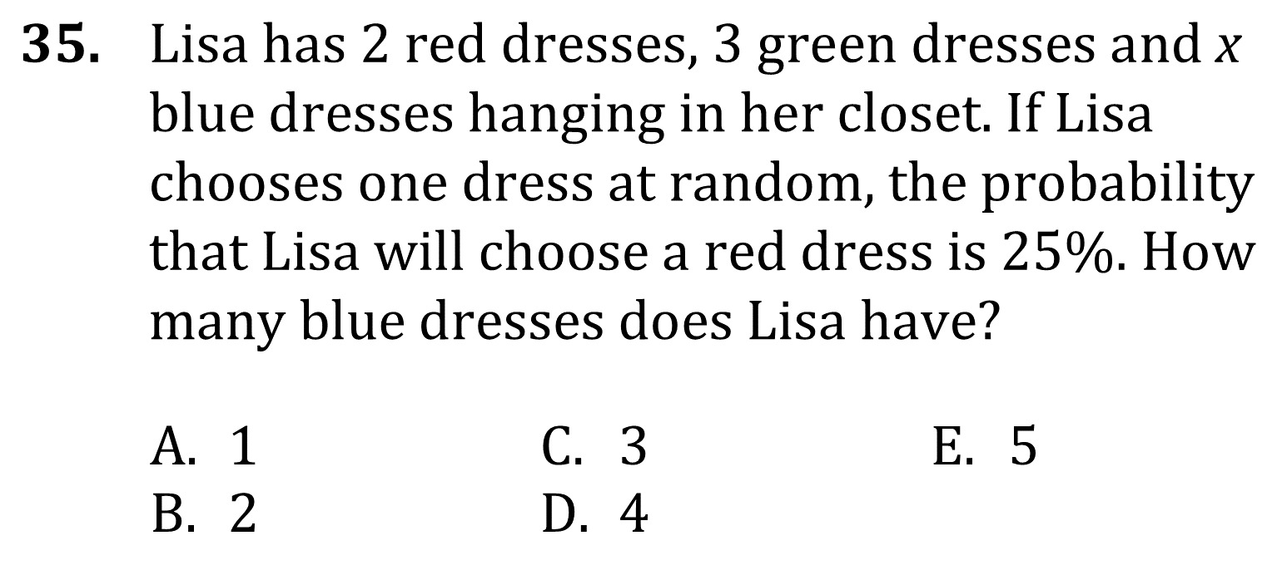
Probability

Slide 6

Probability

Slide 7

Probability

Slide 8
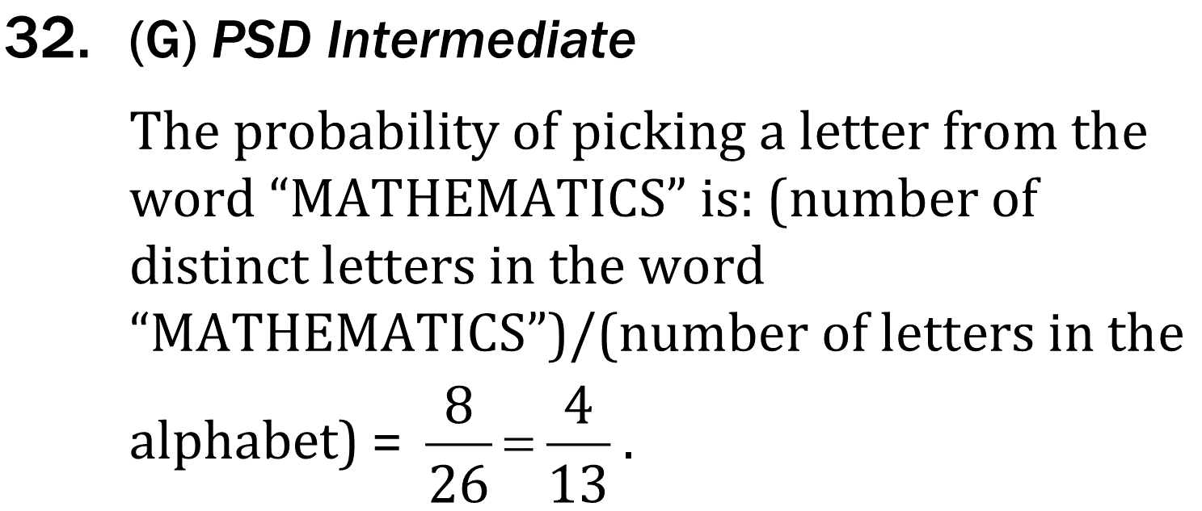
Probability

Slide 9

Probability

Slide 10
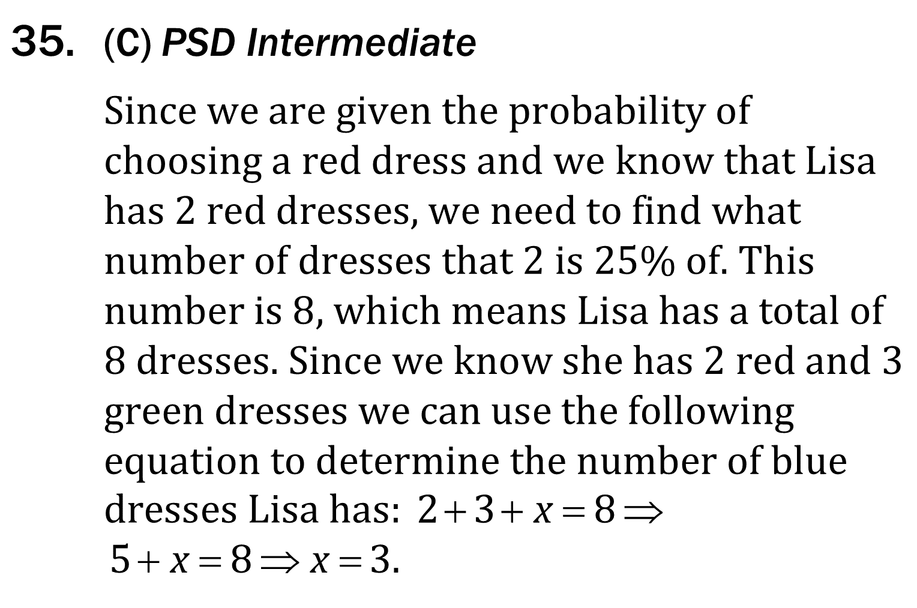
Probability

