Slide 1
Notes:
Read and interpret data in more complex data presentations; Understand the relationship between variable in more complex data presentations. Level: Intermediate Skill Group: Interpretation of Data

Slide 2
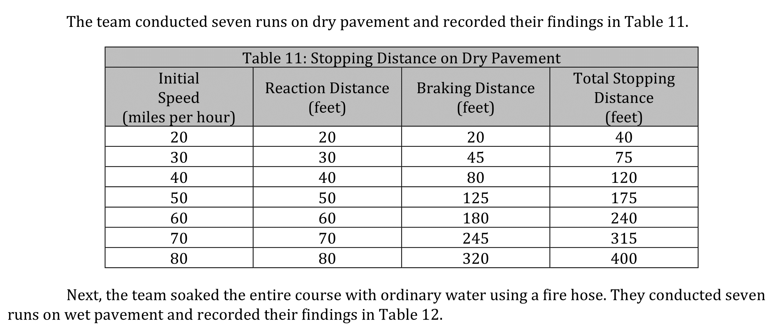
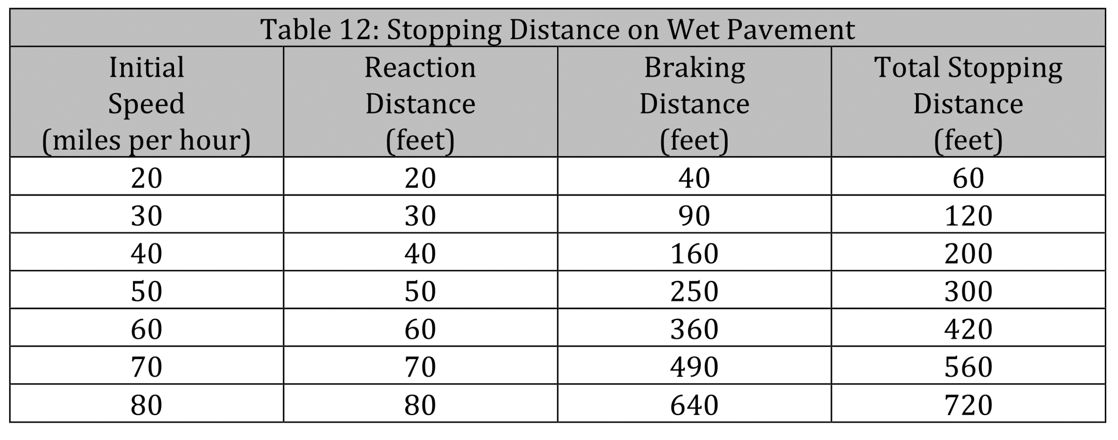
Notes:
Read and interpret data in more complex data presentations; Understand the relationship between variable in more complex data presentations. Level: Intermediate Skill Group: Interpretation of Data

Slide 3
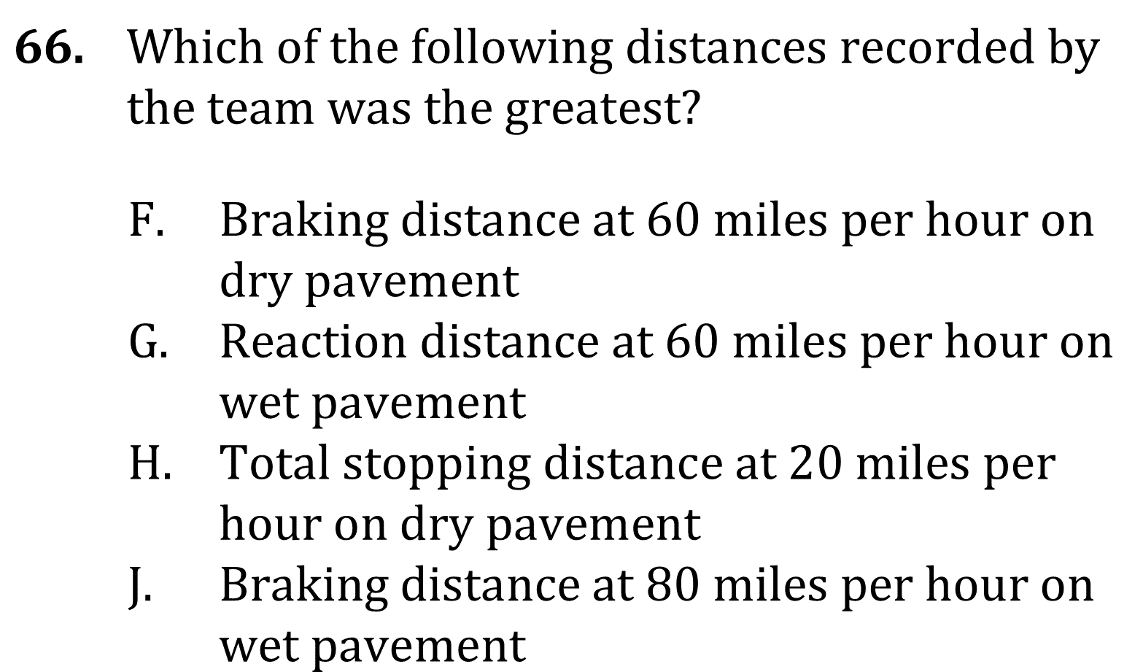
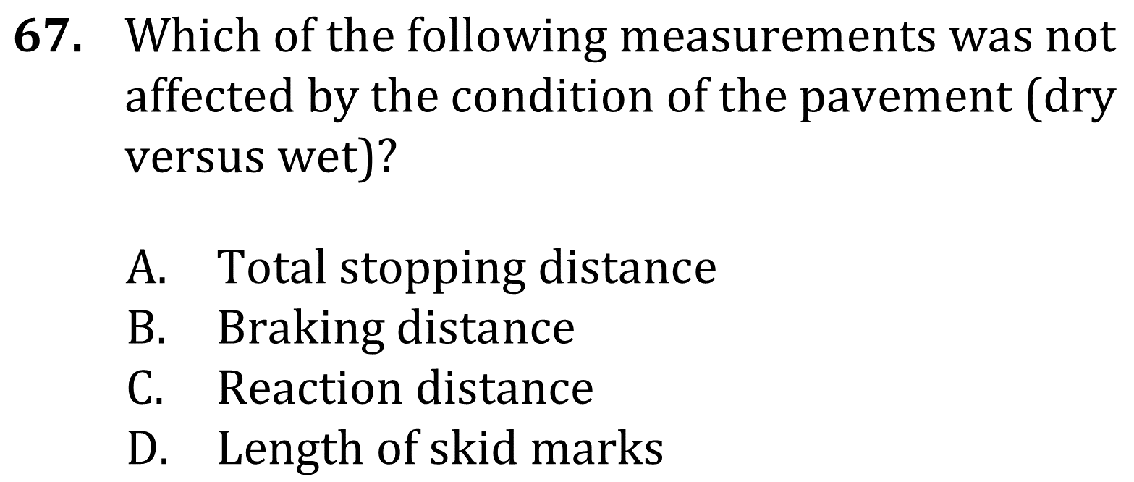
Notes:
Read and interpret data in more complex data presentations; Understand the relationship between variable in more complex data presentations. Level: Intermediate Skill Group: Interpretation of Data

Slide 4
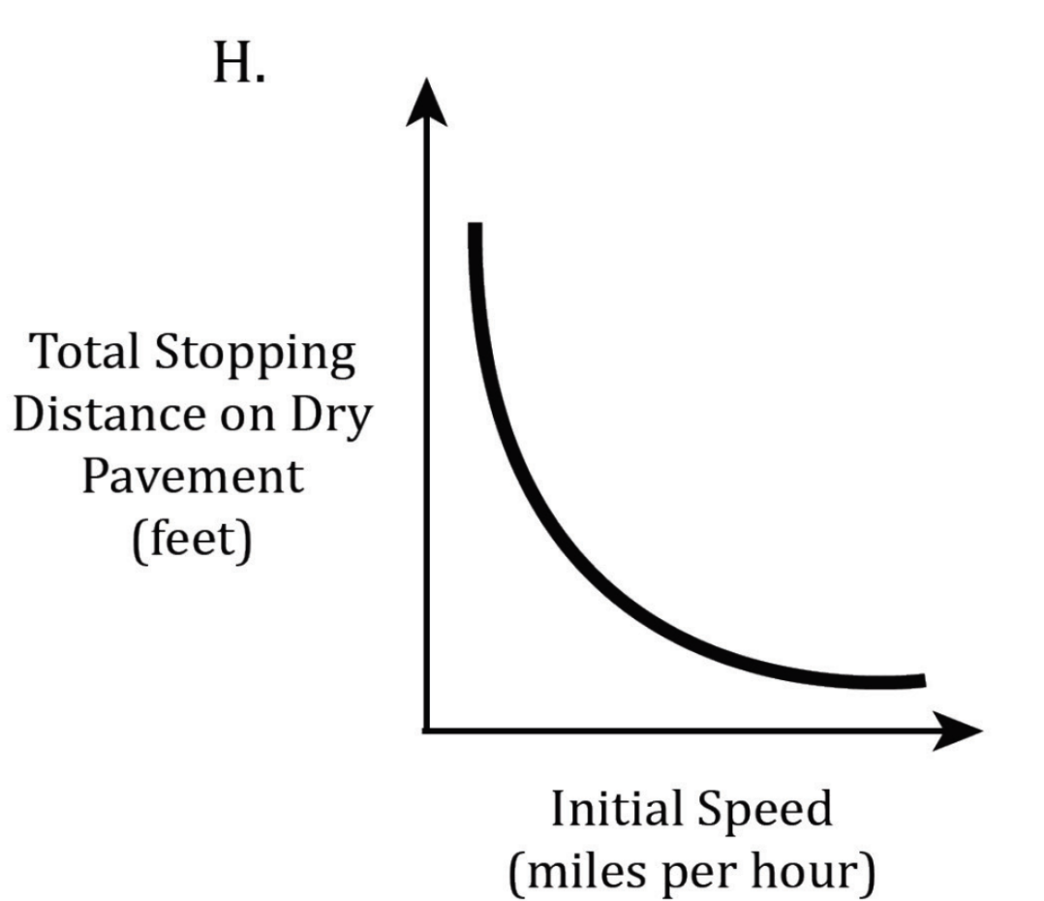
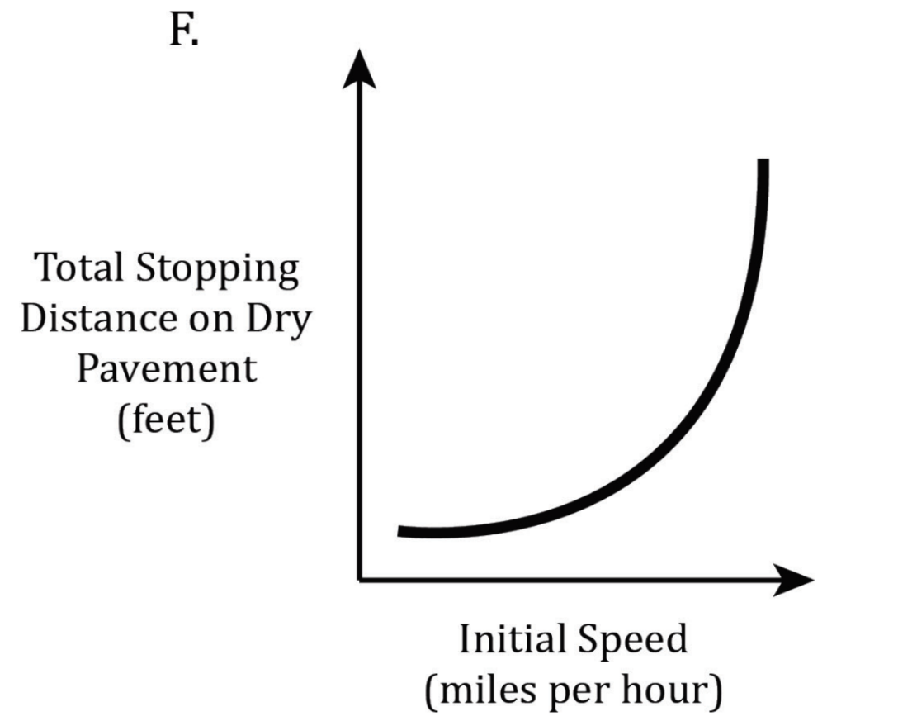
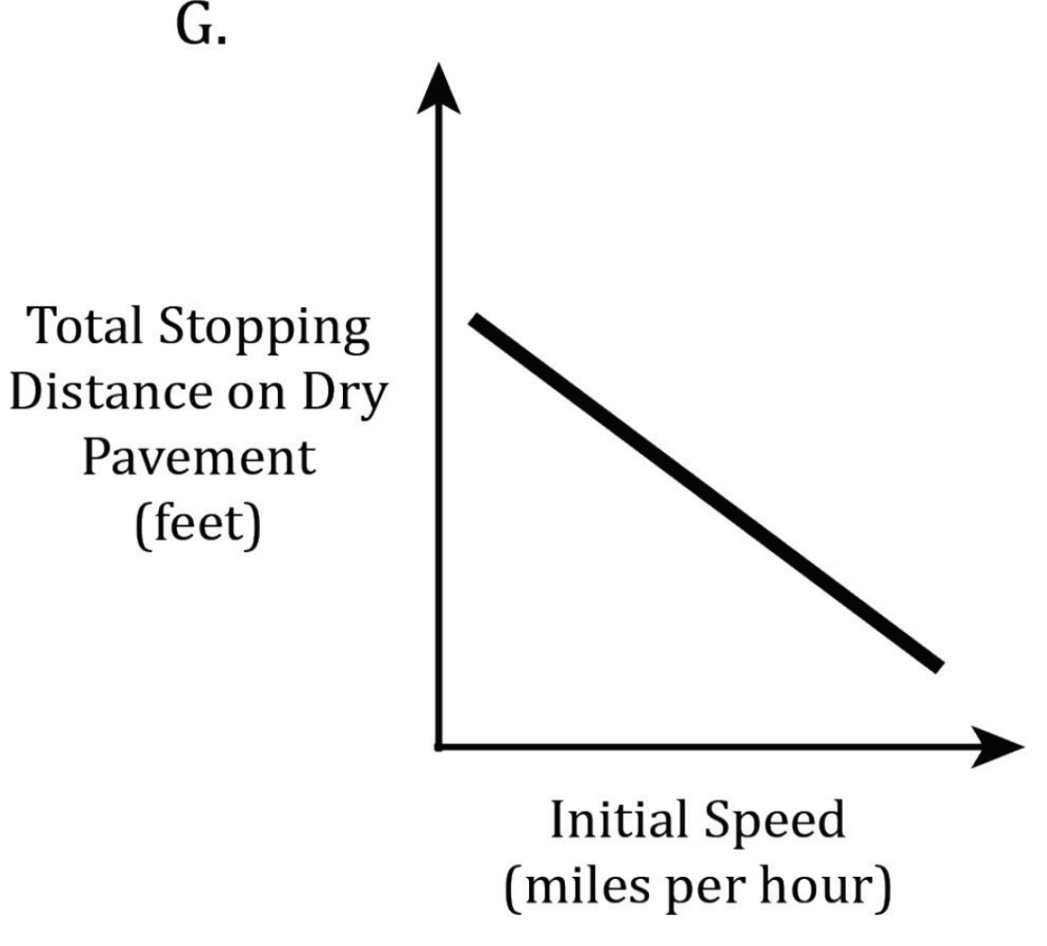
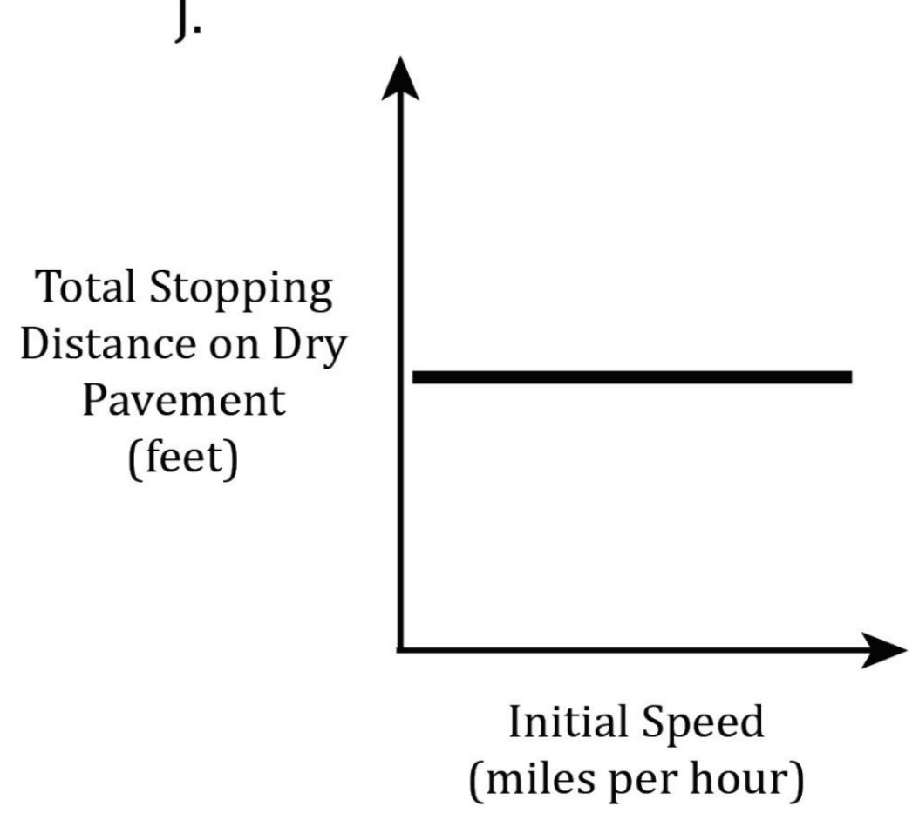
Notes:
Read and interpret data in more complex data presentations; Understand the relationship between variable in more complex data presentations. Level: Intermediate Skill Group: Interpretation of Data

Slide 5
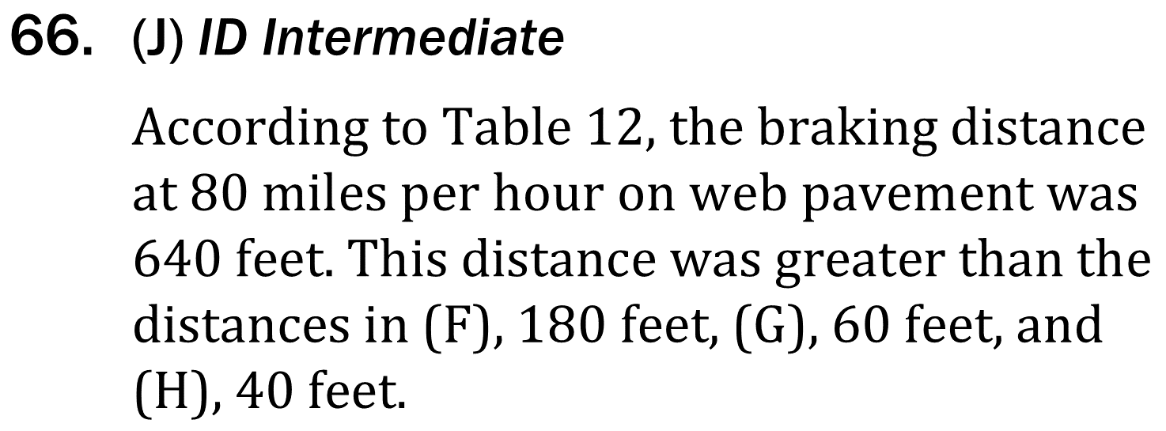
Notes:
Read and interpret data in more complex data presentations; Understand the relationship between variable in more complex data presentations. Level: Intermediate Skill Group: Interpretation of Data

Slide 6
Notes:
Read and interpret data in more complex data presentations; Understand the relationship between variable in more complex data presentations. Level: Intermediate Skill Group: Interpretation of Data

Slide 7
Notes:
Read and interpret data in more complex data presentations; Understand the relationship between variable in more complex data presentations. Level: Intermediate Skill Group: Interpretation of Data

