Slide 1
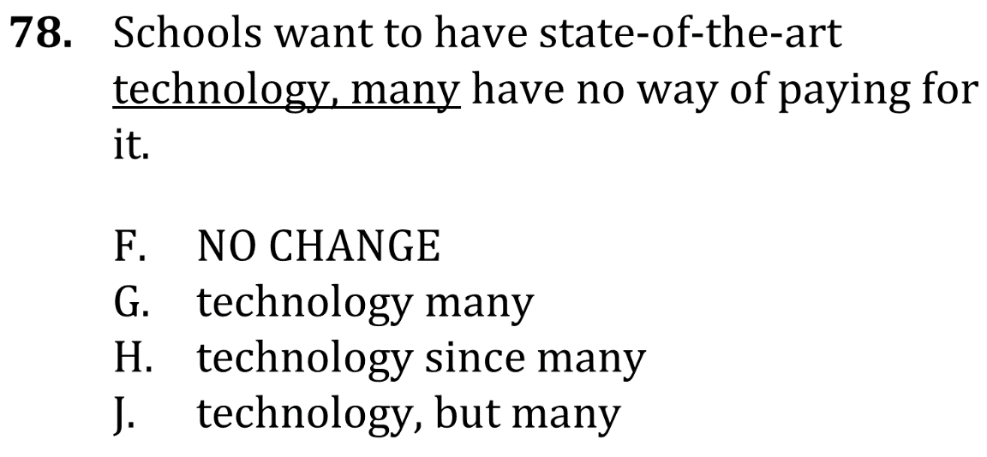
eliminate Fragments and Run-ons

Slide 2
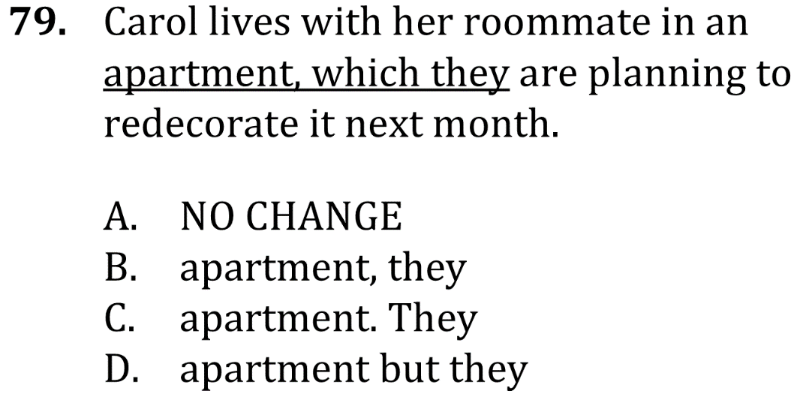
eliminate Fragments and Run-ons

Slide 3
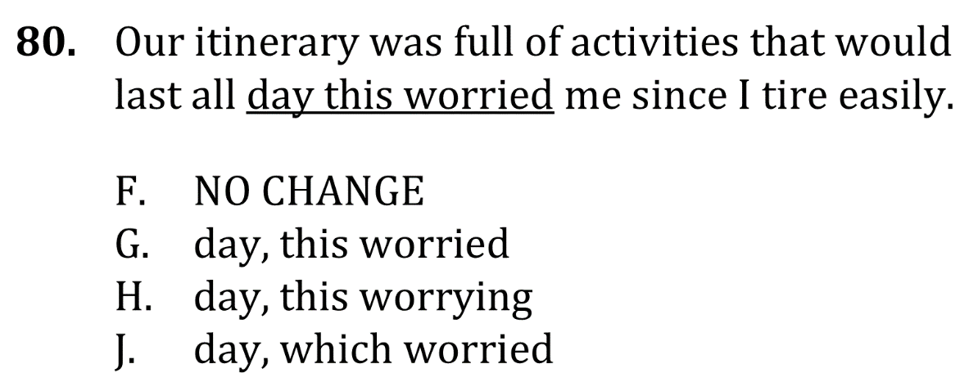
eliminate Fragments and Run-ons

Slide 4
eliminate Fragments and Run-ons

Slide 5
eliminate Fragments and Run-ons

Slide 6
eliminate Fragments and Run-ons

