Slide 1
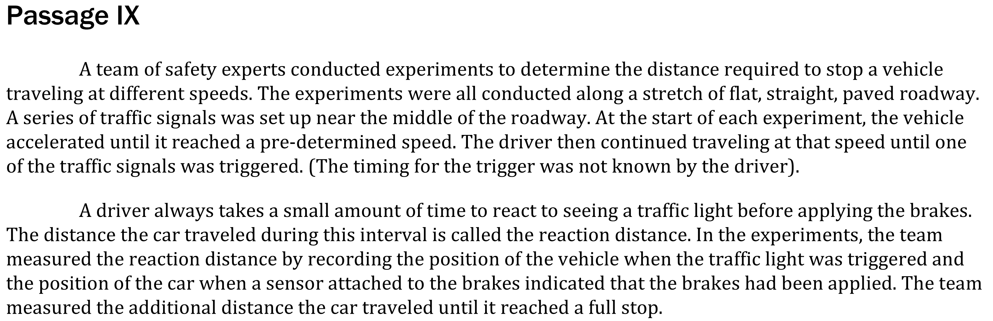
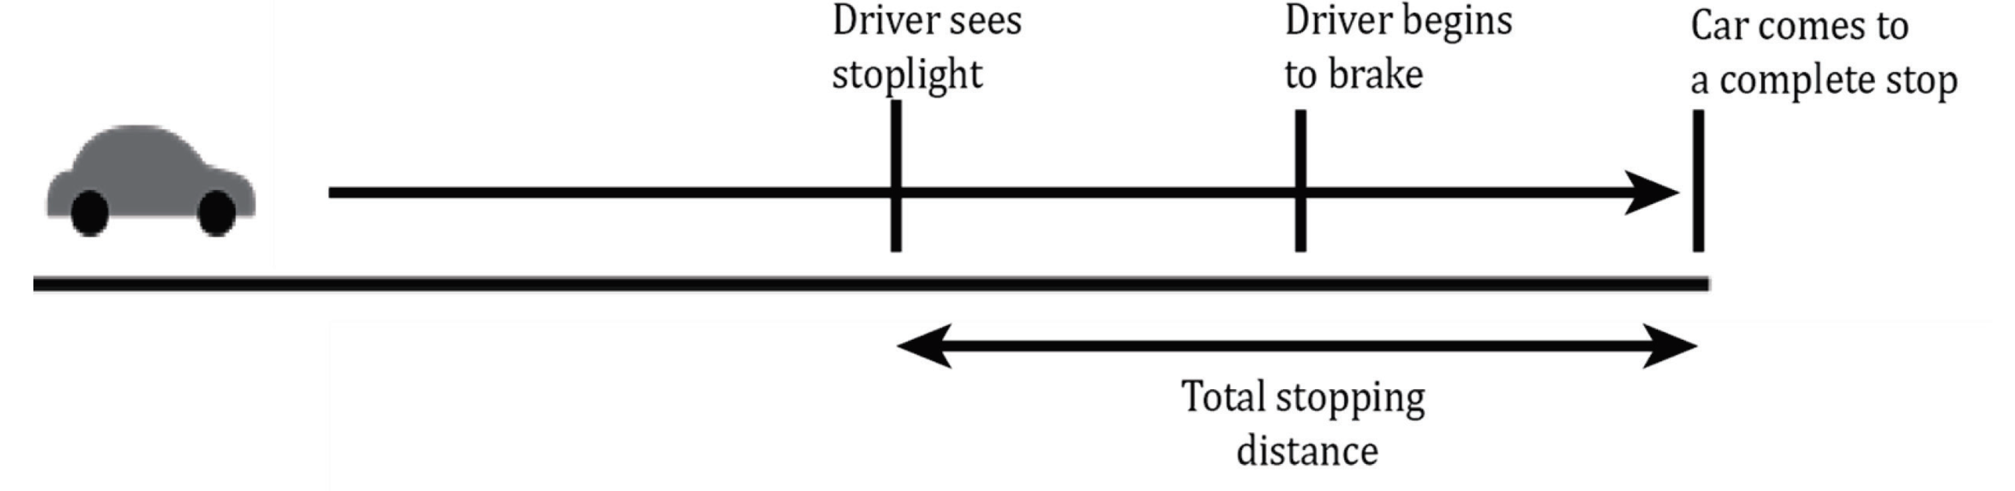

Notes:
Understand basic scientific terms; Understand tools and methods in an experiment; Understand experimental design. Level: Intermediate Skill Group: Scientific Investigation

Slide 2
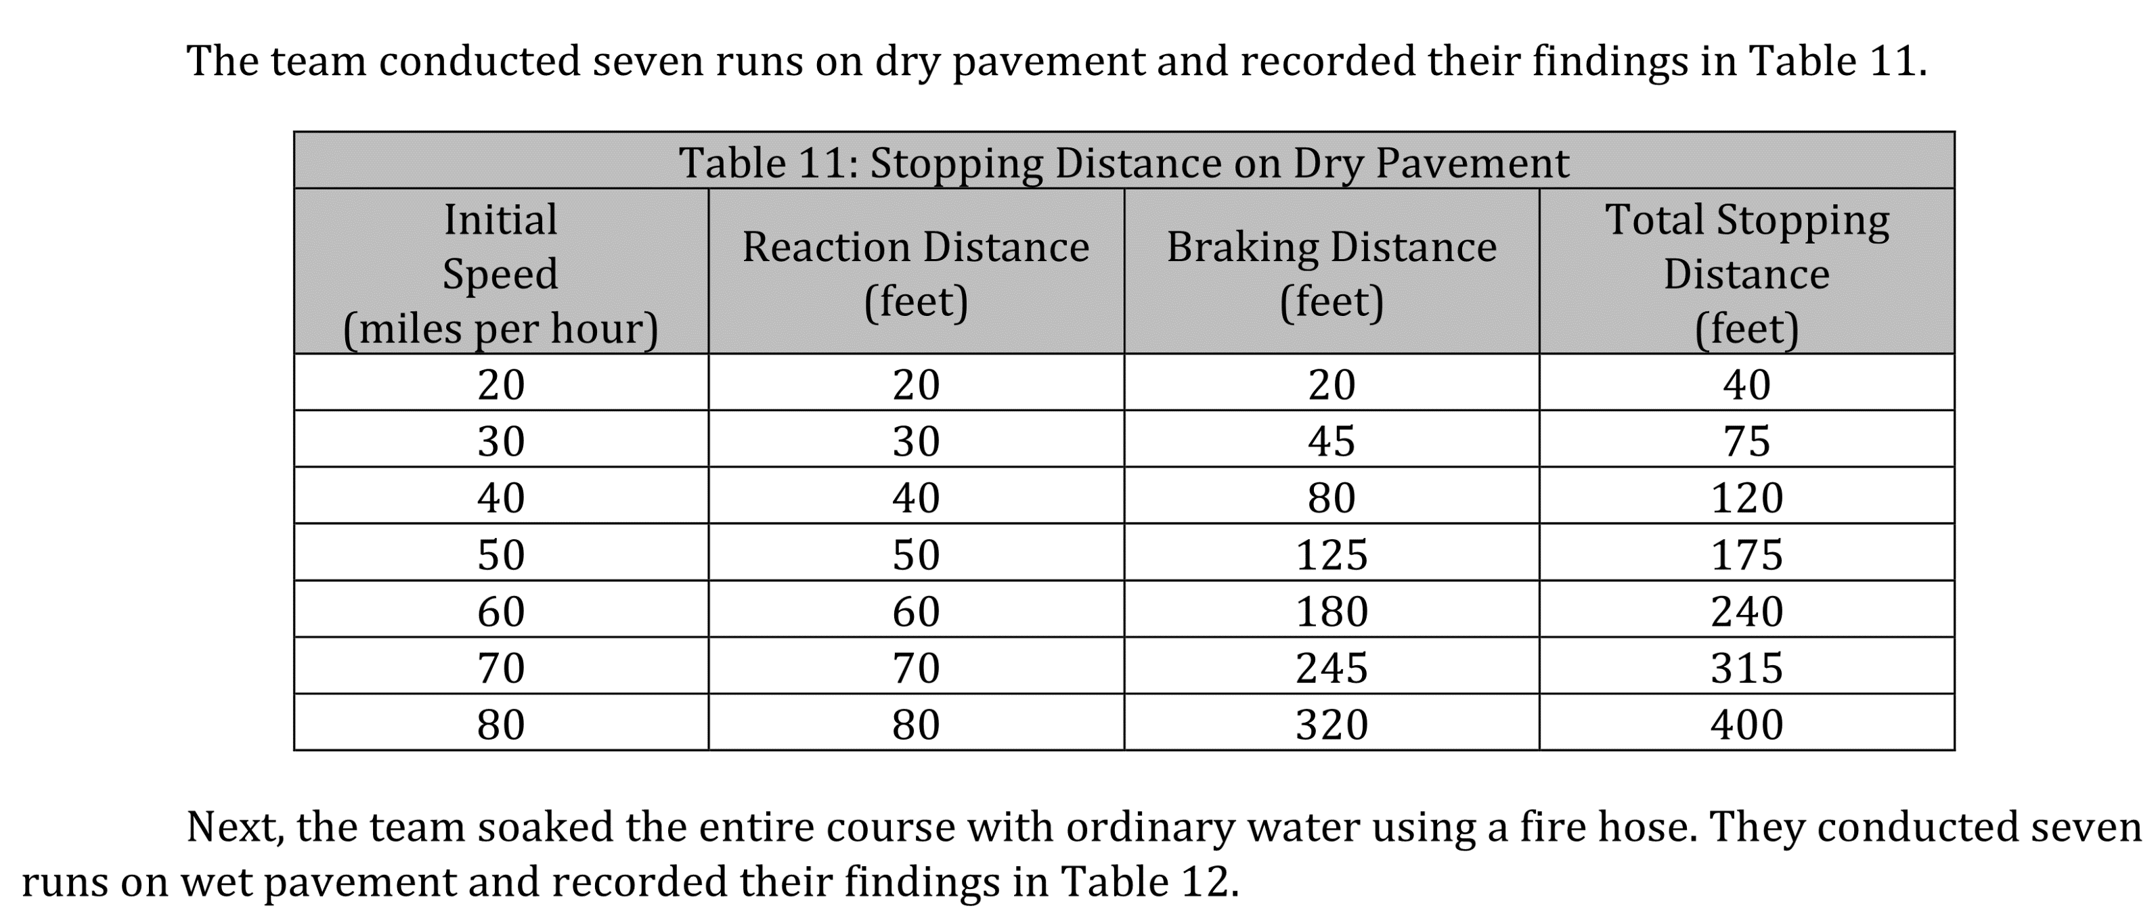
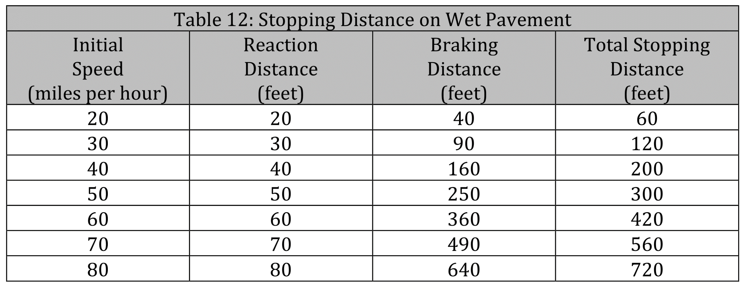
Notes:
Understand basic scientific terms; Understand tools and methods in an experiment; Understand experimental design. Level: Intermediate Skill Group: Scientific Investigation

Slide 3
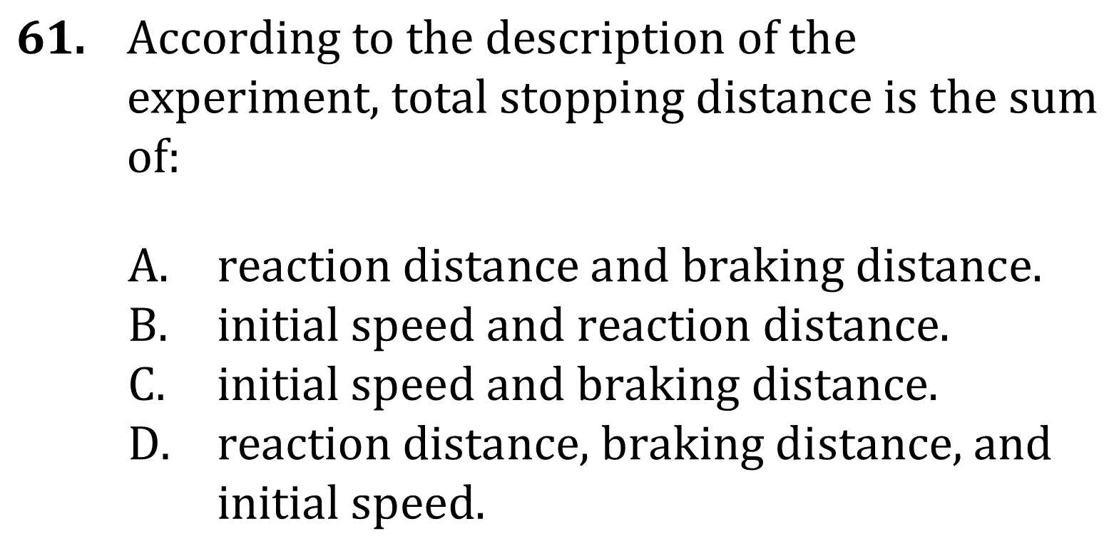
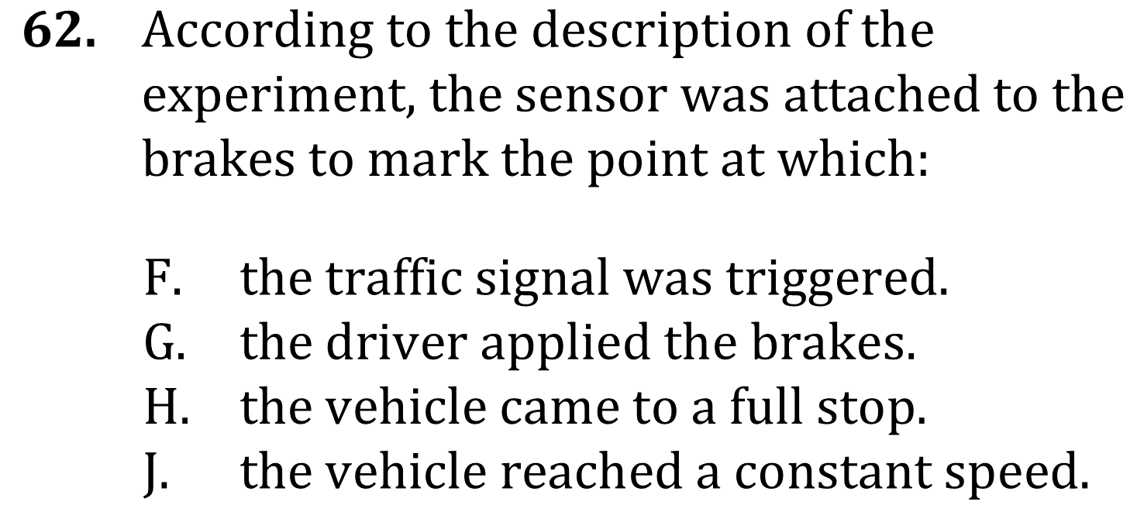
Notes:
Understand basic scientific terms; Understand tools and methods in an experiment; Understand experimental design. Level: Intermediate Skill Group: Scientific Investigation

Slide 4
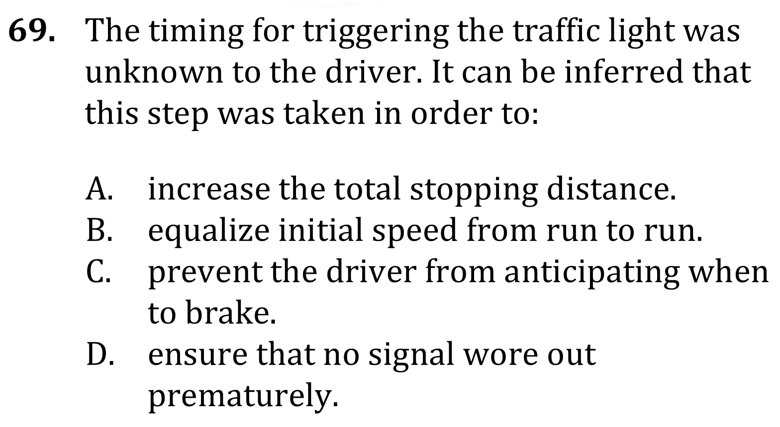
Notes:
Understand basic scientific terms; Understand tools and methods in an experiment; Understand experimental design. Level: Intermediate Skill Group: Scientific Investigation

Slide 5
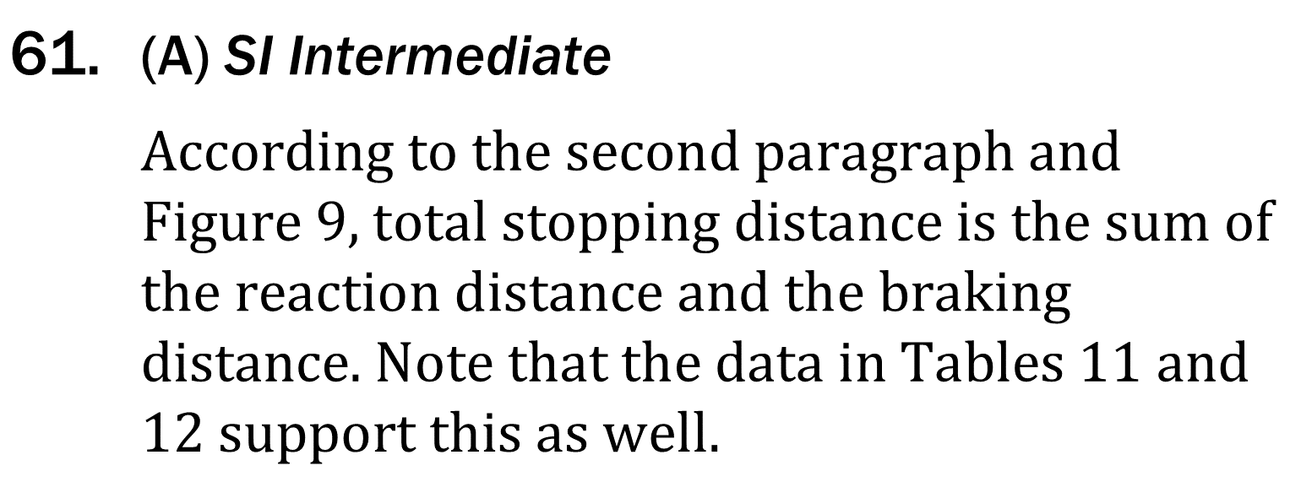
Notes:
Understand basic scientific terms; Understand tools and methods in an experiment; Understand experimental design. Level: Intermediate Skill Group: Scientific Investigation

Slide 6
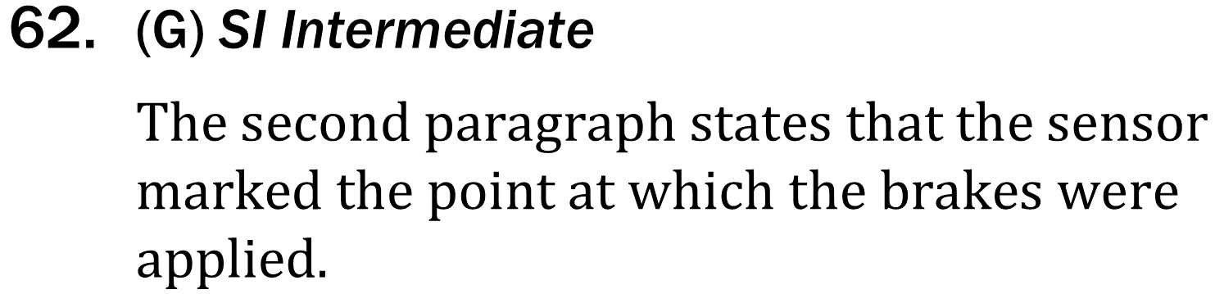
Notes:
Understand basic scientific terms; Understand tools and methods in an experiment; Understand experimental design. Level: Intermediate Skill Group: Scientific Investigation

Slide 7
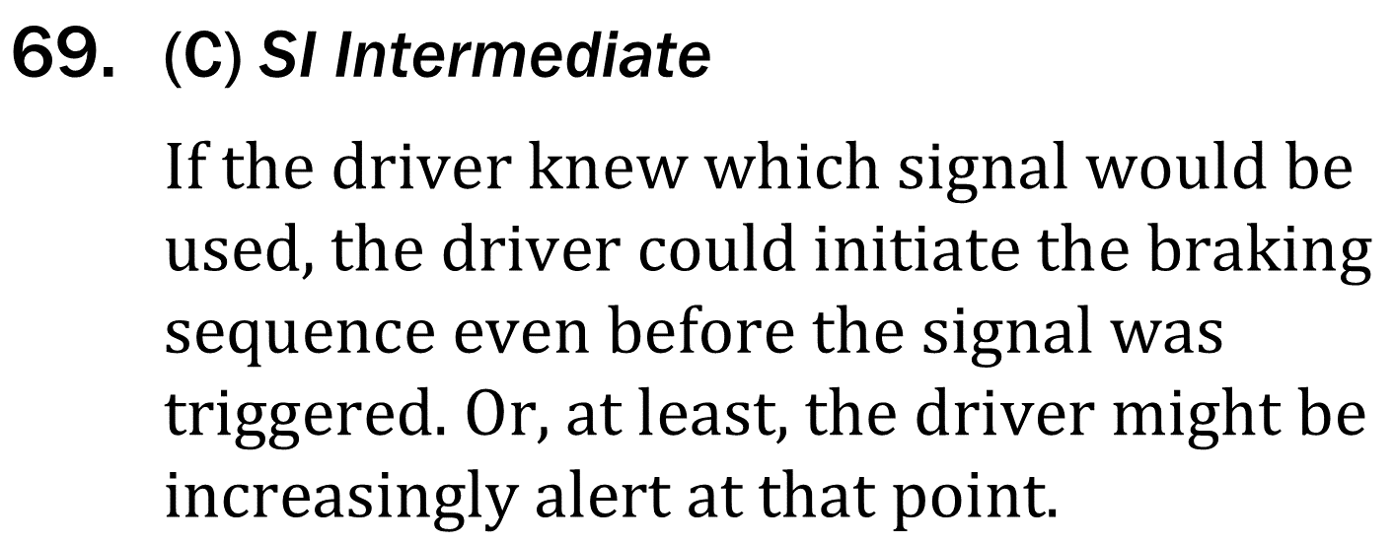
Notes:
Understand basic scientific terms; Understand tools and methods in an experiment; Understand experimental design. Level: Intermediate Skill Group: Scientific Investigation

