Slide 1
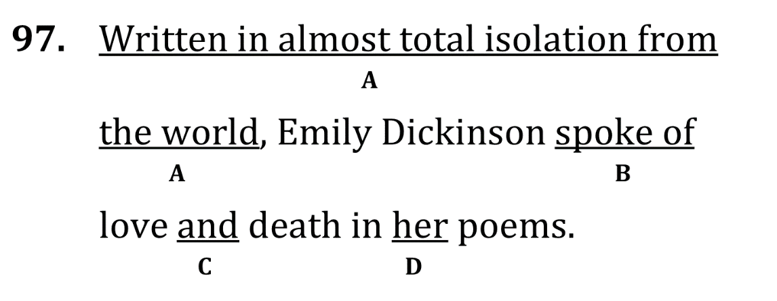
Correct Dangling Modifiers

Slide 2
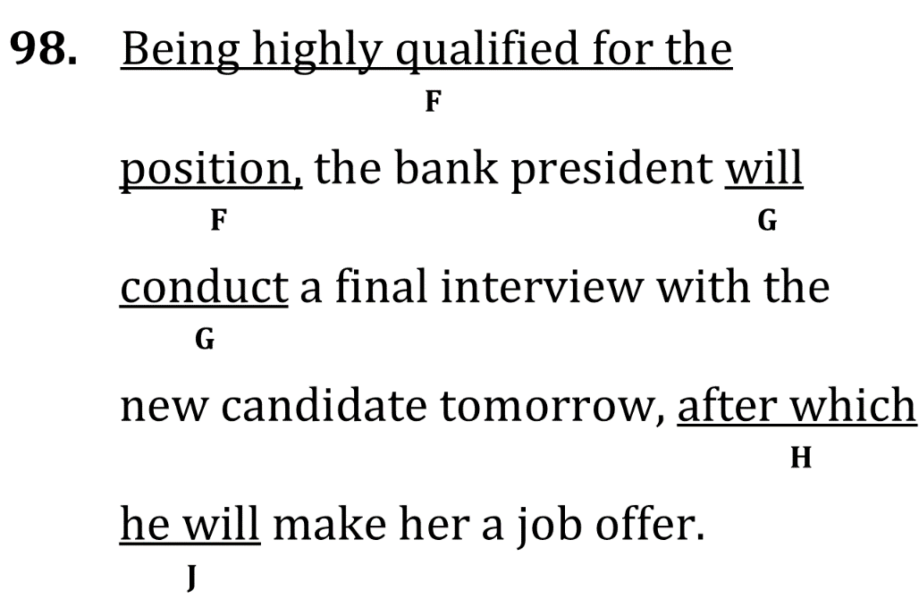
Correct Dangling Modifiers

Slide 3
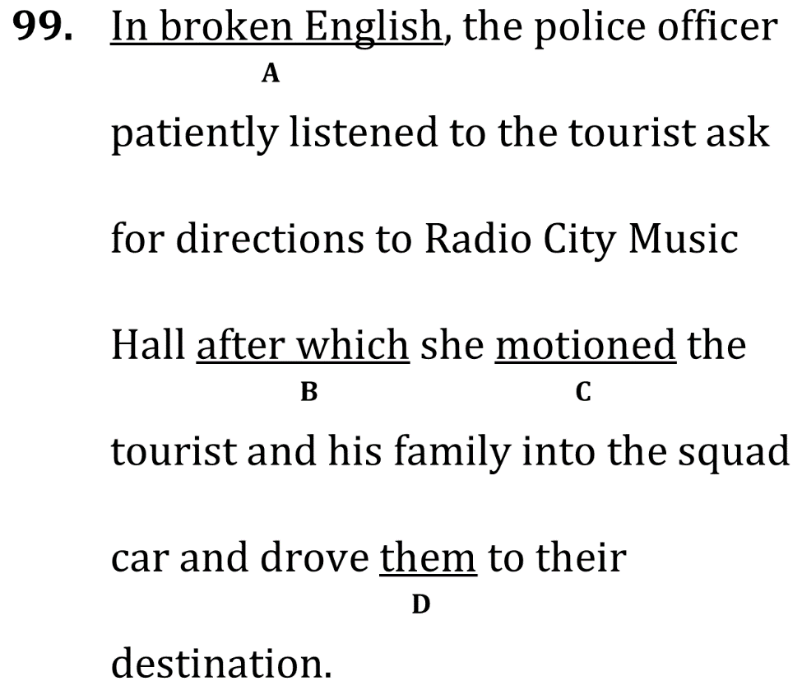
Correct Dangling Modifiers

Slide 4
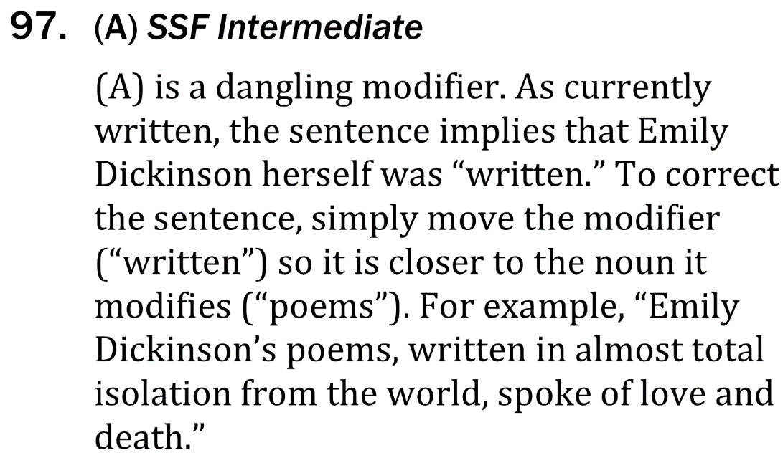
Correct Dangling Modifiers

Slide 5
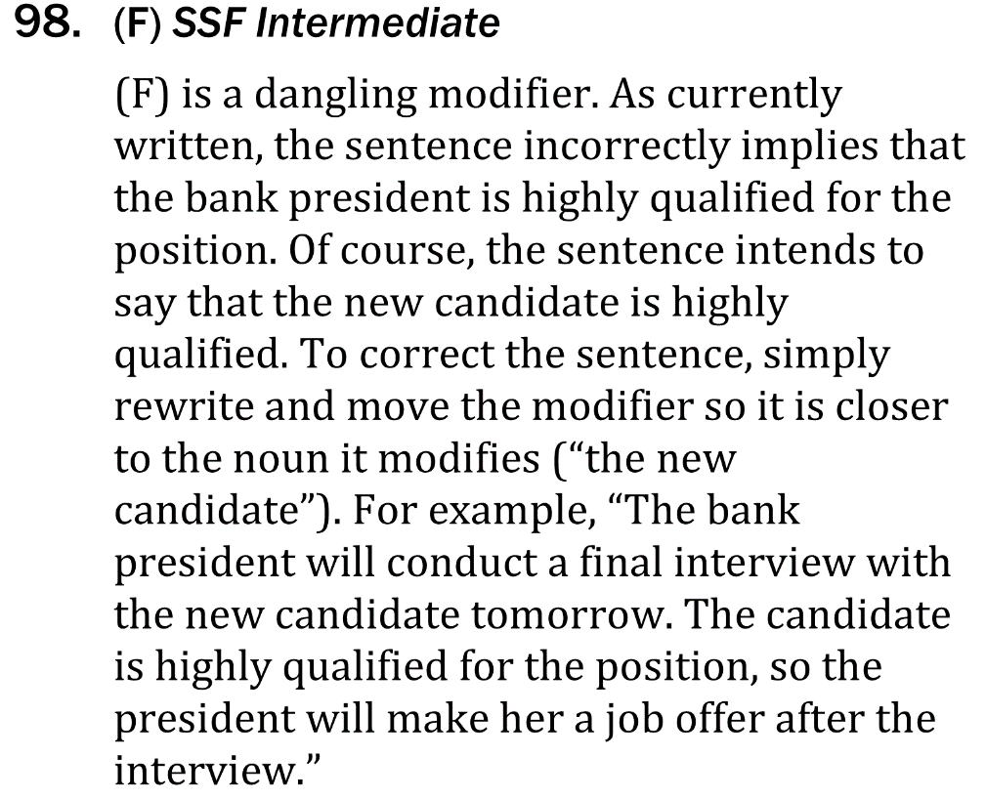
Correct Dangling Modifiers

Slide 6
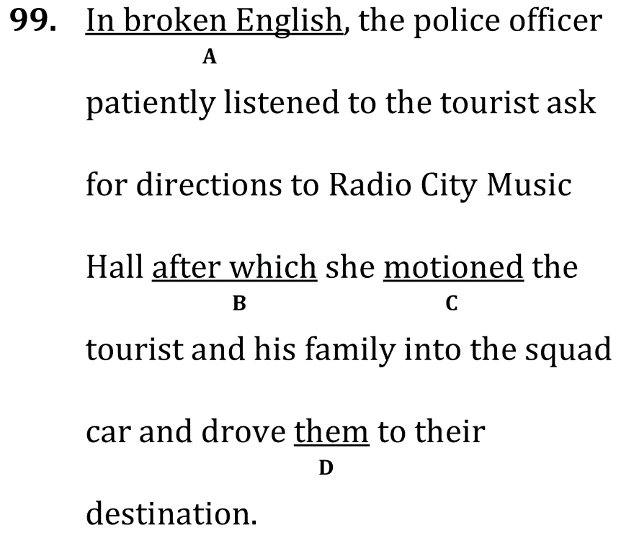
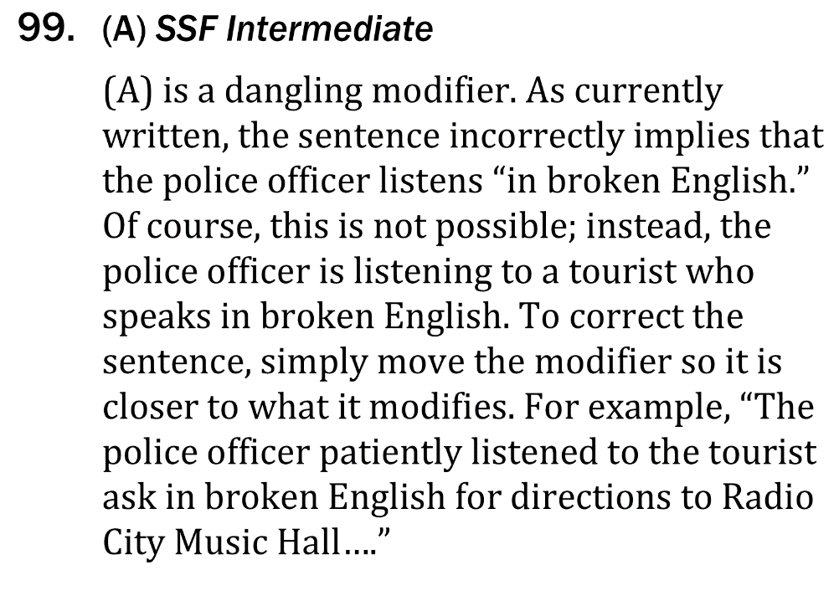
Correct Dangling Modifiers

