Slide 1
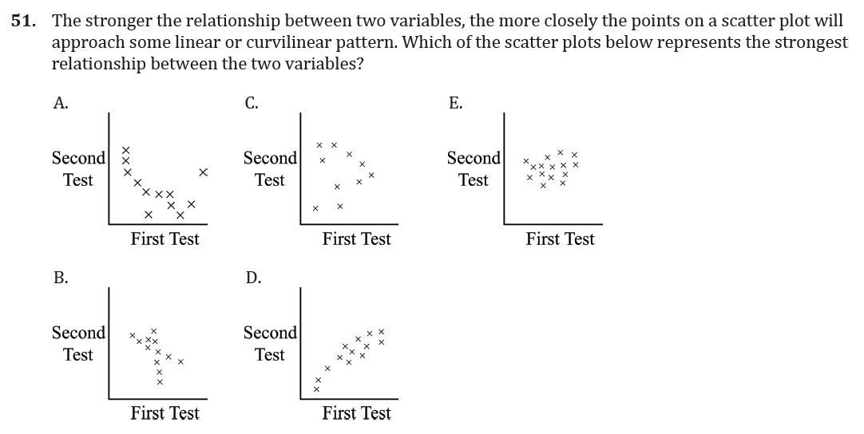
Tables and Graphs

Slide 2
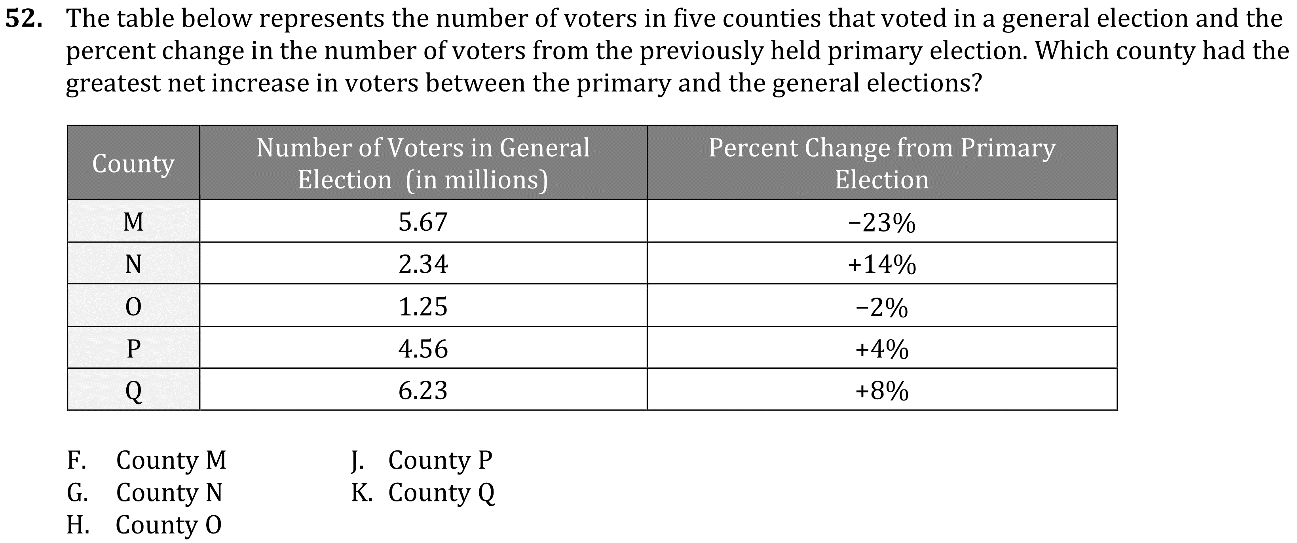
Tables and Graphs

Slide 3
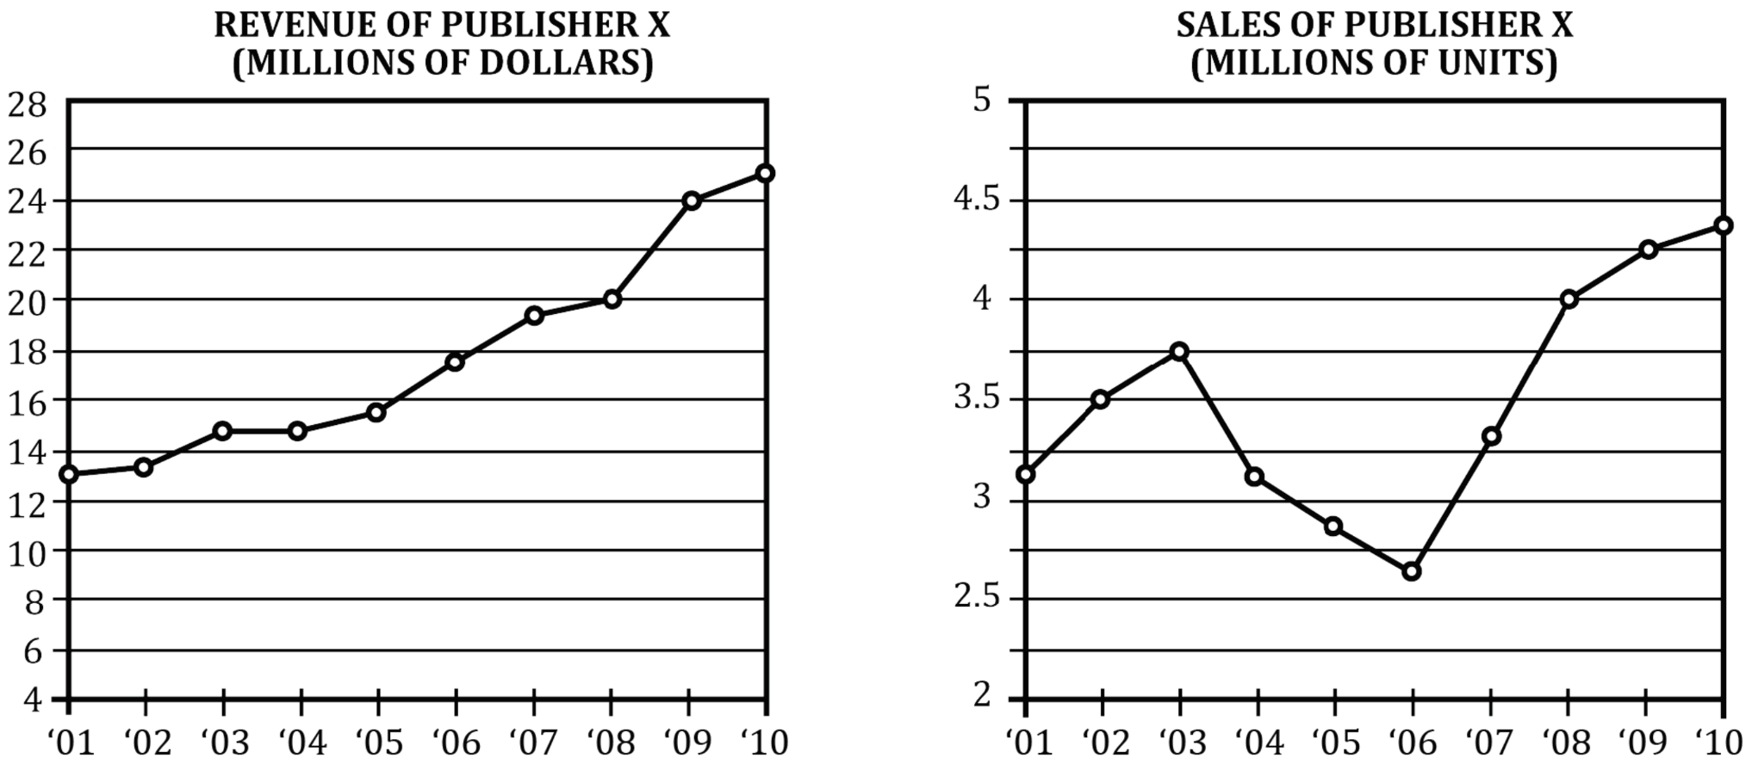
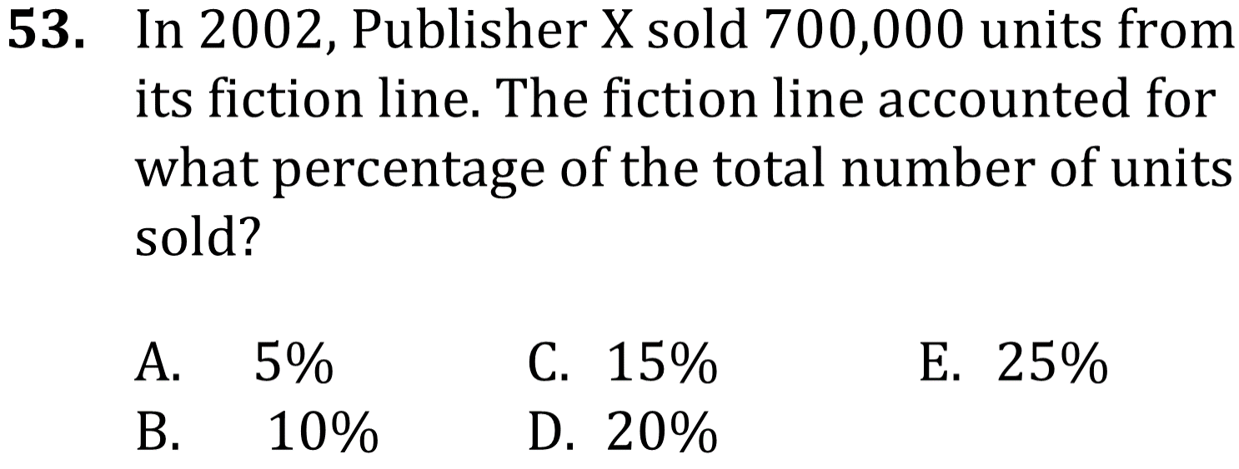
Tables and Graphs

Slide 4
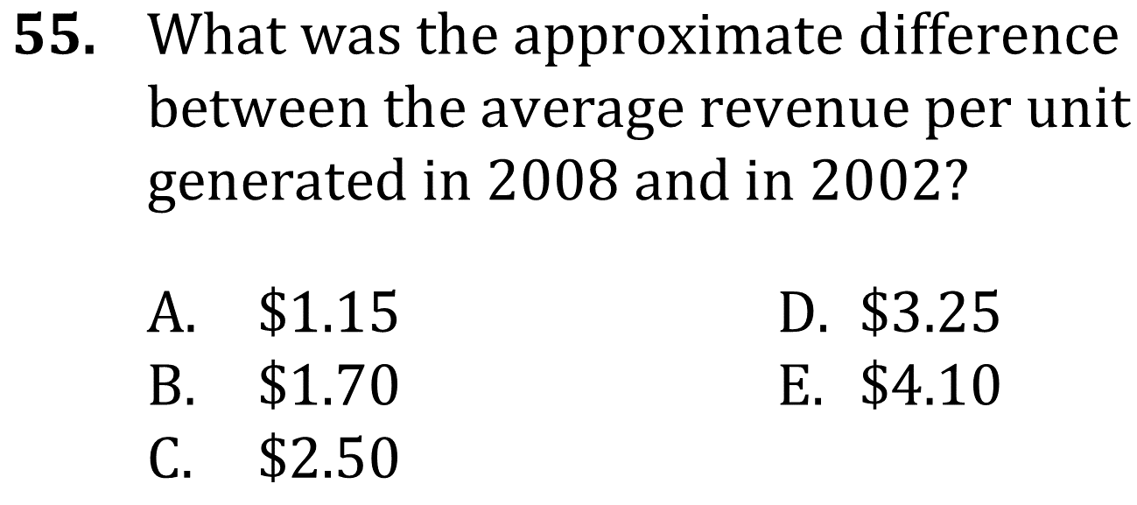
Tables and Graphs

Slide 5
Tables and Graphs

Slide 6
Tables and Graphs

Slide 7
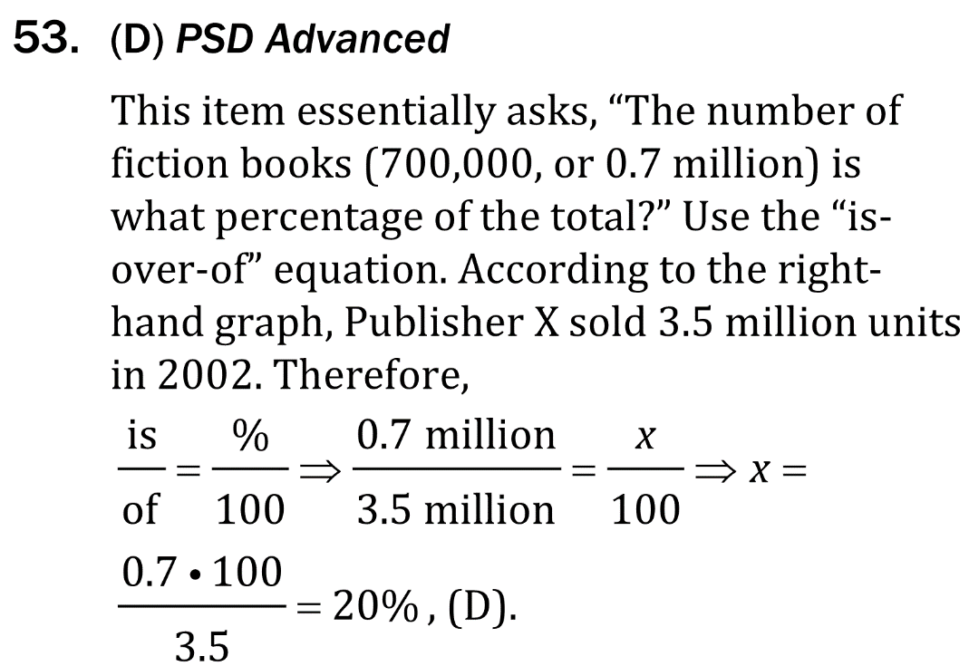
Tables and Graphs

Slide 8
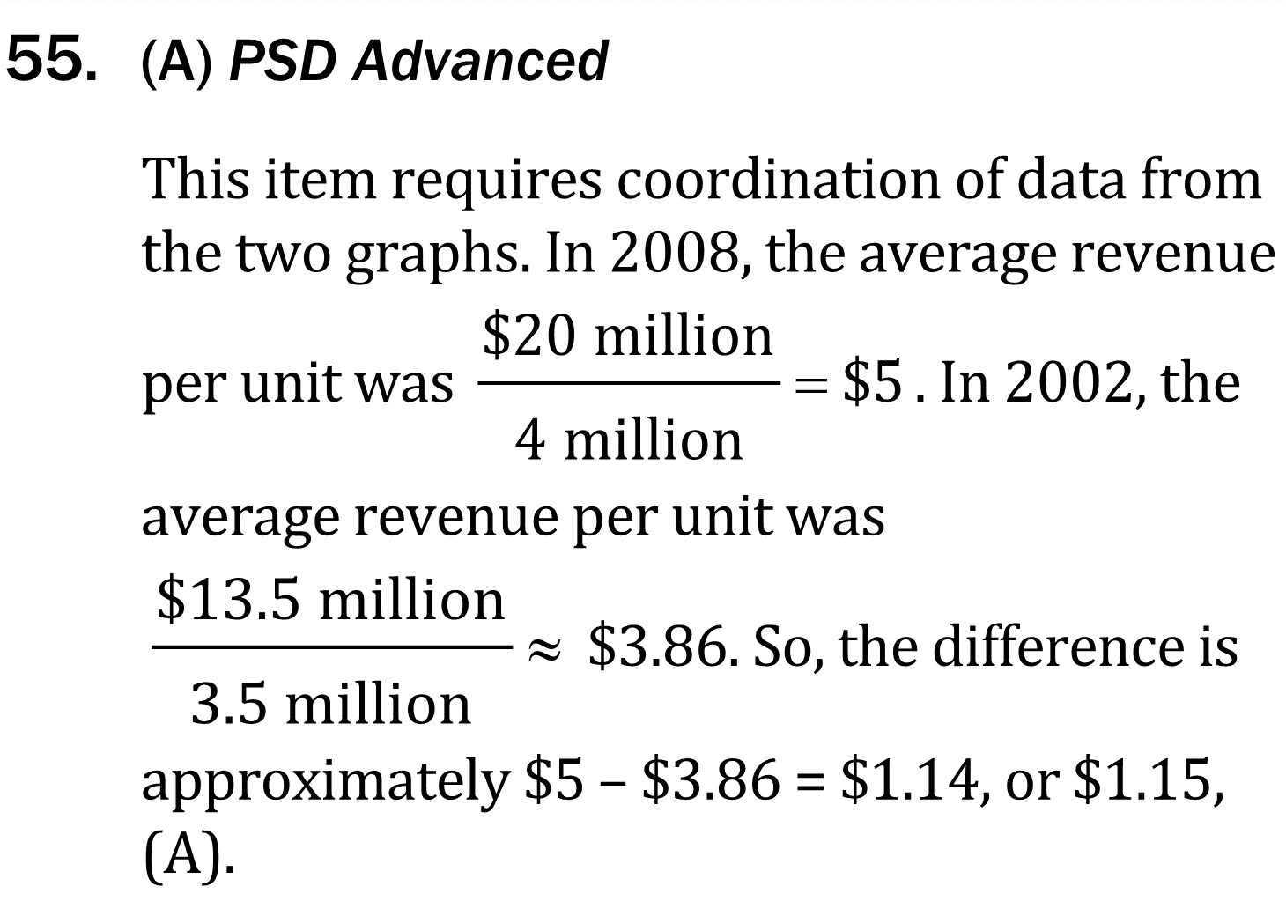
Tables and Graphs

