Slide 1
Complex Numbers

Slide 2
Complex Numbers

Slide 3
Complex Numbers

Slide 4
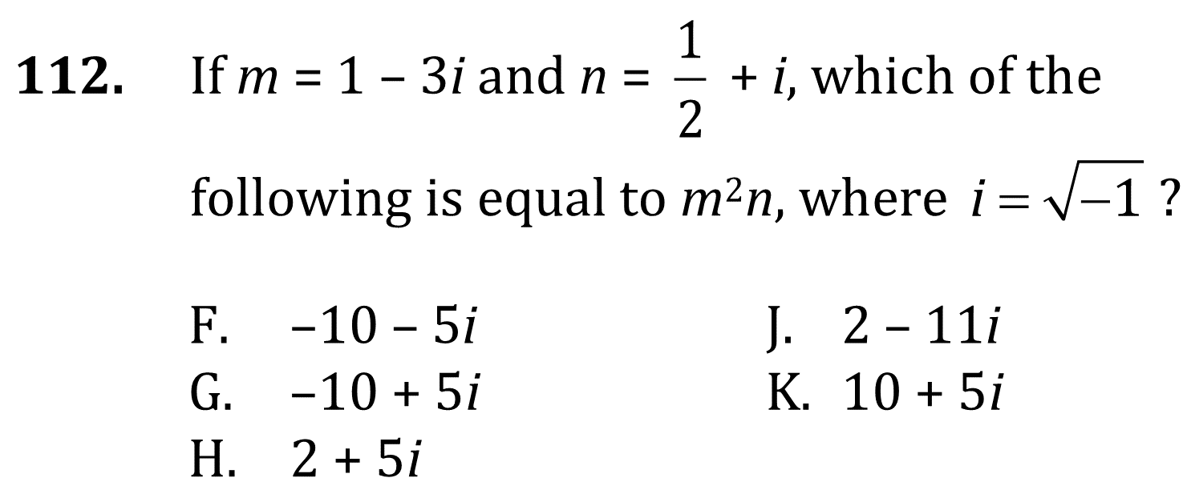
Complex Numbers

Slide 5
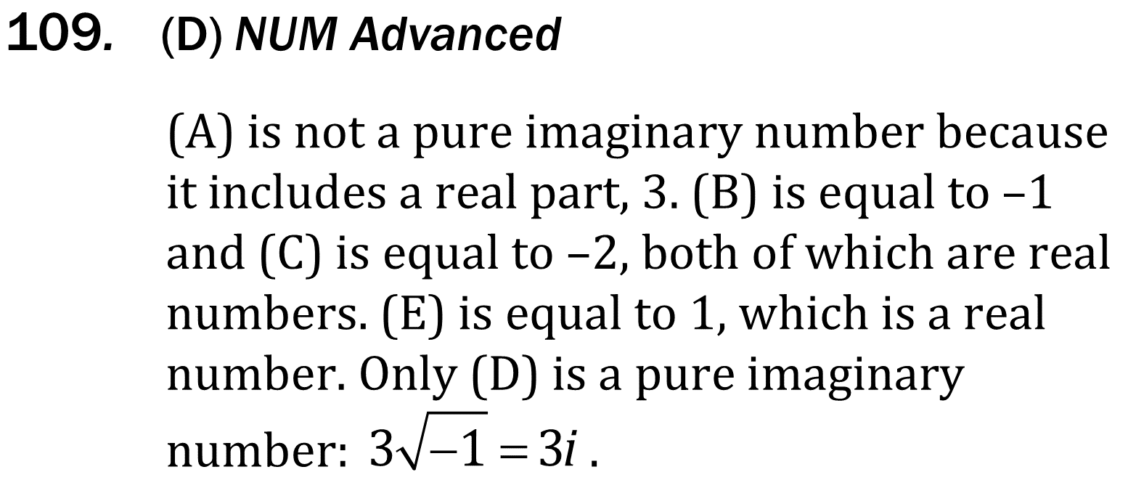
Complex Numbers

Slide 6
Complex Numbers

Slide 7
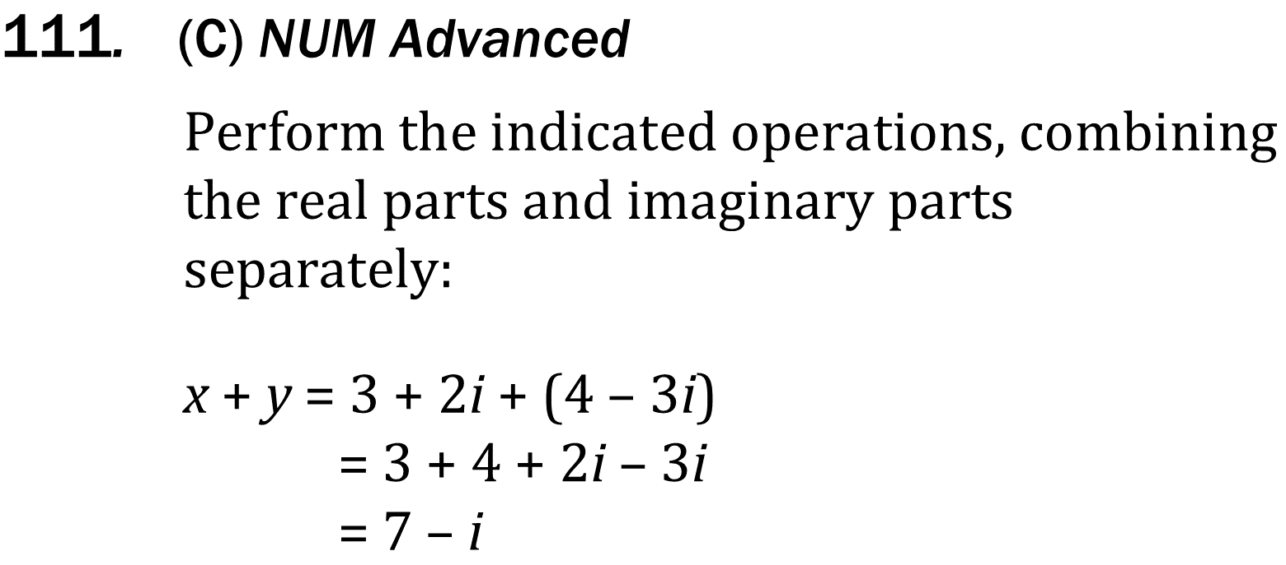
Complex Numbers

Slide 8
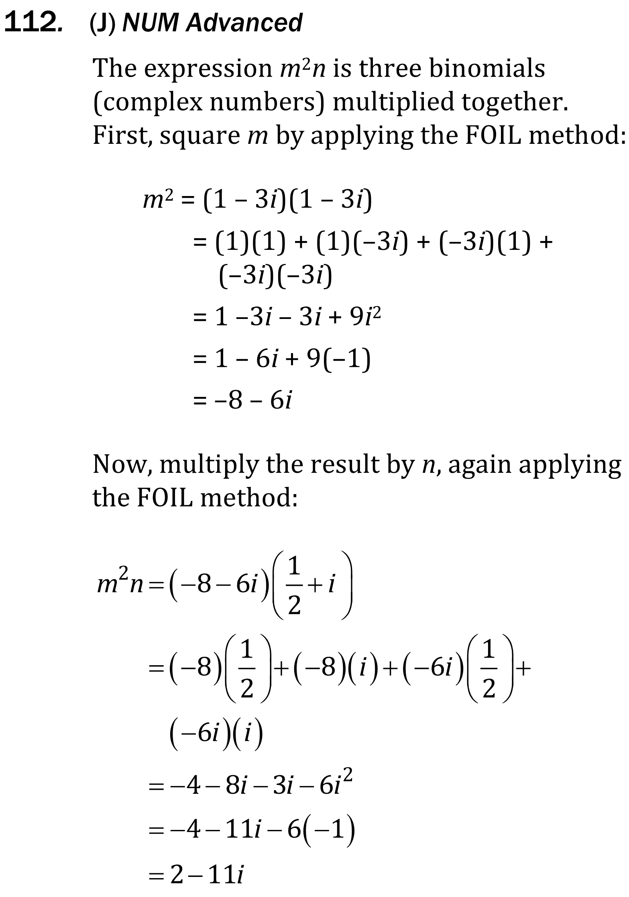
Complex Numbers

