Slide 1
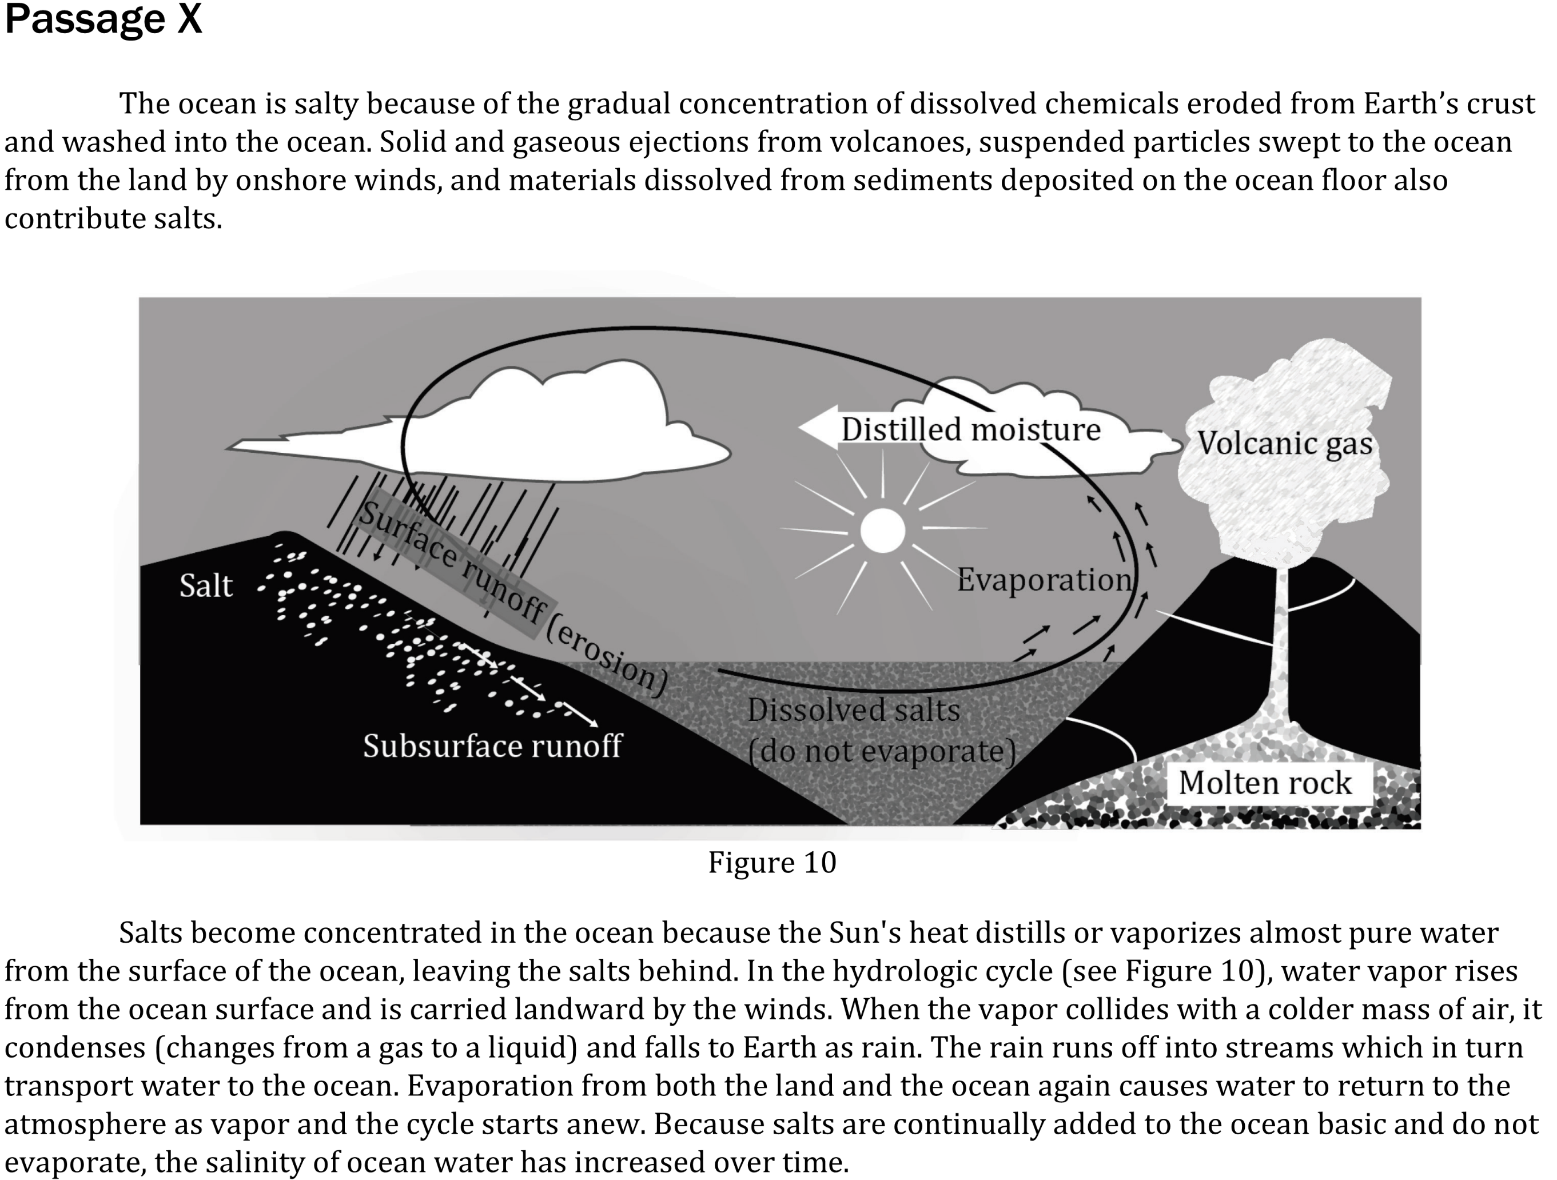
Notes:
Read and interpret data in more complex data presentations; Understand the relationship between variable in more complex data presentations. Level: Intermediate Skill Group: Interpretation of Data

Slide 2
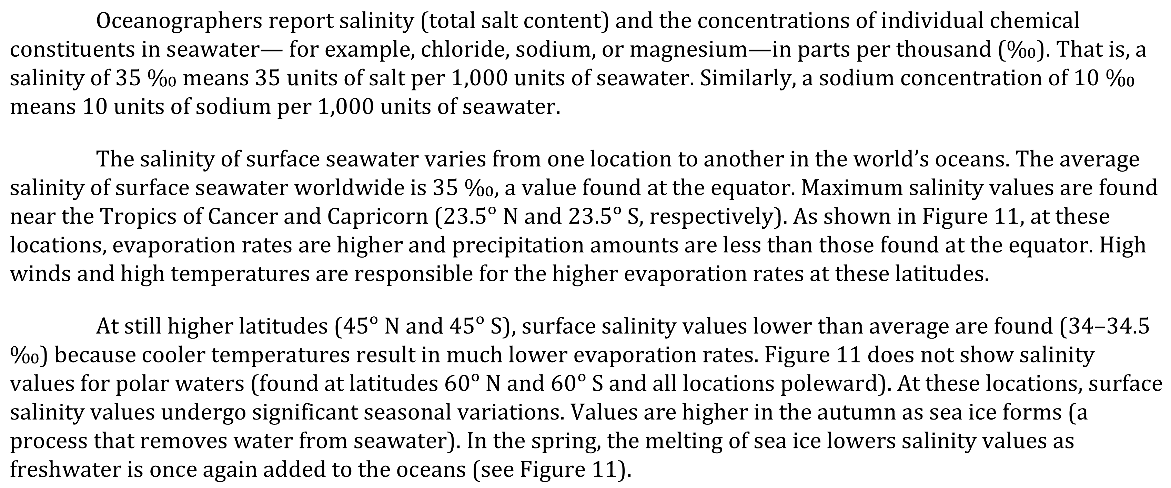
Notes:
Read and interpret data in more complex data presentations; Understand the relationship between variable in more complex data presentations. Level: Intermediate Skill Group: Interpretation of Data

Slide 3
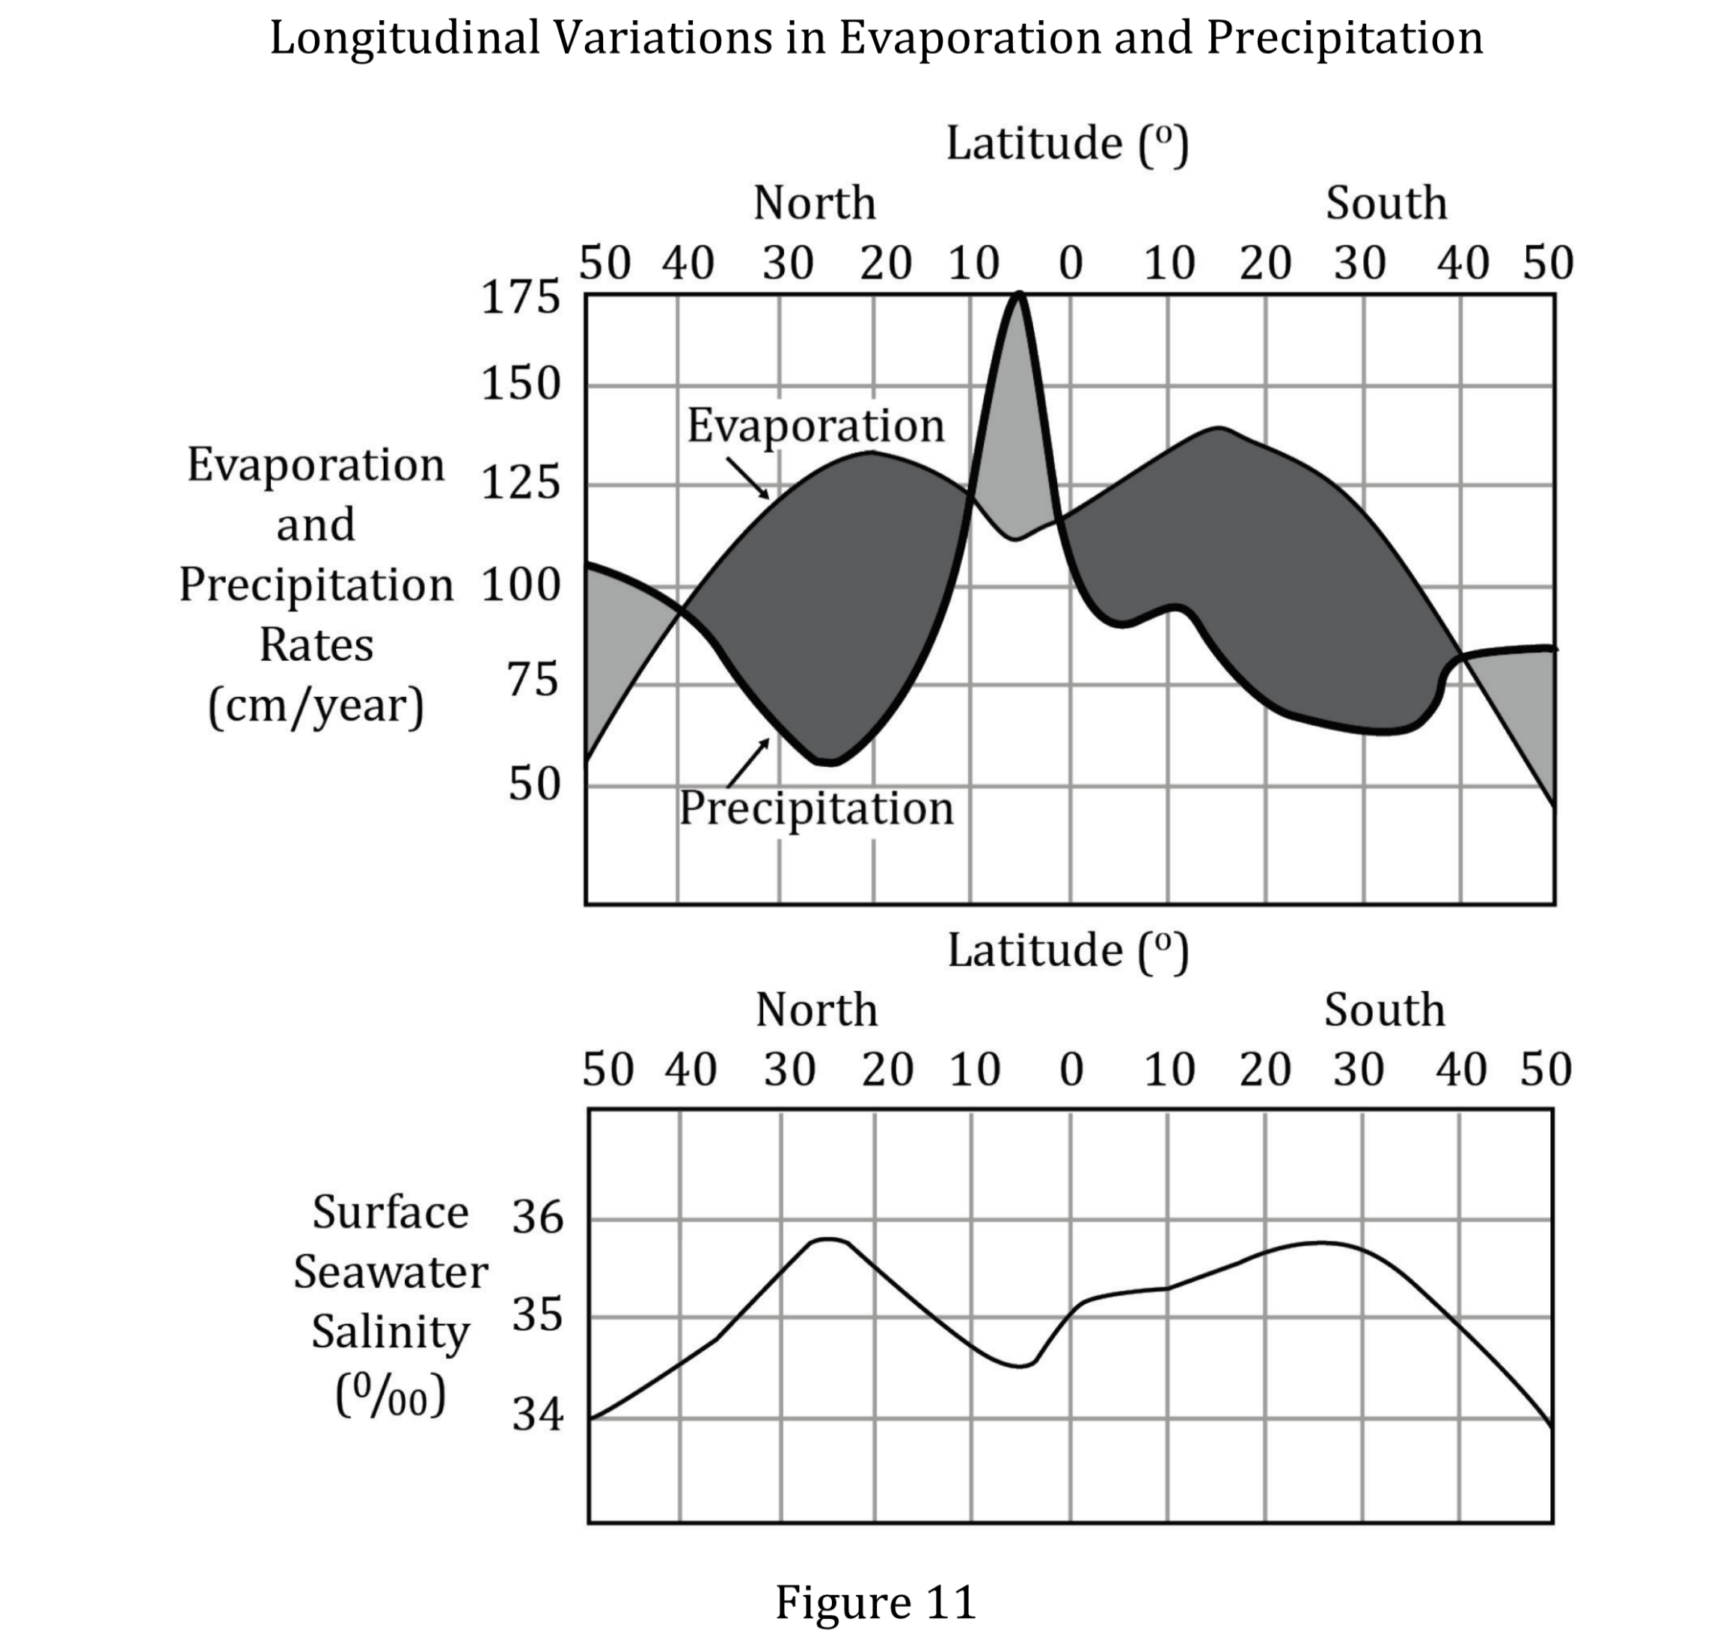
Notes:
Read and interpret data in more complex data presentations; Understand the relationship between variable in more complex data presentations. Level: Intermediate Skill Group: Interpretation of Data

Slide 4
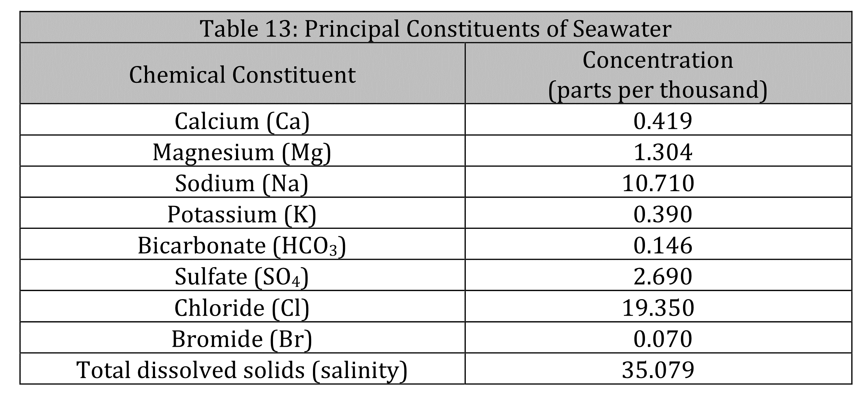
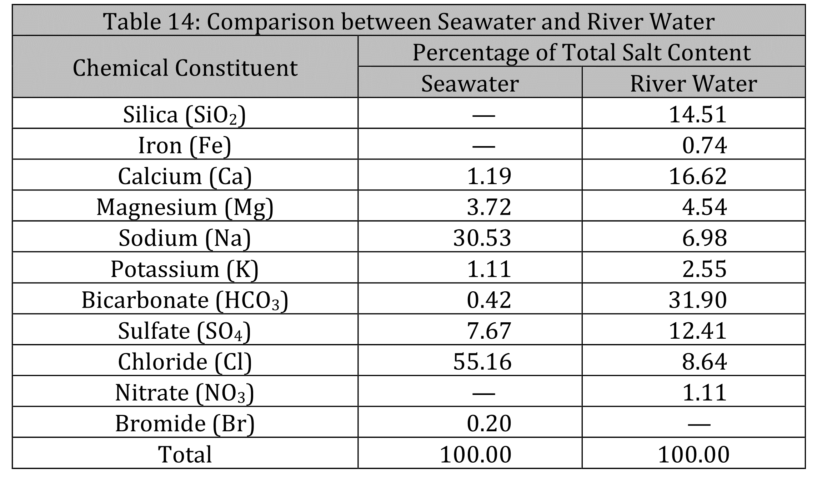
Notes:
Read and interpret data in more complex data presentations; Understand the relationship between variable in more complex data presentations. Level: Intermediate Skill Group: Interpretation of Data

Slide 5
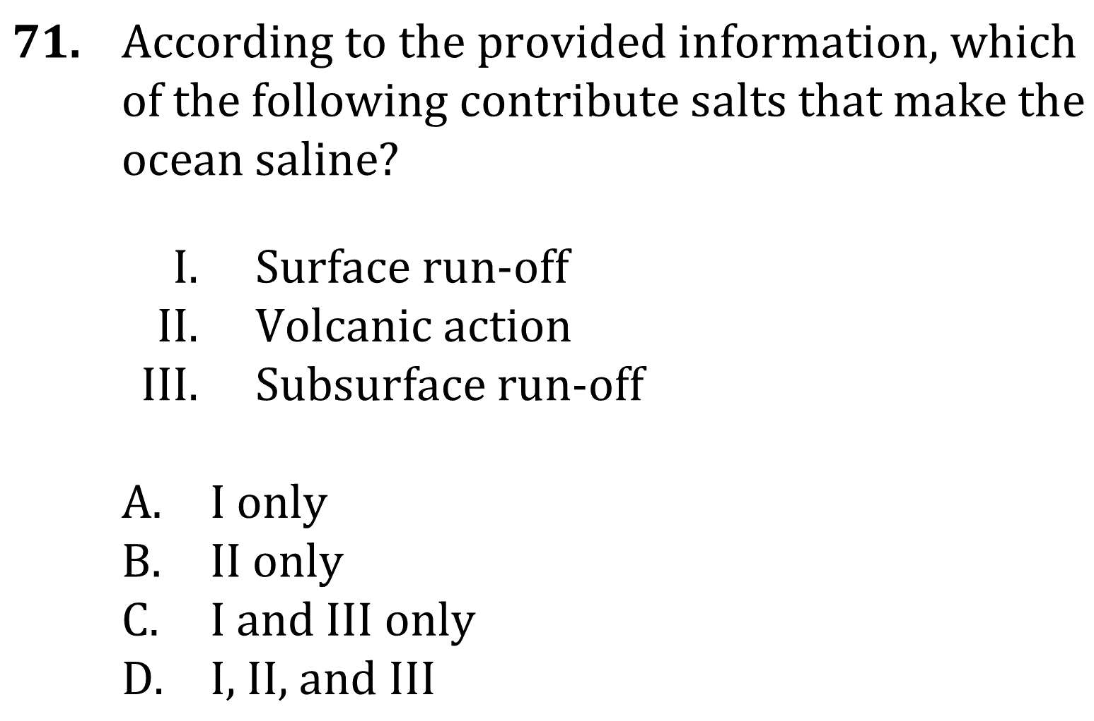
Notes:
Read and interpret data in more complex data presentations; Understand the relationship between variable in more complex data presentations. Level: Intermediate Skill Group: Interpretation of Data

Slide 6
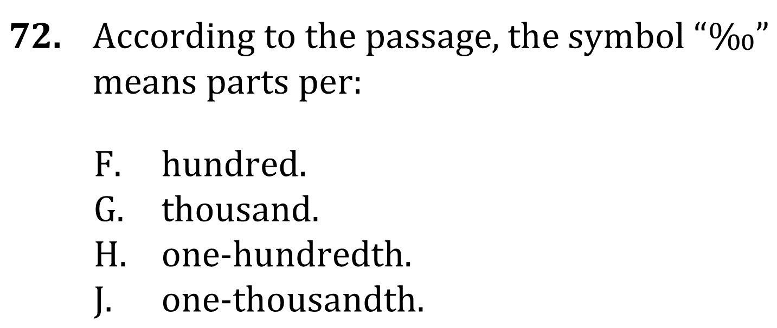
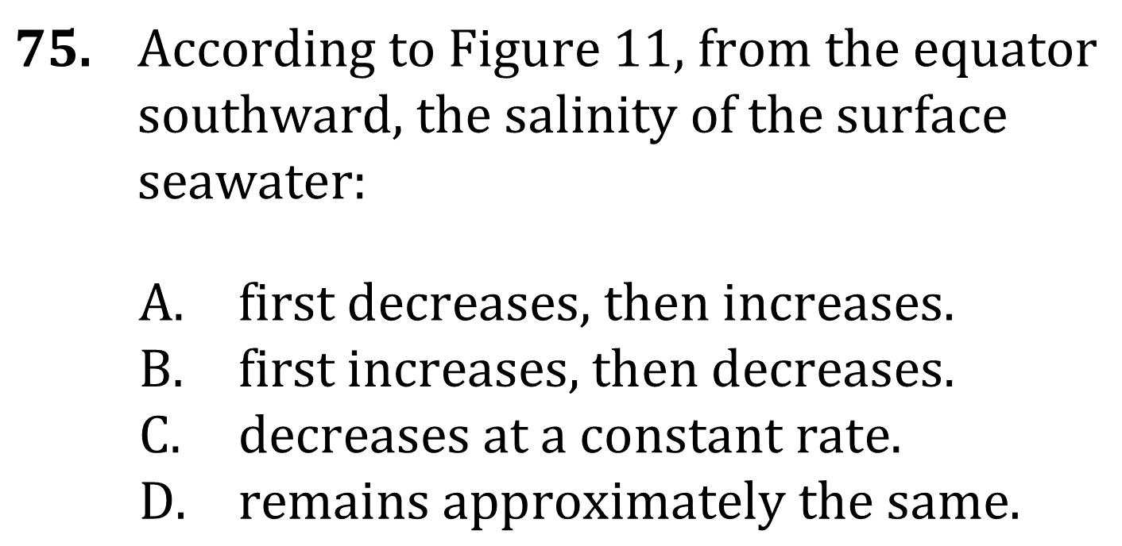
Notes:
Read and interpret data in more complex data presentations; Understand the relationship between variable in more complex data presentations. Level: Intermediate Skill Group: Interpretation of Data

Slide 7
Notes:
Read and interpret data in more complex data presentations; Understand the relationship between variable in more complex data presentations. Level: Intermediate Skill Group: Interpretation of Data

Slide 8
Notes:
Read and interpret data in more complex data presentations; Understand the relationship between variable in more complex data presentations. Level: Intermediate Skill Group: Interpretation of Data

Slide 9
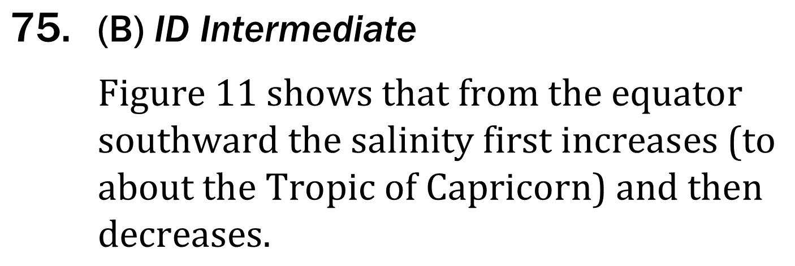
Notes:
Read and interpret data in more complex data presentations; Understand the relationship between variable in more complex data presentations. Level: Intermediate Skill Group: Interpretation of Data

