Slide 1
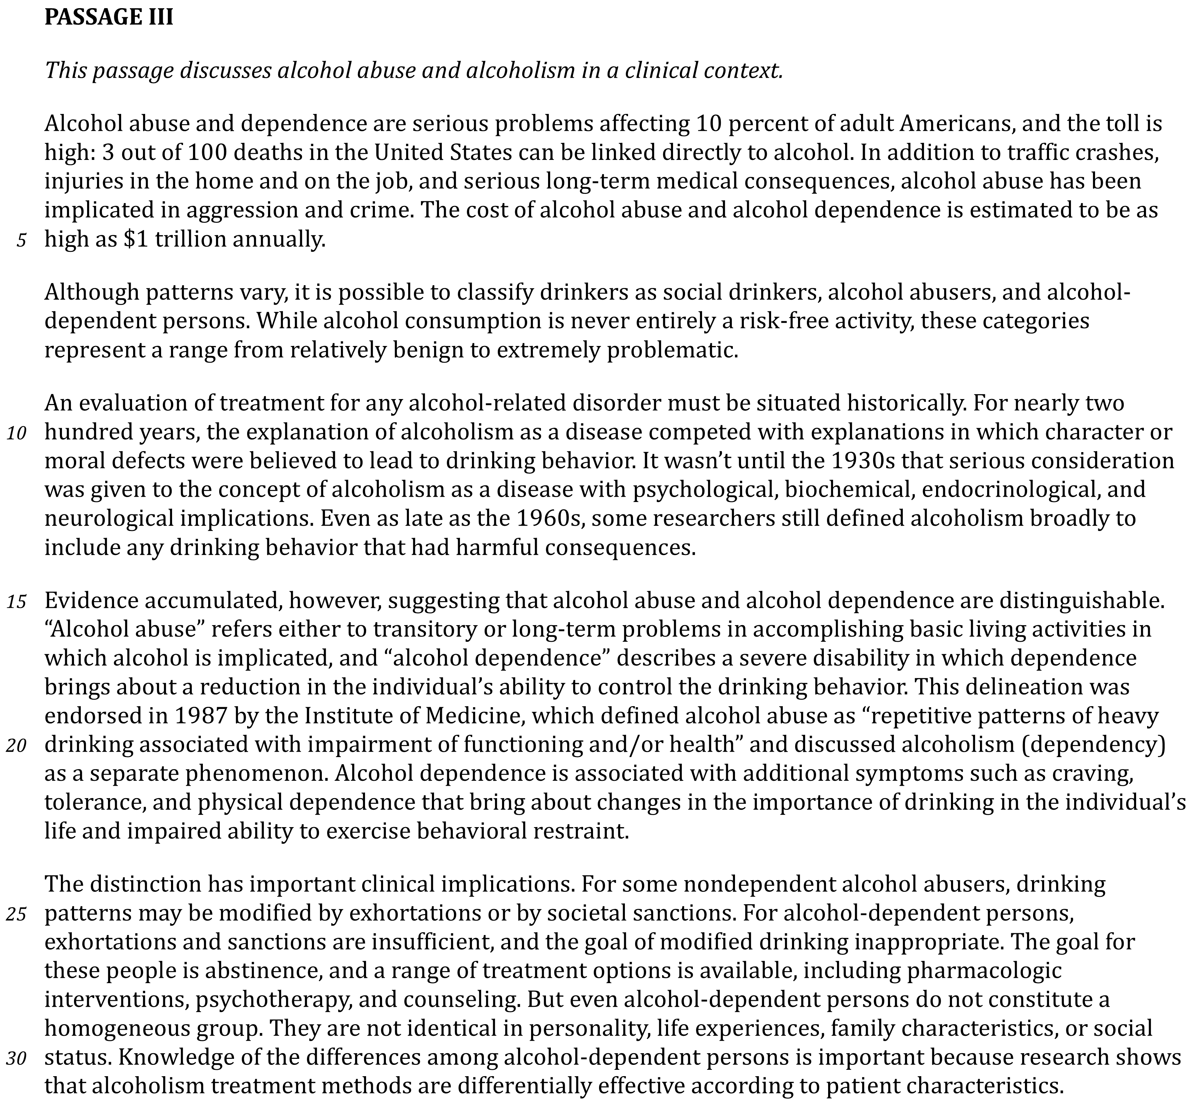

Slide 3
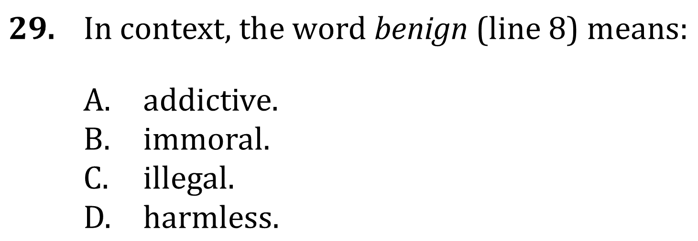
Use Context Clues

Slide 4
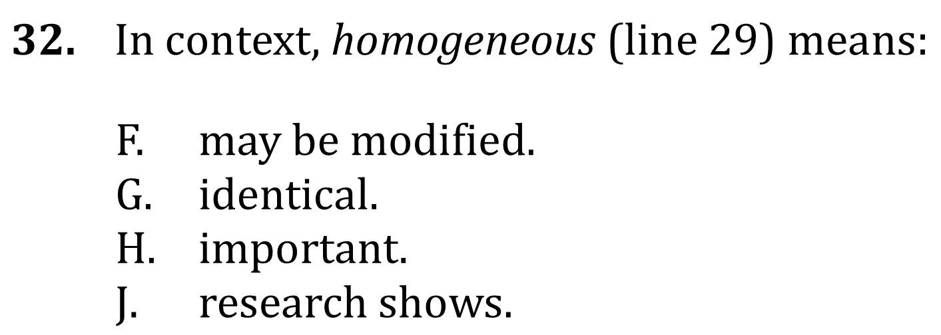
Use Context Clues

Slide 5
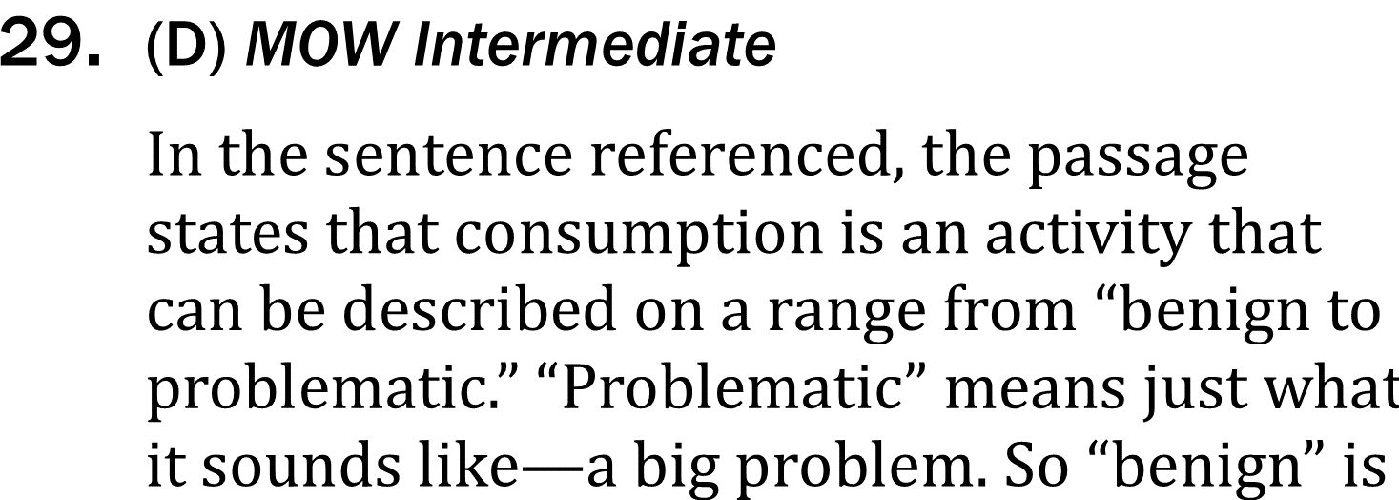
Use Context Clues

Slide 6
Use Context Clues

